Slide 1
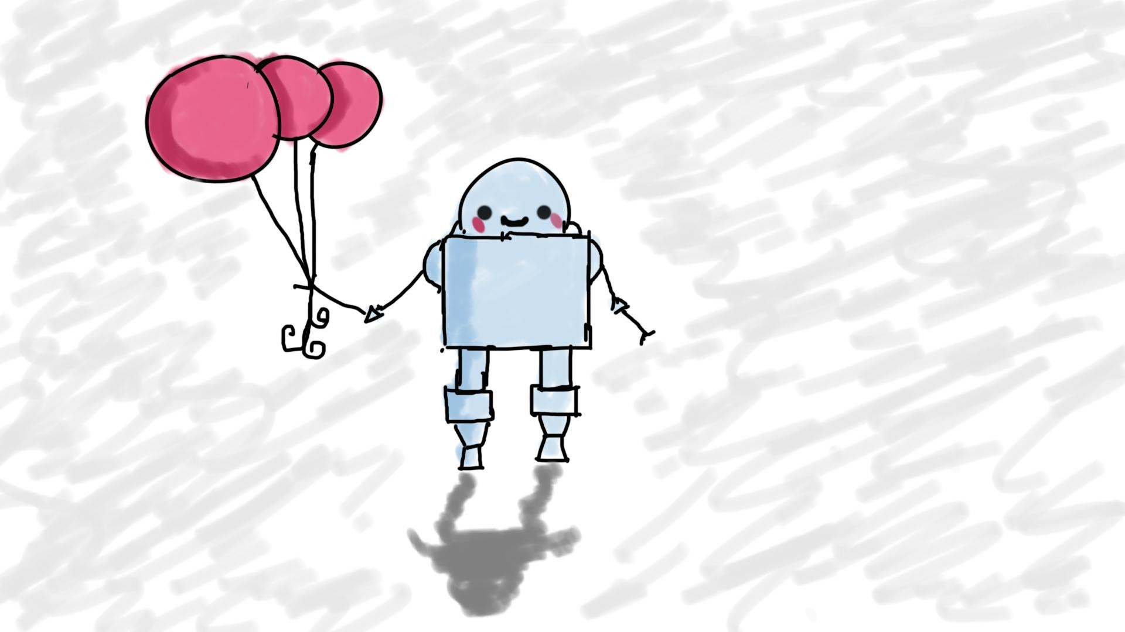
Creating a Web Service with AWS Lambda (Basic)
MIS3502: Web Service Programming
Jeremy Shafer
jeremy@temple.edu
https://community.mis.temple.edu/jshafer
Unless otherwise indicated, all decorative images are by Unknown Author and licensed under CC BY-NC

Slide 2
Get ready!
Start up
Start up VS Code and find the Thunder Extension
Sign in
Sign into AWS Console
Sign in
Sign into workbench

Slide 3
Agenda
Key elements of the endpoint template (see first video!)
Setting up your Lambda function and API gateway (again)
Adding a feature (create event)
The importance of testing

Slide 4
Our endpoint template
Key elements of the endpoint template
The event hander
The routing function
The supporting function(s)
Error trap
Database transactions
The formatres function
I made this for you!

Slide 5
Our new feature!
Issue a POST against ./events to create event. You must provide the following keys: eventcode, eventname, eventnotes (if any), createdby. The key createdby is the userid of the person creating the event. The API will return a JSON object representing the event that was just created.
Issue a POST against ./events to create event. You must provide the following keys: eventcode, eventname, eventnotes (if any), createdby. The key createdby is the userid of the person creating the event. The API will return the id of the event that was just created.

Slide 6
Hot tips! (Getting ready for the Quiz)
Now that you have watched this video, here are some questions you should know the answers to:
In what order do these portions of code get processed or server-side (lambda) code: supporting functions, routing function, event handler
What do each of the above portions of code do?
Where in your lambda code we most likely to see status codes of 200, 400, and 500. Why?
What is formatres ? Is it part of JavaScript? Node? A framework?
Why is the return statement so important?
How can I test/trouble shoot a lambda function? What must I remember to do?
What is result.insertId and why is it important?
Is result.insertId a property? A method? An event? How can you tell?
What is the variable res used for?
What is the syntax of a JavaScript try / catch block? What does the variable “e” represent?

