Slide 1
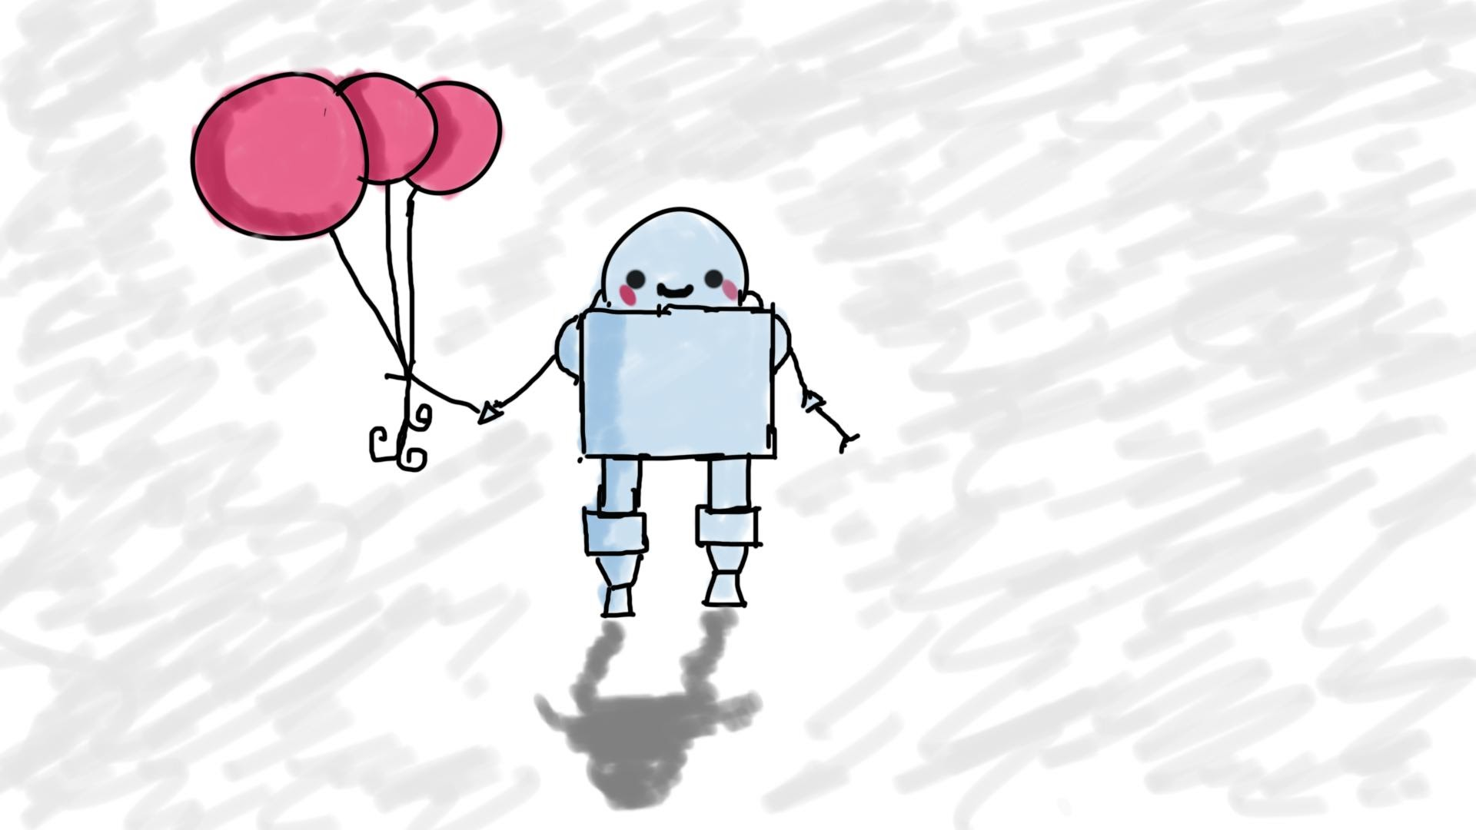
JavaScript and jQuery (new stuff)
MIS3502: Web Service Programming
Jeremy Shafer
jeremy@temple.edu
https://community.mis.temple.edu/jshafer
Unless otherwise indicated, all decorative images are by Unknown Author and licensed under CC BY-NC

Slide 2
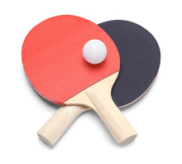
Our strategy

Slide 3
HTML, CSS, JavaScript
HTML
JavaScript
CSS

Slide 4
HTML, CSS, JavaScript (focused!)
HTML
(.html)
JavaScript
(.js)
CSS
(.css)

Slide 5
Our “To Do” list
Folders and relative references
An exploration of Bootstrap
  Layout
  Buttons, Alerts, Contextual Classes
  See: https://www.w3schools.com/bootstrap4/bootstrap_colors.asp
An exploration of CSS
Using the $.ajax method
Other useful jQuery methods
The JavaScript async and await commands

Slide 6

Hands On Examples

Slide 7
The CSS Cascade – A simplified diagram
General
“far away from the tag”
Other notes:
The cascade can be halted with an !important directive
CSS rules that reference a tag by its id take priority over rules that reference a tag by its class because an id is more specific than a class.
Browser
Defaults
External Style Sheet
<link>
Internal Style Sheet
<style>
Inline Style
Tag attribute
Specific
“close to the tag”
Low Priority
High Priority

Slide 8

Variable declaration
const has block level scope
var has function level scope
let has block level scope

Slide 9

Calling an API
Other notes:
Items in blue text represent variables. One represents the url where the web service can be found, and the other variable holds serialized data.
success and error are callback functions.
Use this syntax instead of: $.get(), $.getJSON, or $.post()
$.ajax({
url: endpoint_url,
data: the_serialized_data,
method: "POST " ,
success: (result) => {
console.log(result);
},
error: (data) => {
console.log(data);
}
});

Slide 10
Hot tips for the quiz
Why is control-shift-r important?
What is the role of these special characters in CSS?
  Dot .
  Hashtag #
What is the role of !important in CSS?
What is “float drop”?
What are some examples of bootstrap contextual classes?
In JavaScript, what is the difference between var , const , and let ?

Slide 11
More hot tips for the quiz
The .ready() event of jQuery
The .ajax method of jQuery
A general understanding of these jQuery methods/events seen previously: .on(), .animate()
These new jQuery methods: .focus() , .attr() , .serialize()
The async / await commands in JavaScript
We’ll get this one later!

