Slide 1
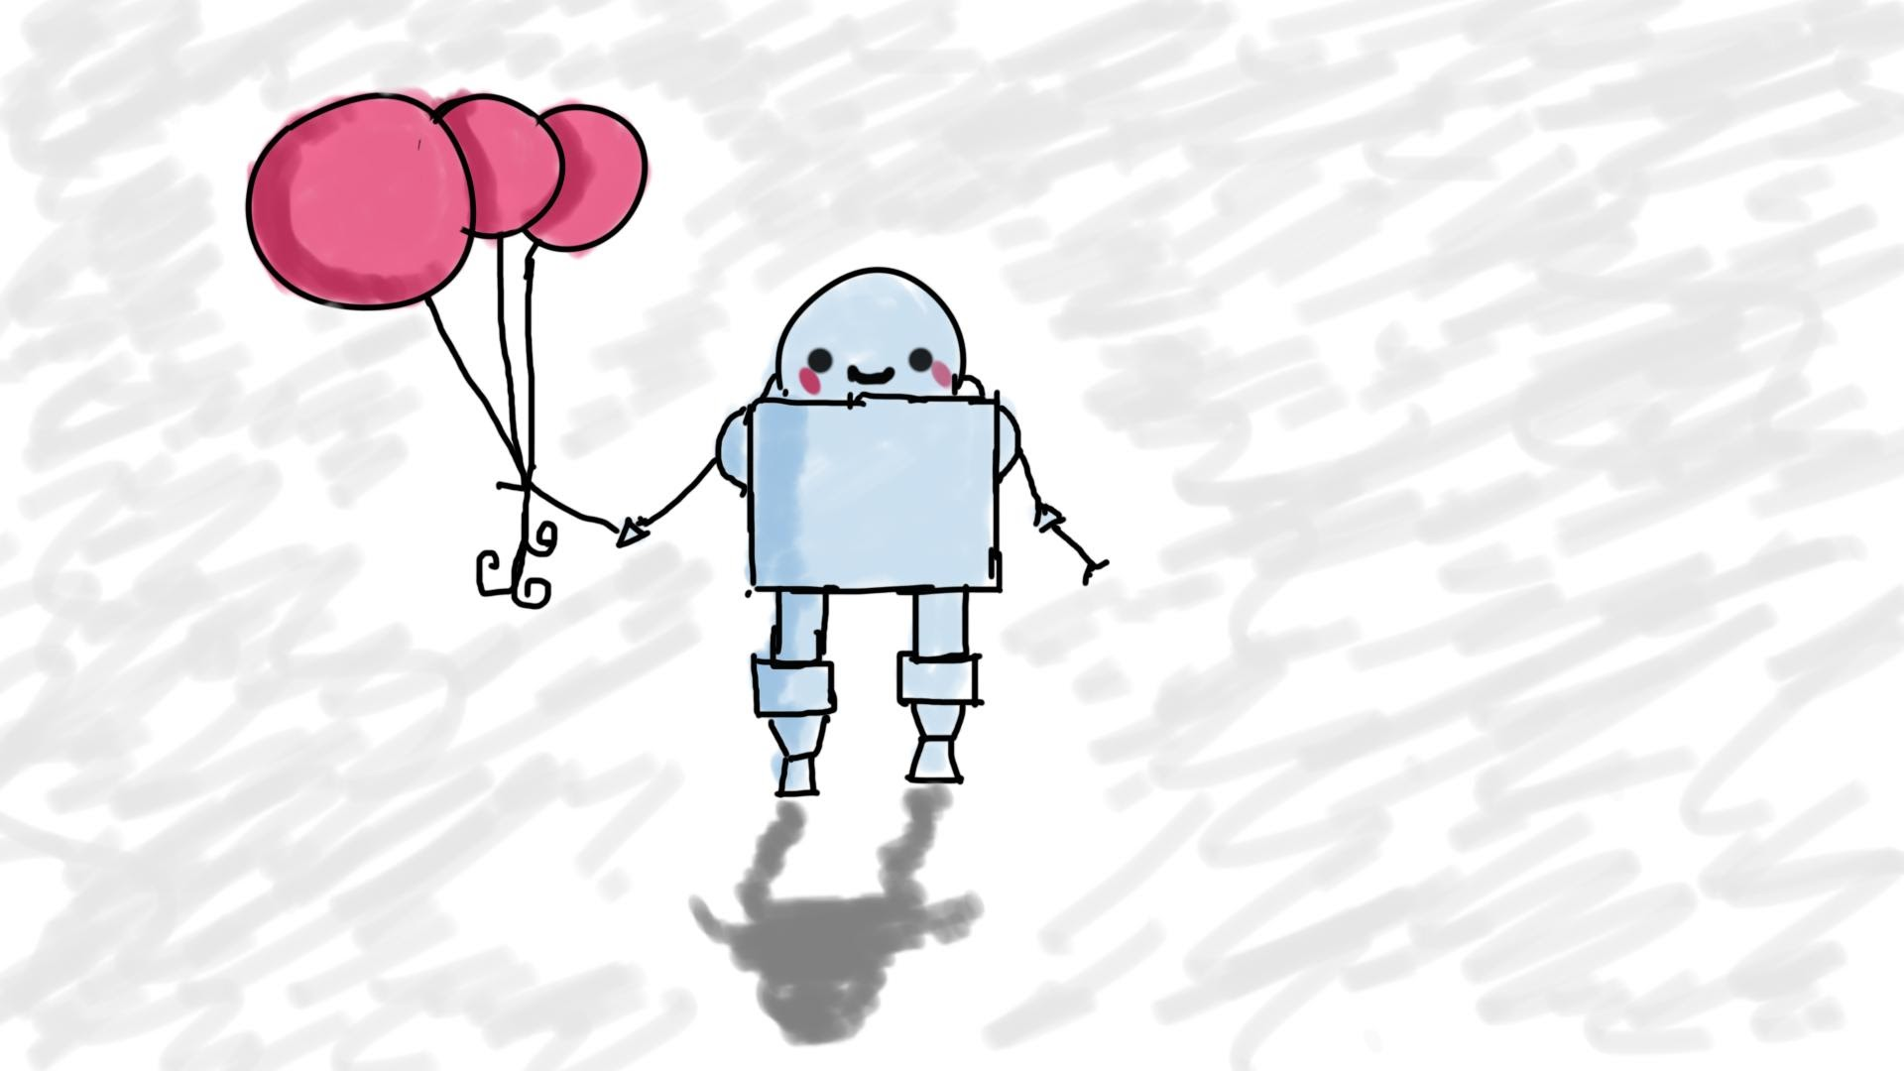
Creating a Web Service with AWS Lambda (Advanced)
MIS3502: Web Service Programming
Jeremy Shafer
jeremy@temple.edu
https://community.mis.temple.edu/jshafer
Unless otherwise indicated, all decorative images are by Unknown Author and licensed under CC BY-NC

Slide 2
Get ready!
Start up
Start up VS Code and find the Thunder Extension
Sign in
Sign into AWS Console
Sign in
Sign into workbench
Download
Download the demos that goes with this slide deck

Slide 3
Agenda
What is formatres doing again?
What makes this the “advanced” Lambda lecture? (You have already seen A and B, below.)
  Web Service features may include multiple SQL statements.
  More than just HTTP GET and POST are used. The other methods are PUT, PATCH and DELETE.
  We can use JavaScript’s try / catch statement to gracefully manage unexpected errors and aid in troubleshooting.

Slide 4


formatres
res
Your API gateway receives an HTTP request.
The request goes to your Lambda code.
Your HTTP event handler code extracts the path, method, and data from the request and prepares a response object
Your routing function determines which supporting function to call.
Your supporting function must then return a response.
formatres
Fill the envelope with data and status

Slide 5
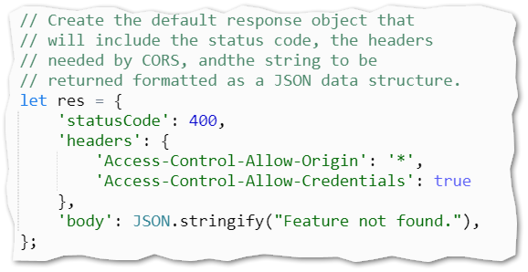
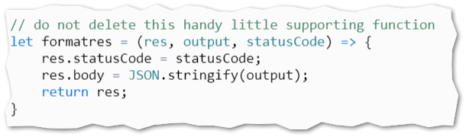

Sample code
From the Lambda event handler
The formatres supporting function

Slide 6
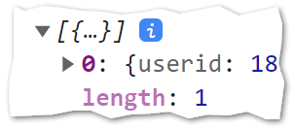


When data comes back …
Might be a string.
"Unexpected Error"
Might be a number.
81
Might be a single database row.
Might be multiple rows… which means I will probably want to loop through those
Might be an object
formatres assigns 200, 400, or 500 here

Slide 7
Try / Catch
Notes
Use try/catch sparingly.
Use the catch block to return diagnostic information while you are debugging / building.
But when your code is in production, you would simply return the text “unexpected error”
try{
// One or more SQL
// statements go here
} catch(e) {
// production
// return formatres(res,"Unexpected Error", 500);
// testing
return formatres(res, e, 500);
}
The variable “e” looks very mysterious. It’s not. Here, “e” is short for “exception” and/or “error”. It is simply the object that contains all the diagnostic information about the error that occurred in the try block. There’s no rule that says you must call this variable “e” but that is a common practice.

Slide 8

Let’s do some work…

Slide 9

Hot tips! (Very similar to last time)
Now that you have watched this video, here are some questions you should know the answers to:
In what order do these portions of code get processed or server-side (lambda) code:
supporting functions, routing function, event handler
What do each of the HTTP methods do? What are they for?
Where in your lambda code we most likely to see status codes of 200, 400, and 500. Why?
What is formatres ? Is it part of JavaScript? Node? A framework?
Why is the return statement so important?
How can I test/trouble shoot a lambda function? (More than one answer here!)
Is result.insertId a simple property? A method? An event? How can you tell?
What is the variable res used for?
What is the syntax of a JavaScript try / catch block?
What does the variable “e” represent?

