Slide 1
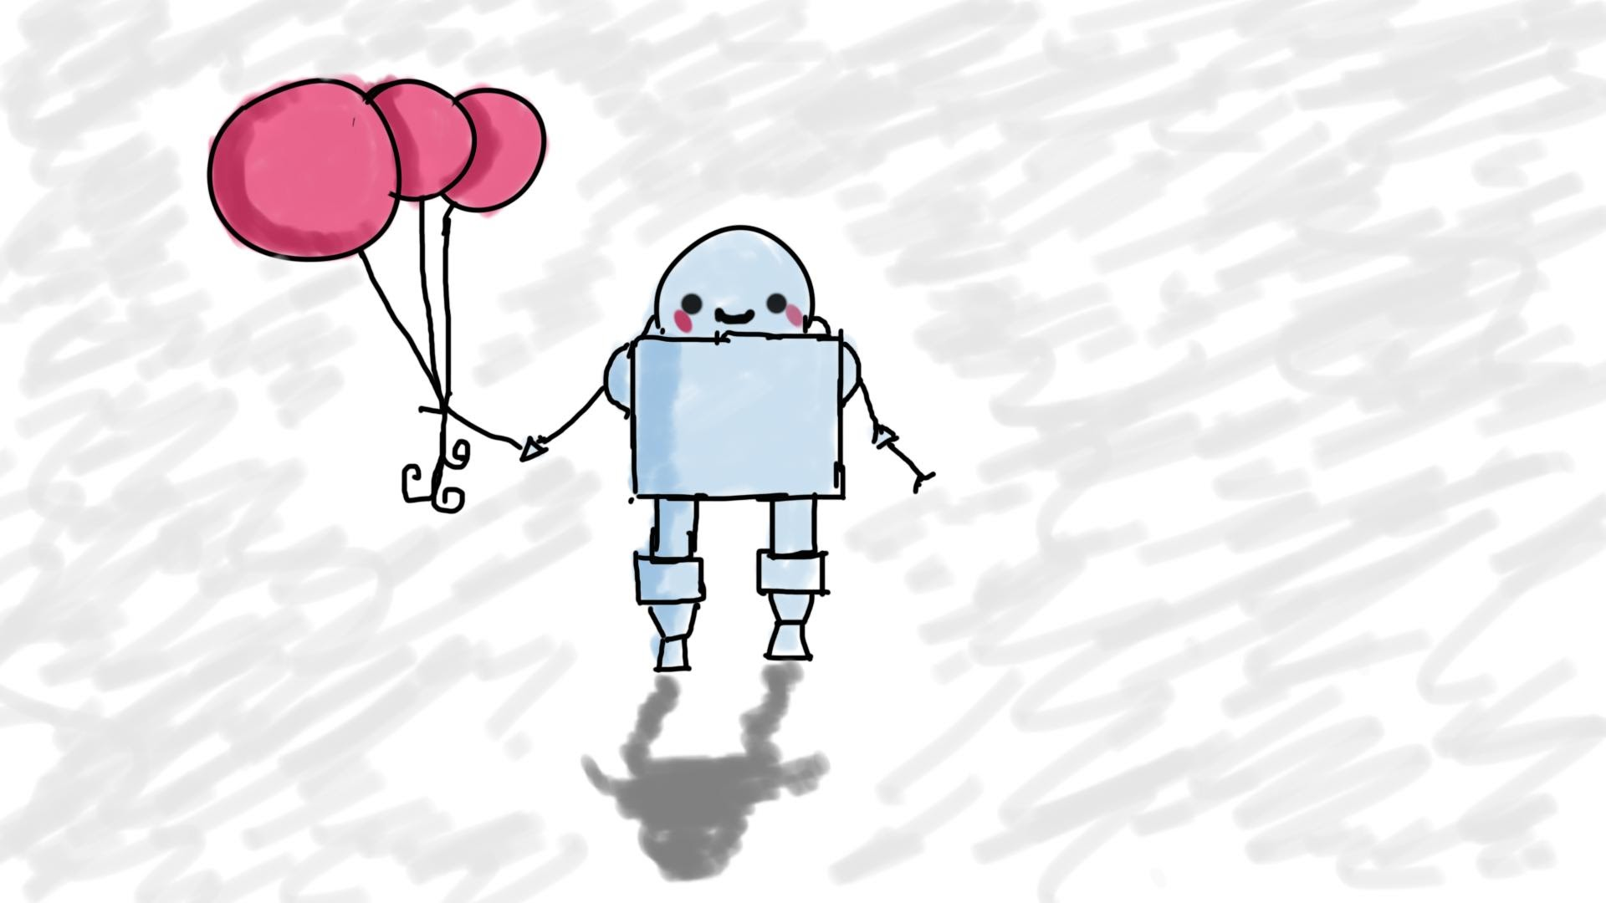
Accessibility
MIS3502: Web Service Programming
Jeremy Shafer
jeremy@temple.edu
https://community.mis.temple.edu/jshafer
Nhi Nguyen, MIS Alumni, Class of 2020
https://community.mis.temple.edu/nhinguyen/
https://www.linkedin.com/in/nhi-h-nguyen/
Unless otherwise indicated, all decorative images are by Unknown Author and licensed under CC BY-NC

Slide 2
Preamble: Why are we starting here?
The topic of accessibility:
Is rooted in good, ethical principles
Gives students an opportunity to reacquaint themselves with HTML
Gives us on-ramp to AWS
Has been a career booster for several recent grads
Provides good universal concepts that improve both UX and UI

Slide 3
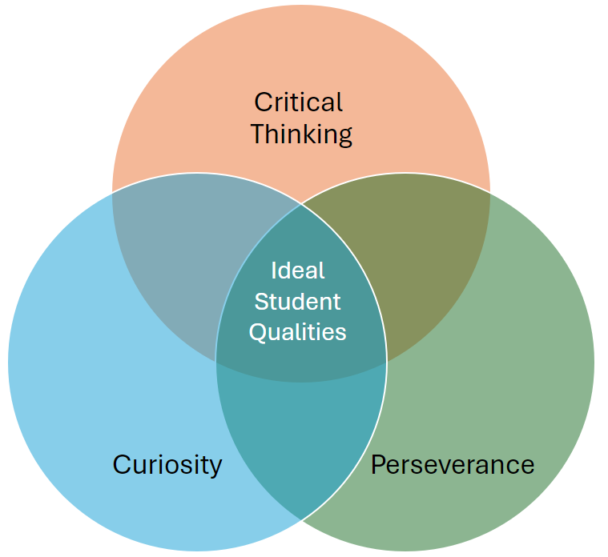
MIS Department Instructional Practices
Download the examples and experiment with it (even though there’s no grade attached!)
Imagine what it would be like to have a disability… what would you want from technology?
Outside of class, work on project 1, a little bit each day.

Slide 4
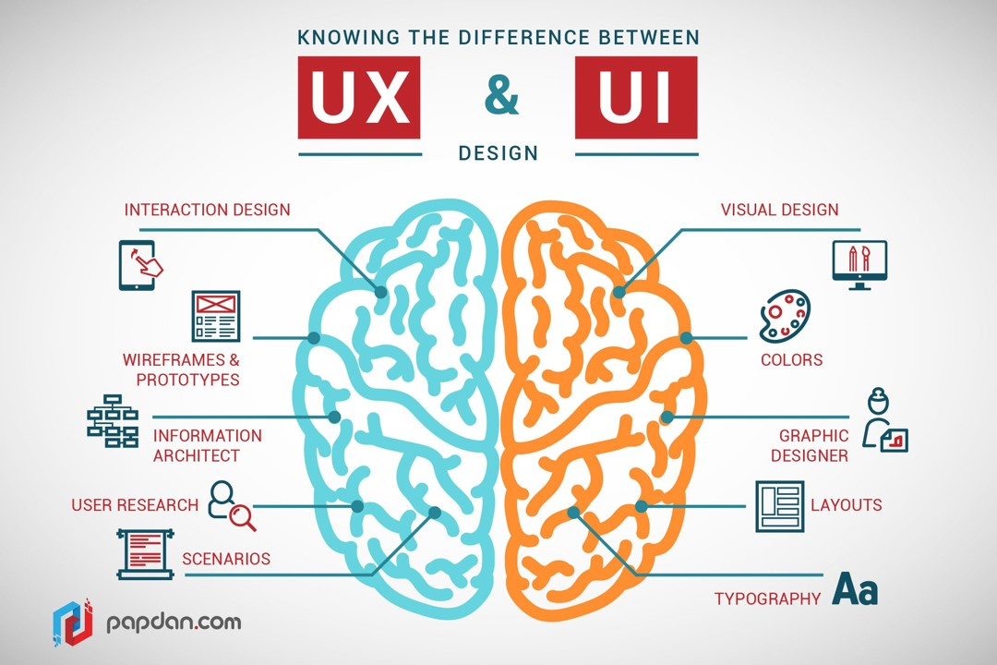
Accessibility is a universal concern

Slide 5
So what’s the agenda?
Talk about what accessibility is.
Talk about why accessibility is important.
Talk about how we can make accessible solutions (from the beginning!)

Slide 6
Part 1: What is accessibility?
accessibility
A11y
(Pronounced “A” eleven “y”)

Slide 7
The definition of accessible …
“easily used or accessed by people with disabilities : adapted for use by people with disabilities”
Merriam-Webster

Slide 8
What is web accessibility?
“Accessibility is the practice of making your websites usable by as many people as possible. We traditionally think of this as being about people with disabilities, but the practice of making sites accessible also benefits other groups such as those using mobile devices, or those with slow network connections.”
https://developer.mozilla.org/en-US/docs/Learn/Accessibility/What_is_accessibility
“Web accessibility is the inclusive practice of ensuring there are no barriers that prevent interaction with, or access to, websites on the World Wide Web by people with physical disabilities, situational disabilities, and socio-economic restrictions on bandwidth and speed.”
https://en.wikipedia.org/wiki/Web_accessibility

Slide 9
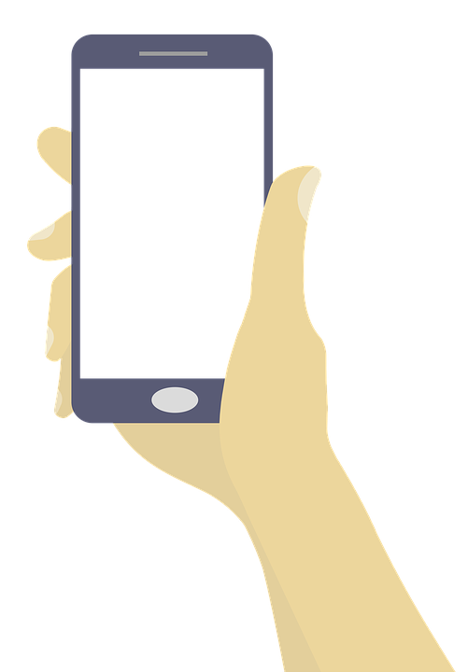
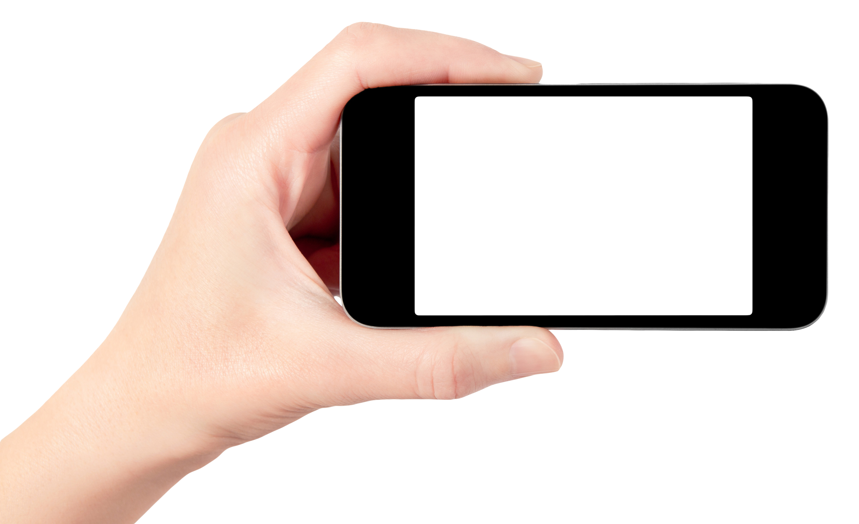
What about mobile accessibility?
See: https://developer.mozilla.org/en-US/docs/Web/Accessibility/Mobile_accessibility_checklist

Slide 10
Part 2: Why is accessibility important?
Disability is “a physical, mental, cognitive, or developmental condition that impairs, interferes with, or limits a person's ability to engage in certain tasks or actions or participate in typical daily activities and interactions.” Merriam-Webster
“Just as it is wrong to exclude someone from a physical building because they are in a wheelchair (modern public buildings generally have wheelchair ramps or elevators), it is also not right to exclude someone from a website because they have a visual impairment. We are all different, but we are all human, and therefore have the same human rights.”
Accessibility is the right thing to do.
Providing accessible sites is part of the law in some countries.
Building accessible sites benefits everyone.
Semantic HTML, which improves accessibility, also improves SEO, making your site more findable.
Caring about accessibility demonstrates good ethics and morals, which improves your public image.
Other good practices that improve accessibility also make your site more usable by other groups, such as mobile phone users or those on low network speed.
(Adapted from https://developer.mozilla.org/en-US/docs/Learn/Accessibility/What_is_accessibility )
10

Slide 11
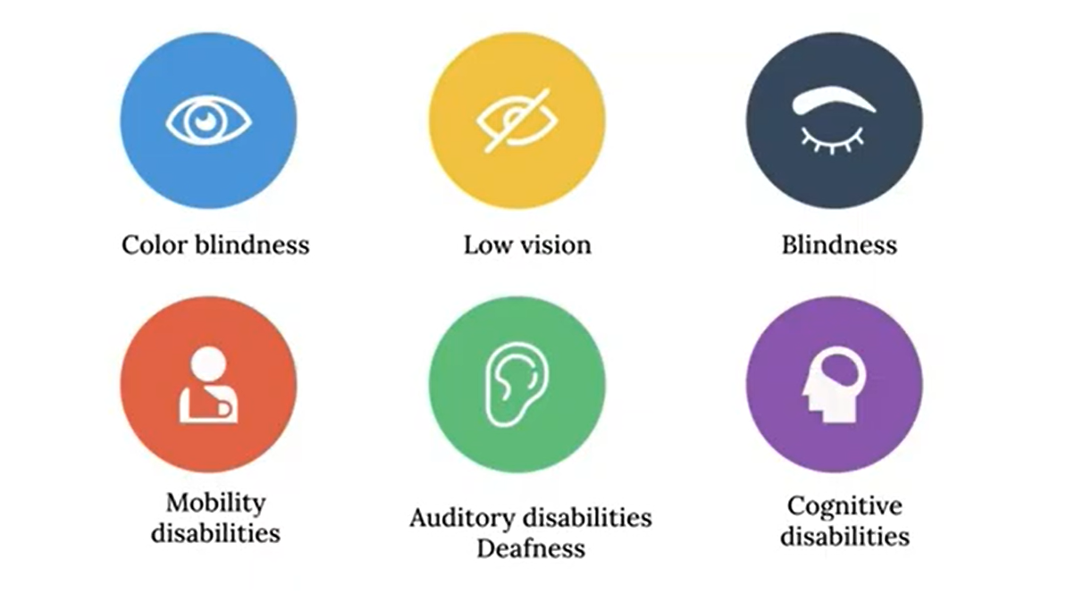
Kinds of disabilities:
Think about how the WWW is used for:
Commerce
News and Information
Entertainment
It would be wrong to exclude persons fr0m these resources based solely on their disability. So, where the WWW can be made accessible, it should be!
IT
Professional
… and don’t forget socio-economic limitations.

Slide 12
A11y benefits everyone!
If we include and design for the edge cases, we will have an accessible universal design for everyone.
We can also:
Improve usability for all users
Broaden market penetration
Improve SEO
Avoid discrimination allegations and legal battles
Build positive public relations

Slide 13
Part 3: How can we make A11y solutions?
Understand your role.
Use good resources.
Use good templates.
Test
13

Slide 14

Your role:
Accessible Technology only supports human content creators…
Accessible Technology
(Screen Readers)
Accessible Platforms
(Medium for content)
Humans creating content with accessibility in mind
For example:
This image needs alt text for a screen reader. You could give it the alt text “cat” or “pet” or “dog” or “cute puppy”…. If you were blind, what text would help best convey the meaning of the image?

Slide 15
Resources MIS3502 students should use:
Firefox View Page Source feature (not really for accessibility, but a good place to start!) See firefox.com
WebAIM’s WAVE extension (Web Accessibility Evaluation Tool) See webaim.org and wave.webaim.org
  Fun fact! The WAVE extension got it’s start right here at Temple University
The Mozilla Developer Network’s Accessibility documentation: https://developer.mozilla.org/en-US/docs/Web/Accessibility
The Web Content Accessibility Guidelines (WCAG) from the W3C:
https://www.w3.org/WAI/standards-guidelines/wcag/

Slide 16
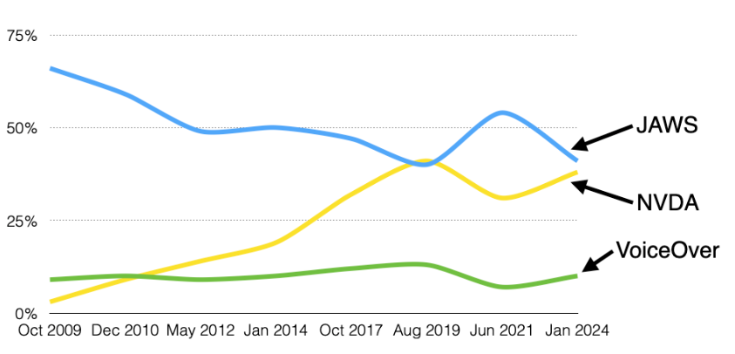
And, if you’re serious… screen reader software:
(Microsoft)
(Apple)
… I don’t expect students to download these!
Source: https://webaim.org/projects/screenreadersurvey10

Slide 17
Common issues students should be able to spot and fix:
Some accessibility problems can be tricky.
But any MIS student should be able to identify and address the following errors.
HTML page title tag is missing or not meaningful
HTML image tags do not have meaningful alt text
HTML Label tags not used with HTML form elements
Color contrast is insufficient
Any Critical Errors identified by the WAVE extension
Any HTML errors identified by Firefox View Page Source

Slide 18
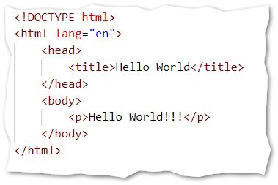
Page title tag is missing or not meaningful
  Tip 1: title content should be concise, meaningful and unique
  Tip 2: list the most specific information first
    Example: Degree Requirements | MIS Department | Fox School of Business
  Tip 3: The more pages in your application, the more important the title tag is
18

Slide 19
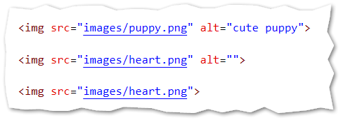
Image tags do not have meaningful alt text
Good
Good if heart.png is purely decorative. A screen reader would ignore this.
Bad!!

Slide 20
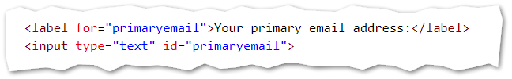
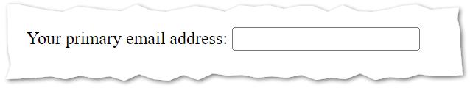
Label tags not used in HTML forms
In the HTML source code:
In the browser:

Slide 21
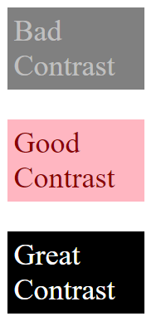
Color contrast is insufficient
Color contrast is represented as a ratio of lumens. The first number is the brightest color, and the second number is the darkest number.
Notes:
Text with bad contrast has a contrast ratio less than 4.5:1
The threshold for large text is a little more lenient, but 4.5:1 is the ratio to remember.
WCAG requires that page elements have both foreground AND background colors defined (or inherited) that provide sufficient contrast.
The WAVE extension will report critical contrast problems!
For example:
Bad!! This contrast ratio is roughly 2:1
Good enough. This ratio is 6:1 and considered accessible.
Great. This ratio is 21:1. You can’t have any more contrast than this. 21:1 is the best there is.

Slide 22
Summary: Students should now …
Understand what A11y is, why it is important, and how it relates to UX and UI.
Install Firefox. Understand the purpose of View Page Source.
Install the WAVE extension. Understand the purpose of the extension.
Understand that the role of human content creators is essential.
Identify and resolve these problems
  Title tag missing or not meaningful
  Missing/Incorrect alt text on images
  Missing/Incorrect label tags on forms
  Insufficient contrast

Slide 23
A final thought
Start with a good template
Keep A11y in mind
Test and correct before launch

