Slide 1

REST
MIS3502: Web Service Programming
Jeremy Shafer
jeremy@temple.edu
https://community.mis.temple.edu/jshafer
Unless otherwise indicated, all decorative images are by Unknown Author and licensed under CC BY-NC

Slide 2

Agenda
Some definitions
Overview the 6 constraints of REST
Practical implications (HTTP)
An “hands on” example

Slide 3

Definitions
What’s an API?
API stands for Application Programming Interface. An API allows specifically exposed methods of an application to be accessed and manipulated outside of the program itself.
What is a Web Service? (What is a Web API?)
Web Services are APIs that use web protocols (HTTP, HTTPS, JSON, XML, etc.). For example, a web service can be used to programmatically obtain data from a resource (such as U.S. postal service zip codes) without the user having to actually visit the application itself (checking the web site usps.com).
What is REST?
REST is short for Representational State Transfer.
REST is a software architectural style… a set of rules and conventions for the creation of an API.
A computer scientist by the name of Roy Fielding defined the principles of REST in his 2000 PhD dissertation.
Notes:
Like any theoretical ideal, there are a lot of practical exceptions to Fielding’s principles. But the principles of REST are intended to make APIs and systems that are: efficient, scalable, simple, reliable and modifiable (i.e. future-proof) among other things … all excellent objectives!

Slide 4
The 6 REST constraints
Client-Server Architecture
Statelessness
Cacheability
Layered System
Code on Demand (Optional)
Uniform Interface

Slide 5
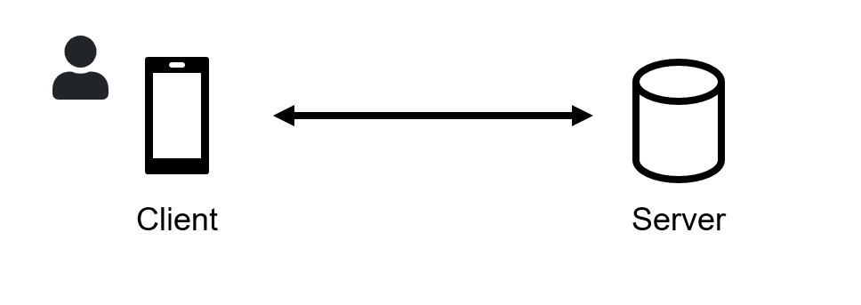
1. Client-Server architecture
RESTful systems separate the systems responsible for storing and processing the data (the server) from the systems responsible for collecting, requesting, consuming, and presenting the data to a user (the client).
This separation should be so distinct that the client and server systems can be improved and updated independently each other.
An upgrade to the client should not necessitate an upgrade to the server… and vice versa.
Think of this as a separation of duties.

Slide 6

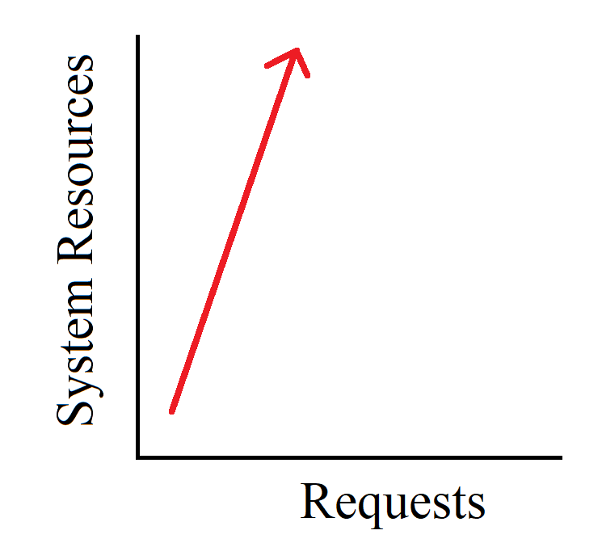
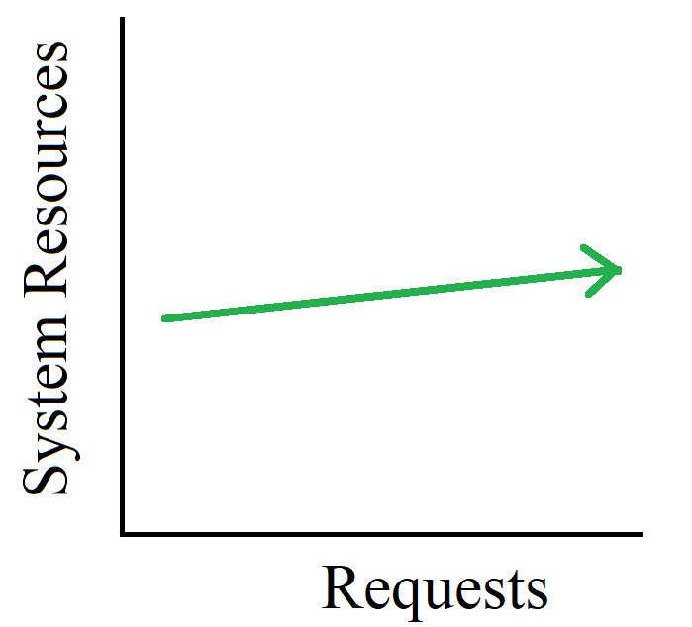
2. Statelessness
As far as the server is concerned, all client requests are treated equally. There’s no special, server-side memory of past client activity. The responsibility of managing state (for example, logged in or not) is on the client. This constraint is what makes the RESTful approach so scalable.
Server Manages State
VS
Client Manages State
Persistent communication.
Intermittent communication.
Be advised! In REST each and every resource request is to convey the application state. That means the state gets transferred with each request!

Slide 7

3. Cacheability
Clients and servers should be able to cache resource data that changes infrequently.
For example, there are 50 states in the U.S.A. That’s not likely to change soon. So, it is inefficient to build a system that queries a database of states each and every time you need that data. Clients should be able to cache that infrequently updated date and web servers should be able to control the duration of that cache.

Slide 8
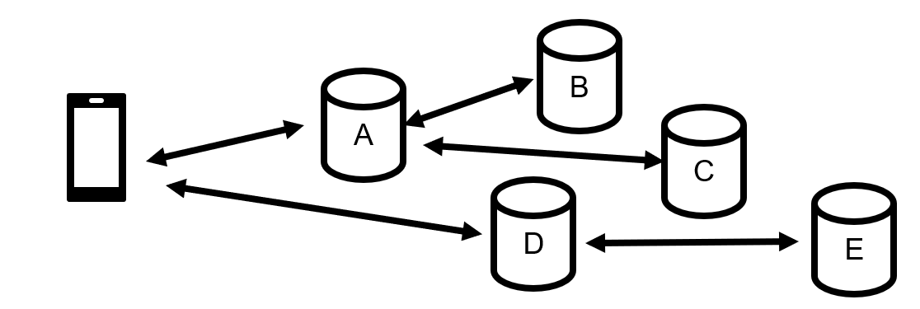
4. Layered System
A client cannot tell whether it is connected directly to an end server, or to an intermediary along the way. Intermediary servers can also improve system scalability.
As far as this client is concerned, only “A” and “D” exist!

Slide 9
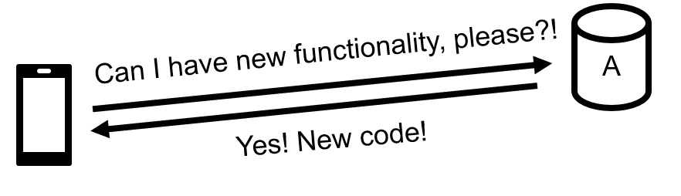
5. Code on Demand (Optional)
Servers can temporarily extend or customize the functionality of a client by transferring executable code. This is constraint is optional.

Slide 10

6. Uniform Interface
This constraint is comprised of 4 additional “constraints” or “principles”. Taken together, these 4 additional principles basically require the API to be consistent with HTTP standards and to be “self describing”.

Slide 11

Practical Implications …
Roy Fielding was also one of the principal authors of the HTTP specification. Fielding created the REST constraints with HTTP in mind.
So, if you use HTTP conventions correctly, you are likely to end up creating a RESTful system.
Ignoring or using HTTP in a non-standard / haphazard way will result in unexpected / unfamiliar scenarios. This can increase the long-term maintenance cost of the system.
This Photo by Unknown Author is licensed under CC BY-NC-ND

Slide 12
HTTP Methods you need to know
GET – GET requests are idempotent. GET requests transmit data in the query string of an HTTP URL. Data sent in the query string is not secure. GET requests are used for reading / retrieving data.
POST – POST requests are not idempotent. POST requests transmit data in the body of an HTTP request. POST requests are used for creating objects.
PUT – PUT requests are idempotent. PUT requests transmit data in the body of an HTTP request. PUT requests are used for redefining (updating) an existing object.

Slide 13
HTTP Methods you need to know (2)
PATCH – PATCH requests are idempotent. PATCH requests transmit data in the body of an HTTP request. PATCH requests are used for updating one specific element of an existing object (for example, a status code.)
DELETE – DELETE requests are idempotent. DELETE requests transmit data in the body of an HTTP request. DELETE requests are used for the removal / destruction / deletion of an existing instance of an object.

Slide 14
HTTP Status Codes you need to know
200 Status codes indicate success. The most common status code is 200, OK.
400 Status codes indicate a client error. That is, the client sent a request that did not make sense.
  A classic example of this is “404 Not Found”. Try it! Go to https://www.google.com/bad then try going to https://www.temple.edu/bad Notice that both pages report the status code 404. That’s not just a coincidence.
  The internet is built on standards like HTTP and these error codes are part of that standard.

Slide 15
HTTP Status Codes you need to know(2)
500 Status codes indicate a server error. That means that the request made by the client appears to be fine. But the server is experiencing some difficulty. The server is saying to the client “it’s not you, it’s me.”
More thorough documentation of the HTTP status codes can be found here: https://www.restapitutorial.com/httpstatuscodes.html

Slide 16

What does REST mean to you?
HTTP request must send all the data necessary for the server to respond to the request. The server will never remember prior requests. So, we will send a userid to the server often to represent the state of “logged in” to the server.
We will use the HTTP methods for their intended purposes
(GET, POST, PUT, PATCH, DELETE)
We will use the HTTP status codes for their intended purposes. Specifically, you will need to know some status codes: 200 (success), 400 (Bad Request), and 500 (Internal Server Error).
Any web service we create should provide simple (but accurate / complete) documentation at the root of the endpoint.

Slide 17
Two common mistakes and a recurring challenge
Abuse of the GET method. (this is bad mistake)
GET is assumed to be idempotent operation that never modifies the state of the resource. But here it has been often contorted into performing other functions:
http://exampleapi.xyz?action=ADD&productname=Widget
APIs are not self-documenting (this is bad mistake)
Finally, recall that the the burden of managing state is on the client. This raises many security concerns. The IT industry favors the efficiency gains made possible by REST … but those gains also introduce risks related to session hijacking and impersonation. Centrally managed state would be easier to secure! There is no one consistent approach to managing the state of a RESTful architecture securely. (This is a recurring challenge!)

Slide 18

Summary (i.e., Hot tips for the quiz)
Students should know what REST is short for.
Students should be able to verbalize what it means to "manage state" in an application. (What is the most common example of state?)
Students should understand why REST puts the burden of managing state on the client. (Is it for security, scalability or both?)
Students know the HTTP status codes and methods that they will use this semester and what they mean.
Students should understand that client-side code is inherently less secure than server-side code.
They should be able to spot the two common REST mistakes described here.

Slide 19

Hands on example
Review a node.js template/example
Install a new VS Code extension

