Slide 1
Wireframing
MIS3506
Fall 2023

Slide 2
WIREFRAMING
Wireframing is a way to design a website service at the structural level.
A wireframe is commonly used to layout content and functionality on a page which takes into account user needs and user journeys.
Wireframes are used early in the development process to establish the basic structure of a page before visual design and content is added.

Slide 3
A wireframe is a layout of a web page that demonstrates what interface elements will exist on key pages.

Slide 4
Advantages
An early visual that can be used to review with the client. Users can also review it as an early feedback mechanism for prototype usability tests. Not only are wireframes easier to amend than concept designs, once approved by the client and the users they provide confidence to the designer.
From a practical perspective, the wireframes ensure the page content and functionality are positioned correctly based on user and business needs.
Vision and scope agreement!

Slide 5
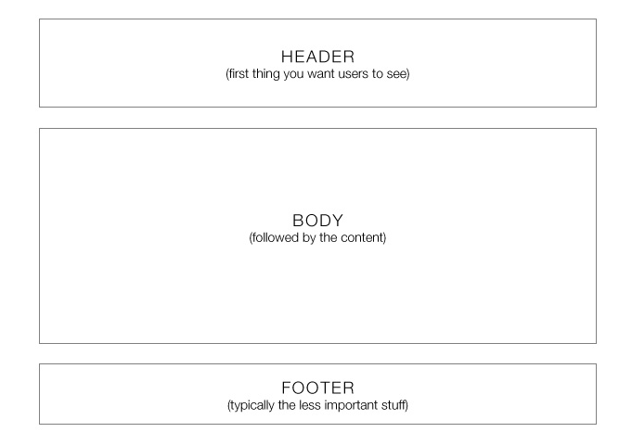
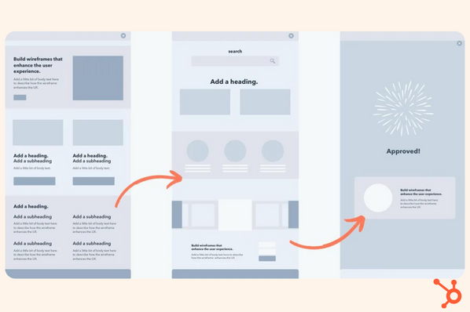
blueprint

Slide 6
Wireframing in practice
Canva.com – Wireframe Review Template
Miro.com – website wireframing template
Class will split in half – canva v. miro
Take your index card prototypes from last week
Convert them to either canva/miro

