Slide 1
MIS3506
In Class Activity
Gulfs

Slide 2
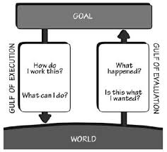
Gulf of Evaluation
Reflects the amount of effort that a person exerts to interpret the physical state of a system
Small when the system provides state information in a form that is easy to get, easy to interpret and matches the users conceptual model

Slide 3
Gulf of Execution
Reflects the amount of effort that a person exerts to complete the goal
Small when the user can execute the intended task in a pleasurable and efficient manner

Slide 4
Design – What Tools Can We Utilize? How can we minimize the challenges that users face engaging with technology?
Visibility – can the user tell the system state and alternative actions? (Signifiers?)
Consistency in presentation of operations & results
Relationship mapping – action & results, controls and effects
Feedback – clear and unambiguous

Slide 5
In Class Activity
How did Amazon improve the Gulf of Execution for shoppers?
Tell possible actions, determine mapping, perform the action, Desired State?
Go back to the Goal you indicated for your project site
How can you improve your Gulfs? Be specific. Draw a diagram of the current state and the future state.

Slide 6
Guiding Questions
What do I want to accomplish and why?
How else can I achieve the same goal? (Alternatives)
What actions can I do now?
How can I do it?
What happened?
What does it mean?
Have I accomplished my goal?

