Slide 1
Constraints, Discoverability & Feedback
MIS3506*Spring2021*Lavin
Featuring Krzywicki ☺

Slide 2
What do you do when you have to operate something you’ve never used before?

Slide 3
Knowledge
In the Head
In the World
Notes:
When we are faced with these situations, we have no choice but to combine knowledge in the world with knowledge in the head.
Knowledge in the world includes perceived affordances and signifiers, mappings, and the physical constraints that limit what can be done.
On the other hand, knowledge in the head includes conceptual models; cultural, semantic, and logical constraints on behavior; and analogies between the current situation and previous experiences with other situations
Chapter 4 focused more on knowledge in the world and how designers can provide the critical information that allows people to know what to do, even when experiencing an unfamiliar device or situation.

Slide 4
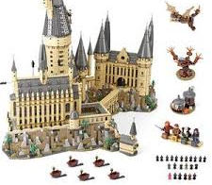
How do you turn that into this?

Slide 5
Constraints
Constraints let people readily determine proper course of action,
even in a novel situation (Norman, p. 125)
Notes:
This is an example of a physical constraint because the square peg cannot fit into the round hole. Based on the shape of the hole, it is obvious that the peg wouldn’t fit. This person took matters into their own hands and broke off some of the peg to force it. You shouldn’t have to do this.
Cultural constraints – elevator – avoid eye contact or touch
The bottom left is an example of a semantic constraint because there is only one correct way to sit on the bike---facing forward.
The last example represents a logical constraint because there was one piece left over after building something. Usually when you have a piece left over that means you forgot to install the part and you’re left to realize oops I made a mistake.

Slide 6
Constraints – some thoughts to consider
Logical – Tell a user to select 5 things & only 4 are readily visible – what does that tell the user?
Logical constraints = good conceptual model
Cultural – scroll bar on the right – what does that tell the user?
Physical constraints make some actions impossible: there is no way to ignore them.
Logical and cultural constraints are weaker in the sense that they can be violated or ignored, but they act as valuable aids to navigating the unknowns and complexities of everyday life.
Cultural constraints evolve over time

Slide 7
Physical Constraints
This Photo by Unknown Author is licensed under CC BY-SA-NC
This Photo by Unknown Author is licensed under CC BY-SA
Notes:
With the proper use of physical constraints, there should only be a limited number of possible actions. Physical constraints are much more effective when they are easy to see and interpret. They should essentially prevent the action before it is even tried. From looking at this, a user should be able to determine that a circle block would not fit in the triangle shaped hole and be able to take the proper course of action.

Slide 8
Cultural Constraints
Notes:
Each culture has an allowable set of actions for social situations. We know how to behave and interact within our own culture, but what about with other cultures?
In some cultures, people shake hands to introduce themselves, whereas in other cultures they bow and avoid touching.
It is important for designers to know the general rules of different cultures not only so that they can guide the correct behavior, but also so they aren’t doing anything that might be seen as offensive. As mentioned earlier, cultural constraints can change and evolve over time so it is important to stay up to date.
Even colors have different meanings from culture to culture; therefore, you might want to consider this when designing your website depending on your target audience.

Slide 9
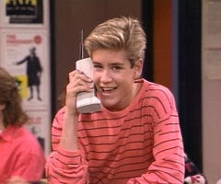
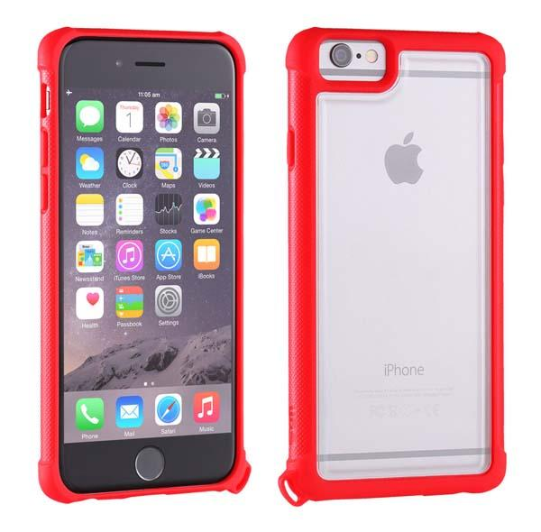
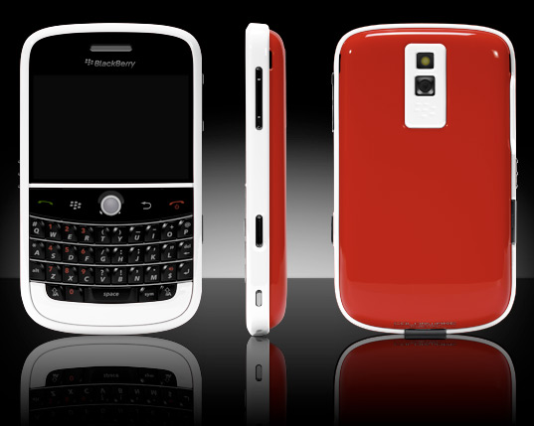
Semantic Constraints
This Photo by Unknown Author is licensed under CC BY-SA
This Photo by Unknown Author is licensed under CC BY-NC-ND
This Photo by Unknown Author is licensed under CC BY-SA-NC
Notes:
Semantic constraints are those that rely on the meaning of the situation to control the set of possible actions
Similar to cultural constraints, semantic constraints can also evolve over time.
Designers change how we interact with technology all of the time! Think about every time they release a new phone---I’m pretty sure apple just announced a new phone a few days ago.
Look at what we started out with not that long ago and how far we’ve come since then.
Think about how much the experience has changed since then. On the 2nd phone, you would have to press the #4 3 times just to get the letter i to appear, now the experience is much different thanks to designers.

Slide 10
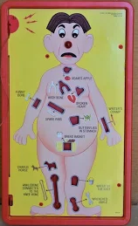
Logical Constraints
Notes:
For logical constraints, this simply means that there is a logical relationship between the spatial or functional layout of components and the things they affect or affected by
Natural mapping plays a role in this. Due to the arrangement, you sort of just logically know what to do. For example, in the second image, the site is prompting you to enter your birthday in a certain format. Most likely, if you try to submit the form in the wrong format, itll prompt you with another constraint in red text to emphasis that there is an error preventing you from submitting the form.

Slide 11
Handling Constraints in a Design Project
IBIT project experience: designing a website for a local bakery
Needed to make sure the platform could be integrated with Clover (the client’s current POS system) and Hazlnut (the ordering system associated with Clover)
Google is your friend–––do your RESEARCH!

Slide 12
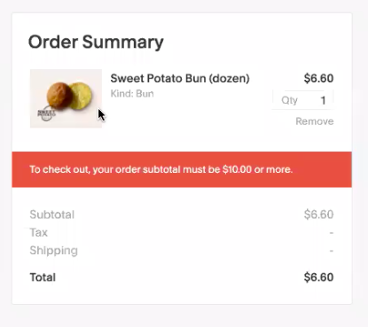

Slide 13
Tools or Bitter Pills?
Interlock the proper sequence
Lock-in to ensure the work is completed
Lockout to keep things away
Conventions are a natural cultural constraint
Annoyance can be your friend
Force the Physical Constraint

Slide 14
Design Principles
Discoverability
Feedback
Conceptual model
Affordances
Signifiers
Mappings
Constraints

Slide 15
The ICA for today is…
Notes:
https://create.kahoot.it/v2/details/b0cf903a-a4d8-41a4-8202-061ae88be2c3

Slide 16
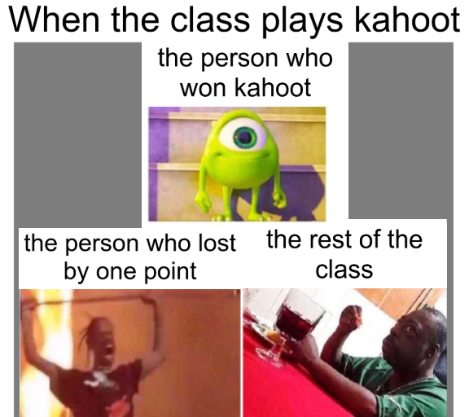
Thank you☺

