Slide 1
Course overview MIS3535 | LEAD GLOBAL DIGITAL PROJECTS
Marie-Christine Martin

Slide 2
ABOUT THE INSTRUCTOR
Marie-Christine Martin
20+ years of experience in the IT industry
E-mail: mcmartin@temple.edu
Office: Speakman 206 B
Office Hours:
By appointment

Slide 3
MY BACKGROUND
Education
BS Industrial Engineering
MBA, Finance
Pre-Temple
IBM (Canada, USA & Singapore)
HP Global
Oracle, USA
Self Employed Consultant
Adjunct Faculty
Temple University, MIS
Full-Time Faculty Temple University
Undergraduate - MIS
Graduate - FOX Business School MBA and Master In Management (MiM)
Academic Director, ITACS BNAI Master Program, MIS
AIS Faculty Advisor (2021-2024)

Slide 4
My Family

Slide 5
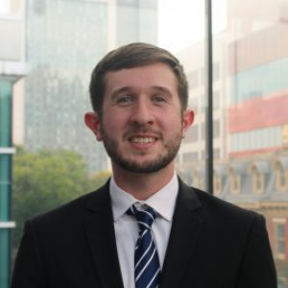
Course Support: Information Technology Assistants (ITA)
Name: Eric Taraborelli
Email: eric.taraborelli@temple.edu
https://community.mis.temple.edu/etaraborelli/
Email: Office hours : by appointment

Slide 6
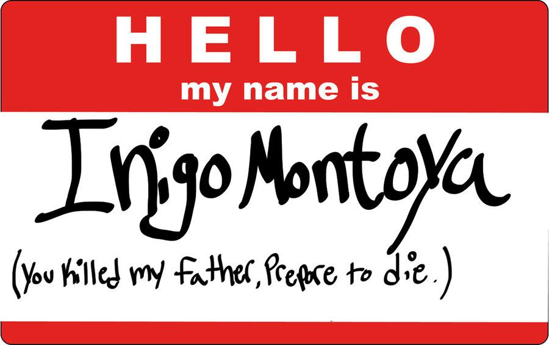
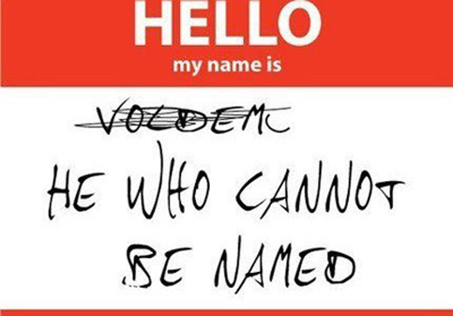
Introductions
Name
Any experience with Agile/Scrum?
One interesting fact about you!
Notes:
Now what about you?
Everyone introduce yourself:
1) Name
2) Undergrade Major
3) Experience
4) One interesting fact about you?

Slide 7
Notes:
https://www.weforum.org/reports/the-future-of-jobs-report-2020/in-full/infographics-e4e69e4de7

Slide 8
“Education is what people do to you, learning is what you do to yourself.” Joi Ito, The Director of MIT Media Lab

Slide 9
What is a “change agent”?
A change agent is a person from inside or outside the organization who helps an organization transform itself by focusing on such matters as organizational effectiveness, improvement, and development. ... The focus is on the people in the organization and their interactions.
The central challenge is changing people’s behavior. “What people do” and the need for significant shifts in what people do.
Notes:
A change agent is a person from inside or outside the organization who helps an organization transform itself by focusing on such matters as organizational effectiveness, improvement, and development. ... The focus is on the people in the organization and their interactions.
The central challenge is changing people’s behavior. “What people do” and the need for significant shifts in what people do.
The heart of change is in the emotion!

Slide 10
Consistent Message from Advisory Board Members
Leading change is one of the biggest challenge in IT today
We need MIS graduates capable of doing this!

Slide 11
Three Major Objectives for this course
Two Major Objectives for this course
1) IT Product Management
Understand how to develop & manage digital products
Learn the Agile approach and the SCRUM framework such as values, roles and events
2) Change Leadership
Develop an understanding of process thinking and key management strategies that support IT-enabled business transformation
Learn how to plan, manage, and lead business change
Notes:
Change Leadership : You can deliver a product efficiently, within the client’s budget, and in perfect working order and still have a complete failure (no adoption)
This is the hard part!

Slide 12
Course Materials
One book to purchase: “The Heart of Change: Real-Life Stories of How People Change Their Organizations”
Online articles
Videos on LinkedIn Learning
Simulation: purchase the Harvard course pack (15$) – see link on our course site
Each week you will also be required to spend some time searching the Internet to learn more about topics covered in class

Slide 13
Course Structure :
Class discussion days: 1/3
Studio days : 1/3
Change Leadership days: 1/3
Notes:
Class discussion : discuss readings/videos/web research
Studio day : work on specific documents for their team project, compare to each other, review/critics
Change leadership day: student get ready to discuss / present 3 topics including how it relates to their project, I will call 3 students (each present a topic)

Slide 14
Want to earn an “A” in this class?
Plan to spend 6-8 hours per week outside the classroom:
Complete your readings and take notes
Watch the videos and take notes
Complete your web research
Work diligently with your team on your team project
And :
Actively participate in class discussion!

Slide 15
Grading Components
Component | Percentage
Weekly quizzes (5) | 15%
Exam 1 | 20%
Exam 2 | 20%
Project (team grade) | 20%
Assignments (4) | 15%
Class Contributions & Team feedback (5% each) | 10%
Note: Exams are not cumulative

Slide 16
MIS Department Instructional Practices
Break large tasks down into smaller tasks & plan (Project Management!)
Relate the course concepts to your team project work
Ask questions in class
Independently experiment to discover answers
Engage in your team project work
Come to class prepared
Take notes ☺
If you fail, get back up and try again – don’t hesitate to seek for help!

Slide 17
Class Sites Review https://community.mis.temple.edu/mis3535sec001spring2025/ https://templeu.instructure.com/courses/150212
Notes:
Focus on those tabs :
Schedule (home page)
Team Project
Assignments

