Slide 1
Take Quiz #1 On Canvas 10 min 4 questions Opened Book

Slide 2
Send me your team list and team name by EOD today one EMAIL PER TEAM : a) 3 To 4 team members B) Name of your team
REMINDER:

Slide 3
Introduction to Agile MIS3535 | LEAD GLOBAL DIGITAL PROJECTS

Slide 4
What does Agile mean?
ag·ile
Adjective
Able to move quickly and easily.
“Sophie was as agile as a monkey"
Synonyms: nimble,lithe,supple,limber,acrobatic,fleet-footed,lightfooted,light on one's feet;
Antonyms: clumsy, stiff, slow, dull
Agile = Able to think and understand quickly.

Slide 5
AGILITY IN BUSINESS
“Agility is the ability to both create and respond to change in order to profit in a turbulent business environment. Agility is the ability to balance flexibility and stability.”
-Jim Highsmith, 2002

Slide 6
MY FAVORITE AGILE QUOTE
“It’s neither the strongest of the species that survive, nor the most intelligent, but the most responsive to change.”
- Charles Darwin

Slide 7
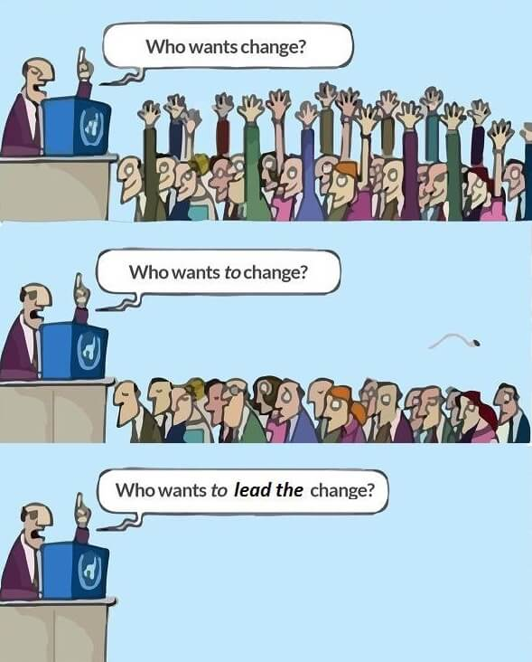
ARE YOU READY TO LEAD?

Slide 8
Agile was not developed in a single day. People across the globe felt the need for adaptive project management because they saw that traditional predictive waterfall methods lacked flexibility.
Notes:
Agile came out formally in 2001

Slide 9
DID YOU KNOW?
The most important thing to know about Agile methods or processes is that there is no such thing. There are only Agile people. The processes that we describe as Agile are designed to create environments for people to learn how to be Agile.

Slide 10
What is the “Agile Manifesto”?
What is the “Agile Manifesto”?
Web research
We are uncovering better ways of developing software by doing it and helping others do it. Through this work we have come to value:
Individuals and Interactions
Working Product/Software
Customer Collaboration
Responding to Change
OVER
Processes and Tools
Comprehensive Documentation
Contract Negotiation
Following a Plan
OVER
OVER
OVER
That is, while there is value in the items on the right, we value the items on the left more

Slide 11
Agile manifesto - FIRST
INDIVIDUALS AND INTERACTIONS
OVER PROCESSES AND TOOLS
Although processes and tools help you in successfully
completing a project, it is people who undertake, participate
in, and implement a project. The key actors in any project are
the people, and the emphasis should be on them and their
interactions.

Slide 12
Agile manifesto - SECOND
WORKING SOFTWARE OVER
COMPREHENSIVE DOCUMENTATION
While documentation is necessary and useful for any project,
the real value is delivered to the customer primarily in the form of
working software. The focus therefore, is on delivering
working software in increments throughout the lifecycle of the
project.

Slide 13
Agile manifesto - THIRD
CUSTOMER COLLABORATION OVER
CONTRACT NEGOTIATION
Traditionally, customers were seen as outside players involved
mainly at the start and end of the product lifecycle and whose
relationships were based on contracts and their fulfillment.
Agile believes in a shared value approach in which customers
are seen as collaborators. The team and customer work
together to evolve and develop the product.

Slide 14
Agile manifesto - FOURTH
RESPONDING TO CHANGE OVER
FOLLOWING A PLAN
In the current market, in which customer requirements,
available technologies, and patterns of business keep
changing, it is essential to approach product development in
an adaptive manner. One that enables change incorporation
and fast product lifecycles, rather than place emphasis on
following plans formed on potentially outdated data.

Slide 15
What are the “Agile Principles”?
Web research
How many?
I need 12 Volunteers to:
Explain the principle
Provide an example on how you can apply it to your project this semester
Notes:
12 Agile principles

Slide 16
AGILE PRINCIPLE ONE
Our highest priority is to satisfy the customer through early and continuous delivery of valuable software.
• Satisfy the customer (not the project management office)
• With early and continuous delivery (to get early feedback and have time to fix issues)
• Offer valuable software (focus is on value and the end product; that is, software, not documentation)

Slide 17
AGILE PRINCIPLE TWO
Welcome changing requirements, even late in development. Agile processes harness change for the customer’s competitive advantage.
• Embrace change; it will happen anyway
• Strive to provide late-breaking, high-value functionality
(competitive edge)
• More time can be spent on the end-product by accepting
change rather than fighting it

Slide 18
AGILE PRINCIPLE THREE
Deliver working software frequently – from a couple of weeks to a couple of months – with preference for the shorter timescale.
• Delivery frequently
• Get feedback early and often
• Detect whether you can proceed or need to change things
• Keep the business people engaged

Slide 19
AGILE PRINCIPLE FOUR
Business people and developers must work together daily throughout the project.
• Developers will learn about, and understand, the business
• Business representatives gain better understanding of what
is difficult/expensive to develop and what is easy/cheap
• Strive for daily meetings; the more frequently, the better

Slide 20
AGILE PRINCIPLE FIVE
Build projects around motivated individuals.
Give them the environment and support they
need and trust them to get the job done.
• The difference in the impact of “having the best people”
versus “having the best processes and tools” is 10:1
• Empowered teams: Rely on their expertise and their teamwork
• Provide support when needed

Slide 21
AGILE PRINCIPLE SIX
The most efficient and effective method of conveying information to, and within, a development team is face-to-face
conversation.
• We all know that emotion and body language are a
significant part of communication.
• Reality (even more right now!!!) will dictate that there cannot always be face-to-face communication; do it as often as possible; when not, use
similar means of communication, such as zoom meetings

Slide 22
AGILE PRINCIPLE SEVEN
Working software is the primary measure of progress.
• Making working software is the primary focus.
• Documentation and design become second priority; take a
support role.
• Measure “done” software.

Slide 23
AGILE PRINCIPLE EIGHT
Agile processes promote sustainable development. The sponsors, developers, and users should be able to maintain a constant pace indefinitely.
• While Agile methodologies are geared toward short-term
flexibility and value, they also strive to maximize value over time.
• Do not burn out valuable individuals.

Slide 24
AGILE PRINCIPLE NINE
Continuous attention to technical excellence and
good design enhances agility.
• In the software world, once the software gets intertwined
heavily, it becomes resistant to change.
• Keep the software maintainable (similar to the previous
principle for people). Keep technical debt under control.
• Spend some effort maintaining software flexibility; if your product becomes inflexible and resistant to change, then even the best intentions will not allow you to address changing requirements quickly.

Slide 25
AGILE PRINCIPLE TEN
Simplicity - the art of maximizing the
amount of work not done - is essential.
• In the software world, 60 percent of the features built are
rarely (or never) used.
• Avoid dead code that wastes effort and causes problems.
• Use the smallest and simplest approach possible first.

Slide 26
AGILE PRINCIPLE ELEVEN
The best architecture, requirements, and
designs emerge from self-organizing teams.
• To get the best out of people, let them organize their set-up
and teamwork themselves.
• It increases commitment to, and pride in, their work.
• The team knows best what is working and what is not.

Slide 27
AGILE PRINCIPLE TWELVE
At regular intervals, the team reflects on how to become more effective, then tunes and adjusts its behavior accordingly.
• These are the lessons learnt. It is done throughout the project not
just at the end.
• Since change is embraced and possible during the project, don’t
wait until after the project for lessons learned; discuss them
regularly, and adjust during the project.
• The team will define necessary changes and implement them.
• By doing so, you can immediately benefit from the improvements
in your current project.

Slide 28
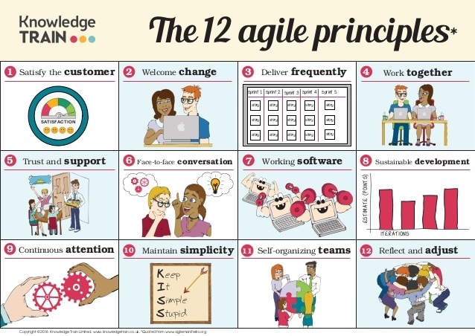

Slide 29
The Right Conditions for Agile
CONDITIONS | FAVORABLE | UNFAVORABLE
Market Environment | Customer preferences and solution options change frequently. | Market conditions are stable and predictable.
Customer Involvement | Close collaboration and rapid feedback are feasible. Customers know better what they want as the process progresses. | Requirements are clear at the outset and will remain stable. Customers are unavailable for constant collaboration.
Innovation Type | Problems are complex, solutions are unknown, and the scope isn’t clearly defined. Product specifications may change. Creative breakthroughs and time to market are important. Cross-functional collaboration is vital. | Similar work has been done before, and innovators believe the solutions are clear. Detailed specifications and work plans can be forecast with confidence and should be adhered to. Problems can be solved sequentially in functional silos.
Modularity of Work | Incremental developments have value, and customers can use them. Work can be broken into parts and conducted in rapid, iterative cycles. Late changes are manageable. | Customers cannot start testing parts of the product until everything is complete. Late changes are expensive or impossible.
Impact of Interim Mistakes | They provide valuable learning. | They may be catastrophic.
Source Bain & Company From “Embracing Agile,” May 2016

Slide 30
What are the differences between Agile & Waterfall?

Slide 31
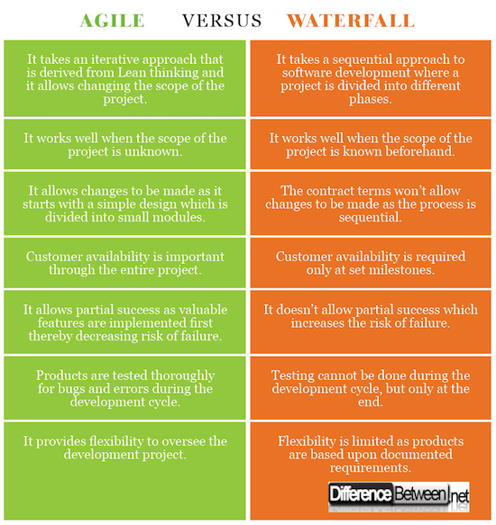

Slide 32
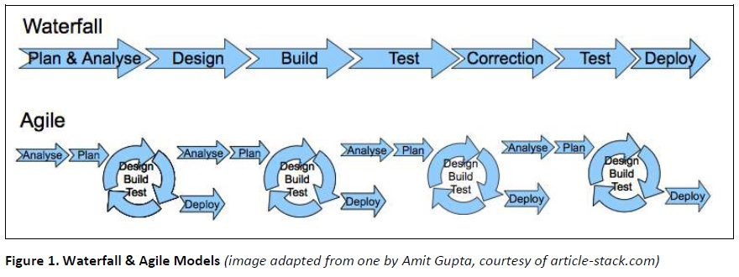

Slide 33
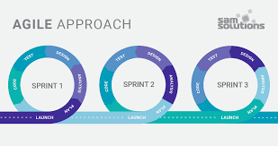
Ask this one question while making any
decision in Agile product management:
Is this decision going to help us
ACHIEVE HIGHEST ECONOMIC VALUE IN
THE SHORTEST POSSIBLE TIME ?

Slide 34
What is a “stakeholder”? Can you NAME a few examples? How do you document your stakeholders? What do you include in your analysis?
Web research
Notes:
A person with an interest or concern in something, especially a business or a person that can be impacted by a process/situation/change.
In a project, stakeholders give or want something from it :
Project sponsor
Project customers
Functional managers
Team members
End Users
Use a stakeholder analysis table

Slide 35
What is a “stakeholder”? What is a “stakeholder register”? What is a “stakeholder management strategy”?
A person with an interest in a project or strategy undertaken by a company, especially if impacted by the process/situation/change.
Web research
The stakeholder register, which records relevant information for each stakeholder or group of stakeholders, is a wonderful tool to keep information organized. It also help you appropriately manage the communication with all your stakeholders.
Stakeholder Management is the process of developing appropriate management strategies to effectively engage stakeholders throughout the lifecycle of the project, based on the analysis of their needs, interests and potential impact on project success.
Notes:
Stakeholder register: a public document that includes details related to the identified project stakeholders
Stakeholder management strategy: an approach to help increase the support of stakeholders throughout the project; often includes sensitive information – not a public document!
https://www.pmi.org/learning/library/stakeholder-management-task-project-success-7736
Stakeholders: those who have a stake or an interest in a project or strategy undertaken by a company or an organisation, they will be affected in some way by the project and so have an interest in influencing it. They may benefit from the project and so will be supportive and positive about it; conversely, the project may damage their interests or they may perceive it will have a negative outcome for them so they will seek to stop it or, at the very least, project it in a bad light

Slide 36
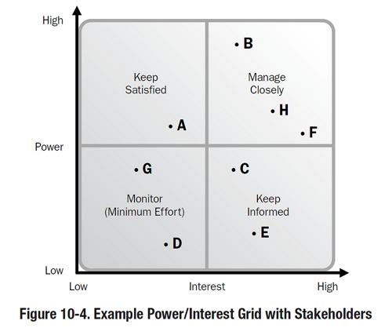
Stakeholder Management

Slide 37
Stakeholder Register - Example
Project Title: ABC of ABC |  |  | Date: November 15, 2024
Name | Position | Role/Expectation in the project | Influence | Classification
Jan Bastien | Founder | Manage internal and external functionality of ABC | High | Internal
Board Members | Internal board members | Provide insight supporting the goals of the organization | Medium | Internal
Veterans/Family Members | External beneficiaries | Receive support/services from ABC | Medium | External
Donors | External support | Provide financial backing to the organization to fund services | Low | External
Team members | Developers | Develop Digital Products | High | Internal
Professor Martin | Advisor | Act as liaison between client and projects teams; provides project direction | Medium | Internal

Slide 38
Change Leadership: Kotter MIS3535 | LEAD GLOBAL DIGITAL PROJECTS
Marie-Christine Martin

Slide 39
Compare & Contrast
See-Feel-Change Vs. Analysis-Think-Change
Technique?
3 major limitations with Analysis-think-Change Technique:
Do we need a 50 pages detailed report to find that the old strategy isn’t working?
Analytical tools have their limitations… even more in a fast paced ever changing environment!
Who will have the desire/time/motivation to read 100 pages analysis?
Which approach do you learn in a business school?
Notes:
3 major limitations with Analysis-Think-Change Technique:
In a remarkable number of cases, we don’t need 50 pages detailed report to find that the old strategy isn’t working
Analytical tools have their limitations in a turbulent world : these tools works best when parameters are known, assumptions are minimal and the future is not fuzzy
Good analysis rarely motivates people in a big way

Slide 40
I need volunteers to briefly explain the eight steps from Kotter:
Increase Urgency
Build the Guiding Team
Get the Vision Right
Communicate for Buy-in
Empower action
Create Short-term Wins
Don’t Let Up
Make Change Stick
Notes:
Need to create a sense of urgency from a critical mass (relevant amount of people). Core issue is behavior of people.
Guiding team with credibility, skills connections, reputations and formal authority. Operate with trust and emotional commitment (no ill task force…HP!)
Sensible, clear, simple, uplifting vision (not only detailed budget & plans)
Simple, Heartfelt, messages. Visual/symbols speak loudly, Repetition is key
Key obstacles are removed (not giving power)
The wins are critical : they provide credibility, resources and momentum. Visible and early/often
Momentum builds after the 1st wins, create wave after wave of change until the vision is a reality
Make change stick by nurturing a new culture (shared values, new norms). A new culture develops through consistency of successful action over a sufficient period of time. Appropriate promotions, orientation for new employees, …

Slide 41
On all future leadership day : Each student prepare a brief PowerPoint presentation (2-5 slides) for your 3 favorite short stories. 1) The first slide will “tell the story”. 2) The following slide will include key lessons learned the reader should take away from the case. 3) The last slide will include a real-life example that relates to the stories (from your past experience or your current project) Students will be selected at random to lead the class discussion on one of these short stories and will use this slide deck to add structure to their discussion.

Slide 42
TEAM PROJECT
FIRST CLIENT INTERVIEW
Thursday January 23
Website Development Brief for Taiga, Inc.
Project Overview: We are seeking a professional, modern, and user-friendly website for Taiga, Inc., a business offering professional services in resource augmentation, company set-up, compliance, payroll services, book-keeping, and additional offering like business tax filing, access to legal counsel. The website should establish our company as a reliable, transparent, and forward-thinking partner for individuals, start-up entrepreneurs and small-to-medium-sized businesses, providing comprehensive support and benefits for their operations so they can focus on their business.
Clients attending the first interview:
Vijay Saini, Co-Founder
Ritu Saini, Co-Founder

Slide 43
TEAM PROJECT
TO DO BEFORE THURSDAY:
Review the Project Document (posted on our community site under the Team Project tab)
Meet with your team and prepare your questions for the interview (data requirements)

Slide 44
Day 2

Slide 45
TEAM PROJECT
FIRST CLIENT INTERVIEW
Thursday January 23
Website Development Brief for Taiga, Inc.
Project Overview: We are seeking a professional, modern, and user-friendly website for Taiga, Inc., a business offering professional services in resource augmentation, company set-up, compliance, payroll services, book-keeping, and additional offering like business tax filing, access to legal counsel. The website should establish our company as a reliable, transparent, and forward-thinking partner for individuals, start-up entrepreneurs and small-to-medium-sized businesses, providing comprehensive support and benefits for their operations so they can focus on their business.
Clients attending the first interview:
Vijay Saini, Co-Founder
Ritu Saini, Co-Founder

Slide 46
TEAM PROJECT
Project Objectives
Primary Objective: Build trust with potential clients by offering a professional, clean, and informative web presence.
Secondary Objective: Highlight the full range of services available, from company creation to ongoing compliance and payroll management.
Tertiary Objective: Promote exclusive benefits for member companies, such as group health benefits and other perks.

Slide 47
PROCESS & SCHEDULE
Each team: name a representative to ask your team’s questions
First round of questions: each team can ask up to 3 questions (after the first round, we will open it up for additional questions from any teams)
Order:
Team # | Team Name | Student Full Name
1 | J & A | Anderson, Jack
 |  | Ingram, Jerry
 |  | Shao, Andy
 |  | Shimchak, Aidan
2 | Team #2 | Albaladejo, Anthony
 |  | Andrew, Rhenece
 |  | Lad, Deep
 |  | Zhang, Peter
3 | Team #3 | Acker, Evan
 |  | Shamai, Jeremy
 |  | Johnson, Deajah
4 | Team #4 | De Jesus, Nick
 |  | Girase, Sweta
 |  | Yang, Dong

Slide 48
TO DO:
Get ready for our Quiz#2 next Tuesday!
You will be taking the quiz at the start of class (first 10 minutes) on your Laptop.
Don’t forget to bring your laptop!
Quiz will cover the content listed for week 3 Day 1 on our community site (readings & web research).

