Slide 1
Take Quiz #2 On Canvas - 10 min

Slide 2
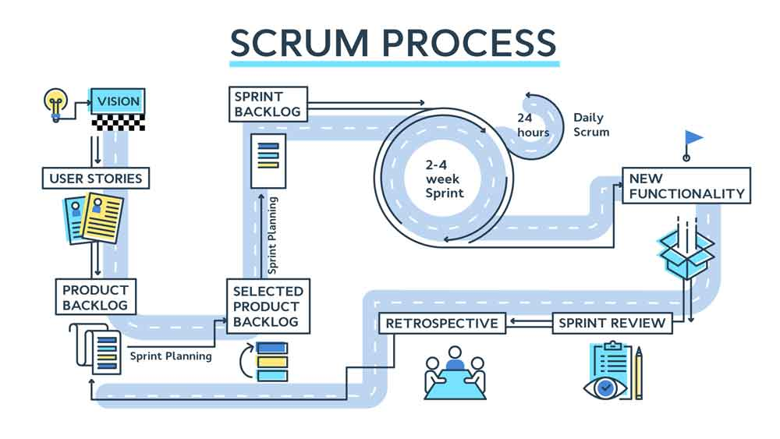
Introduction to SCRUM MIS3535 | LEAD GLOBAL DIGITAL PROJECTS

Slide 3
SCRUM?
SCRUM
Noun
A framework within which people can address complex adaptive problems, while productively and creatively delivering products of the highest possible value.
Scrum is:
• Lightweight
• Simple to understand
• Difficult to master

Slide 4
HISTORY OF SCRUM
First introduced to the agile community by Ken Schwaberand & Jeff Sutherland in 1995.
• Inspired by the work of Hirotaka Takeuchi and IkujiroNonaka published in the HBR case study.
• Borrowed the name from the game of Rugby.
• Scrum is one of the most popular Agile methodologies globally.
Notes:
The most widely-used Agile methodologies include:
Agile Scrum Methodology.
Lean Software Development.
Kanban.
Extreme Programming (XP)
Crystal.
Dynamic Systems Development Method (DSDM)
Feature Driven Development (FDD)

Slide 5
SCRUM
Theory
Roles
Values

Slide 6
1) THEORY: SCRUM BELIEVES IN
Empirical Process Control
Self-organization
Value-based Prioritization
Collaboration
Time-boxing
Iterative Development
Notes:
In Scrum, an empirical process is implemented where progress is based on observation and experimentation instead of detailed, upfront planning and defined processes.

Slide 7
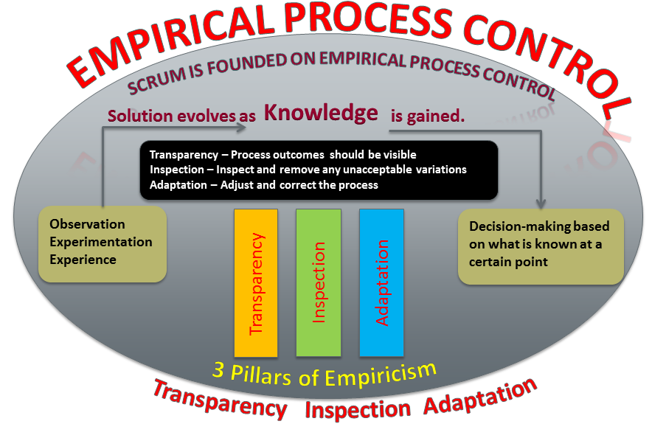
Empirical process control

Slide 8
SELF ORGANIZATION
As opposed to the traditional command and control style of management, Scrum believes that today’s workers have much more knowledge to offer than just their technical expertise and deliver greater value when self-organized.

Slide 9
VALUE-BASED PRIORITIZATION
Delivering the greatest value in the shortest amount of time requires prioritization and dividing what will be done from what needs to be done.

Slide 10
COLLABORATION
Scrum believes that product development is a shared value creation process that needs all the stakeholders working and interacting together to deliver the greatest value. Significant aspects of the process must be visible to ALL of those responsible for the outcome.

Slide 11
TIME BOXING
Time Boxing enforces maximum time allowed for any given event and is treated as a limiting constraint in Scrum.
Time-boxing is kept constant and used as the rhythm (Cadence) to which team and stakeholders work and contribute.
Time-Boxing helps a self organized team focus on one problem (goal) at a time.
Time Boxing helps in maintaining the right Work-in-process (WIP).

Slide 12
ITERATIVE DELIVERY
In most complex projects, the customer may not be able to define very concrete requirements or is not confident of what the end product may look like. The iterative model is more flexible in ensuring that any change requested by the customer can be included as part of the project.

Slide 13
Scrum is intended as a simple, yet sufficient framework for complex product delivery. Scrum is not a one-size-fits-all solution, a silver bullet or a complete methodology. Instead, Scrum provides the minimal boundaries within which teams can self-organize to solve complex problems using an empirical approach. This simplicity is its greatest strength.
-Scrum.org

Slide 14
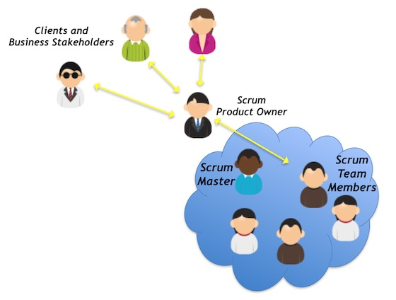
SCRUM ROLES
2) SCRUM ROLES
Scrum Team
The core roles that are required for producing the project’s product or service
Product Owner
Scrum Master
Development Team
Non-Core Roles
Not mandatory but they may have input in the project
Customers / Users
Business Stakeholders
Vendors
Scrum Guidance Body (a coalition body)

Slide 15
SCRUM ROLES
THE THREE CORE ROLES
Scrum Master
Facilitate and protects the process
Removes team impediments
Product owner
Represents the business interests
Sets priorities
Owns the product backlog
The Development Team
Does the work
Self organizes
Owns sprint backlog
Dev test, arch, DBA, BA, SME, etc.

Slide 16
PRODUCT OWNER - THE VALUE MAXIMIZER
The Product Owner (PO) is an individual (not a team or a committee)
• Represents the direct user (Voice of the Customer) of the product with a deep understanding of the user base
• Have absolute clarity on product vision
• Responsible for maximizing business value for the end users
• Ensuring that the requirements in the form of product backlog is visible, transparent, and clear to all
• Complete control of Product Backlog to best achieve business goals and objectives in form of product increment and release goals
• Ensuring the Development Team understands items in the Product Backlog to the level needed and optimizes their work within an iteration
• Validating teams' deliverables to ensure it meets the desired specification
• There should be only ONE PO in a Scrum team

Slide 17
NOT A SCRUM PO
You are on the sidelines of the team, feeding them with
only requirements
You are constantly judging their output
You are interfering on their day to day work
You have a strong opinion on team’s level of effort on a specific job
You do not have the courage to take decision on priority
You are reporting your team capacity and output to stakeholders

Slide 18
A SCRUM PO
You are a distinct member of the team with skin in the game
The team failure is your failure
Your presence brings confidence to the team in delivering the goal
You do what is of high value now for the business and end users and not someone’s wish list
You support your team when they need it
Constantly getting feedback and communicating end users‘ pain and pleasure
Be familiar with team’s strength, weaknesses, and personality types
Socialize with your team and know your team member personality type

Slide 19
SCRUM MASTER – THE FACILITATOR
Two primary Responsibilities:
To make sure that Scrum guidelines are correctly followed by all Scrum Team members including the Product Owner
Acts as facilitator who ensures that the team is provided with an environment conducive to completing the product’s development successfully
The role of the Scrum Master is based on the concept of Servant Leadership in which leaders achieve results by giving attention to the needs of those they lead

Slide 20
SCRUM MASTER SERVICE TO THE PO
The Scrum Master serves the Product Owner in several ways, including:
Finding techniques for effective Product Backlog management;
Helping the Scrum Team understand the need for clear and concise Product Backlog items;
Understanding product planning in an empirical environment;
Ensuring the Product Owner knows how to arrange the Product Backlog to maximize value;
Understanding and practicing agility; and,
Facilitating Scrum events as requested or needed.

Slide 21
SCRUM MASTER SERVICE TO THE DEV TEAM
The Scrum Master serves the Development Team in several ways, including:
Coaching the Development Team in self-organization and cross-functionality;
Helping the Development Team to create high-value products;
Removing impediments to the Development Team’s progress;
Facilitating Scrum events as requested or needed; and,
Coaching the Development Team in organizational environments in which Scrum is not yet fully adopted and understood

Slide 22
FACILITATOR TIPS
DO
DON’T
Do clarify the purpose, outcomes and process of the meeting including the timebox (the Container)
Do define how information will be created and decisions will be made
Do encourage full participation
Do maintain neutrality
Do Listen and ask Questions. Questions that will expand on what they have already said or assumed
Do probe more on common understanding and agreement
Do create a conducive environment for discussion. People should feel psychologically safe to share their views and thoughts
Do have a wrap-up session to ensure everyone is taking responsibility of their next steps
Don’t Assume participants know why they are in the meeting and what they need to accomplish
Don’t offer your opinion and decisions. Let the participants create their own content and make decisions (Content)
Don’t let few people dominate the discussion
Don’t take sides on specific people or views
Don’t engage in discussion. Let participants engage
Don’t interrupt or rush them for answers
Don’t blame or judge people on their views and opinions
Don’t take actions on their behalf

Slide 23
DEVELOPMENT TEAM – THE DEVELOPERS
The Development Team is a group of people responsible for understanding the business requirements specified by the Product Owner, estimating User Stories, and creating the product increment.
TEAM CHARACTERISTICS:
Self Organized with Collective Ownership
Cross-Functional
Co-located that enables face to face communication
Team size of 3-9 people
No hierarchy or further subdivision of team (Everyone is called a developer)

Slide 24
EMOTIONAL INTELLIGENCE (EQ)
FINDING GOOD
PLAYERS IS EASY.
GETTING THEM TO
PLAY AS A TEAM
IS ANOTHER
STORY.
Casey Stengel
IQ MAY GET
YOUR FOOT IN
THE DOOR.
EQ WILL DECIDE
HOW FAR YOU
GO.
KeyTalent
EQ: the capacity to be aware of, control, and express one's emotions, and to handle interpersonal relationships judiciously and empathetically.
"emotional intelligence is the key to both personal and professional success"
Notes:
Also mention Situational awareness

Slide 25
DEVELOPMENT TEAM SOFT SKILLS
Independent
Self-motivated
Generalist-specialist
Customer-focused
Collaborative
Team fosters an environment of independent thinking and group decision-making.

Slide 26
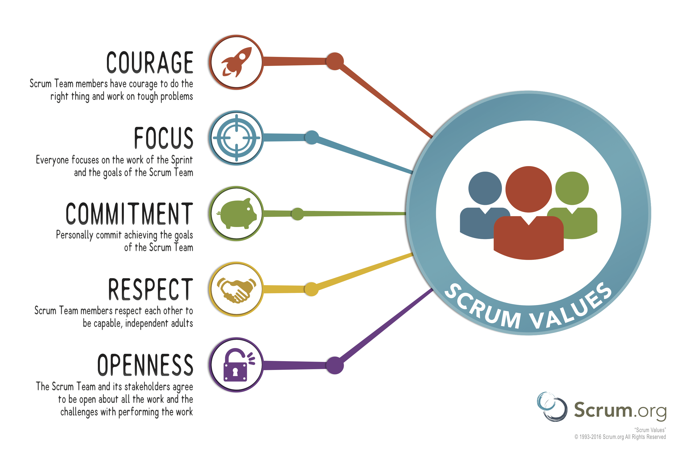
3) SCRUM VALUES
Web research

Slide 27
ADVANTAGES OF A SCRUM TEAM?
Web research
Faster decision making
Increased productivity
Improved communication
Collective ownership
Continuous innovation
Back-up each other
Increase commitment
Increased team moral
Increased quality
Increased customer engagement & satisfaction
Reduced risk
Reduced product release time to market

Slide 28
What is the “Tuckman model” of team development”? Class Exercise : IN YOUR TEAMS
Web research/Video
1- What are the phases?
2- What is the role of the leader in each phase?
Notes:
Bruce Tuckman's Forming, Storming, Norming and Performing, Is one model that describes the typical phases that teams go through.
Dr Bruce Tuckman published his Forming Storming Norming Performing model in 1965. He added a fifth stage, Adjourning, in the 1970s. The Forming Storming Norming Performing theory is an elegant and helpful explanation of team development and behavior.
1- Forming
2- Storming
3 – Norming
4- Performing
5- Adjourning
See next slide/notes page

Slide 29
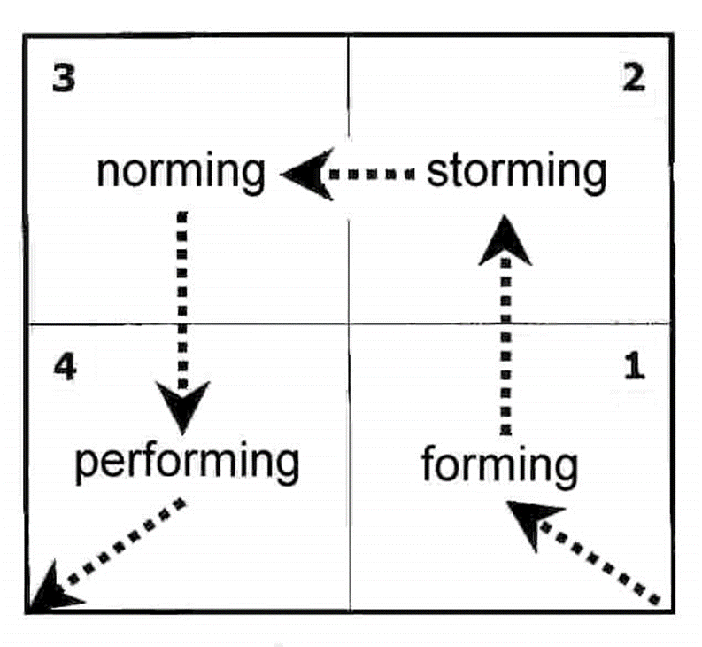
What is the “Tuckman model” of team development”?
Leaders facilitate & enables
Leaders coach
Leaders delegates & oversees
Leaders direct
5 - Adjourning
Notes:
Bruce Tuckman's Forming, Storming, Norming and Performing, Is one model that describes the typical phases that teams go through.
Dr Bruce Tuckman published his Forming Storming Norming Performing model in 1965. He added a fifth stage, Adjourning, in the 1970s. The Forming Storming Norming Performing theory is an elegant and helpful explanation of team development and behavior.
1-Forming : The team members aren't sure of their goal as a team and they don't know who does what. During the Forming stage you have to clearly define the team's goals and give them direction. Like other youngsters, teams in the Forming stage tend to resist and challenge authority. So be prepared to answer their questions and earn their respect.
Leaders direct.
2- Storming : The second stage is called Storming, because things with teams usually get worse before they get better. As team members start to work out their relationships with each other, power struggles often occur. Storming teams have difficulty making decisions, because of the disagreements.
Leaders coach.
The good news though, is that those disagreements lead to communication, which helps members grow as a team. When a team is Storming, you have to help the team members stay focused on their goals and help them make decisions. After the storm is over, you finally have a team.
3- Norming : Agreement and consensus largely forms among the team, who respond well to facilitation by leader. Roles and responsibilities are clear and accepted. Big decisions are made by group agreement. Smaller decisions may be delegated to individuals or small teams within group. Commitment and unity is strong. The team may engage in fun and social activities. The team discusses and develops its processes and working style. There is general respect for the leader and some of leadership is more shared by the team.
Leader facilitates and enables.
4- Performing : Teams don't always reach the Performing stage, but if they do, it's pretty impressive. They know what they're supposed to accomplish, who's supposed to do what, and they often get things done very quickly.
All without any help from you. You only have to step in if the team asks. Helping your people develop as a team, will help your project run smoothly and deliver quality results. . Team members look after each other. The team requires delegated tasks and projects from the leader. The team does not need to be instructed or assisted. Team members might ask for assistance from the leader with personal and interpersonal development.
Leader delegates and oversees.

Slide 30
See you THURSDAY for our first studio day!

Slide 31
Studio Day (Day 2)
Research the Agile Product Management Software and create your Scorecard. You will use this software to manage your product development throughout the semester.
Note: This is not about the website builder that you will be selecting later (wordpress, wix, squarespace, shopify, etc.).
On your scorecard:
Select at least 3 Agile Product Management Software (research all potential software and select at least 3 of them for your analysis)
Define 4-6 criteria to evaluate each software
Add a brief explanation of each criteria below your scorecard
Determine the weight for each criteria
Calculate your weighted average for each software
Clearly highlight your preferred software (highest score)
The output will be your first assignment due by EOD Sunday
Submit one file per team on Canvas
* No late assignment accepted
Notes:
https://www.sitebuilderreport.com/best-website-builder?a=ga&keyword=wordpress%20competitors&ad=574306176472&gclid=EAIaIQobChMItoTexpvc9QIVW25vBB169AS9EAAYAyAAEgIqrvD_BwE

Slide 32
SCORECARDS
Structured comparison of features
Level of rigor can vary
Quantitative or qualitative
 | Product 1 | Product 2 | Product 3 | Product 4
Criteria A (%) | score | score | score | score
Criteria B (%) | score | score | score | score
Criteria C (%) | score | score | score | score
Criteria D (%) | score | score | score | score
(Weighted) Total | SCORE | SCORE | SCORE | SCORE

Slide 33
FIRST STEP: EXAMPLE OF SCORECARD CRITERIA & WEIGHT
Criteria | Weight (%)
Package Requirement | 10%
Lines of Code | 5%
Simplicity | 10%
Popularity | 5%
Development Sources | 10%
Data Visualization | 15%
Functionality | 45%
Total | 100%

Slide 34
EXAMPLE: SCORECARD
Criterias | Weight | Word-Press | Joomla | Drupal | Share-point
Access controls to give people different levels of authoring (add, edit, delete) by entry | 5% | 10 | 5 | 3 | 10
Version control at the page level and at the “publication” level (Ability to “freeze” an entry and archive it) | 5% | 9 | 6 | 8 | 8
Ability to incorporate multimedia into an entry | 10% | 8 | 7 | 4 | 6
Support discussion-board style feedback from readers through different, access-controlled forums (student forum versus instructor forum) | 10% | 9 | 8 | 3 | 7
Support login-based access control and account management | 10% | 9 | 5 | 7 | 5
Convert an entry or a “publication” into a PDF for offline viewing and printing | 10% | 10 | 6 | 5 | 6
Scalability – ability to support a large number of users | 25% | 8 | 8 | 5 | 7
Delivery to browser in standard HTML (web-based delivery) | 25% | 9 | 8 | 9 | 8
TOTAL | 100% | 8.8 | 7.15 | 5.95 | 7.05

Slide 35
EXAMPLE: SCORECARD
 |  | SOFTWARE (1-10)
CRITERIA | WEIGHT | ABC | XYZ | LMN
Cloud-based | 30% | 10 | 10 | 6
Ability to adapt to Agile and Waterfall methodologies | 20% | 9 | 3 | 8
Ability to aggregate multiple projects | 20% | 9 | 4 | 6
Team collaboration | 10% | 10 | 10 | 6
Reporting sophistication | 10% | 8 | 6 | 4
Easy-to-use and and requires minimal training | 10% | 10 | 10 | 5
TOTAL | 100% | 9.4 | 7 | 6.1

Slide 36
TO DO:
Get ready for our quiz#3 next Tuesday!
You will be taking the quiz at the start of class (first 10 minutes) on your Laptop.
Don’t forget to bring your laptop!
Quiz will cover the content listed for week 4 Day 1 on our community site

