Slide 1
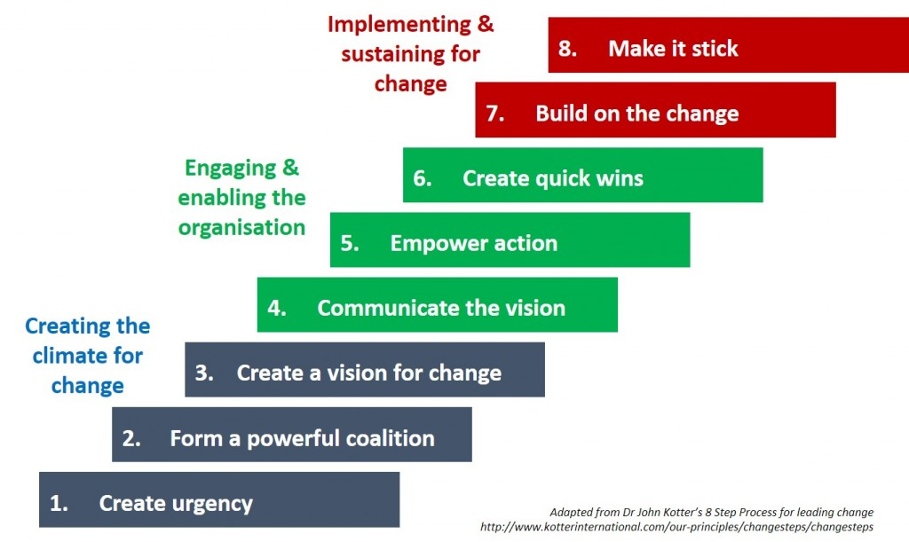
Week 5 MIS3535 | LEAD GLOBAL DIGITAL PROJECTS

Slide 2
Change Leadership Day!
Kotter Chapter 1
Prepare a brief PowerPoint presentation (2-5 slides) for your 3 favorite short stories:
The first slide will “tell the story”.
The following slide(s) will include key lessons learned the reader should take away from the case and how it relates to your current project or past work experience.
Students will be selected at random to lead the class discussion
Kotter Chapter 1 : Increase Urgency
Getting the Boss’ Approval
The Videotape of the Angry Customer
When Alligators are Nipping at Your Heels
Gloves on the Boardroom Table
The CEO Portrait Gallery

Slide 3
DISCUSSION RECAP: Key points in chapter 1 - Increase Urgency
Raise a feeling of urgency so that people say “Let’s go” – aim at communicating the urgency to the entire organization
4 Behaviors commonly stopping launch of change:
Complacency (driven by arrogance)
Immobilization driven by fear
You cant make me move driven by anger
Very pessimistic attitude leading to constant hesitations
What works: “ go after emotions”
Showing others the need for change “SEE”, feel & change
Valid & dramatic evidence
Cheap & easy ways to reduce complacency
What does not work
Focusing exclusively on “rational” & ignoring the feelings that are blocking the changes
Ignoring a lack of urgency and jumping immediately to creating vision & strategy
Thinking that you can’t initiate change if you are not the head person

Slide 4
Simulation Introduction (separate slides)

Slide 5
DAY 2

Slide 6
Let’s review Quiz 1, 2 & 3

Slide 7
STUDIO DAY (Day 2):
1) Create your Stakeholder Register - see example in week 2 slide deck (or next slide)
2) Create your DoD (Definition of Done) – see example on the last slide
3) If you decide not to use WordPress, research & select your web development platform
4) Select your relative estimation technique

Slide 8
Stakeholder Register - Example
Project Title: ABC of ABC |  |  | Date: November 15, 2024
Name | Position | Role/Expectation in the project | Influence | Classification
Jan Bastien | Founder | Manage internal and external functionality of ABC | High | Internal
Board Members | Internal board members | Provide insight supporting the goals of the organization | Medium | Internal
Veterans/Family Members | External beneficiaries | Receive support/services from ABC | Medium | External
Donors | External support | Provide financial backing to the organization to fund services | Low | External
Team members | Developers | Develop Digital Products | High | Internal
Professor Martin | Advisor | Act as liaison between client and projects teams; provides project direction | Medium | Internal

Slide 9
DEFINITON OF DONE – RELEASABLE STATE
List of technical validations as decided by the development organization of the company that would keep the sprint product increment in a releasable state for the PO and increases transparency for everyone involved
An Example of DEFINITION OF DONE (DoD)
Our Product Increment is considered DONE if:
The functionalities are deployed to test server for PO to test
Code review is complete and should be in a releasable state to production
Documentation is complete as per company documentation guidelines
The system responds to all search requests within 3 second of receiving the request
The system responds properly to all major browsers and mobile devices
Test that the system logs a user out after 10 seconds of inactivity and redirects their browser to the home page
Notes:
Other example of DoD:
All features should be responsive to all computer and mobile devices
Search and find populates within three seconds
All payment gets approved through separate security check

