Slide 1
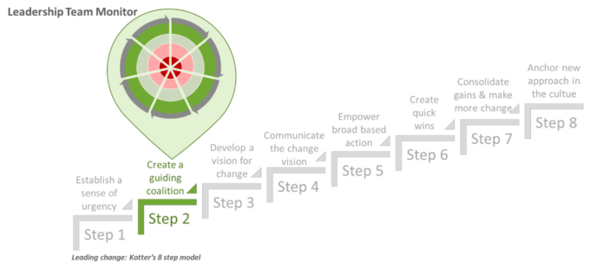
Week 6 MIS3535 | LEAD GLOBAL DIGITAL PROJECTS

Slide 2
Agenda for the week:
Day 1:
Simulation Debrief
Studio Day: Online Grocery ICA
Day 2:
Kotter Chapter 2: Building the guiding team
Debrief from Day 1 ICA
Studio day (part 1 of Assignment #2)
Product Vision
Story Map
Exam Prep

Slide 3
STUDIO DAY (Day 1): Online Grocery Website
As per the scenario provided you will:
Create a Product Vision Statement
Conduct a Release Plan Session using Story Map

Slide 4
STUDIO DAY: Online Grocery Website
Scenario:
You are a Scrum Team of a large grocery chain company
called Farmers Fresh. The company has 220 physical outlets throughout
USA. The Grocery industry is changing the way they do business by
allowing consumers to shop grocery online and providing home delivery
services as well as allowing shoppers to pick up from their physical
stores. Farmers Fresh does not want to lose out on their market share
and want to start selling grocery online as soon as possible. Their
biggest challenge is the size of their operation and how to implement
their online business at all locations. They have decided to use Agile/
Scrum development approach for this initiative. They have an excellent
technology infrastructure with well automated systems for their physical store management.

Slide 5
STUDIO DAY: Online Grocery Website
Deliverables (use posted spreadsheet)
Create a Product Vision Statement
Conduct a Release Plan Session using Story Map:
Release goal is already set (cell F6)
Your release plan is for 1 month with a team of 5
Develop 6 activities (epic) on row 11 under the roles listed (row 10)
Describe the goal for each activity (row 12)
List 2-3 features under each activity (epic)
Categorize each feature as either: “must”, “should”, “could”, “Wont”

Slide 6
STUDIO DAY: Online Grocery Website
Save your file with the naming convention Team Name_Online Grocery
Submit your excel file on Canvas before the end of class

Slide 7
Change Leadership Day (Day 2)!
Read Kotter Chapter 2 : Building the Guiding Team
Prepare a brief ppt for each of your 3 favorite short stories:
The first slide will “tell the story”.
The following slide(s) will include key lessons learned the reader should take away from the case and how it relates to your current project.
Students will be selected at random to lead the class discussion on one of these short stories and will use this slide deck to add structure to their discussion.
Stories :
The Blues versus the Greens
The New and More Diverse Team
General Mollo and I were Floating in the Water
Meetings Down Under

Slide 8
Key points in chapter 2 : Build Guiding Team
A powerful guiding group has 2 characteristics :
Made up of the right people – have capability (membership & method of operating)
Demonstrate Teamwork
What works: “ go after emotions”
Showing enthusiasm and commitment to help draw the right people in the group
Modeling trust and teamwork
Structuring meeting format to increase trust & efficiency
What does not work
Guiding change with weak task force, single individuals, complex governance structures, or fragmented top teams
Not confronting situation when momentum and entrenched power centers undermine the creation of the right group
Trying to leave out or work around the head of the unit to be changed because he or she is hopeless

Slide 9
ICA discussion: Debrief from Day 1
Discuss ICA
Review Do’s & Don’t

Slide 10
Studio Day (Day 2)
Create your Product Vision and Story MAP using the format from Tuesday as a guide

Slide 11
PRODUCT VISION (reminder)
A product development kicks off with a clear and simple vision statement
This product vision forms the foundation of the product development
The Product Owner is responsible for the shared vision
The vision needs to be re-evaluated periodically

Slide 12
PRODUCT VISION TEMPLATE (reminder)
Why are we building this product?
Bring clarity on the purpose of the product.
Commonly used vision template:
For «target customers»
Who: «needs / wants of the target customers»
The: «product name»
Is a: «product category»
That: «product benefit. Reason to buy»
Unlike: «Alternatives or competitors»
Our product: «differentiators or value proposition»

Slide 13
PRODUCT VISION FOR RAREBOOKS.COM (reminder)
For: book collectors < Target users >
Who: are looking to browse and shop rare books online < The Need >
The: rarebooks.com < Product Name >
Is a: an online bookstore < Product Category >
That: provides the convenience of browsing, reviewing and buying collectible books online < The core benefit. Reason to buy >
Unlike: amazon.com, Barnes and Noble stores < Competitors, Other alternatives >
Our product: contains exclusive catalog of collectible books <Differentiators> Provides the option of buying and renting books Validate authenticity of collectible books

Slide 14
STORY MAP (reminder)
Determine the release goal
List Role (Users/Persona)
List Activity (Epics/Stories)
Describe goal of each activity
List Features (detailed stories)
Prioritize features (must, should, could, won’t)
STEPS TO STORY MAPPING

