Slide 1
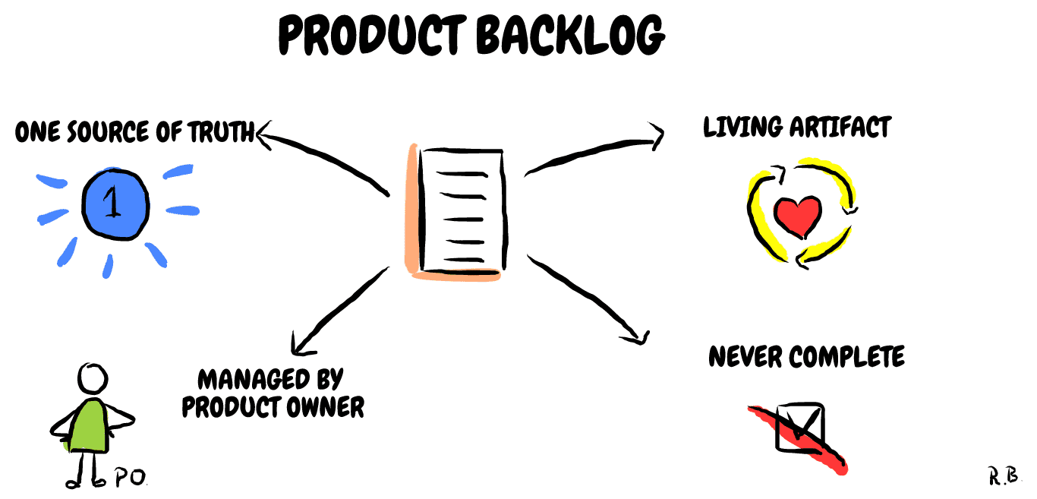
Week 7 MIS3535 | LEAD GLOBAL DIGITAL PROJECTS

Slide 2
Studio Day
By now you have completed your product vision, story map and prioritize your features (must, should, could, won’t)
How many detailed stories (or features) do you have?
Today you will create your product backlog (part 2 of Assignment #2)

Slide 3
Studio Day
Create the Product Backlog for your project
(see examples on the next slides)

Slide 4
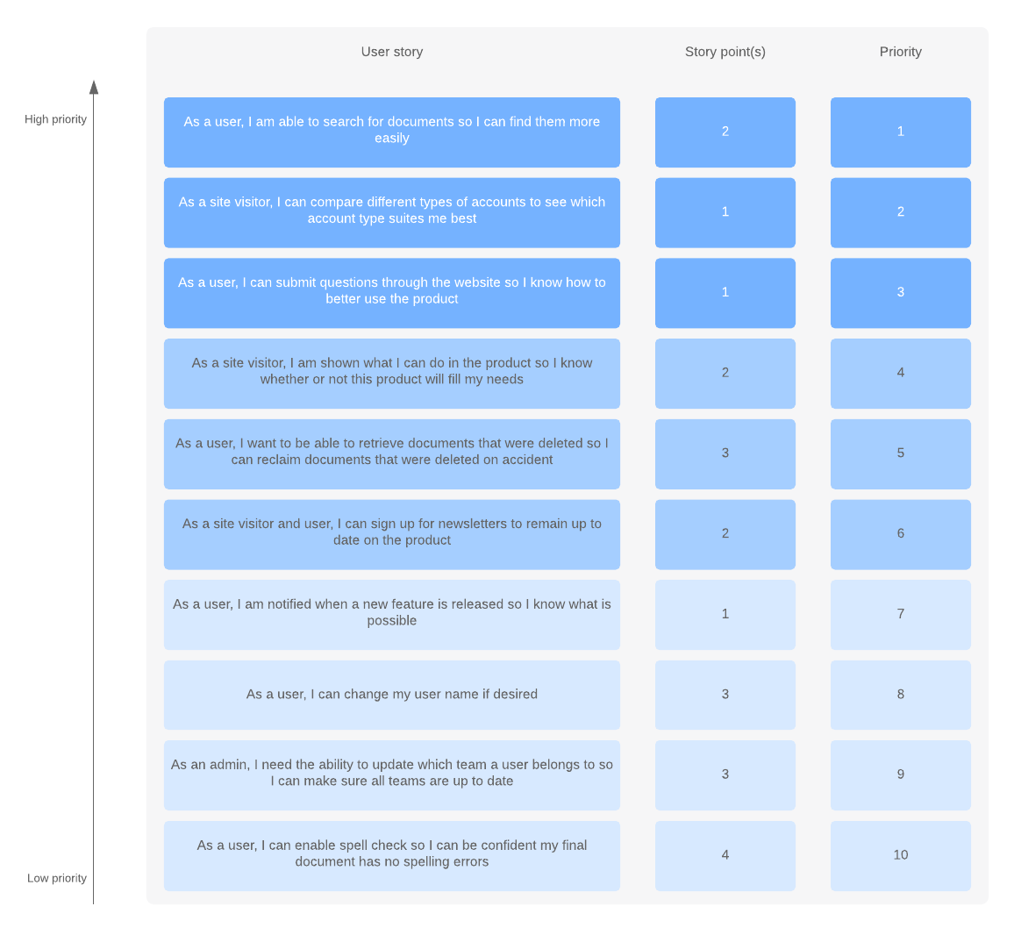
Product backlog
Prioritize your user stories
Estimate your stories – choose your technique for your relative estimation
Create an ID for each story (example on next slide)

Slide 5
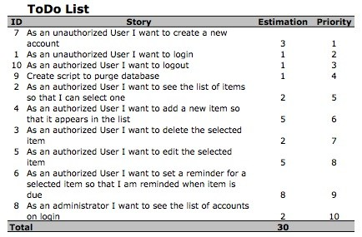
Product backlog (example)

Slide 6
Product backlog (another example)
ID | User Story | Estimation | Priority
1 | As a user, I want to receive up to date information on events and activities. | L | 4
2 | As a user, I want to sign up for upcoming events and activities. | S | 5
3 | As a user, I want to fill out the application to get assistance from the organization. | L | 1
4 | As a donor, I want to find a list of items that the organization needs. | XL | 6
5 | As a donor, I want to find a simple way to donate to the organization. | S | 3
6 | As an administrator, I want to collect our users' information in our database. | XL | 2
7 | As an administrator, I want to update our upcoming events on our website. | M | 7
8 | As an administrator, I want to list items that we need through donations. | M | 8

Slide 7
Assignment #2 (team submission) due by EOD Sunday
Submit your :
Product Vision & Story MAP (excel spreadsheet) and
Product Backlog (second tab on the same spreadsheet), make sure to estimate your backlog and specify which estimation technique you used (ex: bucket system). You also need to prioritize your backlog and itemize each story (ID for each backlog items).
* No late assignment accepted

Slide 8
Reminder: Exam 1 on Thursday
Format :
Closed books
On canvas – in person ONLY
20 questions (15 multiple choices & 5 open ended)
50 minutes
Content :
Week 1 to 6 :
- Readings
- Videos
- Web Research
- Lectures
- Change leadership discussion (stories)
70%
30%

