Slide 1
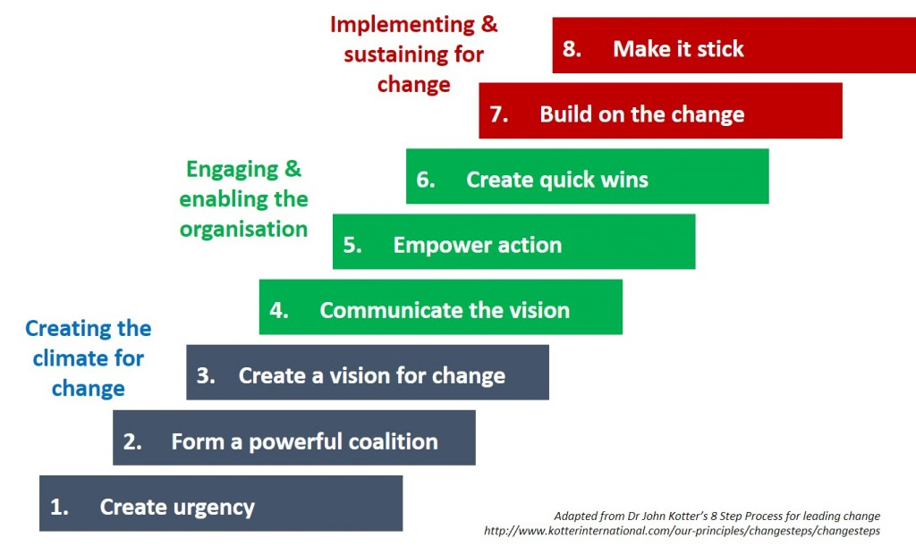
Week 6 MIS3535 | LEAD GLOBAL DIGITAL PROJECTS

Slide 2
Simulation Debrief
Review class output
2) Discuss takeaways from the simulation:
What worked well?
What didn’t work well?
How did you adjust your strategy during the simulation?
Any employee you liked/preferred “working” with in the simulation? Any resistors?

Slide 3
Scenario 1: Low Authority, Low Urgency
Total Number of Students: 15
Results: 67% Achieved critical Mass (10) / 33% Missed (5)
But 4 students (40%) did not achieve on their first run – Achieved after an average of 2.5 runs

Slide 4
Simulation Discussion
Takeaways from the simulation:
What worked well?
What didn’t work well?
How did you adjust your strategy during the simulation?
Any employee you liked/preferred “working” with in the simulation? Any resistors?

Slide 5
Kotter’s 8 Steps
Establishing a Sense of Urgency
Mobilization
(Unfreeze)
Forming a Powerful Guiding Coalition
Creating a Vision
Communicating a Vision
Movement (Change)
Empowering Others to Act on the Vision
Planning for and Creating Short-Term Wins
Sustain (Refreeze)
Consolidating Improvements and Producing Still More Change
Institutionalizing New Approaches

Slide 6
Some Key Process Choices
Build Credibility
Build Coalition
Metrics and Measurement
Training
Communication Plan
Pace and Involvement
Build Organizational Capability

Slide 7
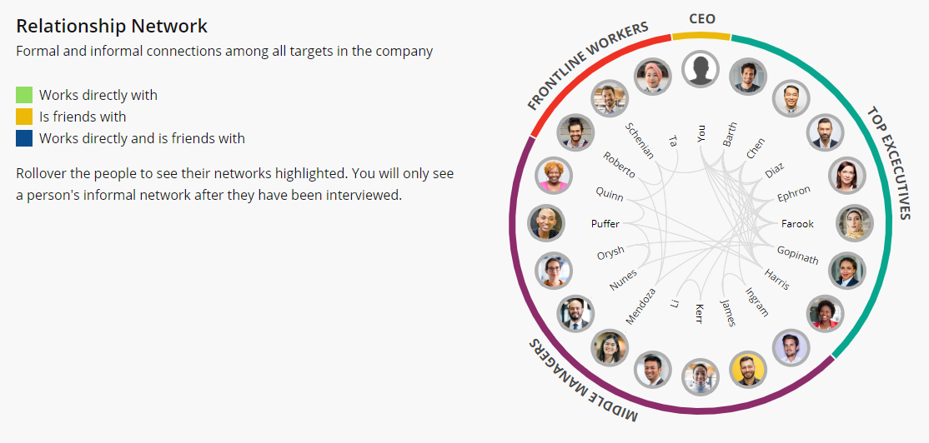
Know Your Social Network

Slide 8
Key Change Lever Attributes in the Simulation
Restructure Firm
Values Clarification
Reward System
Town Hall Meeting
Recognizes Adopter
Goals and Deadlines
Coalition of Support
External Skill Building and Pilot Project
Credibility Required of Change Agent
Issue E-mail and Tell Success Story
Confront Resister
Internal Skill Building
Progress Reports
Conduct Interviews
Walk the Talk and CEO Support
Consultant’s Support

Slide 9
Change in Low Urgency Situations: Gradual Build to Institutionalization
Highly Disruptive Levers |  |  | Confront Resister Goals and Deadlines Revise Reward System Restructure Firm
Moderately Disruptive Levers |  | Internal Skill-Building External Skill-Building Pilot Projects Recognize Adopters Values Clarification | Internal Skill-Building External Skill-Building Pilot Projects Recognize Adopters Values Clarification
Minimally Disruptive Levers | Conduct Interviews Post Progress Reports Issue E-mail Tell Success Story Build Coalition of Support Hold Town Hall Meetings | Conduct Interviews Post Progress Reports Issue E-mail Tell Success Story Coalition of Support Town Hall Meetings | Conduct Interviews Post Progress Reports Issue E-mail
 | Mobilize Phase | Movement Phase | Sustain Phase

