Slide 1

TAKE QUIZ #4

Slide 2
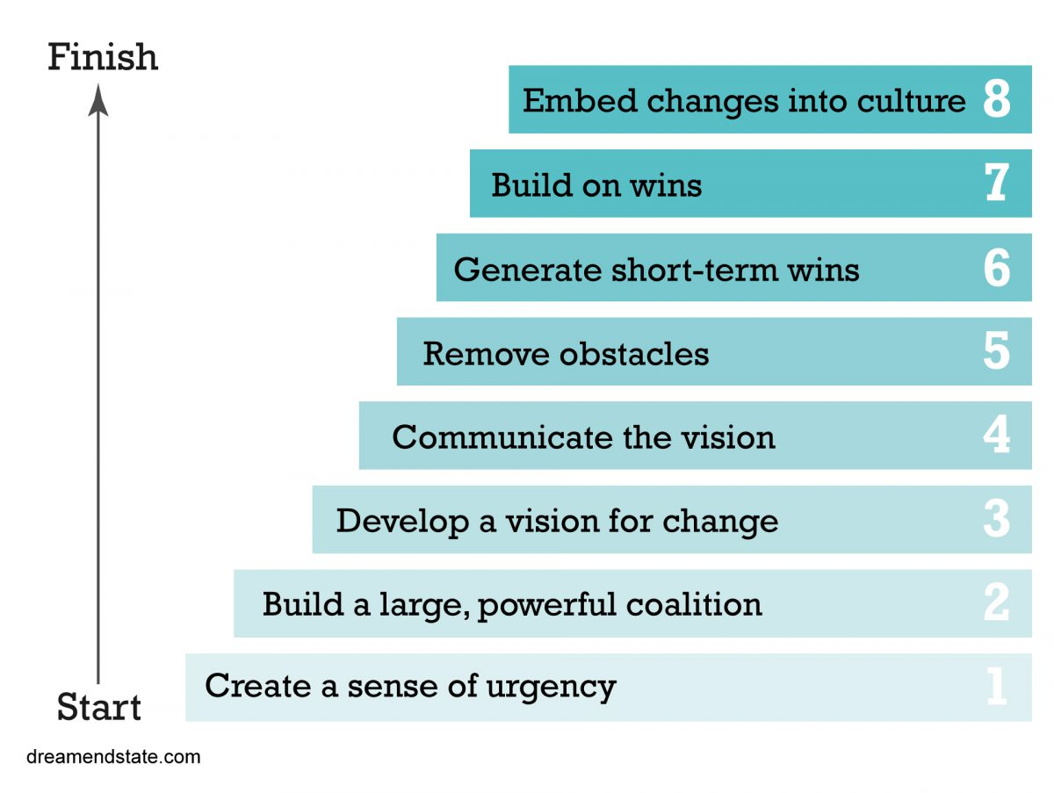
Week 11
MIS3535 | LEAD GLOBAL DIGITAL PROJECTS

Slide 3
AGENDA – Week 11
Quiz #4
Daily Stand up (last 2 teams)
Risk Management Discussion
Kotter Discussion:
  Chapter 4 (day 1)
  Chapter 5 (day 2)
Create your Risk Register – project artifact
Complete Sprint #2 / work on your deliverables
Update and submit your Sprint#2 Burndown chart
Create a snapshot of your Scrum board (as of this week) – project artifact

Slide 4
SCRUM EVENT: DAILY STAND UP (Day 1)
3 Important Questions:
1) What work did you complete yesterday? (for class purpose: last week)
2) What have you planned for today (this week)?
3) Are you facing any problems or issues?
Each team members need to stand up and discuss the 3 points.

Slide 5
SCRUM EVENT: DAILY STAND UP
LAST 2
TEAMS:
Order | Team Name | Student Full Name
1 | Silver | Acker, Evan
 |  | Shamai, Jeremy
 |  | Johnson, Deajah
2 | Team #4 | Chen, Jon
 |  | De Jesus, Nick
 |  | Girase, Sweta
 |  | Yang, Dong

Slide 6
Change Leadership Day! (Day 1)
Read Kotter Chapter 4 : Communicate for Buy-In
- Pick 3 of the stories and be ready to present the key take away/learnings and how it relates to your current project:
Preparing for Q&A
My Portal
Nuking the Executive Floor
The Screen Saver

Slide 7
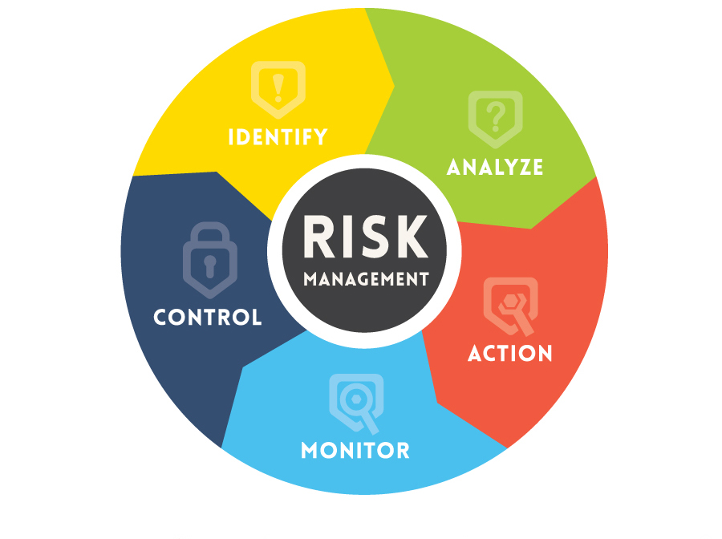
Risk Management Discussion

Slide 8
Questions
Web research
What is the difference between “known risks” and “unknown risks”?
Two identical projects :
  One being led by a new project manager - the other lead by an experienced project manager
  Which has a longer list of “known risks”? Why?
  Who is less likely to be surprised by a problem?
‘Known’ risks are somewhat predictable & proactively managed. ‘Known’ indicates those risk that can be identified, analyzed & planned in advance.
Unknown risks are those unable to be anticipated and described. Unknown risks cannot be managed proactively. These risks that result from the uniqueness of the work and they are difficult or impossible to anticipate.

Slide 9
My top 10 Project Mgmt. Risks:
Scope is poorly defined
Poor data requirements
Scope creep or too many scope changes
Poor leadership / communication
Inadequate Skills for the project or insufficient staff
Staff turn over
No continuity (staff, leadership, project plan, etc.)
Lack of stakeholder Engagement / support
Change to business strategy
Improper risk management

Slide 10
What is “Qualitative Risk Analysis”?
Web research
Qualitative risk analysis is a project management technique concerned with discovering the probability of a risk event occurring and the impact the risk will have if it does occur.
Notes:
Assess the likelihood and impact of identified risks to determine their magnitude and priority
Risk quantification tools and techniques include:
Probability/impact matrixes
The Top Ten Risk Item Tracking
Expert judgment

Slide 11
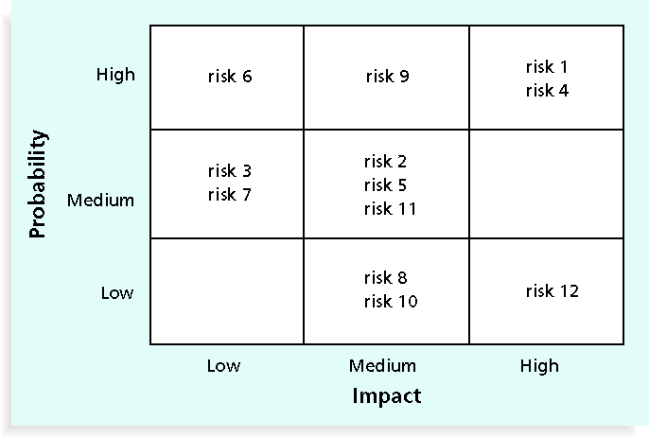
Probability/Impact Matrix
Notes:
probability/impact matrix - probability of a risk occurring on one side/relative impact on the other
1 - List the risks
2 - Label each one as high, medium, or low in terms of its probability of occurrence
3 – Label each on as high, medium, or low in terms of its impact if it did occur
4 – Fill in the matrix
Can also calculate risk factors
Numbers that represent the overall risk of specific events based on their probability of occurring and the consequences to the project if they do occur
Low = 1, Medium = 5, High = 10 then multiply probability * impact

Slide 12
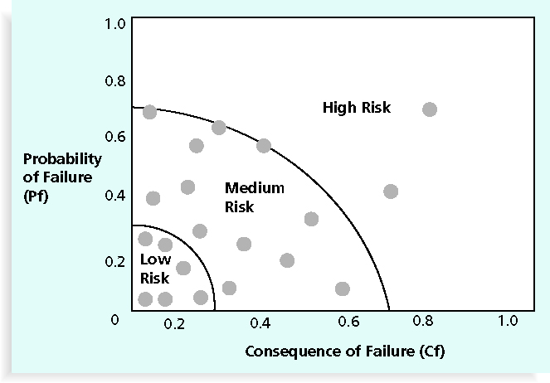
Chart Showing High, Medium, and Low-Risk Technologies

Slide 13
What is “Quantitative Risk Analysis”?
Web research
Quantitative risk analysis assigns a projected value (usually this value is stated in terms of cost or time) to the risks that have already being ranked by the previous process 'perform qualitative risk analysis'.
Notes:
Often follows qualitative risk analysis, but both can be done together
Large, complex projects involving leading edge technologies often require extensive quantitative risk analysis
Main techniques include:
Decision tree analysis
Simulation
Sensitivity analysis
I see this done rarely.
Usually just asked for “how will this risk event impact the time, cost, scope” of project?

Slide 14
Once you have identified your risks, what can you do about them?
Risk avoidance – eliminate the cause of a risk. Forget the new hardware, we’ll use the old proven gear.
Risk acceptance – “If it Happens, It Happens” for threats and opportunities
Risk transfer – Assigning the Risk to Someone Else (subcontract, warranty or insurance)
Risk mitigation – can’t eliminate the risk but can make it hurt less if it occurs : Reducing the Expected Value by reducing Probability or Impact (or both)
Notes:
Four main response strategies for negative risks
Risk avoidance – eliminate the cause of a risk. Screw the new hardware, we’ll use the old proven gear.
Risk acceptance –
Risk transfer – Insurance - AIG
Risk mitigation – can’t eliminate the risk but can make it hurt less if it occurs (HACMP)
4 Threat Response options
(often confused with risk mitigation)
1) Avoidance: Eliminate Threat By Eliminating Cause
2) Mitigation: Reducing the Expected Value by reducing Probability or Impact (or both)
3) Acceptance (defer): “If it Happens, It Happens” for threats and opportunities
4) Transfer: Assigning the Risk to Someone Else (subcontract, warranty or insurance)

Slide 15
Tracking your Risks with a Risk Register
An identification number for each risk event
A description of each risk event
Risk strategy (which of the 4?)
Risk response to each risk (what? how?)
The probability of the risk (occurrence)
The impact of each risk occurring
A risk score (probability multiplied by the impact)
Priority
The risk owner or person who will own or take responsibility for each risk (who?)
The status of each risk (red, yellow, green)

Slide 16
Risk Register Example
1 x 3 = 3

Slide 17
Change Leadership Day! (Day 2)
- Read Kotter Chapter 5 : Empower Action
- Pick 3 of the stories and be ready to present the key take away/learnings and how it relates to your current project:
Retooling the Boss
The Worldwide Competition
I Survived, So You Can Too
Making Movies on the Factory Floor
Harold and Lidia

Slide 18
Studio day (Day 2)
Update your Sprint #2 burndown chart with your actual so far and submit on canvas by EOD
Create your Risk Register – this will be one of your project artifact in your final submission (use template provided)
Create a snapshot of your Scrum Board (as of this week) – this will be one of your project artifact in your final submission
  If the software that you are using does not allow for a clear view of your Scrum board, you can use Lucid chart (free software)
  Make sure to show which team members owns which tasks (color code or initials)
Complete Sprint #2 / Work on your deliverables

Slide 19
Reminder: Project Artifacts due at the end of the semester
Definition of done (from week 4 ICE)
Stakeholder Register
Product Roadmap
Refined Backlog with estimate in story points or hours (as of week 10)
Sprint Burndown chart (sprint# 2)
Risk Register
Scrum Board (as of week 11)
Sprint retrospective
Link to your site/product(s)

Slide 20
Coming up next week: Change Leadership Day!
- Kotter Chapter 6 : Create Short-Term Wins
- Pick 3 of the stories and be ready to present the key take away/learnings and how it relates to your current project:
The List on the Bulletin Boards
Creating the New Navy
The Senator Owned a Trucking Company
Hoopla

