Slide 1
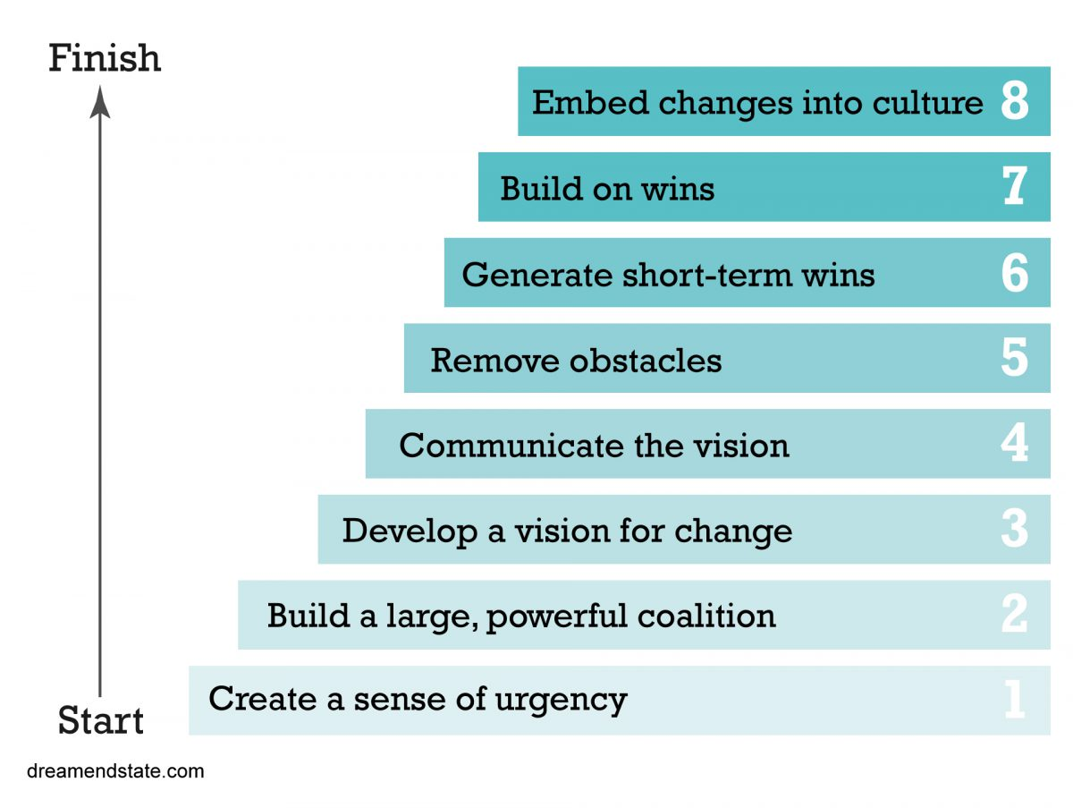
Week 12 MIS3535 | LEAD GLOBAL DIGITAL PROJECTS

Slide 2
Change Leadership Day! (Day 1)
- Kotter Chapter 6 : Create Short-Term Wins
- Pick 3 of the stories and be ready to present the key take away/learnings and how it relates to your current project:
The List on the Bulletin Boards
Creating the New Navy
The Senator Owned a Trucking Company
Hoopla

Slide 3
Studio day (Day 1)
1) Create your Sprint Retrospective:
This is an opportunity for the Scrum Team to take a step back and examine the previous Sprint to identify potential improvements in the process.
For our class purpose, include feedback from the start of the project
This will be one of the artifact included in your final project
2) Work you on your deliverables (Sprint 3)

Slide 4
SPRINT RETROSPECTIVE
IDENTIFY THREE SPECIFIC THINGS:
• Things the team needs to keep doing:
Best practices
• Things the team needs to begin doing:
Process improvements
• Things the team needs to stop doing:
Process Problems and Bottlenecks
It’s a good idea for the team to list at least one process improvement item from the retrospective in
the next product backlog.

Slide 5
Studio day (Day 2) – No Class! – Work Independently
Simulation #2
Report Due by EOD April 13
This will be your Assignment #4 (last one – this one is individual)
* No late assignment accepted

Slide 6
Refresh: Simulation Background
- Single-Player Simulation
- 4 scenarios (2 roles: CEO or Director of Product Innovations)
- Seat time: 90-120 minutes
We played the simulation in week 4 (one run as the Director of Product Innovations). Now we will play it again for 2 runs, both roles: Director of Product Innovations and CEO.
The settings: Spectrum Sunglass Company
The task: Implement and organizational wide change to adopt the process
Critical Mass: convince up to 18 stakeholders (out of 20 or 90%)
Change levels: 18 reusable levers
Duration: 96 weeks initiative
Notes:
Slide added by MC

Slide 7
Four Distinct Scenarios
Power of the Change Agent
Low
High
Scenario 1
Scenario 2
Director, Product Innovation as change agent in non-urgent situation
CEO as change agent in non-urgent situation
Low
Week 4
Urgency for Results
Scenario 3
Scenario 4
Director, Product Innovation as change agent in urgent situation
CEO as change agent in urgent situation
High
Week 12

Slide 8
Instructions:
Prepare:
Review the slides (and recording as needed) from our first simulation debrief discussion, slide deck posted in week 6
Refresh as needed: Read the How to play screen
Read Scenario introduction (for each of the two scenarios)
Analyze (during simulation):
Review the Dashboard Overview
Review the Organizational Readiness
Review the Lever Impact
Review the Network
Read the News
Decide using the decision screen
Notes:
Slide added by MC

Slide 9
What do you need to submit?
By EOD Sunday, you need to submit a word document which will include the following:
At the beginning of your document: Name and TUID
Two screenshots (one per scenario – week 12 runs) that shows your results. Need to see number # of adopters & weeks used.
Two pages double-spaced (excluding the screen shots) for your write-up:
You will describe the actions you took when you first ran the simulation (week 4) and how you adjusted your actions/strategies in your last 2 runs.
You will also describe the different strategies you took for each of the last 2 scenarios (this week).
Finally, you will explain how the change leadership discussions (Kotter) affected your decisions. Include specific examples.
Save your word doc using this convention: last name_first name_simulation 2.
Notes:
Note: tell the students that this is a randomized simulation. Although acts may be successful during the live run, that may not be the case during their version.

Slide 10
COMING UP NEXT WEEK:
Get ready for our quiz#5 on Tuesday! Last one!
You will be taking the quiz at the start of class (first 10 minutes)
Quiz will cover all readings listed for week 13 on our community site:
Kotter Chapter 7
Kotter Chapter 8

Slide 11
Exam Review

Slide 12
Reminder: Grading Components
Component | Percentage
Weekly quizzes (5) | 15%
Exam 1 | 20%
Exam 2 | 20%
Project (team grade) | 20%
Assignments (4) | 15%
Class Contributions & Team feedback (5% each) | 10%
Note: Exams are not cumulative

Slide 13
Final Exam
Content :
Week 8 to 13 :
- Readings/Videos
- Web Research
- Lectures
Kotter Change leadership discussion: Chapter 3 and 6 only
70%
30%
Format :
Closed books
In person only / on canvas
20 questions (14 multiple choices/fill in the blank & 6 open ended)
50 minutes

Slide 14
Final Exam– Lecture/readings/videos/web research (70%)
SCRUM Events
Managing Conflict
Reporting with Agile Charts and Board
Risk Management

Slide 15
Final Exam – Change Leadership / Kotter (30%)
Only Chapters 3 & 6:
Key take away from the story?
What changed?
What was the strategy?
Why was it effective?
How does it relate to the SEE, FEEL & CHANGE concept?
What “works” and “doesn’t work” for these chapters (key take away)?

