Slide 1
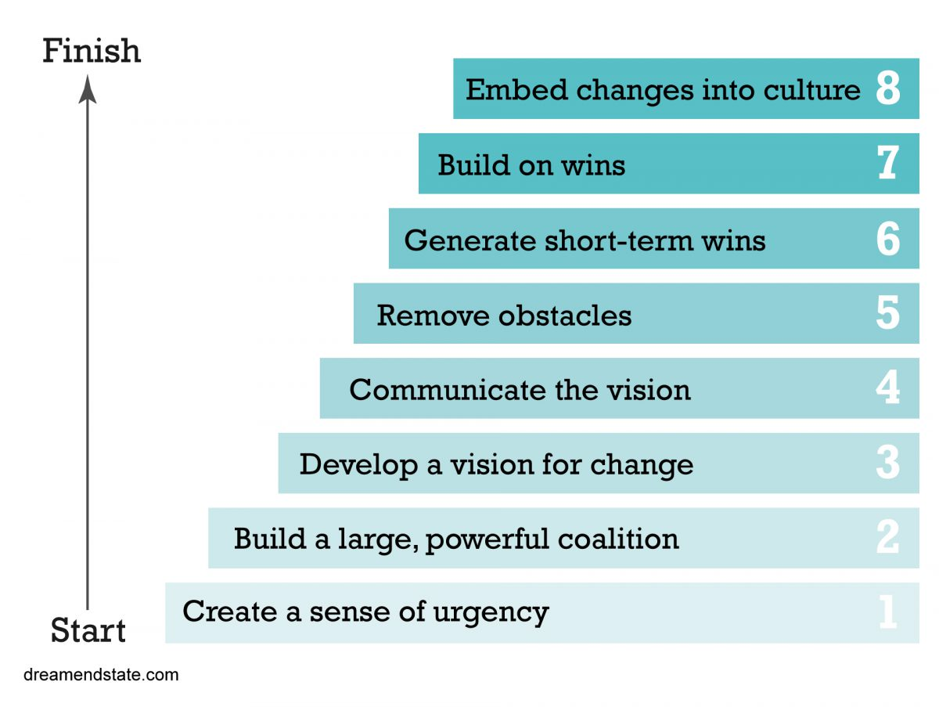
Week 13 MIS3535 | LEAD GLOBAL DIGITAL PROJECTS

Slide 2
AGENDA
Day 1:
Quiz #5 - last one!
Kotter Discussion: Chapter 7
Kotter Discussion: Chapter 8 - last one!
Day 2:
Exam 2 (not cumulative)

Slide 3
Change Leadership Day (Day 1)
Kotter Chapter 7 : Don’t let up
Pick 3 of the stories and be ready to present the key take away/learnings and how it relates to your current project:
PE Ratios
The Merchant of Fear
Reducing Twenty-Five Pages to Two
The Street

Slide 4
LAST Change Leadership Day! (Day 1)
Kotter Chapter 8 : Make Change Stick
Pick 3 of the stories and be ready to explain the key take away/learnings and how it relates to your current project:
The Boss Went to Switzerland
The Path to the Patient
Promoting the Thirty-Something
The Home Mortgage

Slide 5
Final Project Documents
A) Upload your final presentation (ppt) on Canvas
B) Upload a ppt & your spreadsheet that includes the following artifacts (this is for grading purposes and is not presented to the client)
1.On the first page, please include the link to your website (and password if applicable), 2.Definition of done (from week 4 Studio Day)
3.Stakeholder Register
4.Product Roadmap
5. Refined Backlog with estimates in hours or story points (as of week 10)
6. Sprint Burndown chart (sprint 2) – upload your spreadsheet (review my comments on canvas and update your draft version as needed)
7.Scrum Board (as of week 11)
8.Risk Register (week 11)
9.Sprint retrospective (week 12)

Slide 6
Client Presentations
Each team will have 20 minutes to present to the client, including Q&A
Every team members need to be present to earn full credit
Ppt, max 4 pages including title page:
Title page: include team name/members and the link to your website (and password if applicable)
Products developed
Key considerations for the client once they implement the chosen solution
Spend most of your time on a live demo
On your slides:
Use interesting visual
Include minimum words: for details, use the notes section

Slide 7
Presentations Schedule:
Order # | Team Name | Student Full Name
1 | Silver | Acker, Evan
 |  | Shamai, Jeremy
 |  | Johnson, Deajah
2 | J & A | Anderson, Jack
 |  | Ingram, Jerry
 |  | Shao, Andy
 |  | Shimchak, Aidan
3 | SJDN | Chen, Jon
 |  | De Jesus, Nick
 |  | Girase, Sweta
 |  | Yang, Dong
4 | CoreSites | Albaladejo, Anthony
 |  | Andrew, Rhenece
 |  | Zhang, Peter
Tuesday:

Slide 8
Reminders:
Submit your final presentation and project artifacts by EOD April 20
Final presentations on Tuesday are on zoom
If team member(s) absent(s), points will be deducted
Team project feedback will be due by EOD April 25
If you don’t provide feedback, you will not be receiving credit for your team project participation (5% of your grade)
Optional: Pro points submission due by EOD April 27
Submit SFF by EOD April 29

Slide 9
Please Fill out SFF
(Student Feedback Form)

