Slide 1
Week 9 MIS3535 | LEAD GLOBAL DIGITAL PROJECTS

Slide 2
AGENDA – WEEK 9
Today:
Kotter Chapter 3
Scrum event: Daily stand up (2 teams)
Reporting with Agile discussion
Studio Day: work on your deliverables (Sprint 1 and Sprint Review)
Thursday:
Teams work independently (no formal class)
Complete your 1st sprint and your Sprint review

Slide 3
Change Leadership Day! (Day 1)
- Kotter Chapter 3 : Get the vision right
- Pick 3 of the stories and be ready to present the key take away/learnings and how it relates to your current project:
Painting Pictures of the Future
Cost Versus Service
The Plane Will Not Move!
The Body in the Living Room

Slide 4
SCRUM EVENT: DAILY STAND UP (Day 1)
3 Important Questions:
1) What work did you complete yesterday? (for class purpose: last week)
2) What have you planned for today (this week)?
3) Are you facing any problems or issues?
Each team members need to stand up and discuss the 3 points.

Slide 5
SCRUM EVENT: DAILY STAND UP
2 TEAMS:
Order | Team Name | Student Full Name
1 | CoreSites | Albaladejo, Anthony
 |  | Andrew, Rhenece
 |  | Zhang, Peter
2 | J & A | Anderson, Jack
 |  | Ingram, Jerry
 |  | Shao, Andy
 |  | Shimchak, Aidan

Slide 6
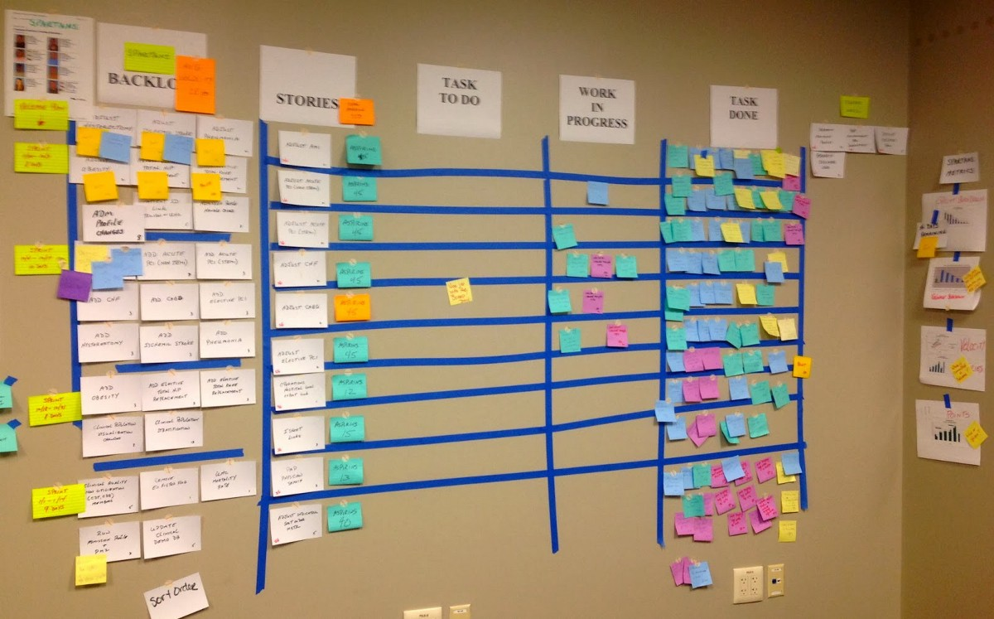
Reporting with Agile Charts & Boards MIS3535 | LEAD GLOBAL DIGITAL PROJECTS

Slide 7
3 main reporting vehicles:
Burndown chart
Scrum Board (also call Team Tasks board)
Product Backlog

Slide 8
Web research
What is a burndown chart in Agile/Scrum?
The Release or Sprint Burndown Chart makes the work progress visible. It is a graphic representation that shows the rate at which work is completed and how much work remains.

Slide 9
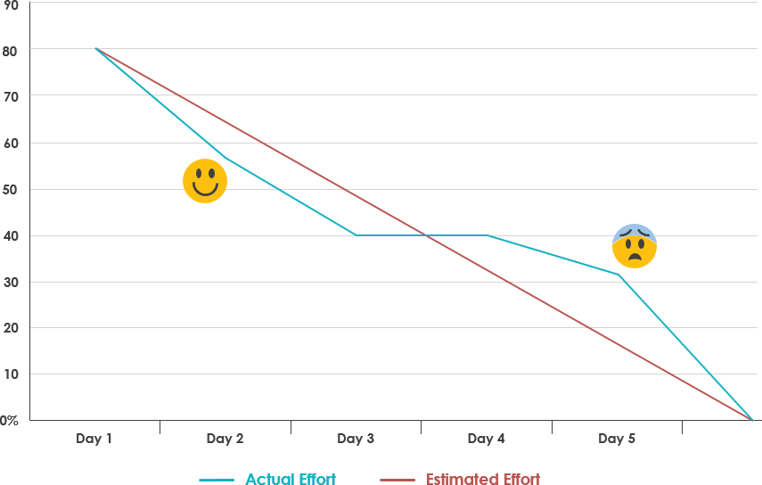
Burndown chart: 2 types
Sprint (by story points or hours - daily)

Slide 10
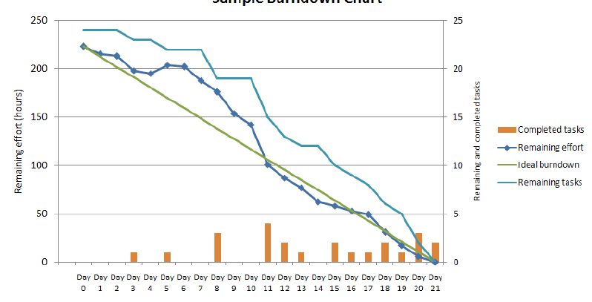
SPRINT BURN DOWN CHART (BY HOURS)

Slide 11
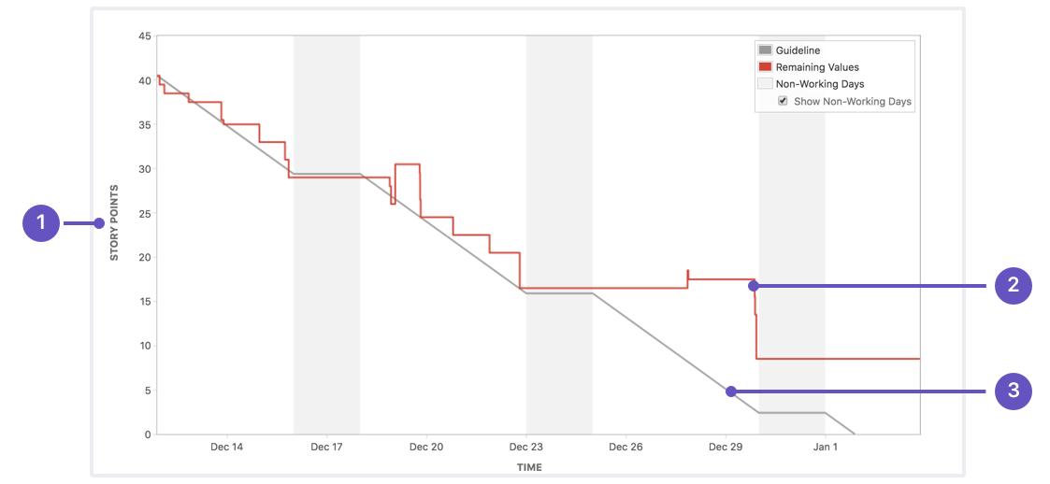
SPRINT BURN DOWN CHART (BY STORY POINTS)

Slide 12
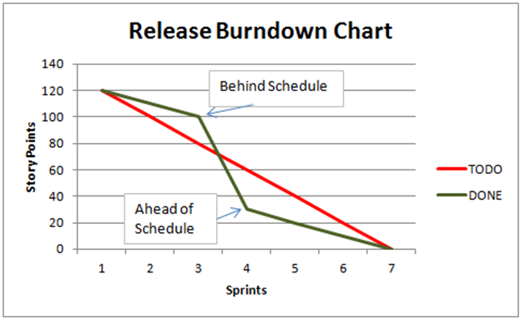
Burndown chart: 2 types
2. Release (by story points or hours - sprint week)

Slide 13
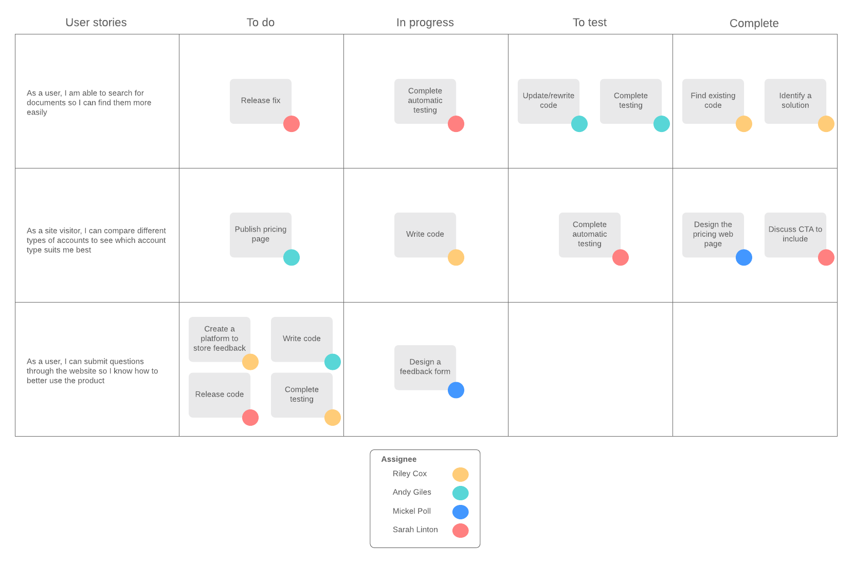
Scrum board: a swim lane!
As discussed in week 7
If the software that you are using does not allow for a clear view of your Scrum board, you can use Lucid chart (free software)
In priority order
Each sticky = 1 day of work for 1 developer

Slide 14
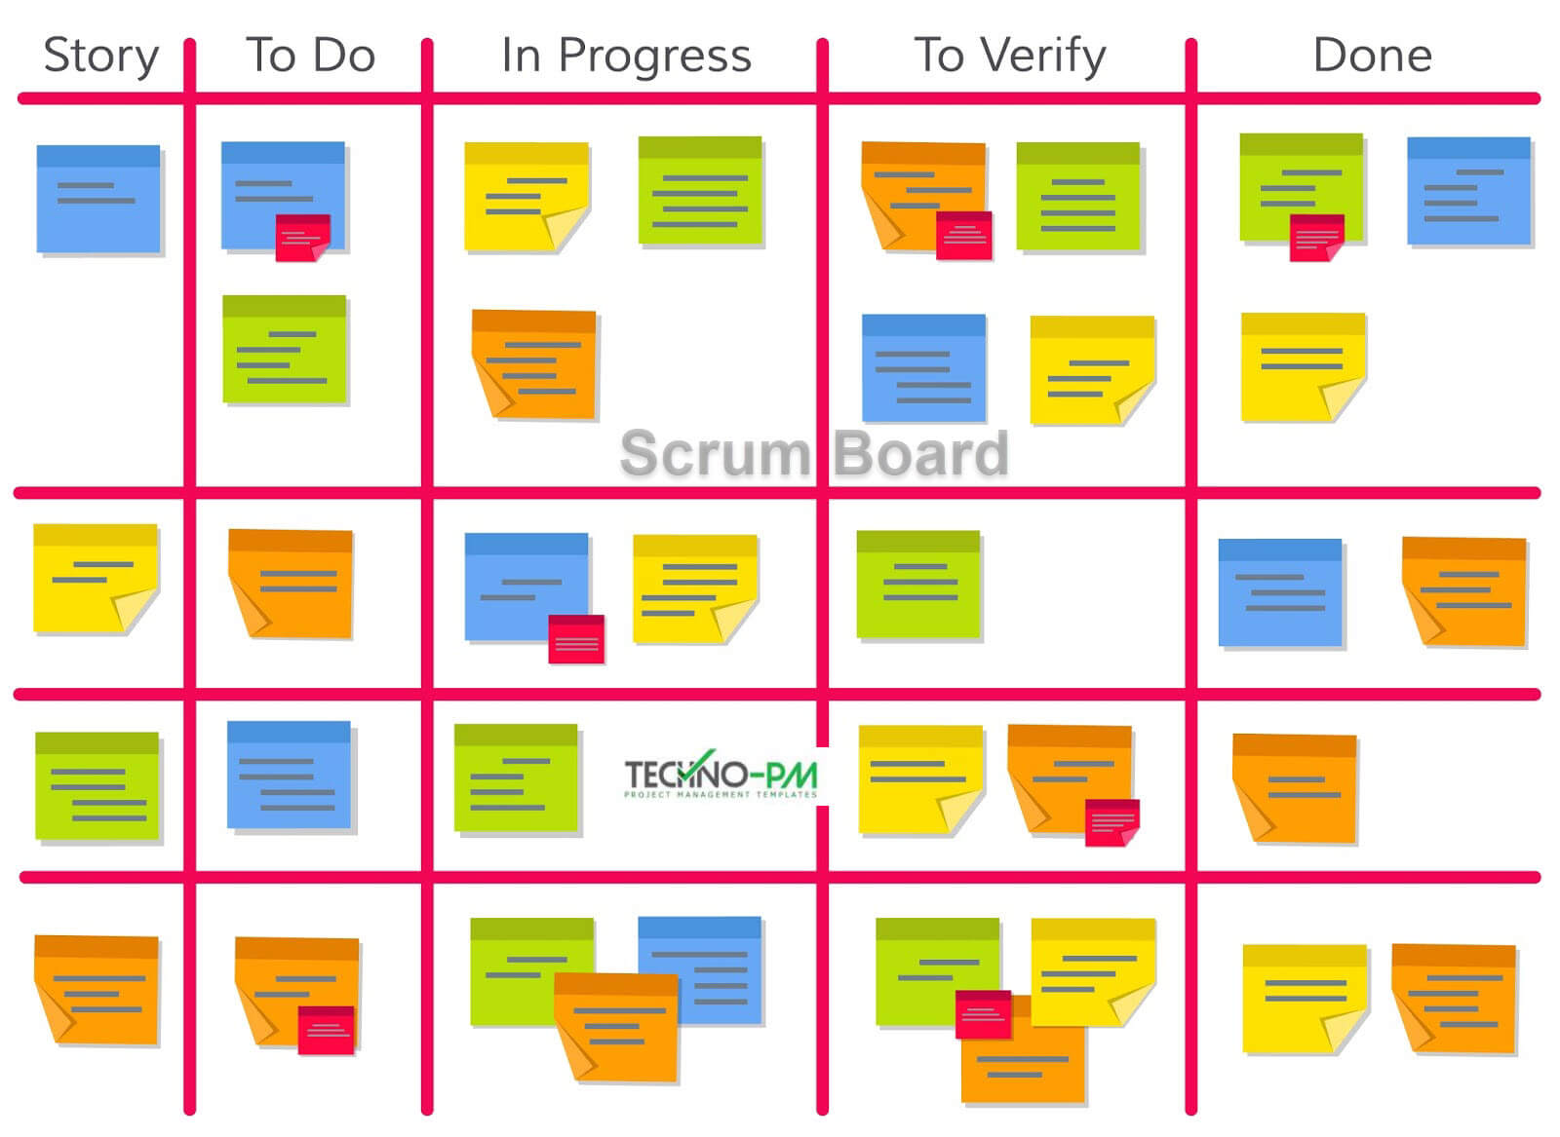
TASK PLANNING ON SCRUM BOARD
SPRINT GOAL: New customers should be able to pay using bank transfers.
As discussed in week 7

Slide 15
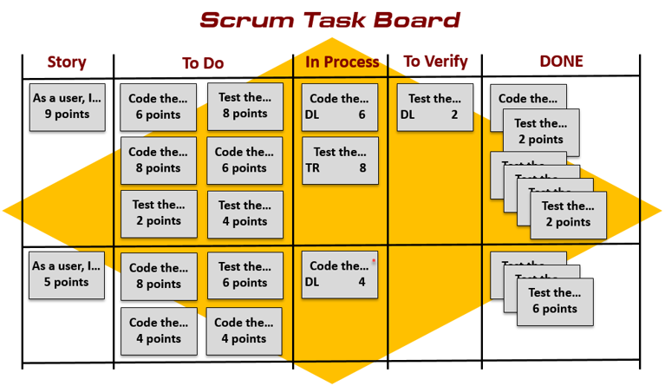
Scrum Board EXAMPLE
As discussed in week 7
Make sure to clearly identify who is working on the task (color or name)

Slide 16
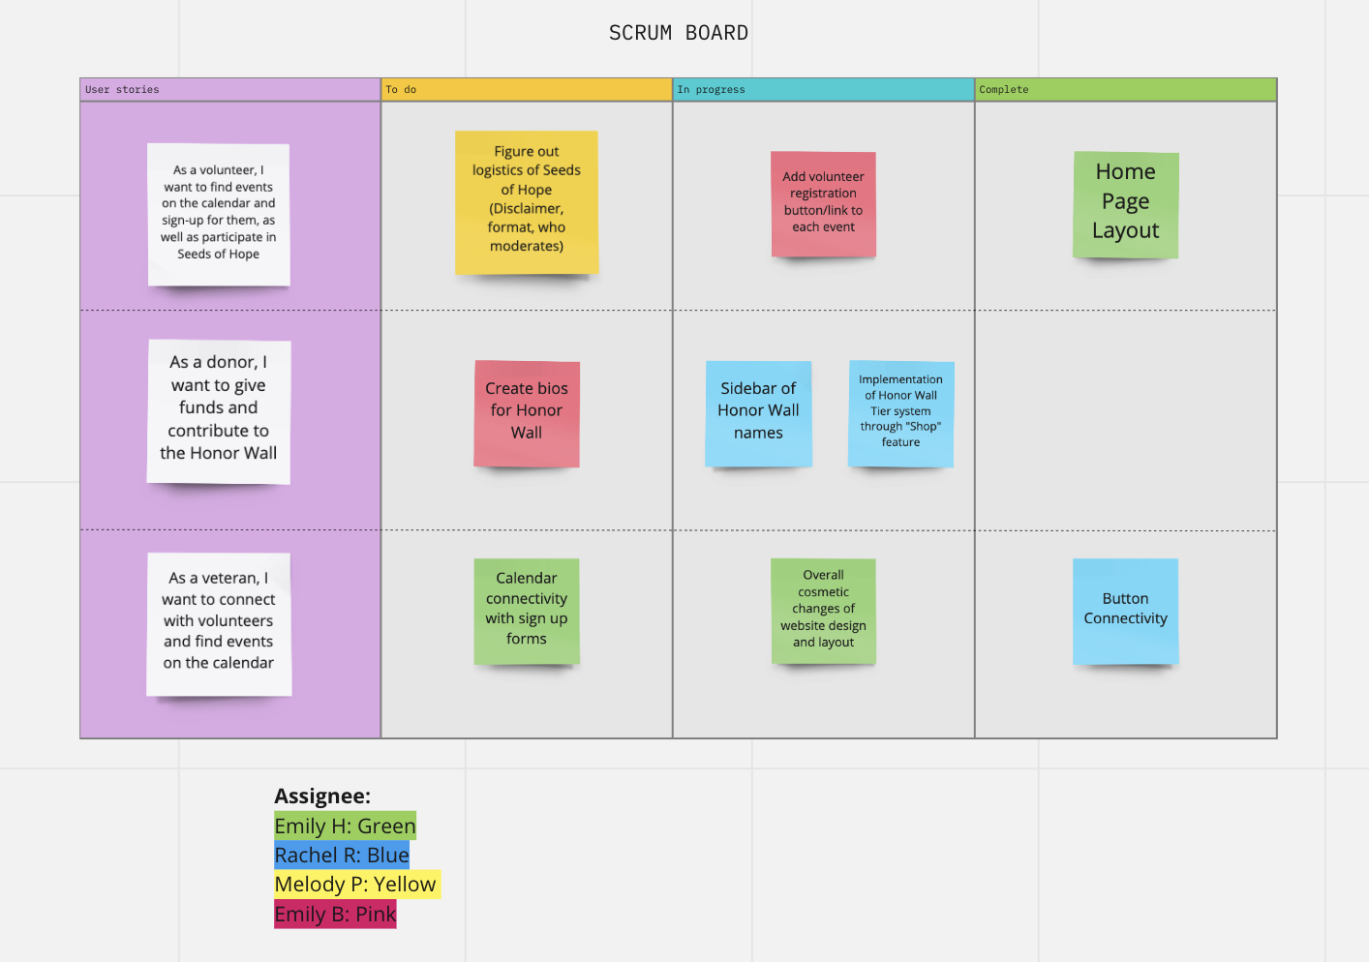
Scrum Board EXAMPLE
As discussed in week 7

Slide 17
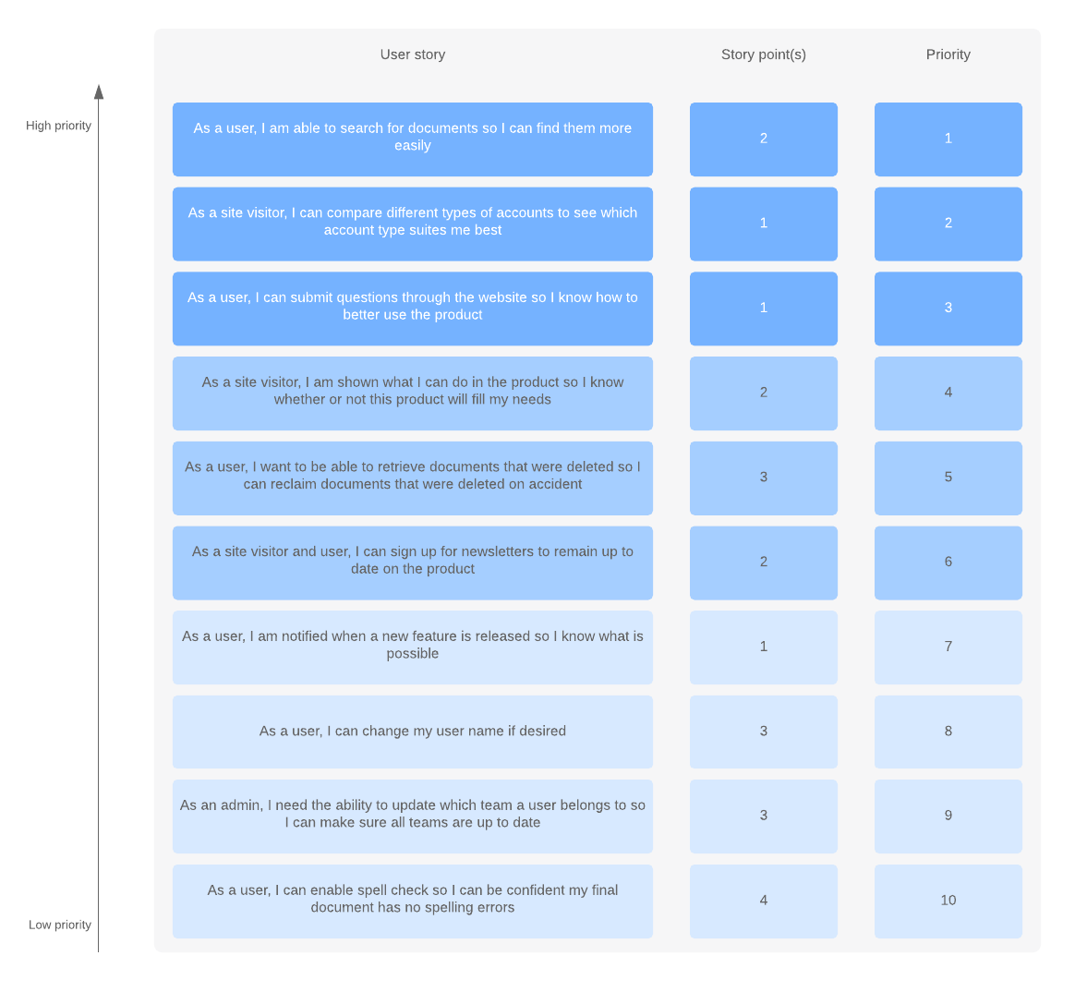
Product backlog
As discussed in week 6
Now add your estimation in hours or point
Prioritize your user stories
Estimate your stories with story points (or hours)
Create an ID for each story (example on next slide)

Slide 18
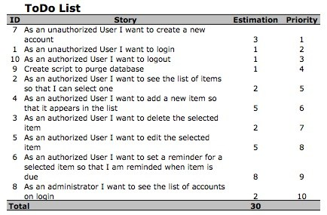
Product backlog (another example)
As discussed in week 6
Now add your estimation in hours or point

Slide 19
Product backlog (another example)
As discussed in week 6
Now add your estimation in hours or point
ID | User Story | Estimation | Priority
1 | As a user, I want to receive up to date information on events and activities. | 4 | 4
2 | As a user, I want to sign up for upcoming events and activities. | 1 | 5
3 | As a user, I want to fill out the application to get assistance from the organization. | 4 | 1
4 | As a donor, I want to find a list of items that the organization needs. | 5 | 6
5 | As a donor, I want to find a simple way to donate to the organization. | 1 | 3
6 | As an administrator, I want to collect our users' information in our database. | 5 | 2
7 | As an administrator, I want to update our upcoming events on our website. | 2 | 7
8 | As an administrator, I want to list items that we need through donations. | 3 | 8
Total |  | 25

Slide 20
Studio Day (Day 1):
Continue working on your first sprint
Start working on your client presentation (sprint review – also your 3rd assignment)

Slide 21
Assignment #3 - Sprint Review (Team Submission)
Prepare a slide deck of 4-5 pages in which you will include:
Title page (include team name/members)
Your product roadmap
The progress you have made to date regarding your client project (you can present a feature that you built or are building) – ideally a Demo!
What is your To Do list until the Final Presentation + Any clarifications or questions for the client
You will present to the client and get feedback on your work and discuss what should be done prior to the final presentation.
You will have 8-10 minutes to present including Q&A.
In your slide deck, make sure that:
You use interesting visual
Minimum words (for details, use the notes section)
One page per topic

Slide 22
Day 2

Slide 23
Studio Day (Day 2):
Teams work independently (no formal class)
Complete your first sprint
Finish your client presentation (sprint review – also your 3rd assignment)

