Slide 1

Course Intro
MIS3536: Info Sys Innovation with AI
Jeremy Shafer
jeremy@temple.edu
https://community.mis.temple.edu/jshafer
Unless otherwise indicated, all decorative images are by Unknown Author and licensed under CC BY-NC

Slide 2
Agenda
MIS Department Instructional Practices
About me.
Why am I teaching this course?
How is this course set up?
Our first discussion exercise.
(If time permits) Reading + discussion.

Slide 3
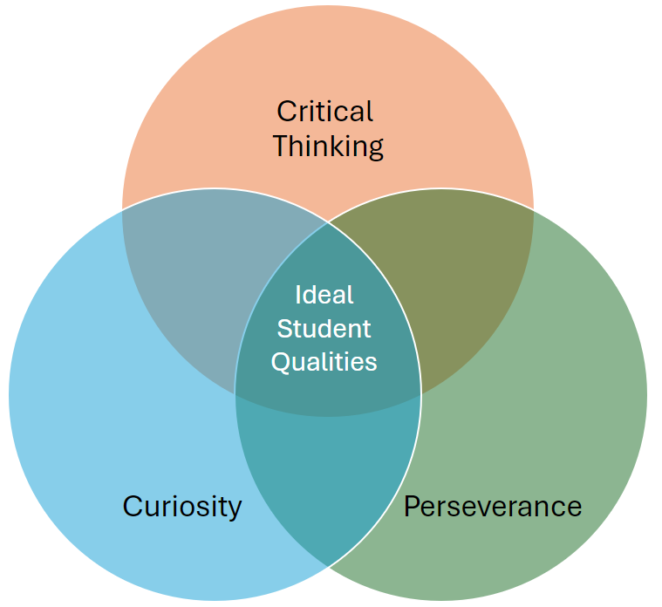
MIS Department Instructional Practices
Constructively participate in class discussions.
Choose project work that is meaningful to you.
Independently experiment to discover AI limitations.
Discern between AI hype and reality.
Come to class prepared.
Take notes.
Submit your work on time.
Notes:
This is for your slide deck at the start of each lecture. You may, of course,

Slide 4
About me
Teaching full time since 2014
Bachelor’s degree in CS, Master’s degree in MIS
Lifelong interest in learning and higher education
Transitions I have witnessed:
  Dawn of the PC (circa 1980)
  Dawn of the Internet and the first browsers (circa 1993)
  Dawn of the iPhone (2007)
  Dawn of ChatGPT (November 2022)

Slide 5
Why am I teaching this course?
According to a report by investment bank Goldman Sachs, artificial intelligence (AI) could replace the equivalent of 300 million full-time jobs. The report suggests that AI could replace a quarter of work tasks in the US and Europe, but it may also lead to new jobs and a productivity boom.
https://www.bbc.com/news/technology-65102150
According to the 2022 Global Workforce Hopes and Fears survey by PwC, almost a third of respondents said they were worried about the prospect of their role being replaced by technology in three years.
According to the 2023 Global Workforce Hopes and Fears survey by PwC, more than 50 percent of respondents saw or envisioned some positive impact from AI.

Slide 6
How is this course set up?
First half the semester – lectures, activities, and quizzes
Second half the semester – activities and assignments. The last two assignments combined make for a “mini project”
Participation is graded. My mechanisms for gauging participation may vary.
You are expected to listen to The AI Daily Brief Podcast with Nathaniel Whittemore (a.k.a. NLW) on Spotify.
Let’s review the class site.

Slide 7

Some food for thought
Some people describe themselves as AI Accelerationists
AI Accelerationists want AI to be developed as quickly as possible
Other people described themselves as Effective Altruists
Effective Altruists tend to believe that AI development should be approached cautiously and with regulation.
Use Edge Bing Chat (or ChatGPT) to look up the defintions of “AI Accelerationist” and “Effective Altruist”.
Which one are you?

Slide 8

Our first activity
Go on to Canvas and comment on the discussion question there.
When done, review the answers of some of your peers.
You should “like” one other student’s answer.
You should comment on another student’s answer. (Two or three constructive sentences.)
This Photo by Unknown Author is licensed under CC BY-SA

