Slide 1
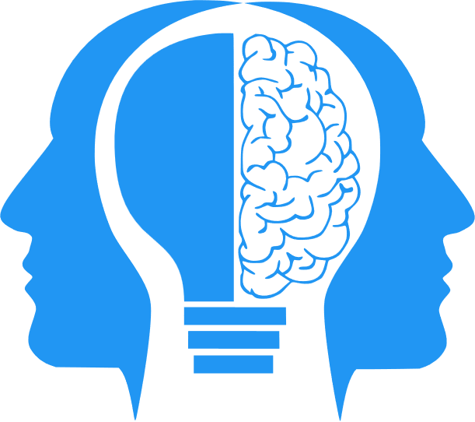
Reinforcement Learning and Interpretability
MIS3536: Info Sys Innovation with AI
Jeremy Shafer
jeremy@temple.edu
https://community.mis.temple.edu/jshafer
Unless otherwise indicated, all decorative images are by Unknown Author and licensed under CC BY-NC

Slide 2
Where are we?
There is a third kind of ML that we have not yet discussed.
AI
ML
DL
DL has a problem with something called “Interpretability”. How to solve that?

Slide 3
Agenda
A quick overview of steps in the process of Machine Learning
Define Reinforcement Learning
Discuss: What is Interpretability and why is it important?
Introduce LIME as way to address the Interpretability problem
Install software necessary for future activities

Slide 4
Machine Learning steps
Data Collection
Data Cleaning
Model Training
The “GPT” in ChatGPT is short for Generative Pretrained Transformer. The training of the model has already been done.
The extensive training and quality of the underlying data is what makes ChatGPT so powerful.
Training GPT-3, one of the largest models of its kind, was a significant computational task. It was estimated that it would take 355 years to train GPT-3 on a single NVIDIA Tesla V100 GPU.
By using (massive) parallel computing on a large number of GPUs, the actual training was a little over a month.
Microsoft built a supercomputer with 10,000 V100 GPUs exclusively for OpenAI.

Slide 5

1 – Data Collection
Data collection is a systematic process of gathering observations or measurements. The process involves identifying the data types, the sources of data, and the methods used. Accurate data collection is necessary to make informed business decisions, ensure quality assurance, and maintain research integrity.

Slide 6

2– Data Cleaning
Data cleaning, also known as “data cleansing” or “data scrubbing”, is the process of fixing or removing incorrect, corrupted, incorrectly formatted, duplicate, or incomplete data within a dataset.
When combining multiple data sources, there are many opportunities for data to be duplicated or mislabeled. If data is incorrect, outcomes and algorithms are unreliable, even though they may look correct.
The necessary steps will vary from dataset to dataset, and industry to industry.
In the workplace, it is important to document and standardize your data cleansing process wherever possible.

Slide 7

3 – Model Training
Model training is a process in machine learning where an algorithm learns from a given dataset.
Model training can be supervised or unsupervised.
In supervised learning, the training data contains both the input and output values. Each set of data that has the inputs and the expected output is called a supervisory signal.
In unsupervised learning, the goal is to determine previously unknown patterns in the data.
Notes:
The training is done based on the deviation of the processed result from the documented result when the inputs are fed into the model.

Slide 8
Definition – Reinforcement Learning
Reinforcement Learning – Technically this is a third kind of machine learning. IMHO … there is significant overlap with the other kinds of ML.
What makes “Reinforcement Learning” distinct is its terminology and its focus / application.
  Terminology: It is described in terms of an “Agent”, “Environment”, “Reward” and “Policy”.
  Application: Typically, robotics and/or agents that interact with the physical world.
  Video: https://youtu.be/G7ZPWR28TJE?si=g6a-AMww4ynwXtDw

Slide 9

Changing gears now…

Slide 10
The Interpretability problem
  Interpretability in AI is crucial for several reasons:
  Trust: Understanding the 'why' of AI recommendations help builds trust between users (customers/consumers) and AI. Trust increases user acceptance.
  Transparency: Interpretability enhances transparency. It's not enough for an AI algorithm to generate the right result—knowing "the reason why" is now a business fundamental.
  Fairness and Bias Reduction: AI systems that are more interpretable and transparent can help to reduce bias and increase fairness.
  Compliance: Interpretability ensures compliance with legal and regulatory requirements.
  Better (Human) Decision Making: It enables better decision-making as businesses gain an AI-powered framework that provides clear evidence to support outcomes.

Slide 11

LIME
LIME is short for Local Interpretable Model-Agnostic Explanations
It is one of many techniques used to address the Interpretability problem.

Slide 12

LIME
Imagine that LIME is a skeptic who's trying to understand how a magic trick works. The magic trick is like a machine learning model - it's complex and hard to understand. But our skeptic, LIME, is smart and has a plan:
Choose a specific trick (Sample) to Understand: First, LIME picks one magic trick that it wants to understand. It’s the sample that makes the approach “local”.
Watch the Trick Many Times (Perturbation): Next, LIME watches the magic trick many times. Each time, it changes something small about the trick and sees what happens. Those little changes are the perturbations.
Take Notes (Weighting): While watching, LIME takes notes on what it sees. It pays more attention to outcomes that are most like to the original trick.
CONTINUED …

Slide 13
LIME
Find the Key Steps (Interpretable Model): Using its notes, LIME tries to find the key steps that make the trick work.
Collectively, those notes make simple explanation that works for the subset of tricks it has seen.
Check the Explanation (Interpretation): Finally, LIME checks if its explanation makes sense with the original trick.
And that's it! LIME has figured out how the magic trick works, or in other words, it has created an explanation for the machine learning model.

Slide 14
A simple illustration
{x₀, x₁, x₂ … x_{n}}
{y₀, y₁, y₂ … y_{n}}
We sample the outcomes of interest.
This is what makes it “Local”
{x₀, x₁, x₂ … x_{n}}
{y_{n}}

Slide 15
A simple illustration (continued)
{x₀, x₁, x₂ … x_{n}}
{y_{n}}
We perturb each one of the inputs, run the model, and take note of the outcome.
{x_{i}, x_{j}} + Ε
{y_{n}}
We choose the most important inputs to create a new model. The new model is simpler and has an acceptable level of error.

Slide 16

A (better?) explanation…
https://www.youtube.com/watch?v=hUnRCxnydCc
A key point of this video is that some outcomes of LIME increase our trust in the model, and some decrease our trust.
For example – if the presence of “snow” key factor in image recognition that attempts to discerns between a Husky dog, and a arctic wolf then we should not trust it, even if the accuracy is high.
Again, this approach is model agnostic. It works for any / all AI models.

