Slide 1
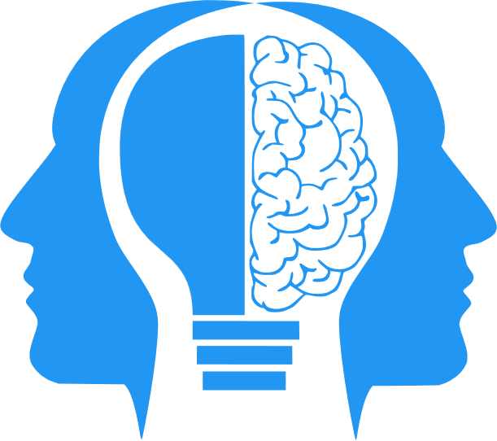
Managing Bias
MIS3536: Info Sys Innovation with AI
Jeremy Shafer
jeremy@temple.edu
https://community.mis.temple.edu/jshafer
Unless otherwise indicated, all decorative images are by Unknown Author and licensed under CC BY-NC

Slide 2
Agenda
My primary source of information for this lecture
Thinking about bias
Where does this fit in to our roadmap?
Talk about technique
Notes:
NIST is the National Institute of Standards and Technology at the U.S. Department of Commerce. The NIST Cybersecurity Framework helps businesses of all sizes better understand, manage, and reduce their cybersecurity risk and protect their networks and data. The Framework is voluntary.

Slide 3
Today’s lecture is brought to you by…
NIST special publication 1270
Towards a Standard for Identifying and Managing Bias in Artificial Intelligence
Published in March of 2022 (Pre ChatGPT3.5)
NIST is short for National Institute of Standards and Technology (which is under the U.S. Department of Commerce)
You can read the whole thing here.

Slide 4
Why bias in AI is important
Consumers are using AI and are being influenced by AI already
AI has influence over many facets of life, large and small.
For example:
Where will I go to college? Will my application be accepted?
Will my mortgage application be accepted?
What video will I watch next?
eHarmony? Match.com?

Slide 5
Another reason bias is important…
There are laws and regulation in the U.S. (and elsewhere!) addressing discrimination and fairness, especially in the areas of consumer finance, housing, and employment.
Breaking the law is a bad (and costly) thing.
There is no consistent, universal or standardized method used by regulators and courts to assess or measure unacceptable bias across all areas.
Sometimes courts will use statistical tests to evaluate evidence of disparate impact.

Slide 6
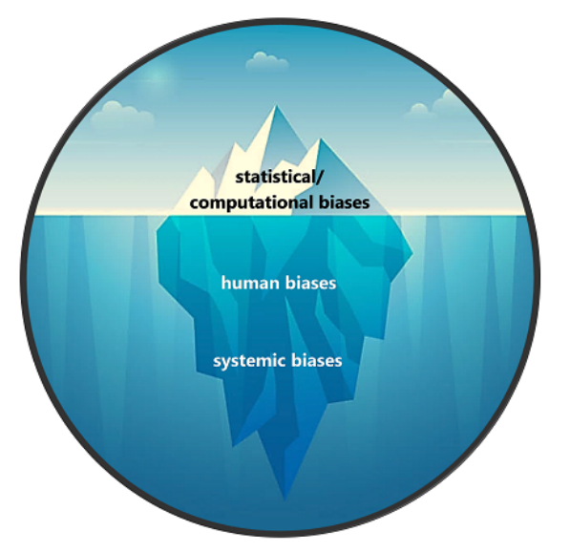
There are different kinds of bias

Slide 7
Statistical/computational bias:
“Statistical and computational biases stem from errors that result when the sample is not representative of the population.
These biases arise from systematic as opposed to random error and can occur in the absence of prejudice, partiality, or discriminatory intent.”

Slide 8
Human bias:
“Human biases reflect systematic errors in human thought. Biases are a fundamental part of the human mind.” We all have them.
“There is an entire field of study centered around biases and heuristics in thinking, decision-making, and behavioral economics.” (Three examples follow on the next slide.)
“These biases are omnipresent in the institutions, groups, and individual decision-making processes across the AI lifecycle, and in the use of AI applications once deployed.”

Slide 9
Examples of human bias (subcategories!)
Confirmation Bias: Individuals tend to seek out information that confirms their existing beliefs or hypotheses while ignoring or dismissing evidence that contradicts those beliefs.
Anchoring Bias: An example of anchoring bias is when a person's judgment is influenced by an initial piece of information, called the "anchor," even if it's arbitrary or irrelevant to the decision at hand.
Social Desirability Bias: Individuals tend to answer questions in a way that they believe will be viewed favorably by others. This often leads respondents to overreport behaviors that are considered socially acceptable and underreport behaviors that are not.
There are many, many, more..

Slide 10
Systemic bias:
“Systemic biases result from procedures and practices of institutions that operate in ways which result in certain social groups being advantaged or favored and others being disadvantaged or devalued.”
“This need not be the result of any conscious prejudice or discrimination but rather of the majority following existing rules or norms.”
“Institutional racism and sexism are the most common examples.”
“Other systemic bias occurs when infrastructures for daily living are not developed using universal design principles, thus limiting or hindering accessibility for persons with disabilities.”
“Systemic bias is also referred to as institutional or historical bias. These biases are present in the datasets used in AI, and the institutional norms, practices, and processes across the AI lifecycle and in broader culture and society.”

Slide 11
A form of bias to guard against:
Techno solutionism is the belief that technology can solve complex social, political, and economic problems without considering broader societal implications or addressing underlying structural issues.
It often involves a simplistic faith in technological solutions as panaceas for all problems, overlooking the complexities of human behavior, power dynamics, and systemic inequalities.
Techno solutionism can lead to the over-reliance on technology to address social issues without adequately considering ethical, cultural, or unintended consequences.
It’s not “bias” in the traditional sense … but it is a *form* of bias. That is, you won’t find it in a psychology textbook!

Slide 12
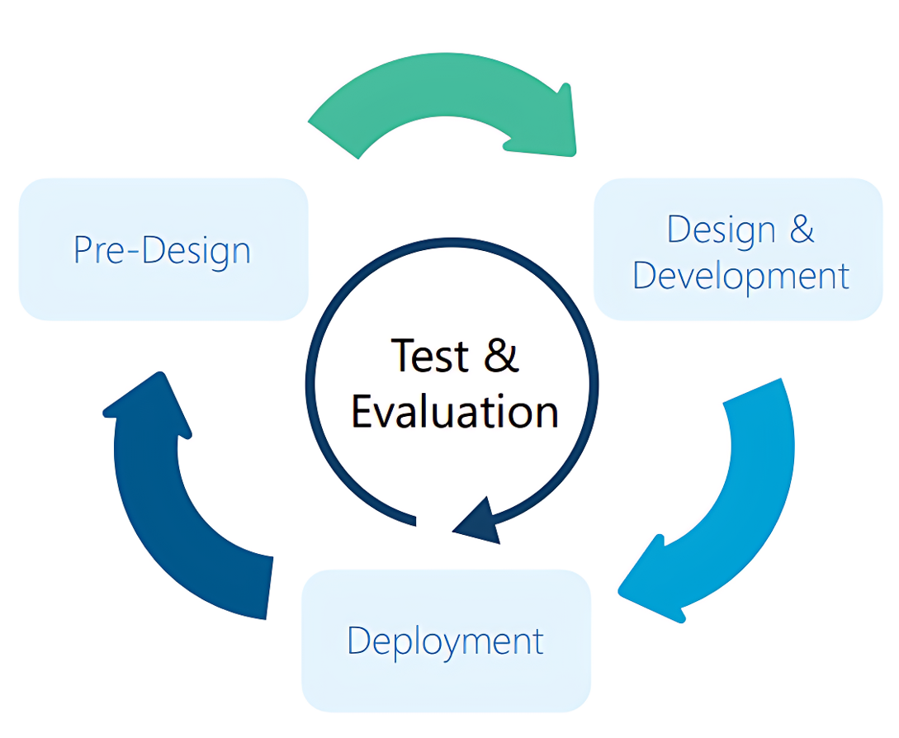
The updated AI life cycle
Needs to be an iterative, multi-stakeholder approach.
Pre-design stage: initial planning, problem framing, and decision-making.
Design and Development stage: choosing the correct model (or building / training a new one) and pre-defining limits before deployment.
Deployment stage: requiring continuous monitoring and reassessment

Slide 13
6 Practical Recommendations
Establish and apply criteria for data quality and representativeness, ensuring that the data used to train, test, and validate the AI system reflects the diversity and characteristics of the target population and domain.
Conduct testing, evaluation, verification, and validation (TEVV) of the AI system throughout its lifecycle, using appropriate methods and metrics to measure and mitigate AI bias and ensure performance, reliability, and safety.
Involve human experts and users in the design, development, and deployment of the AI system, applying human-centered principles and practices to ensure usability, accessibility, and accountability.

Slide 14
Practical Recommendations (continued)
Provide transparency and explainability of the AI system, disclosing the relevant information about its purpose, functionality, limitations, and potential biases to the users and other stakeholders.
Enable user feedback and redress mechanisms, allowing the users to report, correct, or challenge the AI system's outputs or decisions, and providing remedies for any harms or grievances caused by AI bias.
Establish and implement governance policies and procedures for the AI system, defining the roles and responsibilities of the developers, operators, and overseers, and ensuring compliance with ethical and legal standards.

Slide 15
Discussion – where does this fit into our roadmap?

Slide 16
“Shafer’s Roadmap” Semi-Supervised Machine Learning
The “official” 3 steps of M.L.
#1 Data Collection
#2
Data Cleaning
#3 Model Training
Evaluation
Documentation
Consistency
Dimension Reduction
Supervised
Unsupervised
L.I.M.E.
Visualization
Dimension Reduction

Slide 17
“Shafer’s Roadmap” Semi-Supervised Machine Learning v1.1
The “official” 3 steps of M.L.
#1 Data Collection
#2
Data Cleaning
#3 Model Training
Evaluation
Manage Bias
Documentation
Consistency
Dimension Reduction
Manage Bias
Supervised
Unsupervised
Manage Bias
L.I.M.E.
Visualization
Dimension Reduction
Manage Bias

Slide 18
What could we do now?
Using only the models and techniques we have seen so far, could we attempt to detect bias?
How?
Notes:
DISCUSS - Can we ever completely eliminate bias?

