Slide 1
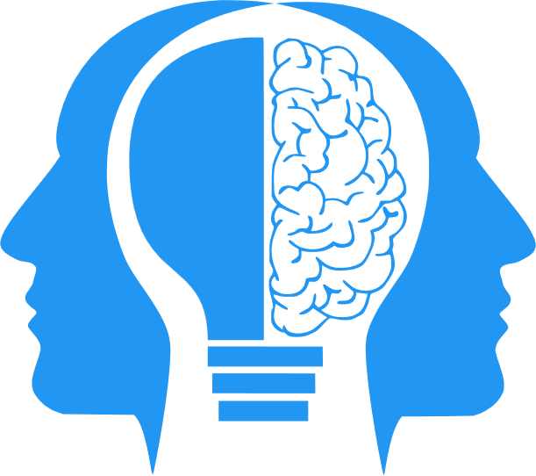
Bayesian Cognition
MIS3536: Info Sys Innovation with AI
Jeremy Shafer
jeremy@temple.edu
https://community.mis.temple.edu/jshafer
Unless otherwise indicated, all decorative images are by Unknown Author and licensed under CC BY-NC

Slide 2
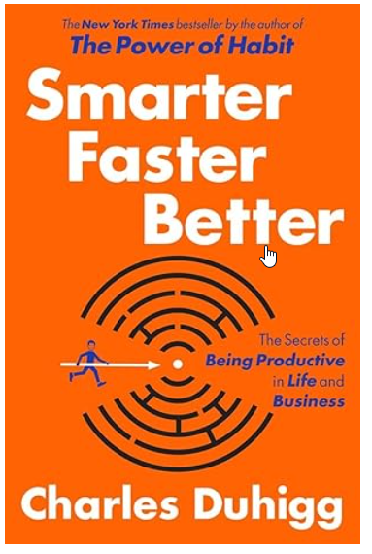
Inspiration
I got interested in the Bayesian Cognition in decision making a little over a year ago, before I started working on this course.
It was introduced to me in the book, Smart Faster Better buy Charles Duhig (2016)
Here’s the gist of what got my attention…
“If asked, few of the participants were able to describe the mental logic they used to make their forecasts. They just gave answers that felt right. On average, their predictions were often within 10 percent of what the data said was the correct answer.”
“Just as important, each student intuitively understood that different kinds of predictions required different kinds of reasoning.”

Slide 3
More from the Duhigg book
“Some researchers call this ability to intuit patterns ‘Bayesian cognition’ or ‘Bayesian psychology,’ because for a computer to make those kinds of predictions, it must use a variation of Bayes’ rule, a mathematical formula that generally requires running thousands of models simultaneously and comparing millions of results.”
“At the core of Bayes’ rule is a principle: Even if we have very little data, we can still forecast the future by making assumptions and then skewing them based on what we observe about the world.”

Slide 4
For instance …
… suppose your brother said he’s meeting a friend for dinner. You might forecast there’s a 60 percent chance he’s going to meet a man, since most of your brother’s friends are male. Now, suppose your brother mentioned his dinner companion was a friend from work. You might want to change your forecast, since you know that most of his coworkers are female.
Bayes’ rule can calculate the precise odds that your brother’s dinner date is female, or male based on just one or two pieces of data and your assumptions.

Slide 5
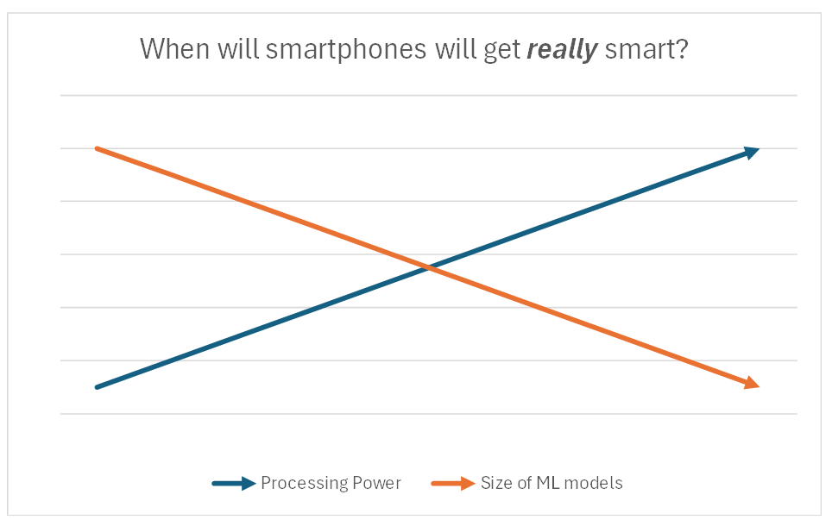
Why this is a timely topic …

Slide 6
The general idea…
We are going to look at a model that simulates Bayesian Cognition. It is called Naïve Bayes Classification.
It is a relatively small, efficient model that makes good estimations with little information.
It can be applied to both the calculation of numeric probabilities, and also on the evaluation of text. (We’ll see that next class.)
Again… how does this relate to the last slide?

Slide 7
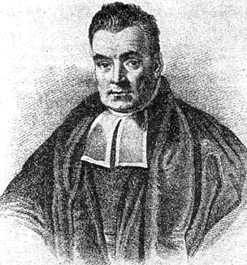
So… what’s with the word “Bayesian”?
The term "Bayesian" in Bayesian analysis comes from the Reverend Thomas Bayes, an 18th-century British mathematician and theologian.
Bayes developed the foundation of what would later be known as Bayesian probability theory, although his work was not widely recognized during his lifetime.
Bayes' most famous contribution is his theorem, now known as Bayes' theorem, which provides a way to update probabilities based on new evidence.
The theorem is fundamental to Bayesian analysis, as it forms the basis for updating beliefs or probabilities in light of new data.

Slide 8
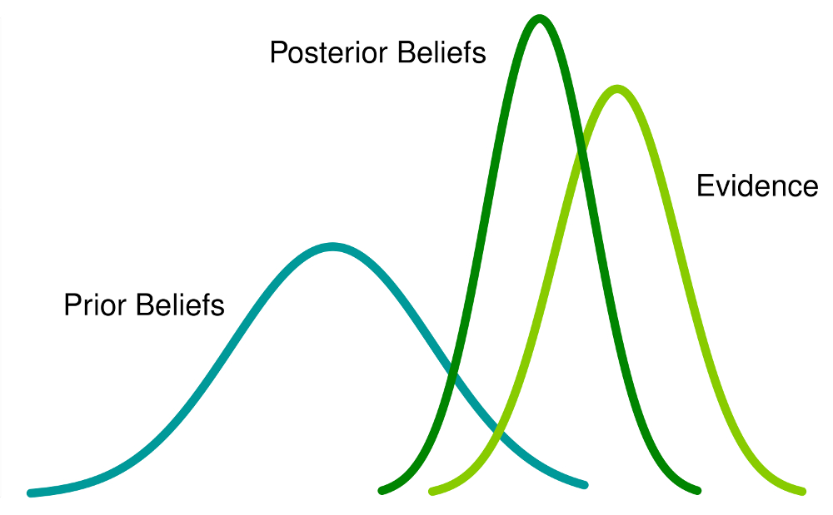
The key idea again … predictions can get better with just a little extra information

Slide 9
Why is it called “Naive”?
Naive Bayesian classification is called Naive because it assumes 2 things.
First, it assumes that all the factors outside the test have remained constant.
Second, is assumes that the prior tests don't influence the current test.

Slide 10
Now, again, restated with the $5 words…
Conditional Independence: The model assumes that all the events don’t depend on each other. Example: Flipping 3 coins simultaneously is the same flipping 3 coins one at a time.
Feature Irrelevance: The model also assumes that no other features of the problem are influencing the outcome. Example: It doesn’t matter who is flipping the coins. One person is as good as another. It doesn’t matter if coin flipper is alone or in a group, or if it is sunny outside, or if the month has the letter “R” in it.

Slide 11
Dramatic illustration goes here

Slide 12
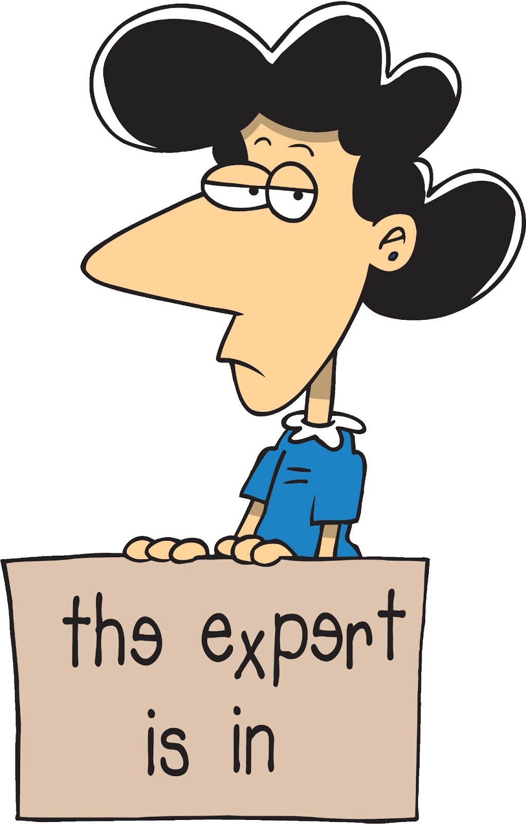
Think about how this can be applied…

Slide 13
Mistral
Mistral AI is a French company specializing in artificial intelligence. It was founded in April 2023 by researchers who were previously employed by Meta and Google DeepMind: Arthur Mensch, Timothée Lacroix, and Guillaume Lample.
Mistral AI focuses on creating open large language models (LLMs).
The EU AI Act would not directly apply to open-source models like Mistral’s unless they are considered high risk or used for banned purposes.

Slide 14
Mixtral
Mixtral 8X7B is an advanced language model (LLM) developed by Mistral AI.
Mixture of Experts (MoE): Mixtral employs a Mixture of Experts approach.
This unique design allowed Mixtral to achieve better performance than GPT-3.5 while being computationally efficient.
Mixtral was the first open-weight LLM that performs exceptionally well.

Slide 15
Reasons to be hopeful….
can you make the case that open source software has saved the world from big tech monopoly
Can you make the case that open-source software has saved the world from big tech monopoly?
Ask ChatGPT or Bing Chat!

