Slide 1

LLMs
(Large Language Models)
MIS3536: Info Sys Innovation with AI
Jeremy Shafer
jeremy@temple.edu
https://community.mis.temple.edu/jshafer
Unless otherwise indicated, all decorative images are by Unknown Author and licensed under CC BY-NC

Slide 2
Large Language Models (LLMs)
LLMs rely on Neural Networks.
LLMs and Neural Networks are not the same thing.
LLMs are (arguably) the most popular implementation of Neural Networks
https://www.youtube.com/watch?v=bfmFfD2RIcg

Slide 3
Terminology
Forward propagation - forward propagation computes the predicted output based on the current state of the network’s weights and biases. Make a prediction! (No learning happens here.)
Backward propagation - Adjusts the weights based on the errors. (This is where the learning happens.)

Slide 4
Terminology
Weights – numeric measure of strength between neurons. Weights are also called “parameters”. It's common to hear about "model size" or "number of parameters", which refers to the total number of these weights (or coefficients) in the model.
Bias – Here we use the word “bias” in a different way. We are just talking about an extra parameter added to the activation function.
Training – Multiple iterations of forward propagation, error calculation, and backward propagation.

Slide 5
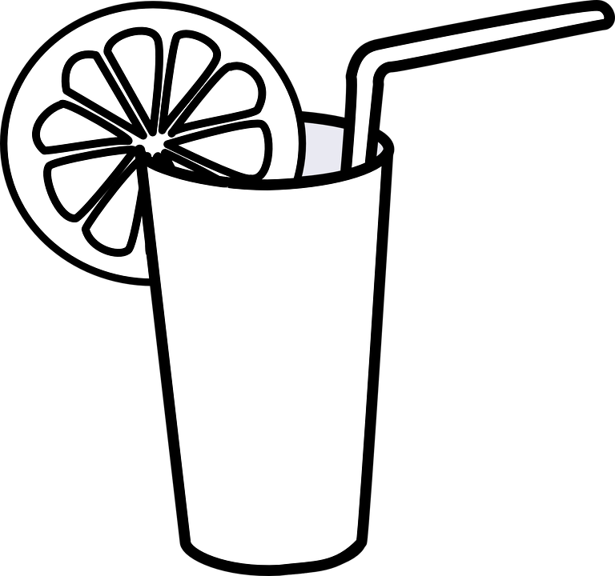
Where does this fit in our Roadmap? (v1.3)
The “official” 3 steps of M.L.
#1
Data
Collection
#2
Data
Cleaning
#3
Model Training
Evaluation
Manage Bias
Documentation
Consistency
Dimension Reduction
Manage Bias
Supervised
  Regression
  Decision Tree
  K-NN (Recommender)
  Bayesian Classification
Unsupervised
  K-Means Cluster
Manage Bias
L.I.M.E.
Visualization
Dimension Reduction
Manage Bias

Slide 6
A Neural Network could be used for either…
Supervised Learning: In supervised learning, neural networks are trained on a labeled dataset, where each input comes with a corresponding target output. The network learns to predict the output from the input data by minimizing the difference between its predictions and the actual targets during training. Examples of supervised learning tasks include classification and regression.
Unsupervised Learning: Neural networks can also be used for unsupervised learning, where the training data does not include any labels. In this case, the network tries to learn useful patterns or features from the data itself without any explicit guidance on the output. Examples of unsupervised learning tasks include clustering, dimensionality reduction (e.g., autoencoders), and generative modeling.
So… neural networks are not exclusively unsupervised machine learning models.
But their most exciting / intriguing / popular use cases are for “unsupervised” learning.

Slide 7
Shafer’s Semi-Supervised Roadmap (v1.4)
The “official” 3 steps of M.L.
#1
Data
Collection
#2
Data
Cleaning
#3
Model Training
Evaluation
Manage Bias
Documentation
Consistency
Dimension Reduction
Manage Bias
Supervised
  Regression
  Decision Tree
  K-NN (Recommender)
  Bayesian Classification
Unsupervised
  K-Means Cluster
  Neural Networks * *
Manage Bias
L.I.M.E.
Visualization
Dimension Reduction
Manage Bias
* * As most commonly used

Slide 8
Comparison of LLMs
A good resource is HELM at Stanford
(A Holistic Evaluation of Language Models)
https://crfm.stanford.edu/helm/lite/latest/#/leaderboard

Slide 9
How are LLMs compared and talked about?
The number of parameters.
The size of the context window.
Training size: The amount of data used to train the model can impact its performance and capabilities.
Accuracy: The model's ability to correctly predict or generate text.
Inference speed: The speed at which the model can generate text, which can be important for real-time applications.
Memory usage: The amount of memory required to store and run the model, which can impact hardware requirements.

