Slide 1
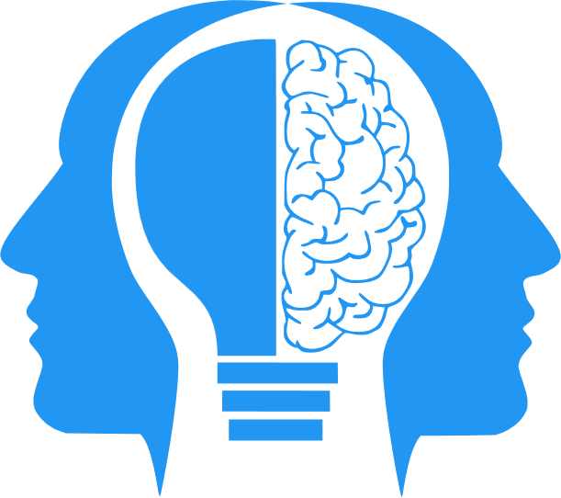
LLMs (Revisited)
MIS3536: Info Sys Innovation with AI
Jeremy Shafer
jeremy@temple.edu
https://community.mis.temple.edu/jshafer
Unless otherwise indicated, all decorative images are by Unknown Author and licensed under CC BY-NC

Slide 2
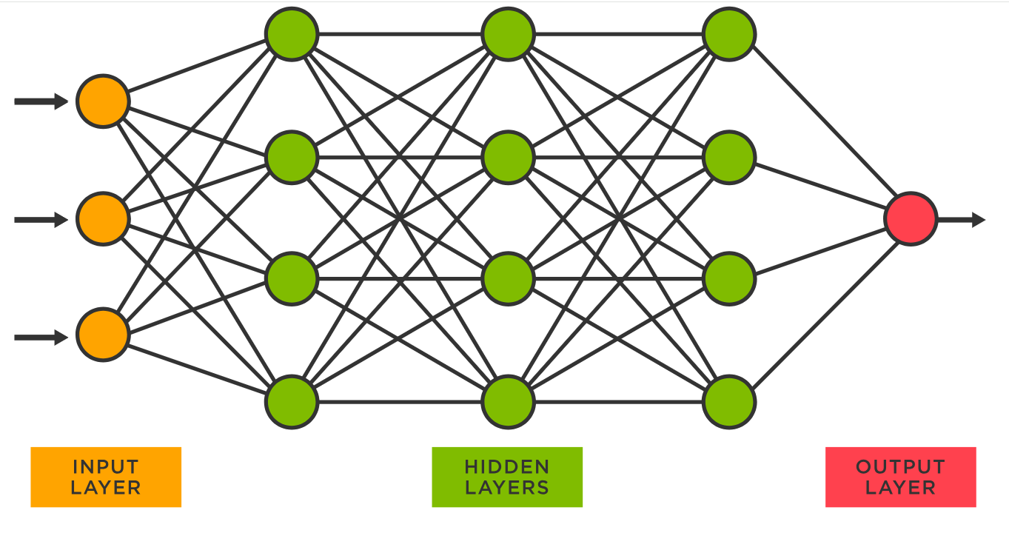
LLMs illustrated again
Each circle represents a neuron with each one connected to other neurons in the next layer via programmable parameters that are adjusted as the model ‘learns’ to do the desired task.
“Learning” is implemented by the adjusting parameters in the hidden layer. The parameters are coefficients in a big math problem used to predict the values in the next layer.
GPT-3 was trained on a neural network with 96 layers and 175 billion parameters. GPT-4 reportedly has 1 trillion parameters.
Sources
https://www.spotfire.com/glossary/what-is-a-neural-network
https://pub.towardsai.net/building-intuition-on-the-concepts-behind-llms-like-chatgpt-part-1-4cb6654ab67

Slide 3
LLMs illustrated again (2)
Moving from input ( on the left ) to output ( on the right ) is called forward propagation.
Error is calculated at the output layer. If the error is “bad” then we need to move from right to left through the hidden layer, adjusting the parameters.
That is called backward propagation.
Speaking casually, the parameters of the hidden layer are essentially the same as the weights of the hidden layer.
Technically speaking, each individual parameter is a function of a weight, and another value called bias.
Sources
https://www.spotfire.com/glossary/what-is-a-neural-network
https://pub.towardsai.net/building-intuition-on-the-concepts-behind-llms-like-chatgpt-part-1-4cb6654ab67

Slide 4
Terminology (Tokens, Weights, Parameters)
Tokens are the text units the model processes.
Weights are values learned during training that guide how the model processes information.
Parameters include weights and other tunable elements (like bias) that define the model’s structure and performance.

Slide 5
“Attention”
LLMs as they popularly exist today use what is known as an “attention mechanism”.
An “attention mechanism” seeks to determine the significance of a word (or token) as it appears in a string.
For instance, in the sentence "The cat sat on the mat, and it looked fat," the attention mechanism helps the model understand that "it" refers to "the cat," not "the mat."

Slide 6
“Attention”(2)
There are many models for determining attention. But the modern explosion in LLM functionality can be traced to what is called the “transformer model” and the “transformer architecture”
The transformer architecture, introduced by the paper "Attention is All You Need" (2017) by A Vaswani revolutionized the landscape of AI. Key ideas from that paper:
You don’t need a more complicated model to get better attention, you need a model that can grow with more hidden layers.
Your attention process must evaluate input sequences in parallel (rather than sequentially).

Slide 7
Changing topics now

Slide 8
LLM Cybersecurity (1)

Slide 9
LLM Cybersecurity (2)
Web Service
This is the “gate”
Business rules are implemented here
DATA

Slide 10
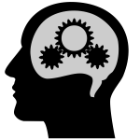
LLM Cybersecurity (3)
Web Service
This is the “gate”
Business rules are implemented here

Slide 11
Why is this necessary?
Because, sometimes, LLMs hallucinate.

