Slide 1

Course Intro
MIS3536: Info Sys Innovation with AI
Jeremy Shafer
jeremy@temple.edu
https://community.mis.temple.edu/jshafer
Unless otherwise indicated, all decorative images are by Unknown Author and licensed under CC BY-NC

Slide 2
Agenda
MIS Department Instructional Practices
About me.
Why am I teaching this course?
How is this course set up?
Our first discussion exercise.

Slide 3
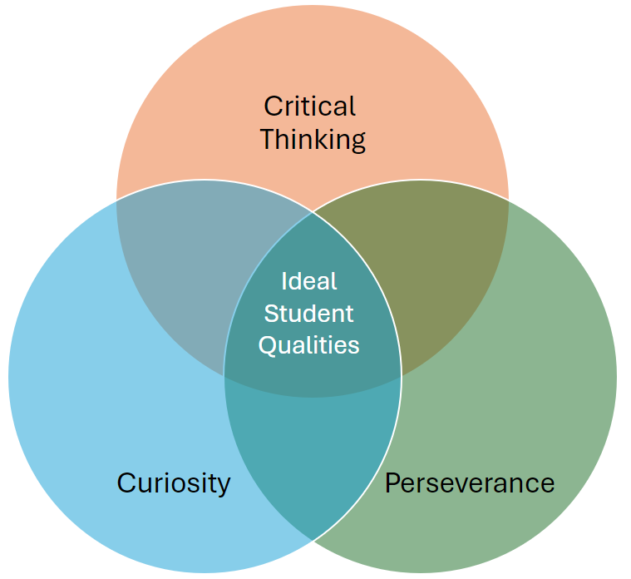
MIS Department Instructional Practices
Constructively participate in class discussions.
Choose project work that is meaningful to you.
Independently experiment to discover AI limitations.
Discern between AI hype and reality.
Come to class prepared.
Take notes.
Submit your work on time.
Notes:
This is for your slide deck at the start of each lecture. You may, of course,

Slide 4
About me
Teaching full time since 2014
Bachelor’s degree in CS, Master’s degree in MIS
Lifelong interest in learning and higher education
Transitions I have witnessed:
  Dawn of the PC (circa 1980)
  Dawn of the Internet and the first browsers (circa 1993)
  Dawn of the iPhone (2007)
  Dawn of ChatGPT (November 2022)

Slide 5
Why am I teaching this course?
According to a report by investment bank Goldman Sachs, artificial intelligence (AI) could replace the equivalent of 300 million full-time jobs. The report suggests that AI could replace a quarter of work tasks in the US and Europe, but it may also lead to new jobs and a productivity boom.
https://www.bbc.com/news/technology-65102150
No other advancement has generated more concern, more media attention, more misleading claims, or more valid enthusiasm.
A course like this is a valuable addition to any student’s resume.

Slide 6
How is this course set up?
Review the
  class site
  syllabus
  schedule

Slide 7
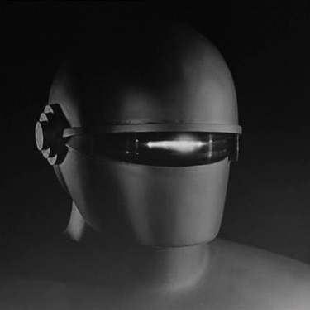
Our first activity
Get into discussion groups of four.
Nominate a spokesperson.
Discuss “how AI has helped you?”
Be prepared to share your thoughts with the class.
This Photo by Unknown Author is licensed under CC BY-SA

