Slide 1

Discussion
Week 1
MIS3536: Info Sys Innovation with AI
Jeremy Shafer
jeremy@temple.edu
https://community.mis.temple.edu/jshafer
Unless otherwise indicated, all decorative images are by Unknown Author and licensed under CC BY-NC

Slide 2
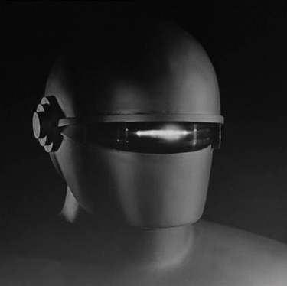
Gort
This robot was the “big bad” in the 1951 film “The Day the Earth Stood Still”.
Or .. Was he?
This Photo by Unknown Author is licensed under CC BY-SA

Slide 3
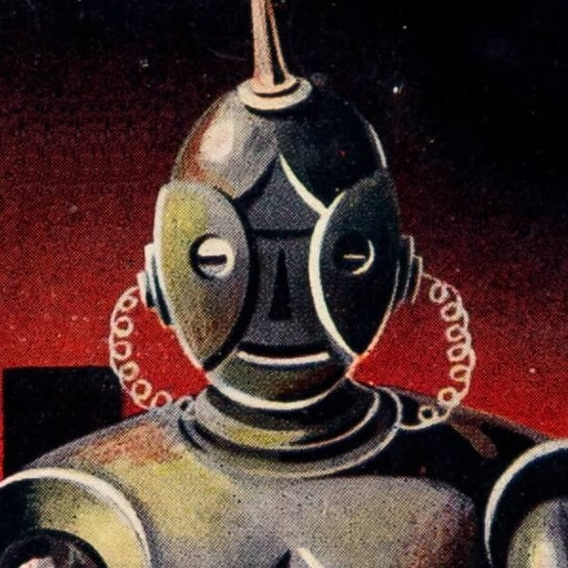
Discussion 1 –
“The Fun they Had”
I hope you actually read the story.
Laptops and phones away, please.
First question(s):
  What was the story about?
  How did it make you feel?
  Why?
This Photo by Unknown Author is licensed under CC BY-SA

Slide 4
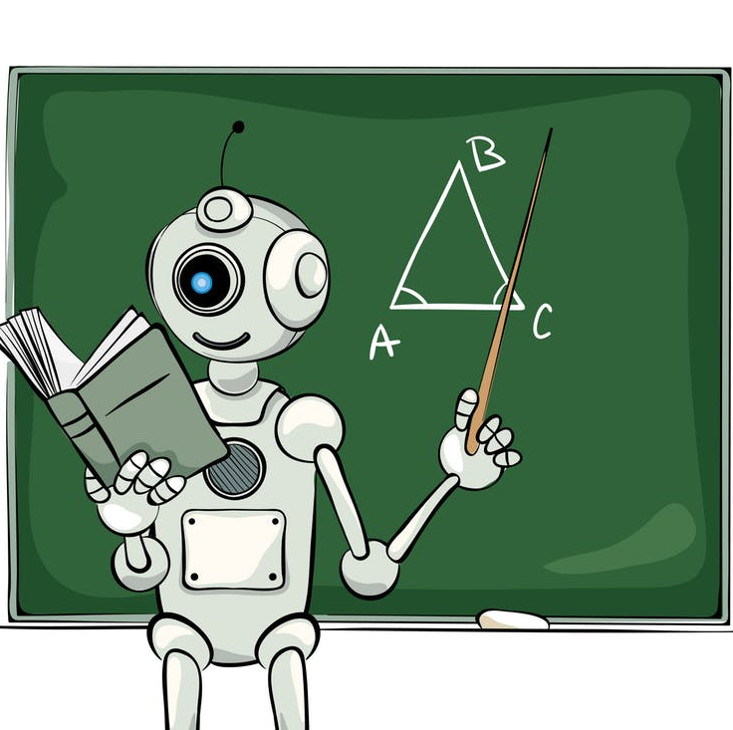
Discussion 2 – Will AI Destroy or Reinvent Education?
What two perspectives have historically competed for attention in higher education?
Which is right?
What role does AI play?
What is one thing that you can do differently to give yourself an advantage that will last for years to come?

