Slide 1
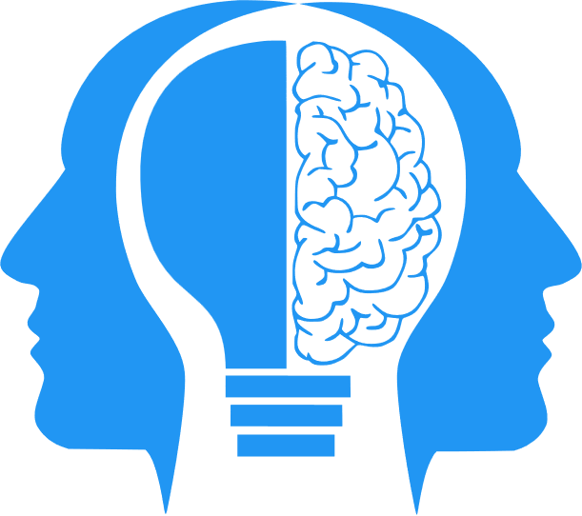
AI, ML and Deep Learning
MIS3536: Info Sys Innovation with A.I.
Jeremy Shafer
jeremy@temple.edu
https://community.mis.temple.edu/jshafer
Unless otherwise indicated, all decorative images are by Unknown Author and licensed under CC BY-NC

Slide 2

Shifting sands!
Sam Altman, CEO of OpenAI writes “We are now confident we know how to build AGI as we have traditionally understood it.” ( post on blog.samaltman.com, 1/5/2025)
Sam Altman tells AI fans to “lower their expectations” (article on fortune.com, 1/20/2025)
What motivations might Altman have to (knowingly or unknowingly) stretch the truth?
This Photo by Unknown Author is licensed under CC BY-SA-NC

Slide 3
Agenda
Let’s meet Eliza (again?)
Discuss: How our expectations of AI have shifted over time.
The definitions of AI, ML, and Deep Learning.
The focus of modern AI.
Shafer’s General Intelligence Criteria
Reasons to be hopeful

Slide 4
AI Expectations have shifted
The philosopher Hubert Dreyfus famously doubted that a computer could beat a human playing chess. In 1972, he his book “What Computers Can’t Do” was published. In that book he questioned the computer’s ability to serve as a model for the human brain and asserted that no computer program could defeat even a 10-year-old child at chess. https://chesspulse.com/are-chess-computers-unbeatable/
In 1968, the International Chess Master David Levy bet that no computer could beat him at chess in 10 years, and that if he did win, it would be another ten after that before a computer beat him. Levy won the bet, but in 1989, it finally happened. Deep Thought, initially created by programmers at Carnegie Mellon University, beat Levy. https://science.howstuffworks.com/innovation/big-thinkers/computer-defeat-chess-champion.htm

Slide 5
AI Expectations keep shifting!
The Turing Test is a method for evaluating a machine's ability to exhibit human-like intelligence through conversation12. Developed by Alan Turing in 1950, it involves a human judge engaging in text-based conversations with both a human and a machine, without knowing which is which. https://www.geeksforgeeks.org/turing-test-artificial-intelligence/
Your own example?

Slide 6
Definitions
Artificial Intelligence (AI) is the ability of machines to perform tasks that typically require human intelligence. AI is a broad field that encompasses many subfields, including machine learning and deep learning.
Machine Learning (ML) is a subset of AI that involves training algorithms to learn patterns in data and make predictions or decisions based on that data.
Deep Learning (DL) is a subset of ML that involves training artificial neural networks to discover patterns in data. DL algorithms are particularly good at handling large, complex datasets and can be used for tasks such as image recognition, speech recognition, and natural language processing. https://www.geeksforgeeks.org/difference-between-artificial-intelligence-vs-machine-learning-vs-deep-learning/

Slide 7
An illustration:
Artificial Intelligence (AI) is any automation that appears to be intelligent. Early AI efforts relied on decision-making workflows that were known in advance.
Machine Learning (ML) keeps track of past successes and failures in the context of a certain kind of problem. The record of those successes and failures is used to respond to future events. ML allows a computer to improve its decision-making ability without being explicitly programmed. ML is a subset of AI.
Deep Learning (DL) Deep Learning is a subset of ML. Deep Learning makes use of Neural Networks (similar to the neurons working in our brain) to mimic human brain-like behavior. DL algorithms focus on identifying patterns and classifying information accordingly. DL works on larger sets of data (i.e. “Big Data”) when compared to ML and the prediction mechanisms are self-administered by machines.
AI
ML
DL
https://www.geeksforgeeks.org/difference-between-artificial-intelligence-vs-machine-learning-vs-deep-learning/

Slide 8
Applications of AI (not a complete list!)
AI (simple, classic)
Games
ML
Recommendation Systems
DL
Image recognition
Simple chatbots
Speech recognition
Automated Voicemail systems
Natural Language Processing
Sentiment Analysis
Predictive Maintenance
Fraud Detection
Autonomous Vehicles
Medical Diagnosis (simple)
Generative Models
Medical Diagnosis (advanced)

Slide 9
The focus of modern AI
Modern Al focuses on 3 major aspects: learning, reasoning, and self­-correction.
Because “learning” and “self-correction” are now understood to be so important, there is inevitable overlap between the definitions of AI, ML, and DL.
Here is an alternate perspective ...

Slide 10
Types of (modern) Al
Artificial Narrow Intelligence (ANI) / Weak AI
Artificial General Intelligence (AGI)
Artificial Super Intelligence (ASI)
ANI is AI that does a specific thing. ANI can be created with human-created workflows (programs) or, more likely, ML. DL may or may not be appropriate, depending on the context.
AGI a theoretical form of AI that aims to create machines that can perform any intellectual task that a human can. It will undoubtedly employ a mix of ML and DL techniques.
Artificial Super Intelligence (ASI) is a hypothetical form of AI that is capable of surpassing human intelligence by manifesting cognitive skills and developing thinking skills of its own

Slide 11
What would AGI look like?
These are “Shafer’s General Intelligence Criteria” only
It passes the Turing test.
It can perform agentic search against the Internet.
It remembers context indefinitely (or in terms of decades, not minutes).
It has agency to perform computing tasks. (See “computer use” from Anthropic, and the upcoming “Operator” from OpenAI.)
It can independently investigate a topic using the scientific method: observation, fact-gathering, hypothesis, testing, analysis, conclusion.
It knows when to stop.

Slide 12

Reasons to be hopeful: Catch a vision for yourself
“Human in the loop” is a real thing
Examine/Detect/Address Biases in training data
Red Teaming
Quality Assurance
Continuous review process
AI Governance
AI Risk
AI Compliance

