Slide 1
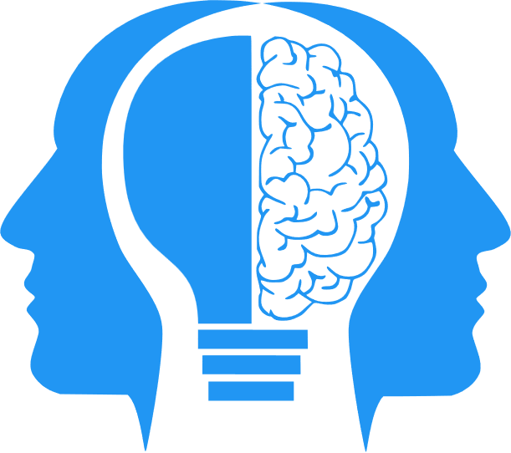
Supervised and Unsupervised Learning
MIS3536: Info Sys Innovation with AI
Jeremy Shafer
jeremy@temple.edu
https://community.mis.temple.edu/jshafer
Unless otherwise indicated, all decorative images are by Unknown Author and licensed under CC BY-NC

Slide 2
AGI Update
https://techcrunch.com/2024/12/26/microsoft-and-openai-have-a-financial-definition-of-agi-report/
https://youtu.be/pz9FQ1gwh3g?si=Trcba81p1O4A1juL

Slide 3
Where are we?
AI
ML
DL
Both Supervised and Unsupervised Learning are subsets of Machine Learning

Slide 4
Agenda
Discuss: Moore’s Law has made ML and DL possible
The definitions of Supervised vs Unsupervised Learning
Examples of Supervised Learning
Examples of Unsupervised Learning
Semi-Supervised Learning

Slide 5
Moore’s Law
Moore's Law is an observation made by Gordon Moore, co-founder of Intel, in 1965 that the number of transistors on a microchip doubles approximately every two years . This exponential growth in computing power has been a driving force behind the development of artificial intelligence (AI) .
The slowdown of Moore's Law in 2005 has led to a shift in the way computer hardware is designed and manufactured . The slowdown was caused by the physical limitations of the materials used to make microchips, which made it difficult to continue shrinking the size of transistors.
Despite the slowdown, the exponential growth in computing power predicted by Moore's Law has continued, albeit at a slower pace. Chip manufacturers have had to find new ways to improve performance, such as using multiple processors and specialized hardware for AI applications.

Slide 6
Definitions – Supervised Learning
Supervised Learning – Supervised Learning uses data sets that have been labelled (by humans) to build a model which can be used to predict an outcome.
If the outcome is categorical (for example: fraudulent vs legitimate, on vs off, keep vs discard, buy/hold/sell) then a classification model is used. The simplest classification model is a Decision Tree.
If the outcome is a value that exists on a continuous scale (for example: temperature, age, price) then a Linear Regression model is used.

Slide 7
Definitions – Unsupervised Learning
Unsupervised Learning – Unsupervised Learning attempts to discover previously unknown patterns in data.
The simplest unsupervised classification algorithm is K Means clustering. It is “unsupervised” classification because the clusters are not known in advanced.
A more powerful (and more complicated) approach is to train and query a Neural Network. The behavior of a neural network cannot be fully known in advance due to its complex nature. Neural networks are designed to learn from data and make predictions or decisions without being explicitly programmed to perform the task.

Slide 8
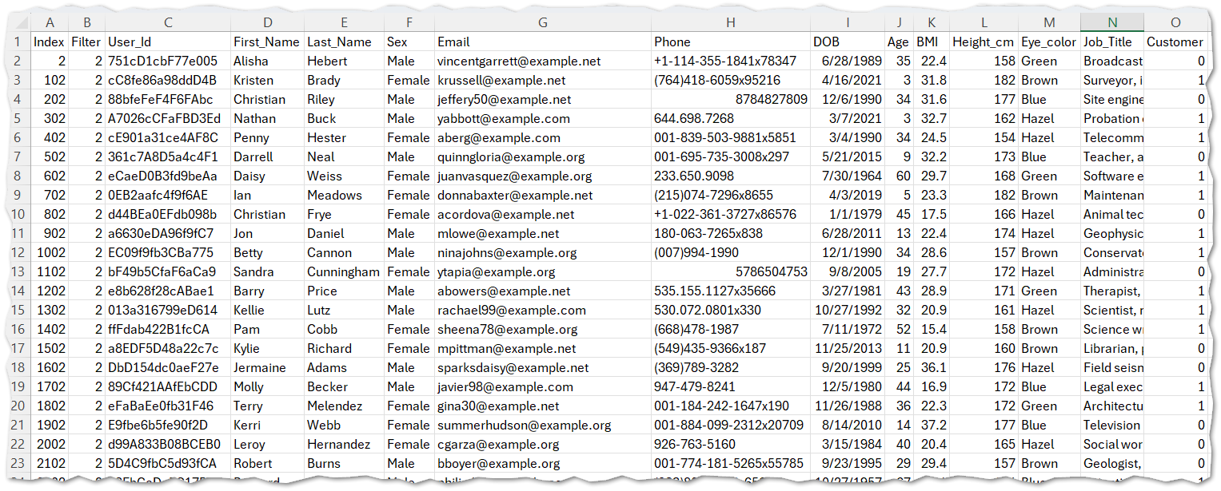
Examples use this Excel spreadsheet

Slide 9
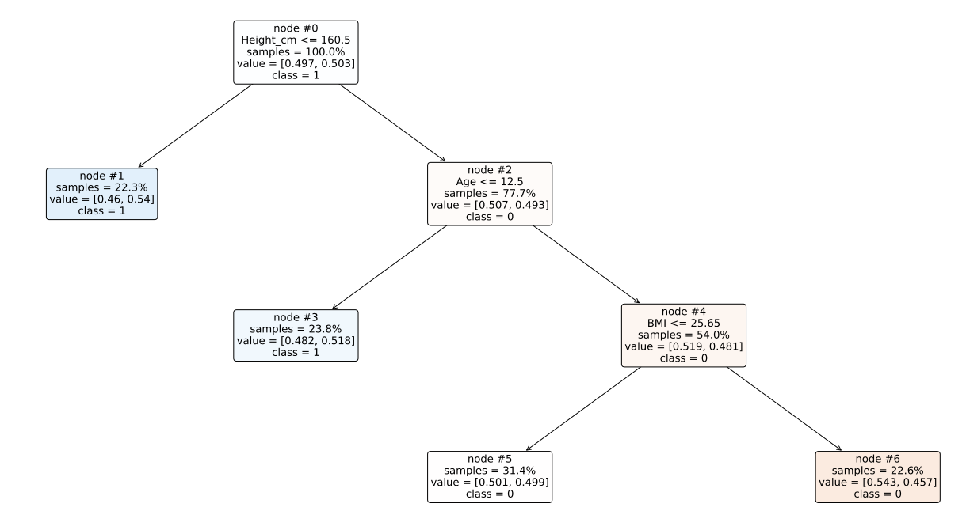
An example of a Decision Tree
Answers the question … will this person be a customer?

Slide 10
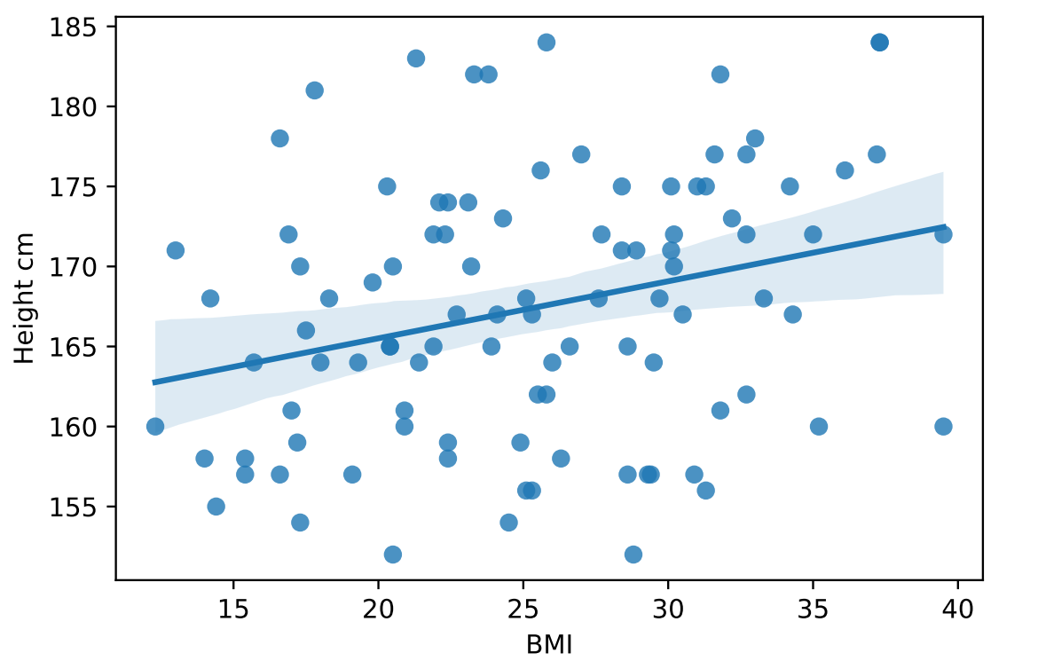


An example of a Regression Model
I had to reduce the dimensions of the data to make a scatter plot on an X Y axis.
A computer would solve a multiple linear regression equation!
More and better examples: https://aegis4048.github.io/mutiple_linear_regression_and_visualization_in_python

Slide 11
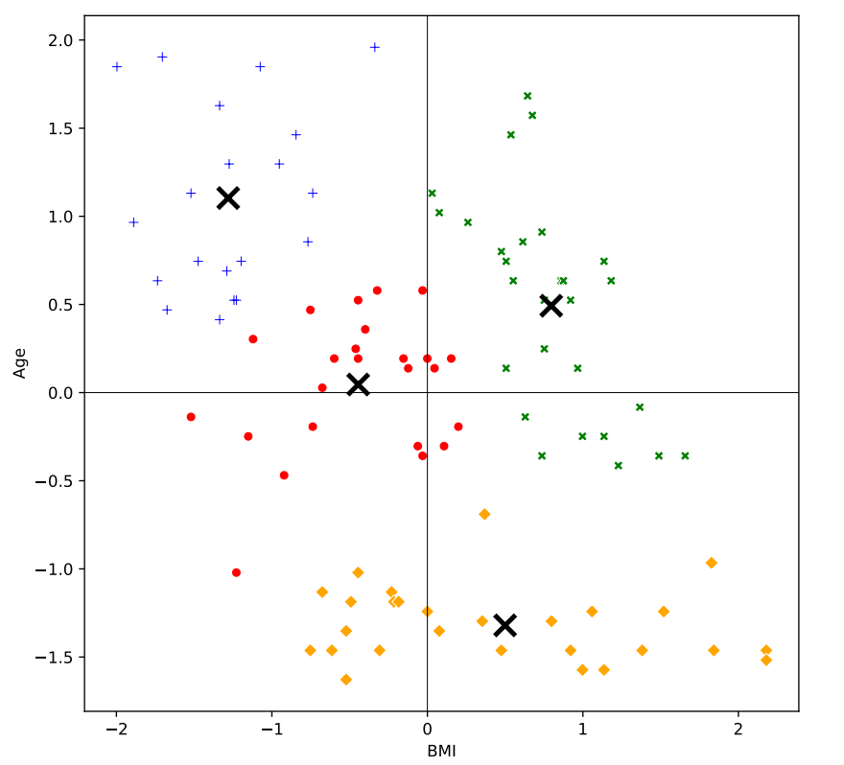
An example of a Cluster Analysis
Again, dimension reduction was employed here … for the sake of creating a 2-d diagram.

Slide 12
An example of a Cluster Analysis (2)
 | Age | BMI | Height_cm
Cluster 1 | -0.919094499 | 0.577568261 | 1.115316018
Cluster 2 | 0.656731595 | -0.63185569 | 0.529503933
Cluster 3 | 0.939609087 | -0.637242534 | -1.134449729
Cluster 4 | -0.60210412 | 0.62955702 | -0.544306326
This model is more accurate. It has more dimensions. But not as easily visualized!

Slide 13
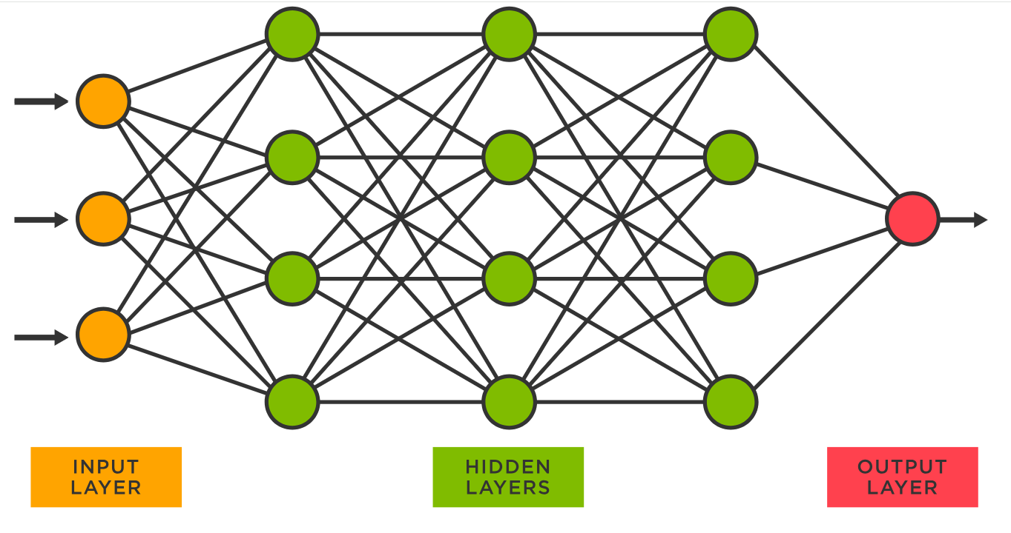
Neural Networks
Each circle represents a neuron with each one connected to other neurons in the next layer via programmable parameters that are adjusted as the model ‘learns’ to do the desired task.
“Learning” is implemented by the adjusting parameters in the hidden layer. The parameters are coefficients in a big math problem used to predict the values in the next layer.
GPT-3 was trained on a neural network with 96 layers and 175 billion parameters. GPT-4 reportedly has 1 trillion parameters.
Sources
https://www.spotfire.com/glossary/what-is-a-neural-network
https://pub.towardsai.net/building-intuition-on-the-concepts-behind-llms-like-chatgpt-part-1-4cb6654ab67

Slide 14
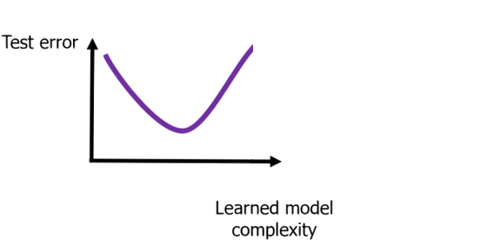
The (amazing, mysterious) double-descent
We build our model based on “training data”.
We then test our model with new/different data called “validation data”.
As we build more and more complex models, the amount of error decreases. The general idea being that more model complexity = less error.
That works for a while until we reach a place of “over fitting” and the model starts to tailor all its answers to the training data set.
The uptick in error is sometimes referred to as a “elbow” or a “knee”.

Slide 15
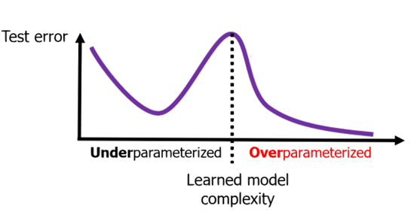
The (amazing, mysterious) double-descent(2)
But, when the model complexity gets really, really big … specifically when the number of model parameters is greater than the number of observations in my training data set, something mysterious happens.
Error starts to decrease again, and the predictive model gets more and more powerful.
So, we can call a model “Under parameterized” when the number of model parameters p is less than the number of observations N.
Conversely, an “Over parameterized” model has more parameters than training observations N.
References: https://m-clark.github.io/posts/2021-10-30-double-descent/
https://openreview.net/forum?id=YD2o0xXI9w (2019 paper by Belkin, et. al.)

Slide 16

Definitions – Semi-Supervised Learning
Semi-Supervised Learning – Semi-supervised learning is a type of machine learning that falls in between supervised and unsupervised learning . It is a method that uses a small amount of labeled data and a large amount of unlabeled data to train a model .
You can think of this as humans, actively shepherding the learning and behavior of the model(s).

