Slide 1

Linear Regression vs Neural Networks: A Conceptual Comparison
MIS3536: Info Sys Innovation with AI
Jeremy Shafer
jeremy@temple.edu
https://community.mis.temple.edu/jshafer
Unless otherwise indicated, all decorative images are by Unknown Author and licensed under CC BY-NC

Slide 2
Why are we here?
To demystify modern AI as much as possible
To understand AI, so that we can manage and apply AI to our future workplaces
Sometimes, the key to learning a new thing, is to tie it to something you already know
You’ve all had your share of math classes, so maybe this will help

Slide 3
Disclaimer!
I am not a mathematician
I am not a statistician
But, as is often the case, I know enough to be dangerous

Slide 4
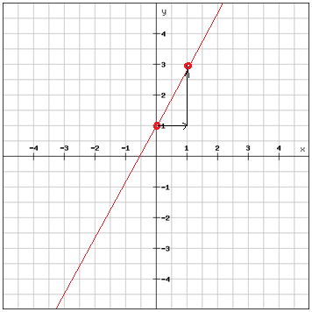
The simplest linear expression …
A straight line, in 2 dimensions
y=β0​+β1​x
y=b+mx

Slide 5
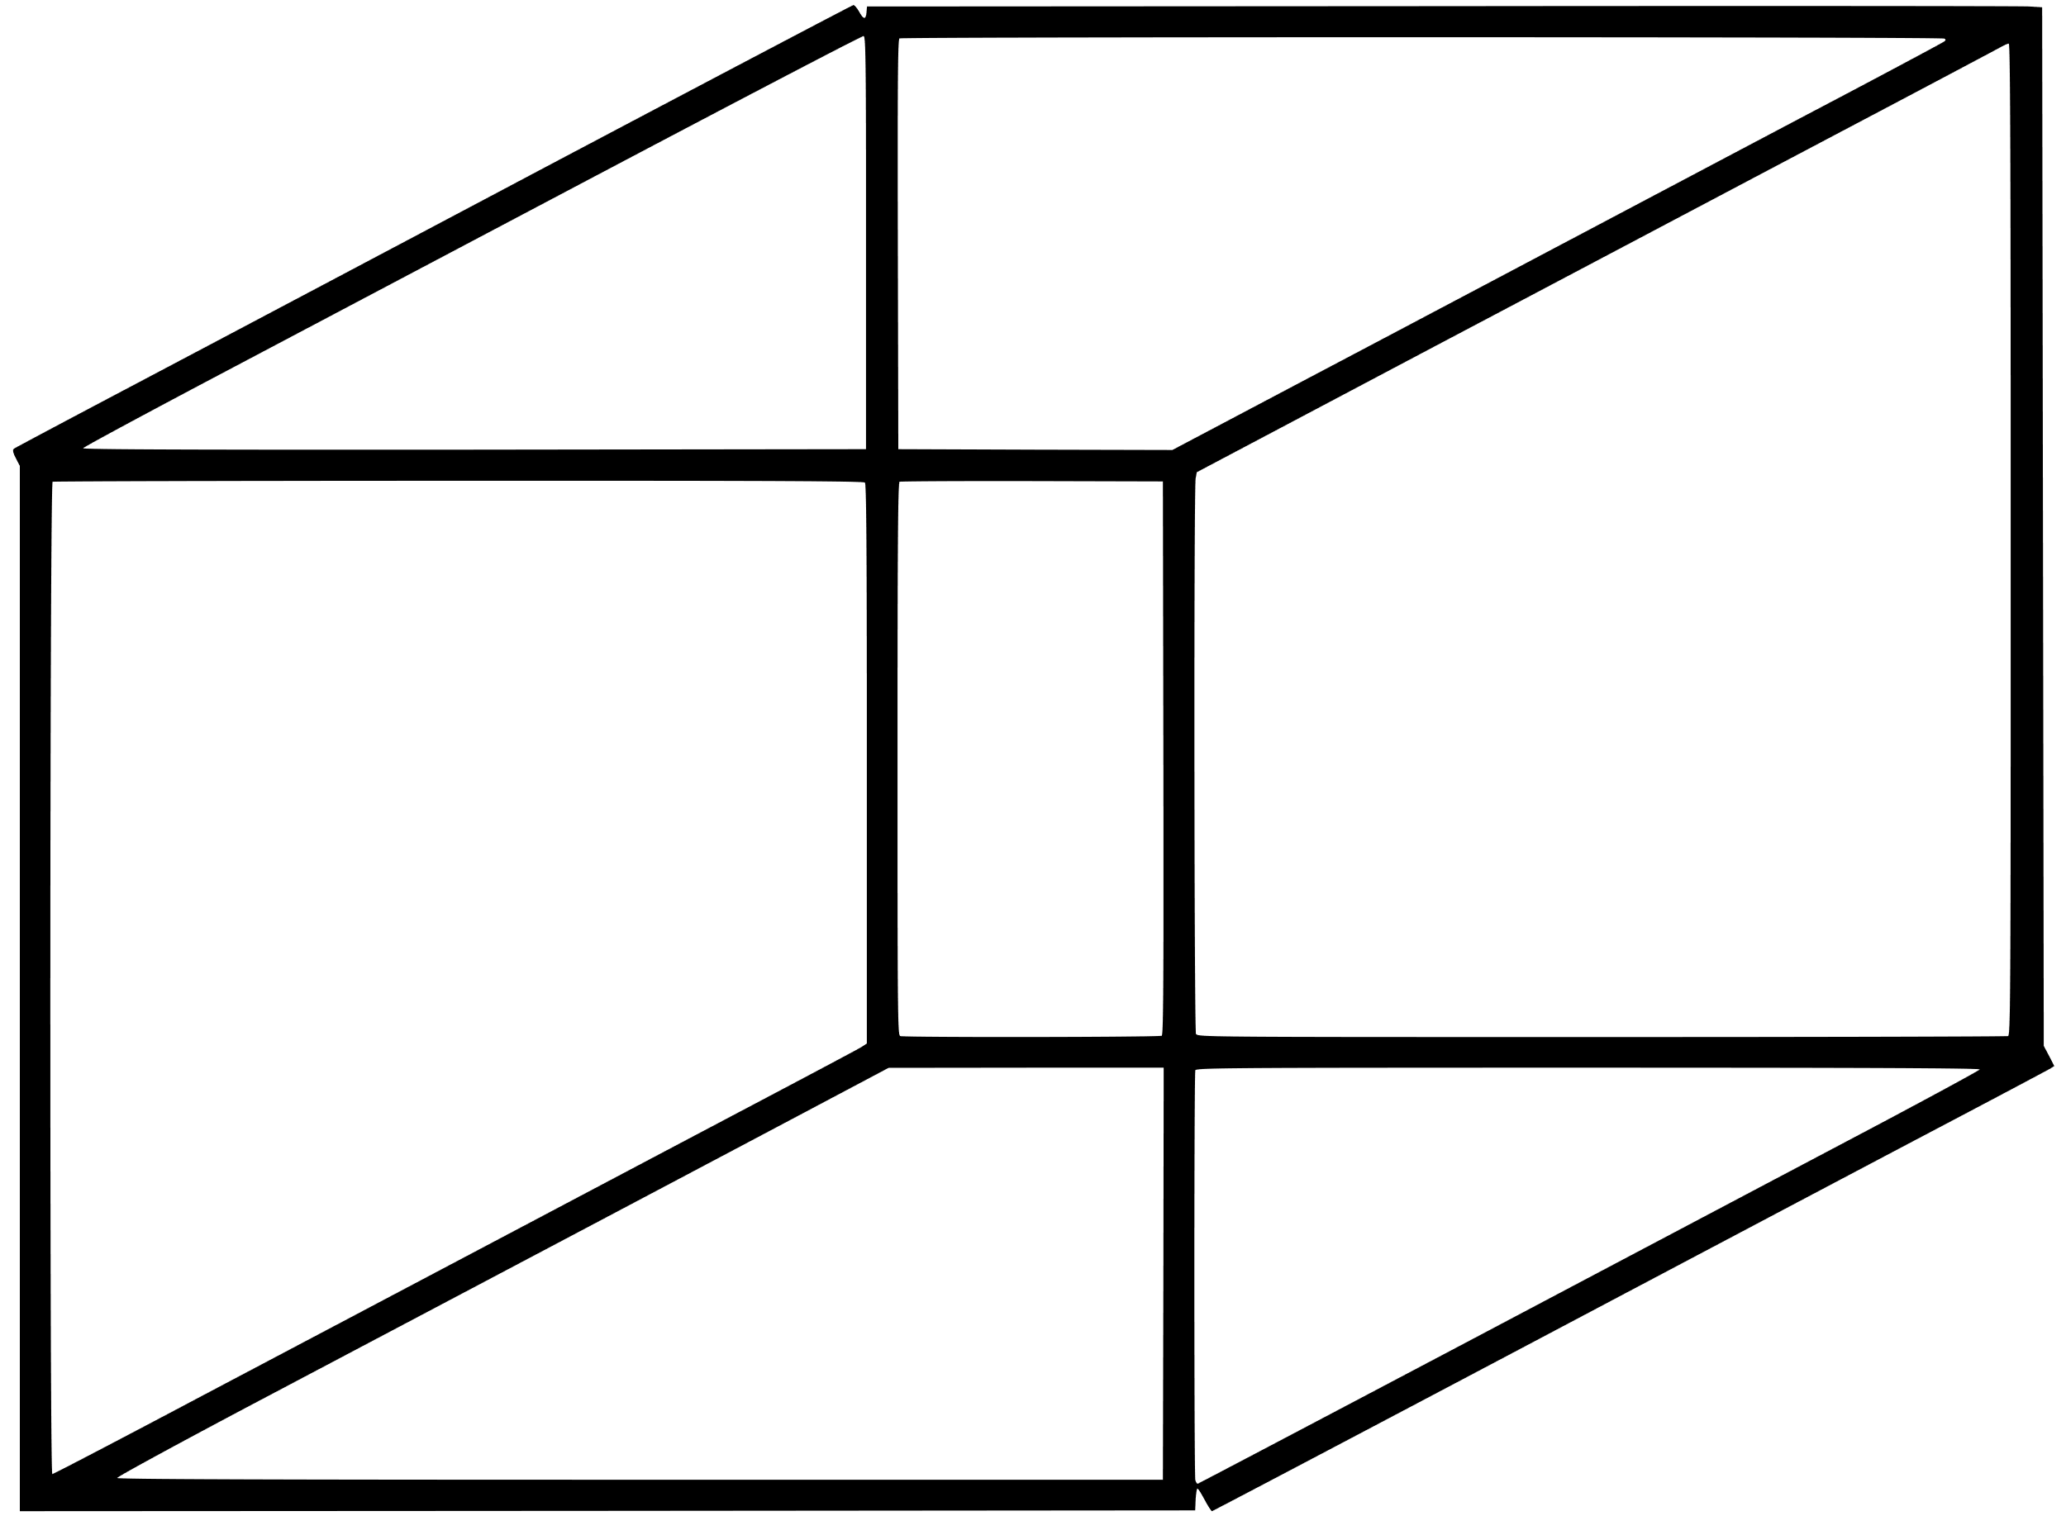

Adding another dimension
Adding another variable, adds another dimension
y=β0​ +β1​x1 +β2​x2
We can’t draw beyond 3D, but the math extends to any number of features.
$y=β_{0}+β_{1}x_{1}+β_{2}x_{2}+⋯+β_{n}x_{n}+ε$

Slide 6
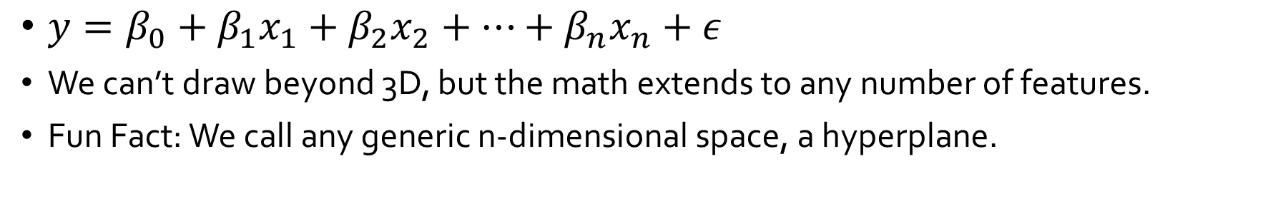
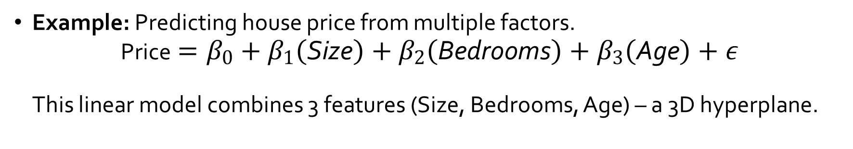
More features = better predictions
$y=β_{0}+β_{1}x_{1}+β_{2}x_{2}+⋯+β_{n}x_{n}+ε$
We can’t draw beyond 3D, but the math extends to any number of features.
Fun Fact: We call any generic n-dimensional space, a hyperplane.
Example: Predicting house price from multiple factors. $\text{Price}=β_{0}+β_{1}\left(\text{Size}\right)+β_{2}\left(\text{Bedrooms}\right)+β_{3}\left(\text{Age}\right)+ε$ This linear model combines 3 features (Size, Bedrooms, Age) – a 3D hyperplane.
Notes:
The simple house price formula above illustrates this: each feature contributes via its coefficient, and adding more features just adds more terms to the sum. The key point is that linear regression easily generalizes to any number of input dimensions – it’s not just for two-variable plots.

Slide 7
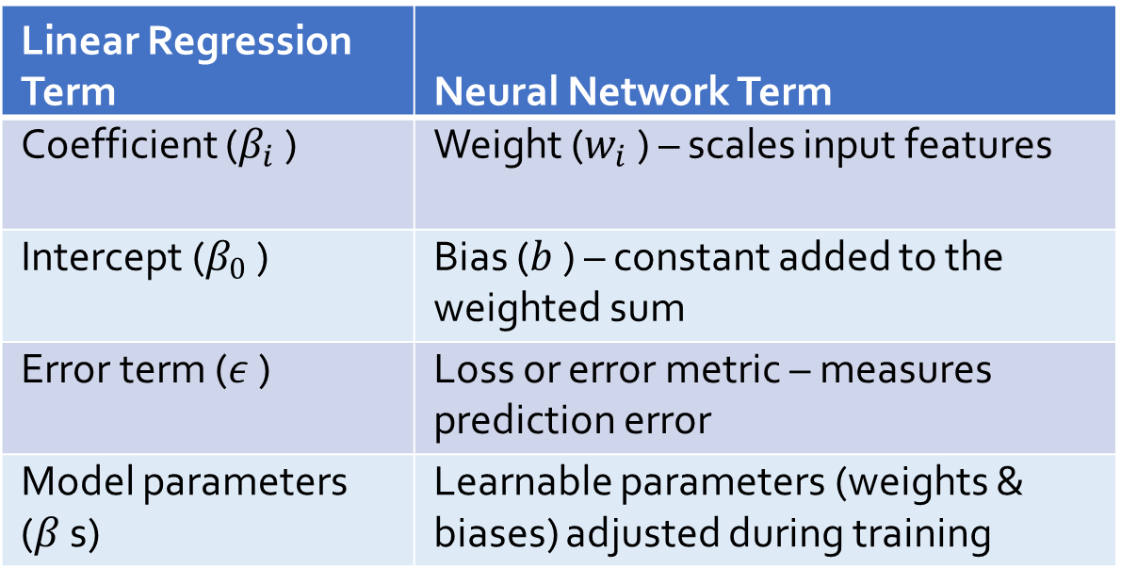
Comparing Terminology
Linear Regression Term | Neural Network Term
Coefficient ($β_{i}$ ) | Weight ($w_{i}$ ) – scales input features
Intercept ($β_{0}$ ) | Bias ($b$ ) – constant added to the weighted sum
Error term ($ε$ ) | Loss or error metric – measures prediction error
Model parameters ($β$ s) | Learnable parameters (weights & biases) adjusted during training
Notes:
We can draw a direct analogy between a linear regression model and a very simple neural network (one without any hidden layers). In regression, we have a set of coefficients $β_{1},β_{2},…$ that multiply each input – in a neural network these play the role of weights $w_{1},w_{2},…$ on each connection[4]. The regression’s intercept $β_{0}$ is analogous to the network’s bias term $b$ , which is added to the weighted inputs[4]. Essentially, a single neuron computes

Slide 8
Where the Metaphor Holds: Similarities
Weighted Inputs + Bias: Both a linear regression model and a neural network neuron calculate a weighted sum of inputs plus a bias term.
Essentially, a single neural network’s neuron is performing linear regression.
Supervised Learning: Both are supervised learning techniques in that we feed in labeled examples (with known outputs) and the model “learns” to map inputs to outputs.
Whether it’s finding the best-fit line or adjusting network weights, the goal is to generalize from training data to make accurate predictions.

Slide 9
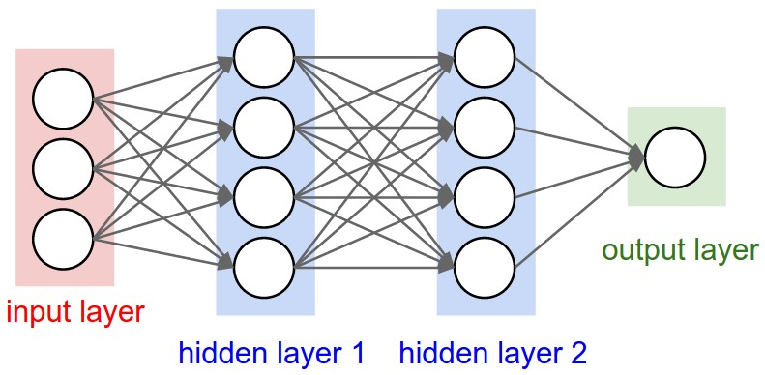
Let’s look at some neurons…

Slide 10
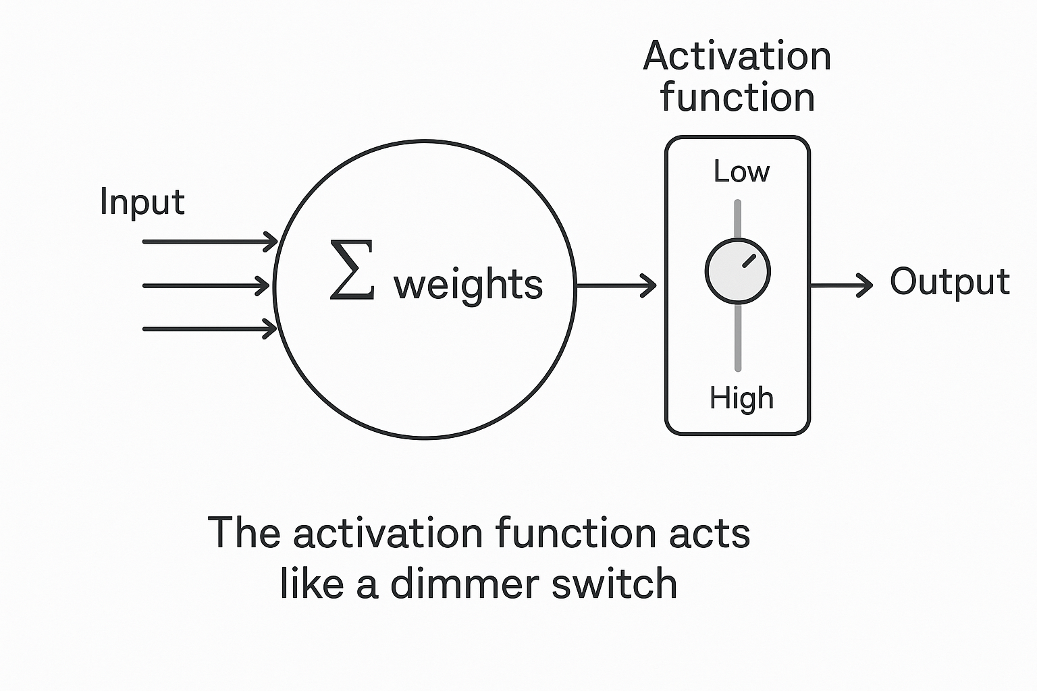
One neuron, one linear equation

Slide 11
Where the Metaphor Breaks: Differences
Complexity: Again, single neural network’s neuron is performing linear regression. A neural network is made up of millions of neurons, spread over multiple layers.
Determinism: Solving a linear regression (with the least squares method) yields a unique, deterministic solution – there’s a direct formula for the best-fit line.
Training a neural network is typically a process that depends on random initialization and can yield slightly different results each run.
The neural network’s learning might converge to a good solution, but it’s not guaranteed to be consistent.
Notes:
In linear regression, we compute the best-fitting coefficients (analytically or via an optimization procedure) that minimize the errors. In neural networks, we start with random weights and iteratively adjust them (using algorithms like gradient descent/backpropagation) to minimize the loss[7]. The core principle is the same: the model has numbers it can tune, and those are tuned to make predictions as close to the true values as possible.
Furthermore, both methods explicitly aim to minimize error. In regression, the classic approach is to minimize the sum of squared residuals – that difference $y−\hat{y}$ (actual minus predicted) is what we call the error term $ε$ , and we find parameters that make those $ε$ as small as possible on average. Neural networks do something very analogous: define a loss function (like mean squared error, cross-entropy, etc.) that measures the discrepancy between predictions and truth, and then find weights/biases that minimize that loss[6]. So both are firmly grounded in the concept of empirical risk minimization – tweaking parameters to make errors as small as we can.

Slide 12

Where the Metaphor Breaks: Differences (2)
Interpretability: Linear regression is relatively easy to interpret – each coefficient $β_{i}$directly shows how much that feature influences the prediction.
Neural networks, especially deep ones, are often considered “black boxes.”
This is a conceptual difference: regression gives a transparent model, while neural nets trade some interpretability for greater modeling power.

Slide 13

This is just to plant a seed… we will look at Neural Networks more in the future!

