Slide 1
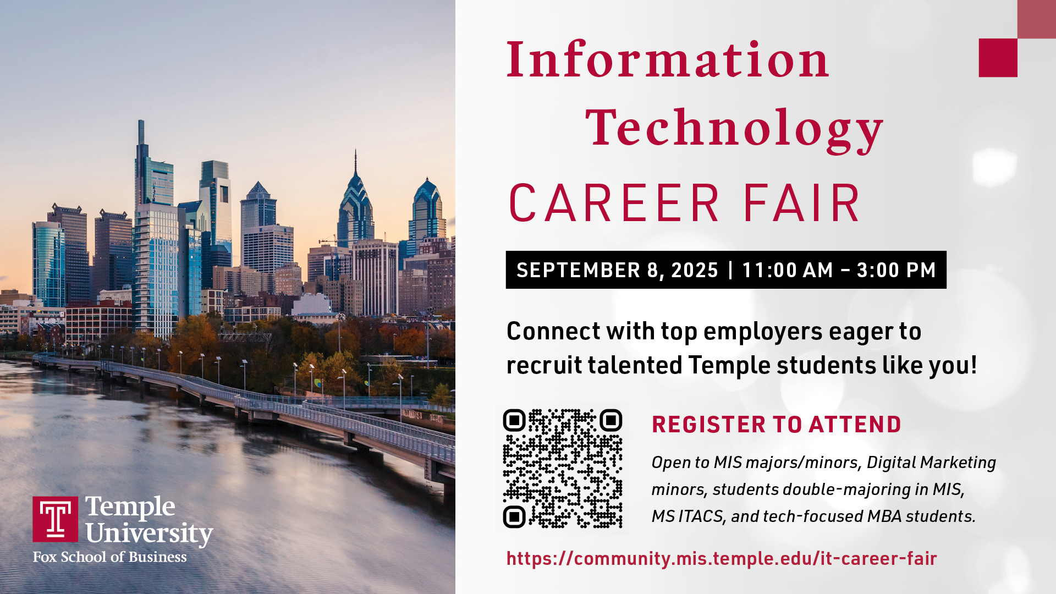

Slide 2
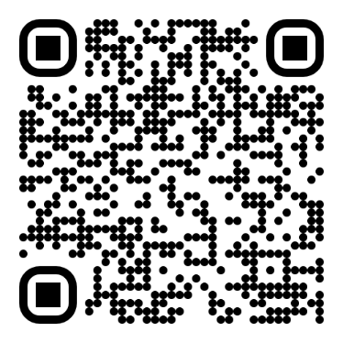
IT Career Fair 2025: September 8
Date & Time: Sep 8, 2025, Monday, 11 am – 3 pm
Location: Howard Gittis Student Center – Room 200
18 Companies registered as of August 24
https://community.mis.temple.edu/it-career-fair-for-students/
Students Registration is open and will close on September 5
Registration Link: https://community.mis.temple.edu/it-career-fair-registration/
Companies will recruit exclusively for full-time and internship positions for undergraduate MIS majors, MIS minors, and MIS graduate students.
Excellent opportunity for students:
Networking + Securing Internship + Securing Full Time position
https://community.mis.temple.edu/it-career-fair/

Slide 3
To register and attend, you need to do the following:
Make sure your portfolio is up to date. If you don’t have an e-portfolio, you can find out how to make one here: https://community.mis.temple.edu/professionalachievement/get-started If you need help with your portfolio, contact our MIS Student PRO Points Ambassadors.
Make sure your resume is also up to date and consistent with your portfolio. The URL for your portfolio should be on your resume and in your email signature. Employers participating in the career fair will receive access to the MIS portfolio search engine.
Register at https://community.mis.temple.edu/it-career-fair-registration/ by Friday, September 5 at 11:59pm. Only registered students can participate in the IT Career Fair.
Download and install the PRO mobile app. You will need the app to check out when leaving the venue to receive your PRO points.
Professional attire is required to attend the event.
For more information go to: https://community.mis.temple.edu/it-career-fair/
https://community.mis.temple.edu/it-career-fair/

