Slide 1
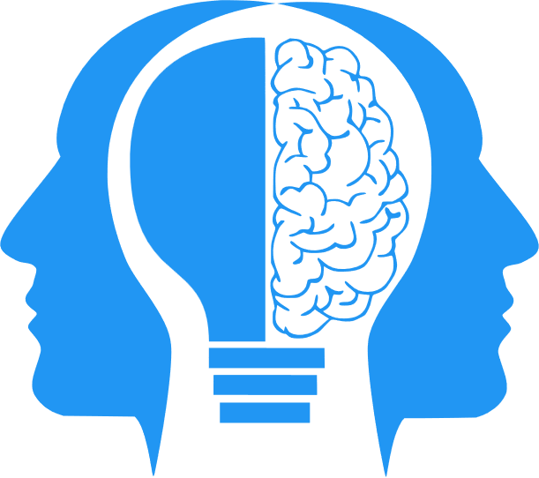
AI “Imagination” Part 1
(Image Generation)
MIS3536: Info Sys Innovation with AI
Jeremy Shafer
jeremy@temple.edu
https://community.mis.temple.edu/jshafer
Unless otherwise indicated, all decorative images are by Unknown Author and licensed under CC BY-NC

Slide 2
Agenda
What is AI image generation?
How it’s built and trained
How it works step-by-step
Current uses and leaders
Ethical and social questions
Future directions
Preview of Part 2: AI World Models
Notes:
This first lecture focuses on the visible imagination of AI.
Part 2 will shift to AI’s inner imagination — how it mentally models and predicts the world.

Slide 3
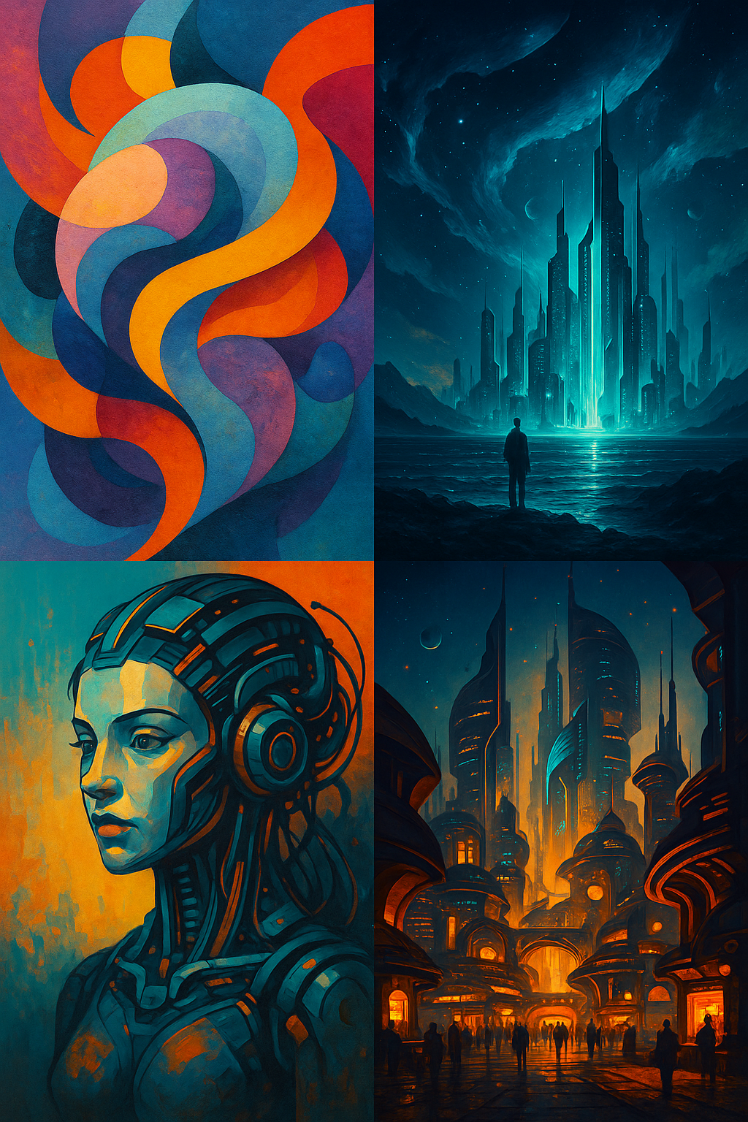
The Idea of Generative AI
Generative AI: AIs that create new content
  Compose text (ChatGPT)
  Compose music
  Generate images from text prompts
Image generation is what I am going to call “Artiicilial Imagination”
Image generation is one kind of Generative Ai
Notes:
Generative AI doesn’t just analyze — it creates.
Image generation has become one of the most accessible and fun applications of this new creative wave.

Slide 4
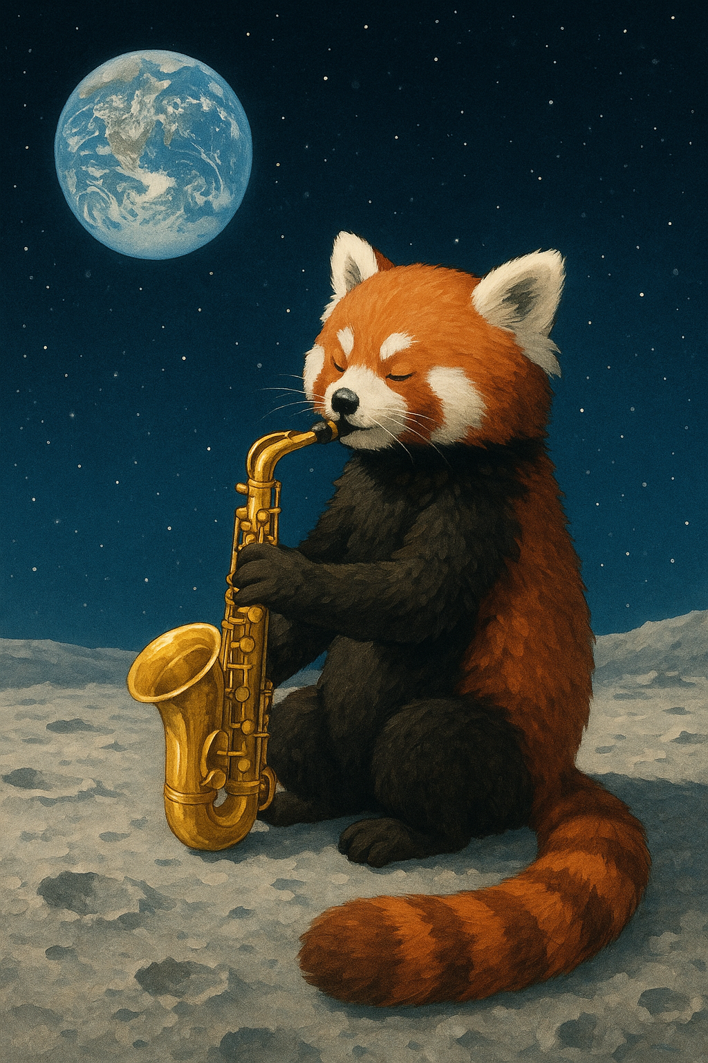
What Is AI Image Generation?
AI that creates new images “from scratch” (we can debate that in a minute)
Often works from a text prompt (e.g., “a red panda playing a saxophone on the moon”)
Uses deep learning and huge image datasets
Notes:
Imagine describing something you’ve never seen — and instantly getting a realistic picture of it.
That’s what modern image generators do.

Slide 5
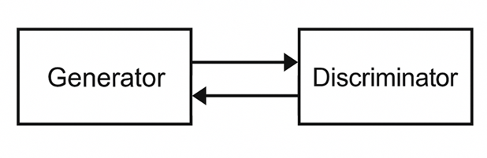
From Early Experiments to “Art”
Early models: GANs (Generative Adversarial Networks)
Two AIs: one creates, one judges
Pushed each other to improve
Results were impressive but unstable
GANs were a big step. One AI tries to fake it, the other tries to spot the fake.
Over time, the faker gets very good — but this approach was hard to scale.

Slide 6
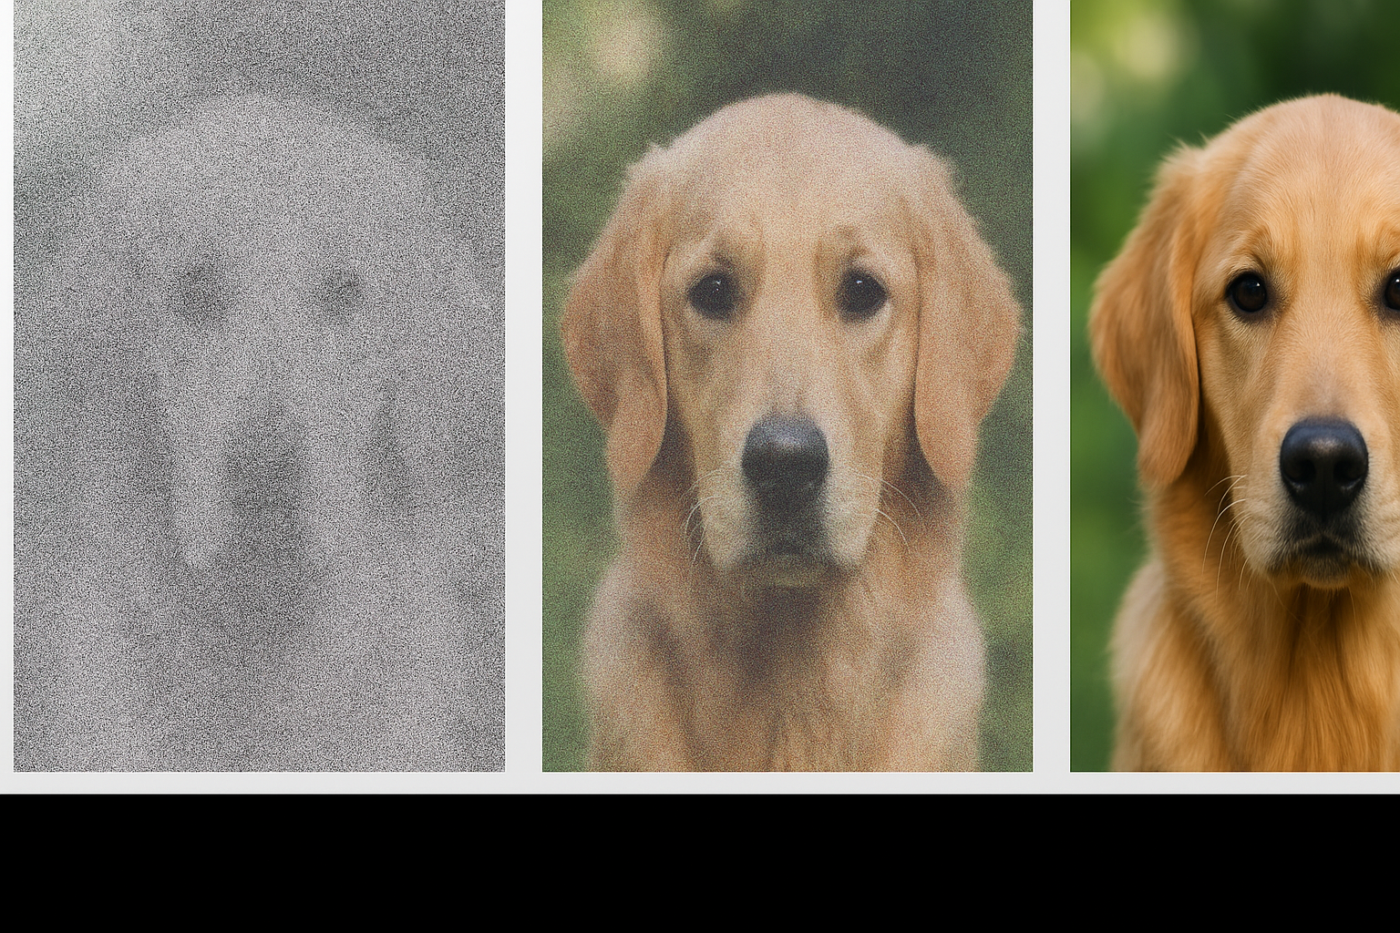
The Diffusion Revolution
Around 2021, a new method: Diffusion models
Process: Start with random noise
Gradually remove noise to reveal an image
Reliable, flexible, and capable of stunning detail
The diffusion generative process starts with “static” (a.k.a. “Gaussian noise”)
Notes:
Diffusion is like reverse erosion — the AI cleans up random static until a picture emerges.

Slide 7

What Is Gaussian Noise?
“Noise” = random static (like TV snow)
“Gaussian” = small changes are common, big ones rare
Diffusion models add and remove this noise to learn how images are structured
After training, AI image generators try to un-randomize the static, step by step.

Slide 8
How AI Image Generators Are Built
(Model Training)
Based on neural networks
Trained on billions of image-text pairs
Learn patterns like: “What does a dog look like?”, “What makes a sunset look warm?”
Key components for training: Noise predictor network
The network doesn’t memorize pictures. It learns relationships — colors, shapes, lighting, and words that go together.

Slide 9
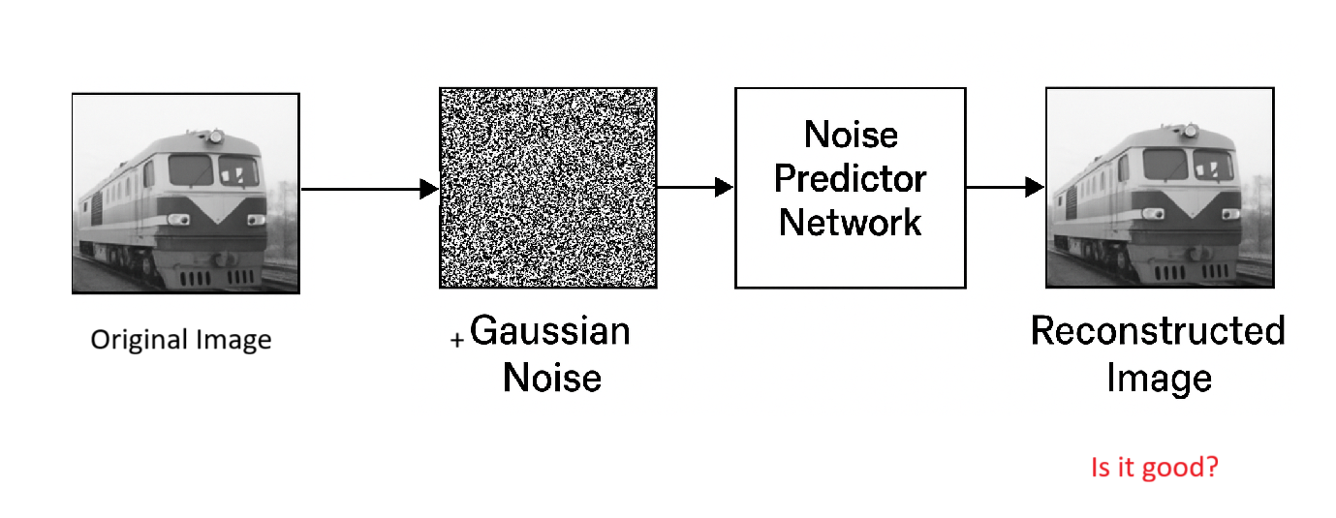
Modern Image Generators (training, simplified)
START
Notes:
Noise predictor network, Latent encoder/decoder, Text encoder (understands prompts)
Noise Predictor Network
This is the core part of a diffusion model.
During training, the model is shown an image that has had random noise added to it many times.
The noise predictor’s job is to guess what noise was added at each step.
Over time, it learns how to remove the noise and recover the clean image.
When you generate a new image, the AI starts with random static and applies the same learned process in reverse — gradually removing noise to reveal a picture.
Think of it like a skilled photo restorer who can tell which specks and scratches don’t belong, and knows how to clean them away.
Latent Encoder / Decoder
These work as a compression system for images.
The encoder converts a large image into a smaller, efficient internal representation called a latent space (like compressing a .zip file).
The decoder does the opposite — it reconstructs a full image from that compact form.
Working in this “latent” form saves computation and helps the model focus on meaningful patterns (shapes, textures, color relationships) rather than every pixel.
Analogy: If you describe a photo to a friend, you don’t list every pixel — you summarize it. That summary is like the latent space.
Text Encoder
The text encoder translates your written prompt into a numerical meaning the AI can understand.
It breaks sentences like “a red panda playing a saxophone on the moon” into concepts — “animal: red panda,” “object: saxophone,” “setting: moon.”
It converts those ideas into vectors that guide the image-generation process.
The image model then aligns what it draws with those text meanings.
It’s like an interpreter that helps the AI “understand” your description and draw something that matches it.

Slide 10
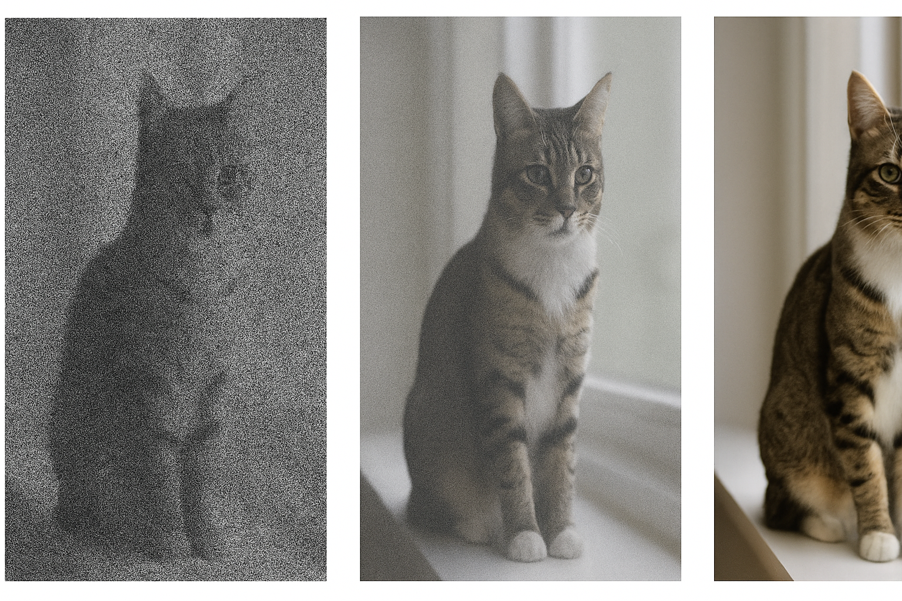
AI Image Generation (after training)
Start with random noise
Apply the model repeatedly to remove noise
Each step reveals more structure
Text prompt guides what appears
Notes:
Each denoising step is like an artist sketching, refining, and coloring until the image looks right.

Slide 11
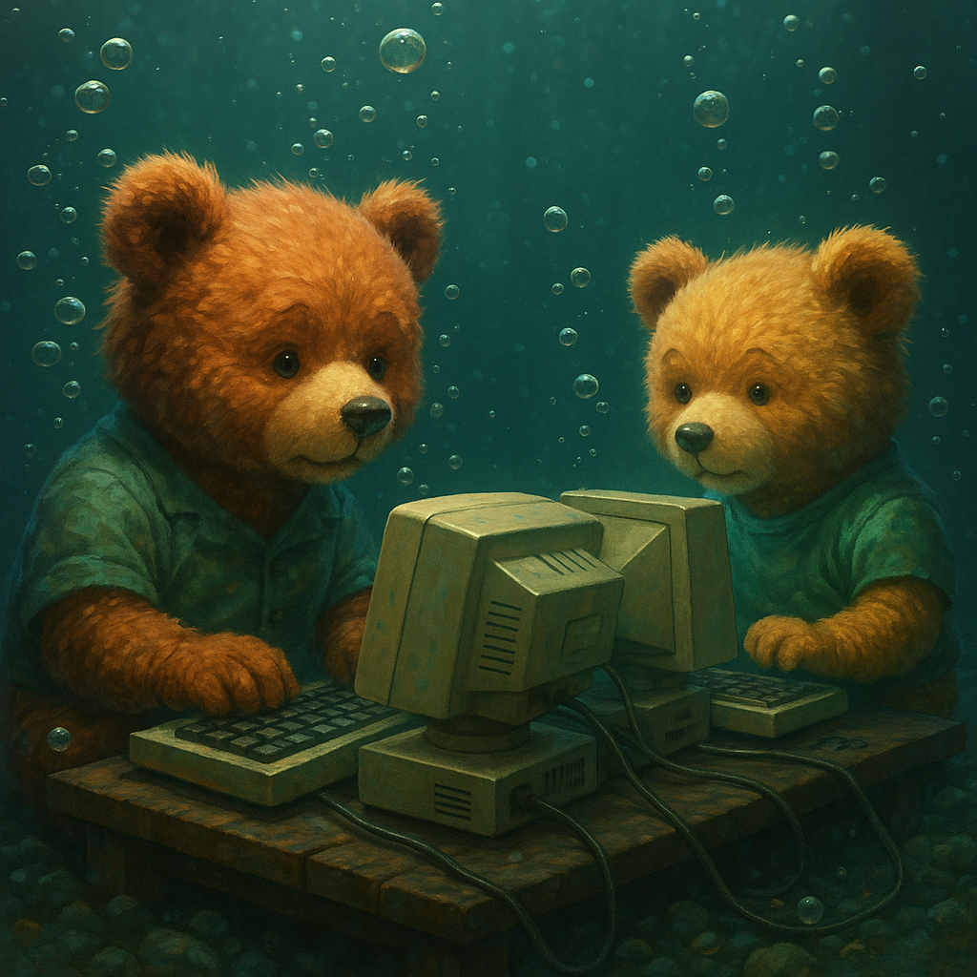
Example: DALL·E’s Teddy Bears
DALL-E is built into ChatGPT
Prompt: “Teddy bears working on AI research underwater with 1990s technology.”
AI creates an entirely new image

Slide 12
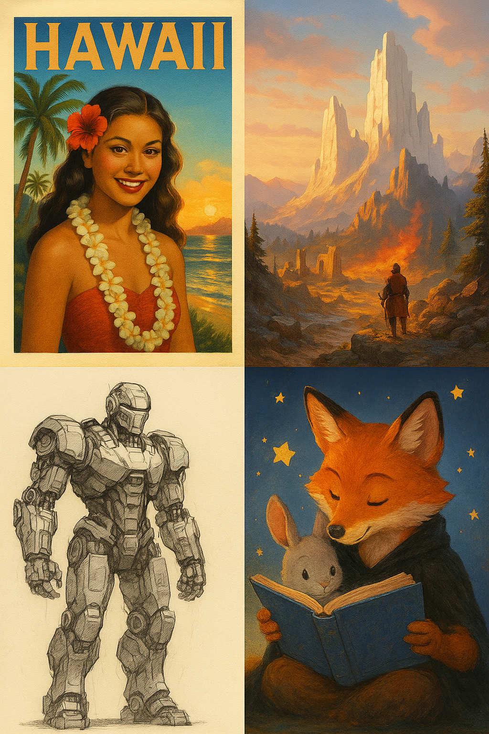
Applications Today
Digital art and illustration
Marketing and design
Concept art for games and film
Education and storytelling
Personal creativity and fun
Notes:
Artists, teachers, and marketers now use AI images as brainstorming tools and creative accelerators.

Slide 13
Future Discussion: Ethical and Social Questions
Is there a problem of (human, computational or systemic) bias in AI-generated Art?
Who owns AI-generated art?
Should artists’ work be used for training? How should they be compensated?
Can AI images spread misinformation?
How do we credit or label AI content?
Notes:
These questions are vital.
As AI creativity grows, so does our responsibility to use it wisely.

Slide 14
Industry Leaders
OpenAI – DALL·E 3
Stability AI – Stable Diffusion (Open Source, Competitor)
Midjourney – art-focused, community-based (Silicon Valley Start Up, Competitor)
Adobe – Firefly in Photoshop
Imagen – Google Competitor
Nano Banana – Google Competitor (New)
Notes:
These are the names shaping the field.
DALL·E and Midjourney for public creativity, Stable Diffusion for open-source innovation, Adobe for commercial integration.

Slide 15
Future of AI Image Generation
Toward video and 3D generation
Greater control and personalization (like Nano Banana)
Built-in ethical guardrails
Integration with virtual and augmented reality
Notes:
The next step is not just static art — it’s living, moving, immersive visuals.

Slide 16
Part 2: World Models
So far: AI can “create” a static image… but that’s trickery and training
A (conceptual) world model can help an AI plan

Slide 17
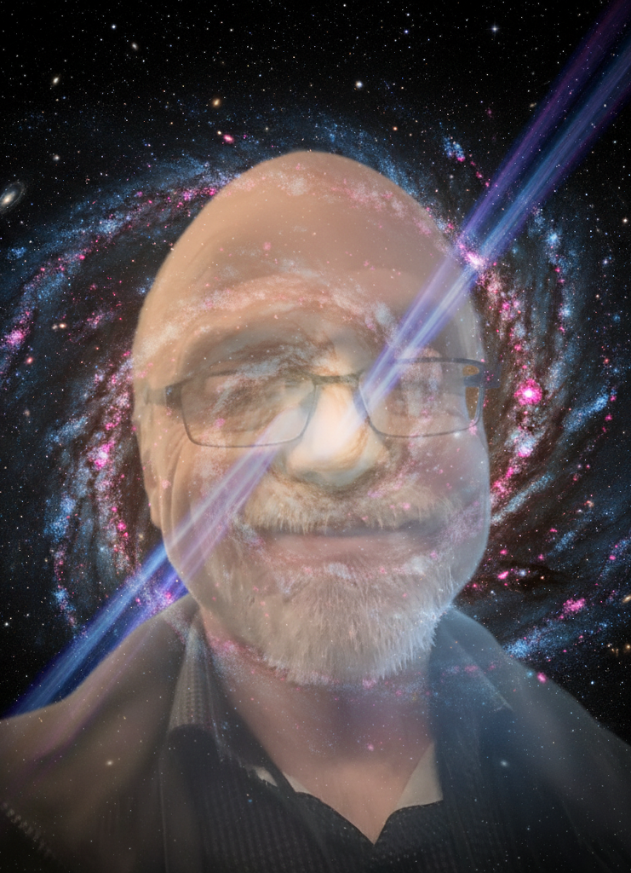
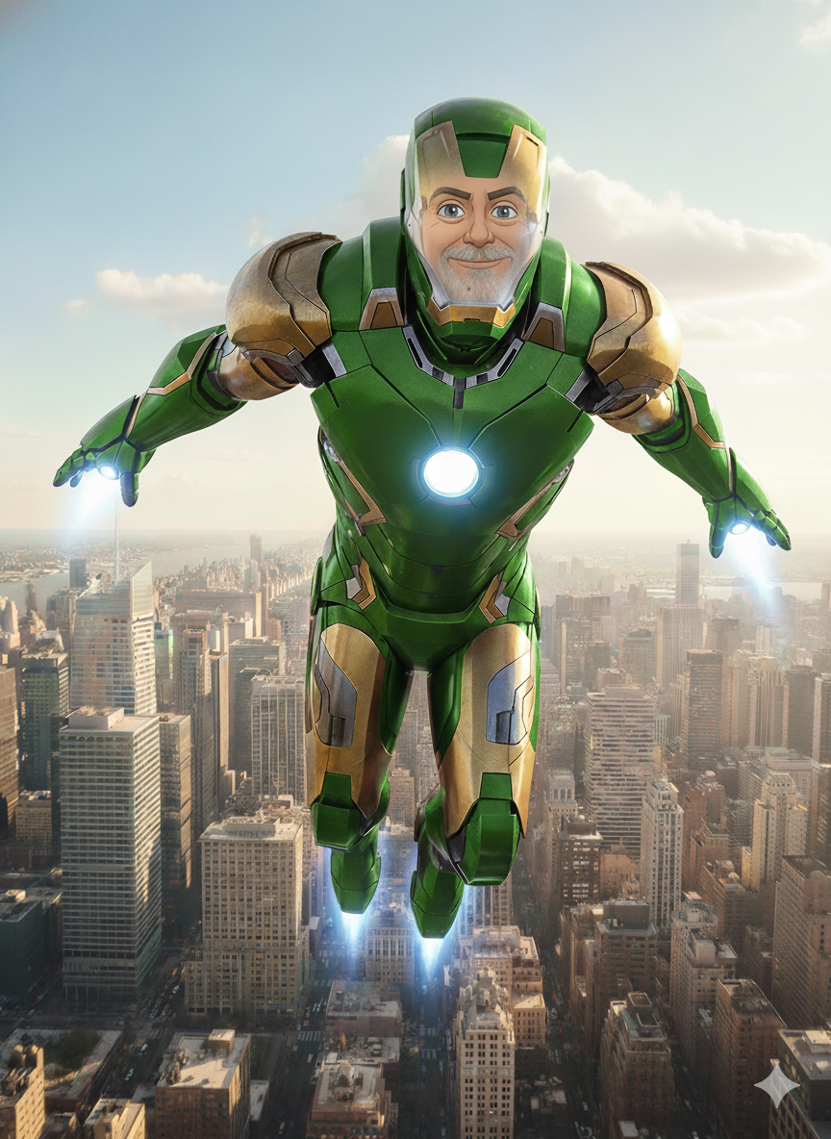
For Fun: Try it yourself
Kevin Stratvert Video
https://gemini.google.com

