Slide 1
Discussion Week 1
MIS3536: Info Sys Innovation with AI
Jeremy Shafer
jeremy@temple.edu
https://community.mis.temple.edu/jshafer
Unless otherwise indicated, all decorative images are by Unknown Author and licensed under CC BY-NC

Slide 2
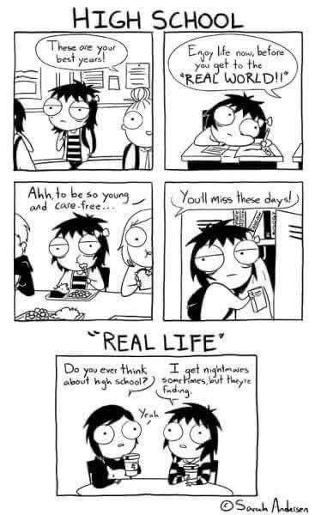
Just for fun…

Slide 3
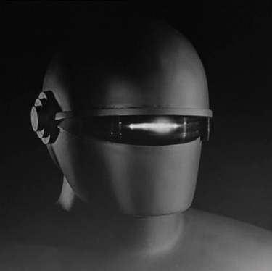
Gort
This robot was the “big bad” in the 1951 film “The Day the Earth Stood Still”.
Or .. Was he?
This Photo by Unknown Author is licensed under CC BY-SA

Slide 4
House points
How I plan to manage participation …

Slide 5
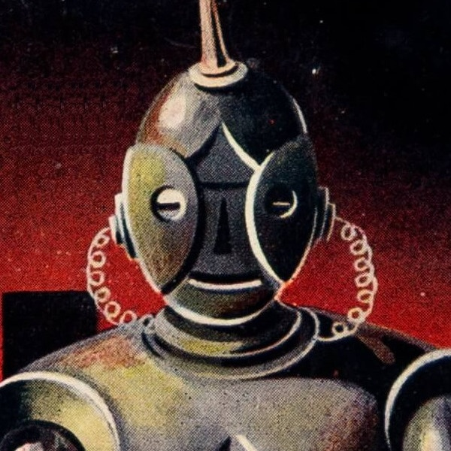
Discussion 1 – “The Fun they Had”
I hope you actually read the story.
Laptops and phones away, please.
First question(s):
What was the story about?
How did it make you feel?
Why?
This Photo by Unknown Author is licensed under CC BY-SA

Slide 6
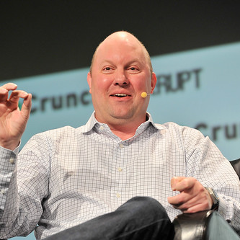
Discussion 2 – The Techno-Optimist Manifesto
What was it about? How did it make you feel? Why?
This Photo by Unknown Author is licensed under CC BY

