Slide 1
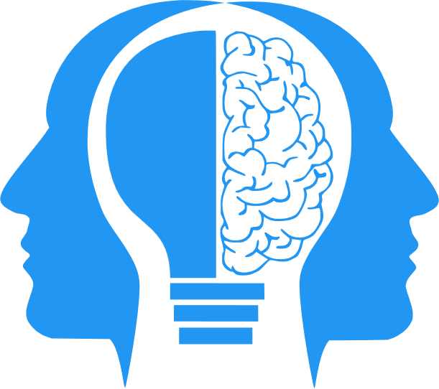
LLMs (Large Language Models)
MIS3536: Info Sys Innovation with AI
Jeremy Shafer
jeremy@temple.edu
https://community.mis.temple.edu/jshafer
Unless otherwise indicated, all decorative images are by Unknown Author and licensed under CC BY-NC

Slide 2
Large Language Models (LLMs)
LLMs rely on Neural Networks.
LLMs and Neural Networks are not the same thing.
LLMs are (arguably) the most popular implementation of Neural Networks
https://youtu.be/R9OHn5ZF4Uo?si=RExtK5tbOKlYrcn3

Slide 3
“Attention”
LLMs as they popularly exist today use what is known as an “attention mechanism”.
An “attention mechanism” seeks to determine the significance of a word (or token) as it appears in a string.
For instance, in the sentence "The cat sat on the mat, and it looked fat," the attention mechanism helps the model understand that "it" refers to "the cat," not "the mat."

Slide 4
“Attention”(2)
There are many models for determining attention. But the modern explosion in LLM functionality can be traced to what is called the “transformer model” and the “transformer architecture”
The transformer architecture, introduced by the paper "Attention is All You Need" (2017) by A Vaswani revolutionized the landscape of AI. Key ideas from that paper:
You don’t need a more complicated model to get better attention, you need a model that can grow with more hidden layers.
Your attention process must evaluate input sequences in parallel (rather than sequentially).

Slide 5
More Terminology
Weights – numeric measure of strength between neurons. Weights are also called “parameters”. It's common to hear about "model size" or "number of parameters", which refers to the total number of these weights (or coefficients) in the model.
Bias – Here we use the word “bias” in a different way. We are just talking about an extra parameter added to the activation function.
Training – Multiple iterations of forward propagation, error calculation, and backward propagation.
Tokens – Tokens can be thought of as the individual "building blocks" of text. For example, if the input text is the sentence "Hello world", the tokens might be: "hello ", " ", "world"

Slide 6
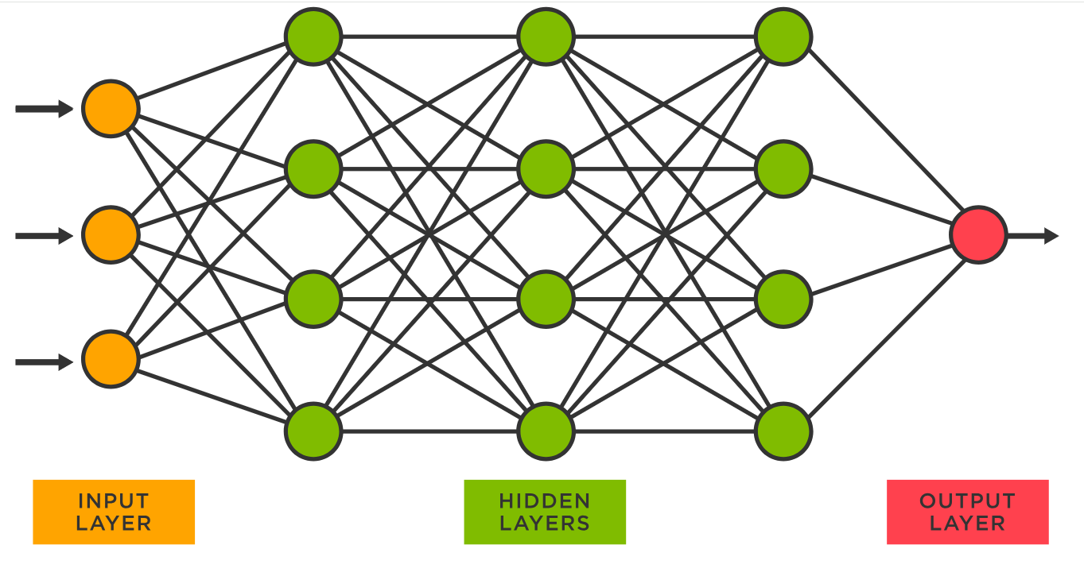
LLMs illustrated
Each circle represents a neuron with each one connected to other neurons in the next layer via programmable parameters that are adjusted as the model ‘learns’ to do the desired task.
“Learning” is implemented by the adjusting parameters in the hidden layer. The parameters are coefficients in a big math problem used to predict the values in the next layer.
GPT-3 was trained on a neural network with 96 layers and 175 billion parameters. GPT-4 reportedly has 1 trillion parameters.
Sources
https://www.spotfire.com/glossary/what-is-a-neural-network
https://pub.towardsai.net/building-intuition-on-the-concepts-behind-llms-like-chatgpt-part-1-4cb6654ab67

Slide 7
LLMs illustrated again (2)
Moving from input ( on the left ) to output ( on the right ) is called forward propagation.
Error is calculated at the output layer. If the error is “bad” then we need to move from right to left through the hidden layer, adjusting the parameters.
That is called backward propagation.
Speaking casually, the parameters of the hidden layer are essentially the same as the weights of the hidden layer.
Technically speaking, each individual parameter is a function of a weight, and another value called bias.
Sources
https://www.spotfire.com/glossary/what-is-a-neural-network
https://pub.towardsai.net/building-intuition-on-the-concepts-behind-llms-like-chatgpt-part-1-4cb6654ab67

Slide 8
Terminology recap
Forward propagation - forward propagation computes the predicted output based on the current state of the network’s weights and biases. Make a prediction! (No learning happens here.)
Backward propagation - Adjusts the weights based on the errors. (This is where the learning happens.)

Slide 9
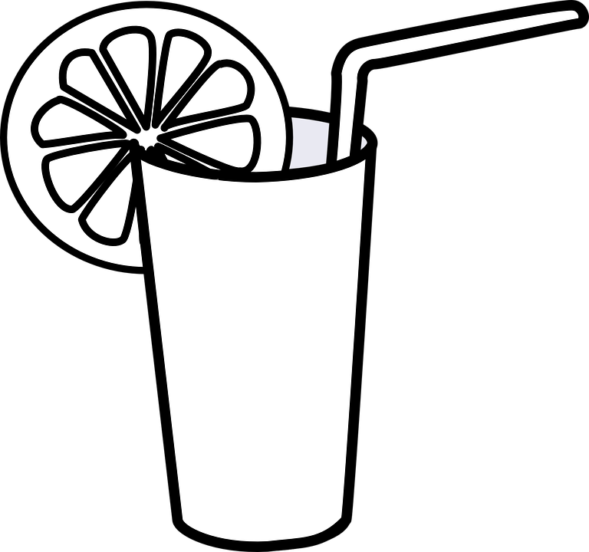
Where do LLMs fit?
The “official” 3 steps of M.L.
#1 Data Collection
#2
Data Cleaning
#3 Model Training
Evaluation
Manage Bias
Documentation
Consistency
Dimension Reduction
Manage Bias
Supervised
Regression
Decision Tree
K-NN (Recommender)
Bayesian Classification
Unsupervised
K-Means Cluster
Manage Bias
L.I.M.E.
Visualization
Dimension Reduction
Manage Bias

Slide 10
A Neural Network could be used for either…
Supervised Learning: In supervised learning, neural networks are trained on a labeled dataset, where each input comes with a corresponding target output. The network learns to predict the output from the input data by minimizing the difference between its predictions and the actual targets during training. Examples of supervised learning tasks include classification and regression.
Unsupervised Learning: Neural networks can also be used for unsupervised learning, where the training data does not include any labels. In this case, the network tries to learn useful patterns or features from the data itself without any explicit guidance on the output. Examples of unsupervised learning tasks include clustering, dimensionality reduction (e.g., autoencoders), and generative modeling.
So… neural networks are not exclusively unsupervised machine learning models. But their most exciting / intriguing / popular use cases are for “unsupervised” learning.

Slide 11
Shafer’s Semi-Supervised Roadmap (v1.4)
The “official” 3 steps of M.L.
#1 Data Collection
#2
Data Cleaning
#3 Model Training
Evaluation
Manage Bias
Documentation
Consistency
Dimension Reduction
Manage Bias
Supervised
Regression
Decision Tree
K-NN (Recommender)
Bayesian Classification
Unsupervised
K-Means Cluster
Neural Networks (as most commonly used)
Manage Bias
L.I.M.E.
Visualization
Dimension Reduction
Manage Bias

Slide 12
How are LLMs compared and talked about?
Training size: The amount of data used to train the model can impact its performance and capabilities.
Accuracy: The model's ability to correctly predict or generate text.
Inference speed: The speed at which the model can generate text, which can be important for real-time applications.
Memory usage: The amount of memory required to store and run the model, which can impact hardware requirements.
The number of parameters: that is, all the weights (a.k.a coefficients) and biases in the model.
The size of the context window: the number of tokens.

Slide 13
Comparison of LLMs
A good resource is HELM at Stanford
(A Holistic Evaluation of Language Models)
https://crfm.stanford.edu/helm/lite/latest/#/leaderboard

