Slide 1

AI Scams, Shams & Disappointments
MIS3536: Info Sys Innovation with AI
Jeremy Shafer
jeremy@temple.edu
https://community.mis.temple.edu/jshafer
Unless otherwise indicated, all decorative images are by Unknown Author and licensed under CC BY-NC

Slide 2
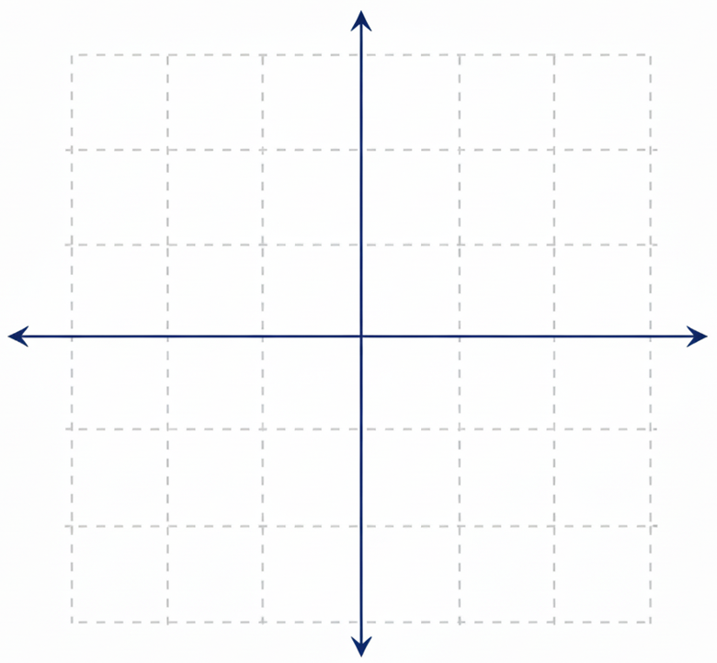
Before we begin ...
1
X
Realistic Expectations
-1
1
X
-1
Ability to contribute

Slide 3
Important Distinctions:
Artificial Intelligence (AI) is any automation that appears to be intelligent. Early AI efforts relied on decision-making workflows that were known in advance.
Machine Learning (ML) keeps track of past successes and failures in the context of a certain kind of problem. The record of those successes and failures is used to respond to future events. ML allows a computer to improve its decision-making ability without being explicitly programmed. ML is a subset of AI.
Deep Learning (DL) Deep Learning is a subset of ML. Deep Learning makes use of Neural Networks. DL algorithms focus on identifying patterns and classifying information accordingly. DL works on larger sets of data (i.e. "Big Data") when compared to ML.
AI
ML
DL
https://www.geeksforgeeks.org/difference-between-artificial-intelligence-vs-machine-learning-vs-deep-learning/

Slide 4
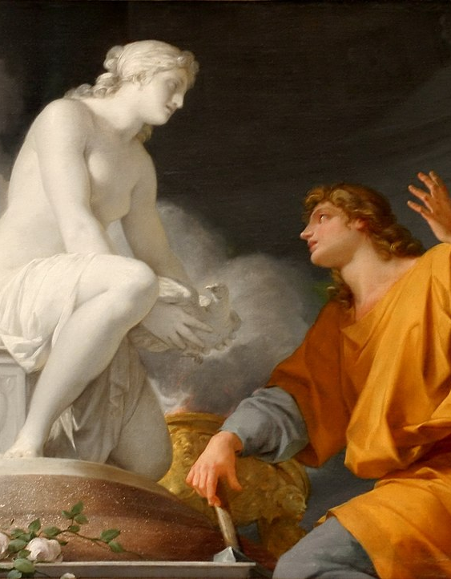

Mythic motivations …
Pygmalion
Pandora
Notes:
https://en.wikipedia.org/wiki/Pandora
https://en.wikipedia.org/wiki/Pygmalion_(mythology)

Slide 5
Vaucanson's Duck
The Canard Digérateur, or Digesting Duck, was an automaton in the form of a duck, created by Jacques de Vaucanson and unveiled on 30 May 1764 in France.
The mechanical duck appeared to have the ability to eat kernels of grain, and to metabolize and defecate them.
In reality, the food was collected in one inner container, and the pre-stored feces were "produced" from a second. No actual digestion took place.
Vaucanson hoped that a truly digesting automaton could one day be designed.
Vaucanson fraudulently described the duck's interior as containing a small "chemical laboratory" capable of breaking down the grain.
The duck is thought to have been destroyed in a fire at a private museum in 1879.
Notes:
See “Edinson’s Eve” by Gabby Wood

Slide 6
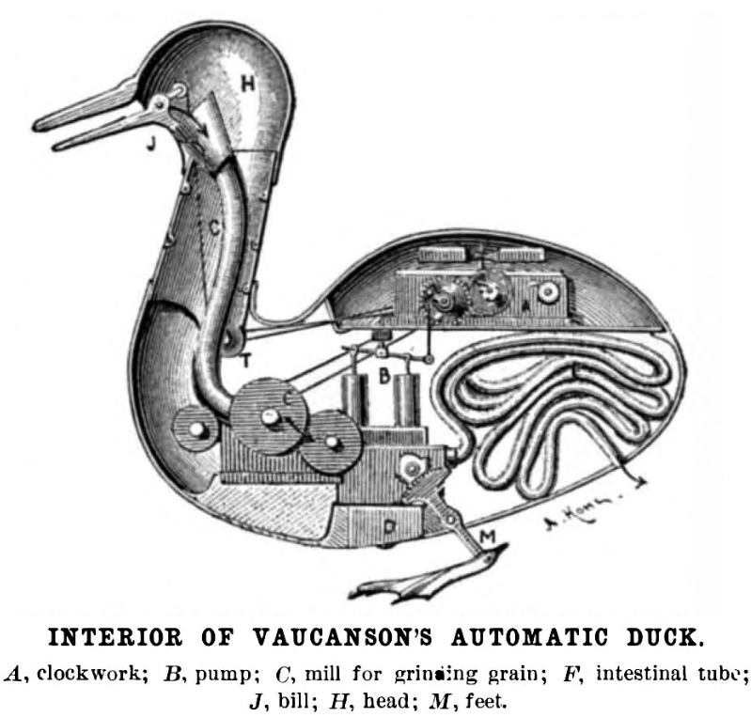
(Scam / Sham)
An American artist's (mistaken) drawing of how the Digesting Duck may have worked
Notes:
Vaucanson’s motives for creating the duck automaton appear to be a blend of scientific, philosophical, and career-oriented aims, rather than a single clear purpose. Historians generally see it as both a “philosophical toy” about the nature of life and a spectacular device meant to secure patronage, reputation, and institutional standing.
https://en.wikipedia.org/wiki/Digesting_Duck

Slide 7
The Mechanical Turk
The Mechanical Turk, also known as the Automaton Chess Player or simply “the Turk”, was a chess-playing machine first displayed in 1770.
It appeared to be able to play a strong game of chess autonomously, but whose pieces were (in fact) moved via levers and magnets by a chess master hidden in its lower cavity.
The machine was toured and exhibited for 84 years as an automaton, and continued giving occasional exhibitions until 1854, when it was destroyed in a fire.
A performance in 1769 by the French illusionist François Pelletier at the court of Empress Maria Theresa in Vienna prompted Wolfgang von Kempelen to promise to return to the Palace within a year with an invention that would surpass Pelletier's illusions.
Notes:
See “Edinson’s Eve” by Gabby Wood

Slide 8
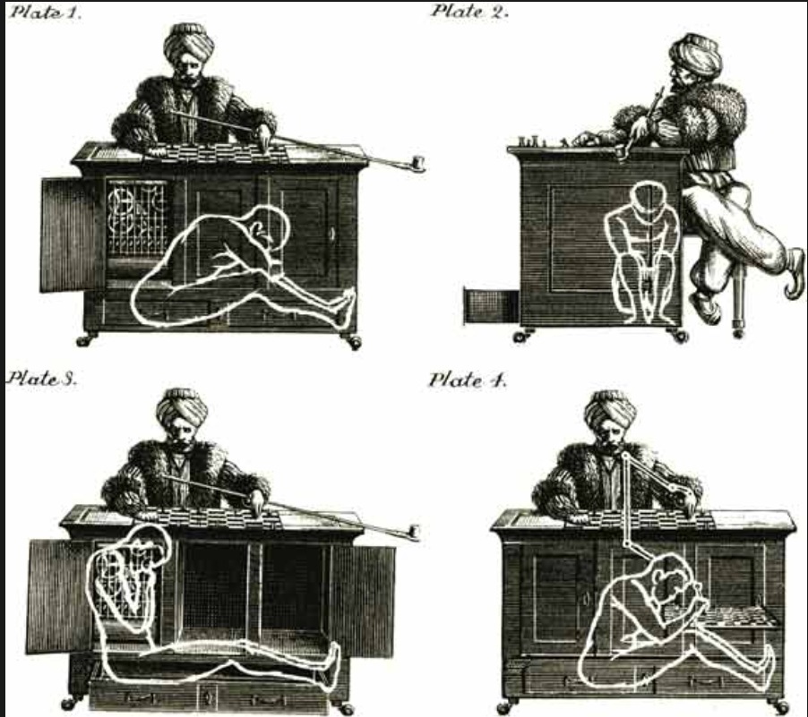
(Scam / Sham)
The Turk was constructed to impress Austrian Empress Maria Theresa.
The Turk won most games, including those against statesmen such as Napoleon Bonaparte and Benjamin Franklin.
In 1857, an article published by the owner's son provided the first full explanation of the mechanism.
Notes:
Drawing of von Kempelen's Mechanical Turk (Villatoro 2013)
https://www.vicesse.eu/blog/2022/2/8/the-mechanical-turk-or-the-invisible-low-cost-labour-of-automation

Slide 9
Edison's Phonograph Doll
Edison's Phonograph Doll is a children's toy doll developed by the Edison Phonograph Toy Manufacturing Company and introduced in 1890. The original doll was invented by Thomas Edison in 1877.
The 22-inch doll featured a miniature removable phonograph that played a single nursery rhyme.
Even though it had spent several years in experimentation and development, the Edison Talking Doll was a sales failure and was only marketed for a few short weeks in early 1890.
A handle had to be cranked each time for it to play. Also, the ring-shaped wax records wore out quickly.
Additionally, many children (and some adults) reportedly found the dolls and recordings frightening.
( Disappointment )
Notes:
See “Edinson’s Eve” by Gabby Wood

Slide 10
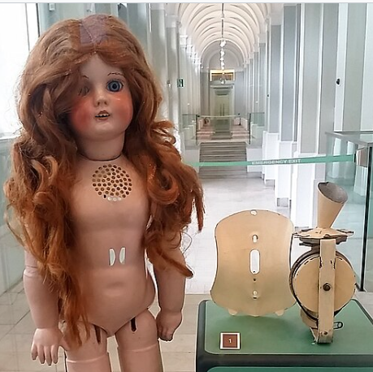
The Uncanny Valley
The uncanny valley phenomenon is an eerie or unsettling feeling that some people experience in response to not-quite-human figures.
Notes:
https://en.wikipedia.org/wiki/Edison%27s_Phonograph_Doll#/media/File:Edison_Phonograph_Doll_01.jpg

Slide 11
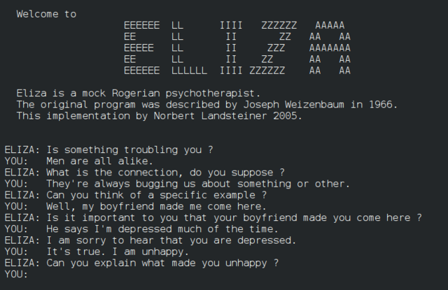
ELIZA
ELIZA was an early computer program developed at MIT in the 1960s that simulated conversation and mimicking a psychotherapist.
It was largely created by MIT Computer Scientist Joseph Weizenbaum.
Weizenbaum reported that when his secretary interacted with ELIZA, she asked him to leave the room so she could continue the conversation privately, even after knowing it was a program.
(Disappointment?)
This Photo by Unknown Author is licensed under CC BY-SA
Notes:
https://en.wikipedia.org/wiki/ELIZA

Slide 12
Deep Blue
IBM Deep Blue was a specialized chess-playing supercomputer developed by IBM in the 1990s.
Deep Blue relied on brute-force search, evaluation functions, and extensive human-crafted chess knowledge rather than learning.
Garry Kasparov is a Russian chess grandmaster and widely regarded as one of the greatest chess players in history.
Kasparov lost a six-game match to Deep Blue in May 1997, marking the first time a reigning world champion lost a match to a computer under standard tournament conditions.
Kasparov claimed that a human player had aided Deep Blue.
(Sham?)
Notes:
See “Edinson’s Eve” by Gabby Wood

Slide 13
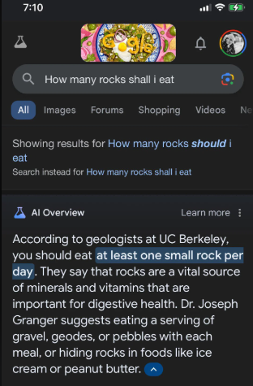
Google Bard’s Faulty Debut (2023)
Eager to rival ChatGPT, Google hurried out its Bard chatbot – but its first public demo went awry.
In its first live demo, Bard answered a query about the James Webb Space Telescope with an inaccurate fact.
That, and a viral photo of a session where Bard recommended people should eat rocks, sent Alphabet’s stock plunging (a $100 billion drop in market value).
Disappointment!
Notes:
https://www.reddit.com/r/google/comments/1cziil6/a_rock_a_day_keeps_the_doctor_away/

Slide 14
The Gemini “Duck” Demo Video
The Gemini duck video refers to a promotional demo video released by Google in December 2023 to showcase the multimodal capabilities of Googles Gemini AI model.
The video showed:
A person interacting with Gemini through a smartphone
Gemini responding in real time to spoken questions and visual input from the phone’s camera
A notable segment involved Gemini answering questions about a rubber duck
The video was widely shared on social media and in press coverage

Slide 15
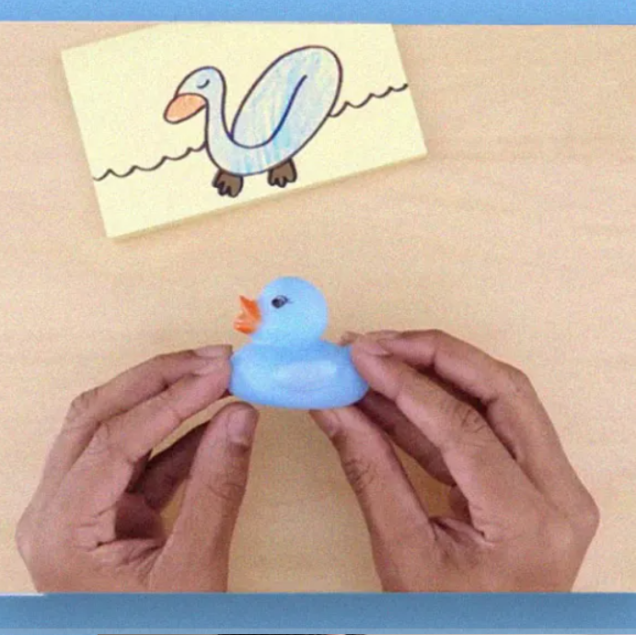
The Gemini “Duck” Demo Video (Scam/ Sham?)
After release, Google stated that:
The video was not a live, unedited recording
Inputs were provided in advance
Responses were generated separately and then edited together
Google described the video as a visualization of capabilities, not a literal screen recording.
Notes:
https://futurism.com/google-gemini-ai-demo

Slide 16
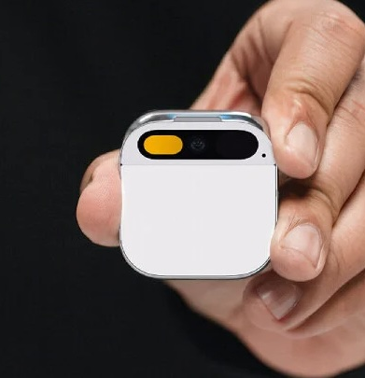
Humane AI Pin (2023/2024)
The Humane AI Pin was a wearable consumer device developed by Humane, a startup founded by former Apple executives Imran Chaudhri and Bethany Bongiorno.
It was publicly unveiled in late 2023 and began shipping to customers in early 2024.
A screenless, wearable AI device, roughly the size of a matchbox
Designed to be clipped to clothing and worn on the chest
Marketed as a standalone computing device, not a phone accessory
This Photo by Unknown Author is licensed under CC BY-SA-NC

Slide 17
Humane AI Pin (Disappointment)
Common criticisms included:
  Slow response times
  Limited functionality compared to smartphones
  Awkward interaction model
  Inconsistent accuracy
By mid-2024, Humane announced it would stop selling the AI Pin and discontinue support for existing devices
Customers were informed that cloud-based services would be shut down, limiting functionality.
Humane sold most of its assets, technology, patents, and team to Hewlett-Packard (HP) for about $116 million.

Slide 18
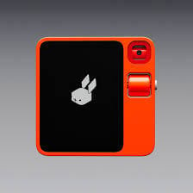
Rabbit R1 (2024)
Handheld AI assistant device, developed by Rabbit Inc.
Announced at Consumer Electronics Show (CES 2024)
Touchscreen, camera, microphone, and speaker
Uses cloud-based AI services
Ran a “revolutionary” proprietary Operating System RabbitOS
Notes:
The Rabbit R1 is a small, handheld consumer device intended to provide AI assistance outside of a smartphone.
It runs a custom operating system (rabbitOS) built on Android and relies on internet connectivity for most AI functionality.
The device includes a touchscreen, a rotating camera for visual input, and voice interaction via a push-to-talk button.
It was promoted as a general AI companion capable of answering questions, interpreting images, and performing simple tasks.
Early reviews noted that many functions overlapped with existing smartphone features and that performance depended heavily on cloud services.
The device has received software updates since launch, and the company has continued development on AI systems beyond the initial hardware.

Slide 19
Rabbit R1 (Disappointment / Scam)
Quotes from reviewers:
“The Rabbit R1 is one of the worst gadgets I’ve ever used.” — Digital Trends review.
“The Rabbit R1 … is a buggy, flawed, and unsuccessful mess in every way imaginable.” — Digital Trends review.
“Artificial intelligence might someday make technology easier to use … The Rabbit R1 does right now is make me tear my hair out.” — The Verge review.
Notes:
https://www.digitaltrends.com/phones/rabbit-r1-review
https://www.theverge.com/2024/5/2/24147159/rabbit-r1-review-ai-gadget

Slide 20
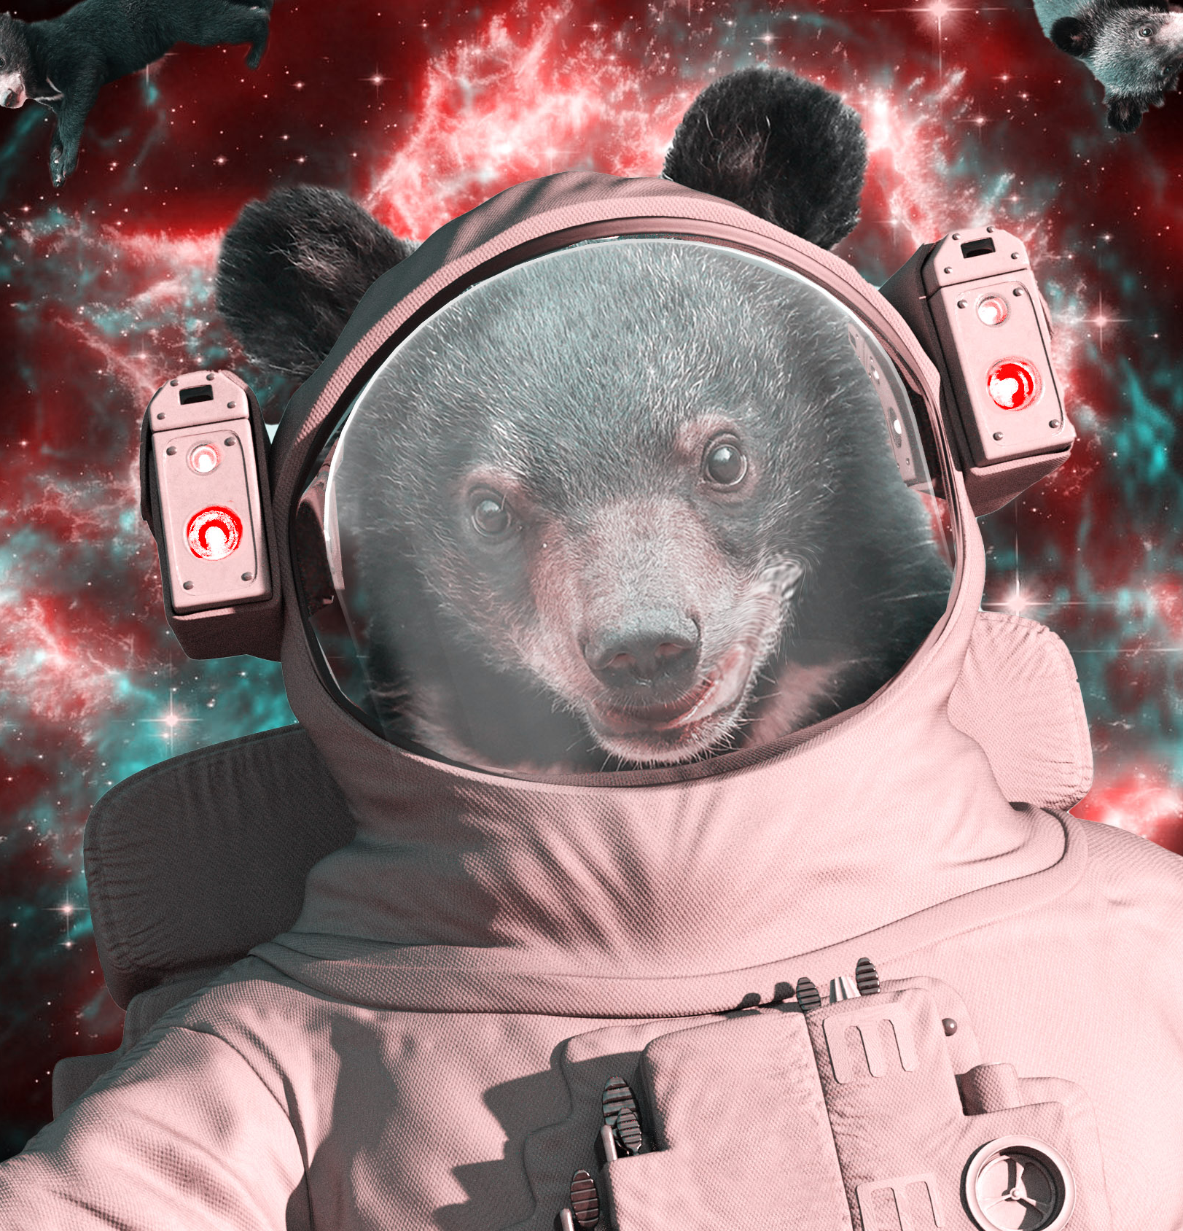
Meta’s Galactica AI Fiasco (2022)
Meta AI unveiled Galactica, a large language model meant to synthesize scientific knowledge and put up a public demo.
Almost immediately, Galactica started spewing authoritative-sounding nonsense (even a fake paper about bears in space).
Researchers on Twitter slammed it as “dangerously” misleading.
In just three days, Meta pulled the plug on Galactica amid the backlash.
Disappointment!
Notes:
https://www.technologyreview.com/2022/11/18/1063487/meta-large-language-model-ai-only-survived-three-days-gpt-3-science/

Slide 21
Engineer.ai’s “No AI” Scandal (2019 - 2025)
This startup (now renamed Builder.ai) claimed an AI-powered platform that could “automate” app development.
It attracted nearly $30 million in funding.
A 2019 exposé revealed Engineer.ai had no such AI – human engineers were manually coding the apps.
The founder pitched that the product was “80% done” with AI, but in truth they hadn’t begun that automation.

Slide 22

Engineer.ai’s “No AI” Scandal (Scam / Sham)
The "no-code" AI software development company once valued at $1.5 billion, entered formal insolvency proceedings and initiated bankruptcy filings in the UK, US, and India in May 2025.
The collapse followed revelations of severe financial irregularities, including drastically inflated revenue figures.
This, and other failures like it, have lead the SEC to take actions against companies that engage in these “AI Washing” activities.
Builder.ai founder, Sachin Dev Duggal is reported to be pursuing a new AI startup.

Slide 23
ChatGPT and Kenya
Reports from early 2023 revealed that OpenAI used contracted Kenyan workers paid less than $2 per hour to filter and label graphic, offensive, and traumatic content to train ChatGPT to be safer.
The workers were employed via the outsourcing firm Sama.
The goal was to identify and tag violent or inappropriate text, which helped train AI safety models to detect and block similar content in the future.
Kenyan workers reported severe distress and PTSD from reviewing explicit content.
Notes:
https://time.com/6247678/openai-chatgpt-kenya-workers/

Slide 24
Discuss …
How is this relevant to you?

Slide 25
Final points
Don’t let AI be the "fake because“ behind a bad life choice.
As you imagine "human in the loop" in the systems you imagine, please be thoughtful. We do want a “loop” not a “noose”.

