Slide 1
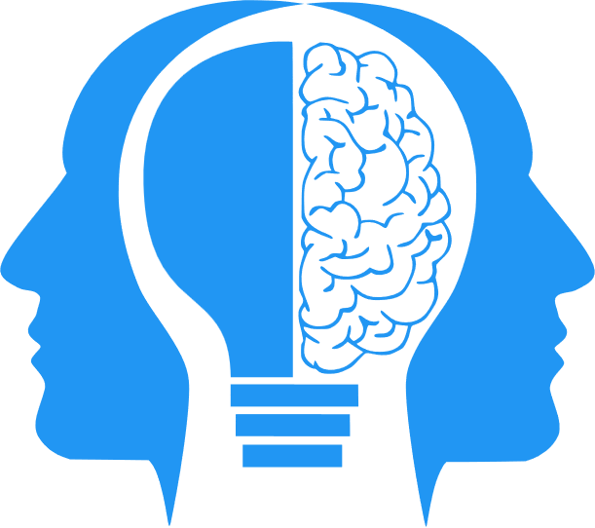
“Primitive” AI
MIS3536: Info Sys Innovation with AI
Jeremy Shafer
jeremy@temple.edu
https://community.mis.temple.edu/jshafer
Unless otherwise indicated, all decorative images are by Unknown Author and licensed under CC BY-NC

Slide 2
Learning Objectives
Reinforce the difference between AI, ML and DL
Illustrate those differences with familiar games
Understand the impact Moore’s Law on AI and Information Systems
Explore how our expectations of AI have shifted over time

Slide 3
Important Distinctions: AI, ML, DL
Artificial Intelligence (AI) is any automation that appears to be intelligent. Early AI efforts relied on decision-making workflows that were known in advance.
Machine Learning (ML) keeps track of past successes and failures in the context of a certain kind of problem. The record of those successes and failures is used to respond to future events. ML allows a computer to improve its decision-making ability without being explicitly programmed. ML is a subset of AI.
Deep Learning (DL) Deep Learning is a subset of ML. Deep Learning makes use of Neural Networks. DL algorithms focus on identifying patterns and classifying information accordingly. DL works on larger sets of data (i.e. "Big Data") when compared to ML.
AI
ML
DL
https://www.geeksforgeeks.org/difference-between-artificial-intelligence-vs-machine-learning-vs-deep-learning/

Slide 4
Primitive AI
This is AI in the broadest possible sense
Primitive AI gives the illusion of intelligence
Primitive AI does not learn
It does not store data
It does not change its behavior based on prior events
Primitive AI is wholly dependent on a pre-written program

Slide 5
But first …
A chicken:
https://www.youtube.com/watch?v=N3OqPhHAqMQ&t=48s
Let’s think:
A chicken is (sort of) intelligent.
A chicken can play Tic Tac Toe.
Therefore, if a computer can play Tic Tac Toe, then it is as intelligent as a chicken.
Discuss: Does anyone see anything wrong with that logic?

Slide 6
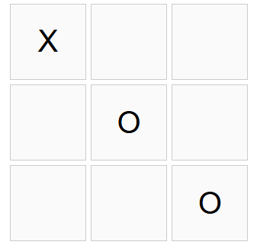
How to build a Tic Tac Toe AI
A tic tac toe board can be thought of as a nine “digit” sequence.
Each “digit” is a blank, an ‘X’, or an ‘O’.
Use the given sequence to look up the computer’s response.
That means that there are 19,683 (3^9) possible boards.
X _ _ _ O _ _ _ O

Slide 7
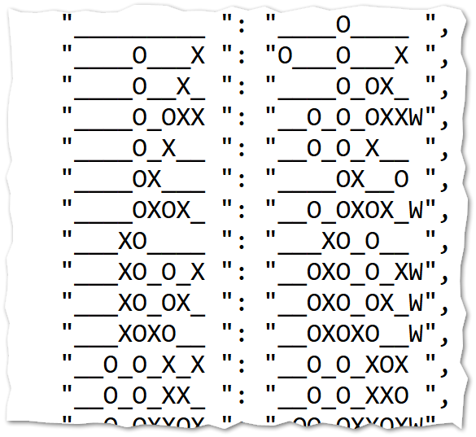
Whoops, I lied
Actually, there are a lot fewer than 19,683 valid boards
Each player takes a turn, and the game ends when you get three in a row
If you let the computer player go first you can get the number of valid combinations to under 200
There is a nice, finite number of valid boards
And a patient human being can enumerate them

Slide 8
Let’s take a look
https://misdemo.temple.edu/tictactoe

Slide 9
Discuss
What could make this game better?
How would you do it?
Can we diagram our improvements?

Slide 10
Conclusions
Primitive AI works when a problem is narrowly scoped
We can make a more satisfying experience by adding a little bit of randomness
We want to avoid the “Fallacy of the Inverse”
The “Fallacy of the Inverse” concern doesn’t stop with Primitive AI

Slide 11
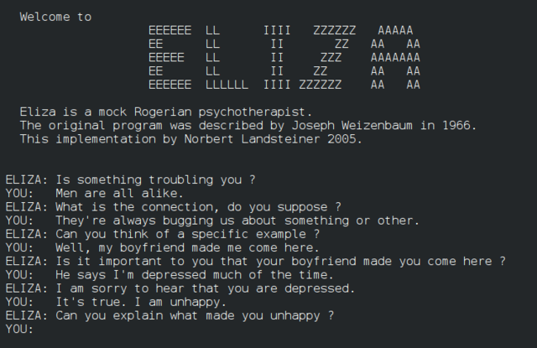
ELIZA
ELIZA was an early computer program developed at MIT in the 1960s that simulated conversation and mimicking a psychotherapist.
It was largely created by MIT Computer Scientist Joseph Weizenbaum.
Weizenbaum reported that when his secretary interacted with ELIZA, she asked him to leave the room so she could continue the conversation privately, even after knowing it was a program.
This Photo by Unknown Author is licensed under CC BY-SA
Notes:
https://en.wikipedia.org/wiki/ELIZA

Slide 12
How ELIZA works
Eliza works because speech follows patterns. Here is a simplified example:
"I want to talk about my cat, Mittens." | <- User input
"i want to talk about my cat mittens" | <- Make everything lower case, remove punctuation
"you want to talk about your cat mittens" | <- Pronoun refection. "I" becomes "you" and so on.
"Tell me why you want to talk about your cat mittens" | <- Prefix the string with a random starter

Slide 13
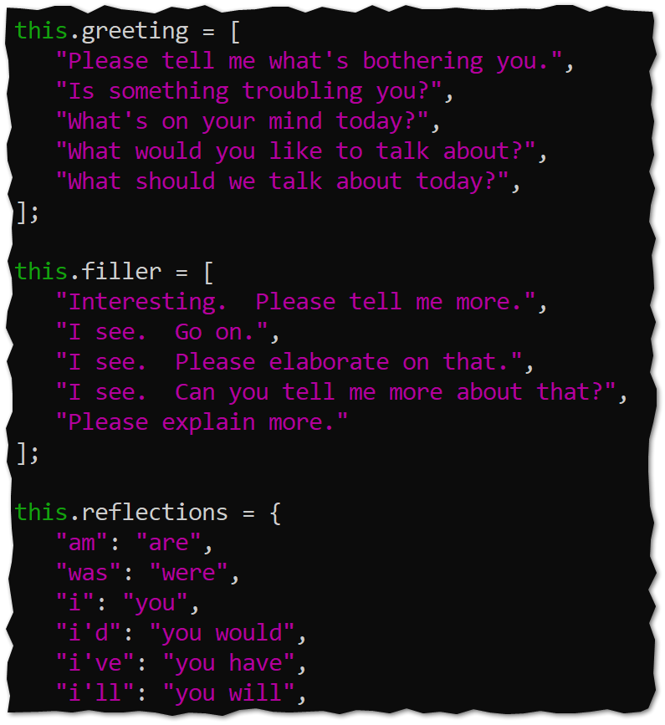
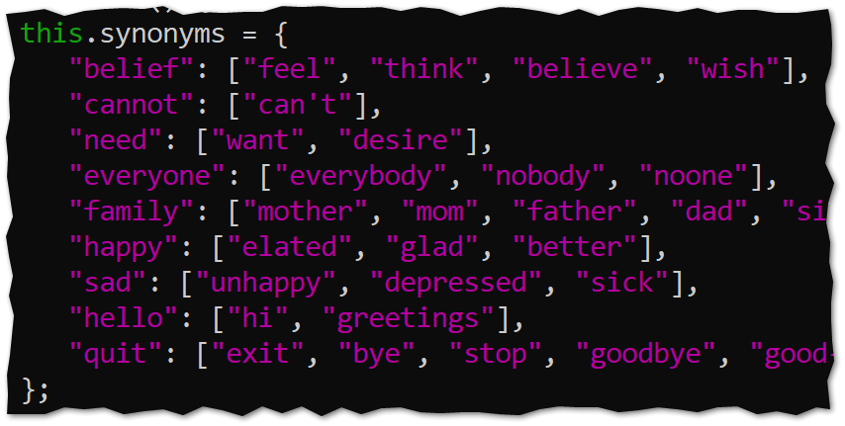
Demo Eliza
https://misdemo.temple.edu/elizademo

Slide 14
Eliza is still Primitive AI
Discuss
What would it take to Eliza more compelling?

Slide 15
Some ideas …
More phrases
Introduce weights
The moment we introduce a feedback loop where weights and phrases are being generated by user interaction and not programmer intervention.
Such a solution would cease to be Primitive AI and would become an example of machine learning.

Slide 16
An observation
AI is an incredibly broad category
Any company can truthfully state “we are using AI”
If you include Primitive AI and ML, the barrier is low!

Slide 17
Chess
The philosopher Hubert Dreyfus famously doubted that a computer could beat a human playing chess. In 1972, he his book “What Computers Can’t Do” was published. In that book he questioned the computer’s ability to serve as a model for the human brain and asserted that no computer program could defeat even a 10-year-old child at chess. https://chesspulse.com/are-chess-computers-unbeatable/
In 1968, the International Chess Master David Levy bet that no computer could beat him at chess in 10 years, and that if he did win, it would be another ten after that before a computer beat him. Levy won the bet, but in 1989, it finally happened. Deep Thought, initially created by programmers at Carnegie Mellon University, beat Levy. https://science.howstuffworks.com/innovation/big-thinkers/computer-defeat-chess-champion.htm

Slide 18
Why was chess thought to be a good benchmark for intelligence?
Because there are roughly 10¹²⁰ possible games of chess. (This is called “The Shannon number”.)
We can’t “brute force” (anticipate) all the possible board combinations like we can with Tic Tac Toe.
So … what did Hubert Dreyfus get wrong??

Slide 19
Dreyfus failed to consider …
Moore’s law
Alternate strategies

Slide 20
Moore’s Law
Moore’s law is the observation that the number of transistors in an integrated circuit doubles about every two years.
That means that our ability to store, retrieve and process data has grown exponentially since 1972!
Dreyfus wasn’t philosophically wrong. He was technologically blindsided.

Slide 21
Alternate Strategies
Chess databases allow users to search through a large library of historical games, analyze them, check statistics, and formulate a responses.
It is not necessary to enumerate every combination. You just need a robust body of rules.
A probabilistic response, combined with a large body of data, can create a very satisfying illusion of intelligence.
Even if there is no “learning” involved.

Slide 22
But.. Beware the fallacy of the inverse!
A person is intelligent.
A person can play Chess.
Therefore, if a computer can play Chess, then it is as intelligent as a person.
Right??? .. No! Wrong!

Slide 23
Key take aways
Our expectations of AI have shifted over time. We take chess playing software, speech to text, language translation and many other AI advances for granted.
Primitive AI is best for narrowly scoped problems.
Be wary of the “fallacy of the inverse” … it is still relevant today.
Probabilistic weights are important to create a convincing system.
Primitive AI is primitive because modifying it is behavior requires human intervention
The ongoing advancement of AI can be explained by Moore’s law and creative strategies for representing rules.

