Slide 1

The Gartner Hype Cycle
MIS3536: Info Sys Innovation with AI
Jeremy Shafer
jeremy@temple.edu
https://community.mis.temple.edu/jshafer
Unless otherwise indicated, all decorative images are by Unknown Author and licensed under CC BY-NC

Slide 2
Innovation, Technology, Hype and Maturity
This course is about AI
This course is about Information Systems
This course is about Innovation
Can anyone give me an example of a disruptive innovation?
Notes:
You may have noticed that new technologies come and go. Sometimes you learn about the next big thing, only to learn a year or two later that it didn't really catch on. Meanwhile other technologies rise in prominence and disrupt entire industries. Can anyone remember a technology first?

Slide 3
About Gartner
Gartner, Inc. is a global research and advisory company (founded 1979) headquartered in Stamford, Connecticut.
It provides insights and analysis to help business and IT leaders make informed decisions. Gartner research outputs include well-known frameworks and tools like the Hype Cycle, which evaluate technologies and market trends.
FUN FACT: Did you know that as a Temple student you have access to Gartner research? See: https://gartner.temple.edu
Notes:
There is also the Magic Quadrant which compares completeness of vision and ability to execute.

Slide 4
Where did the Hype Cycle come from?
The Gartner Hype Cycle framework was first introduced in 1995 by Gartner analyst Jackie Fenn.
Fenn observed a recurring pattern in the maturity of emerging technologies – from early excitement through disappointment to eventual productivity. She dubbed this pattern a "hype cycle" and created a graph with stages from an initial Technology Trigger up to a Plateau of Productivity
The first hype cycle chart appeared in a Gartner research report and was so well-received that it evolved into an annual Gartner report on emerging technologies.
Notes:
There is also the Magic Quadrant which compares completeness of vision and ability to execute.

Slide 5
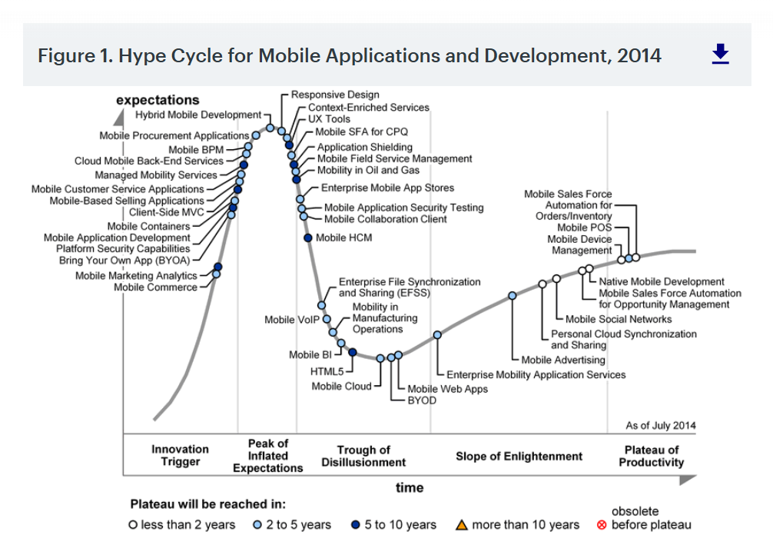
A Sample Hype Cycle
The vertical axis represents expectations (or public visibility/enthusiasm), and the horizontal axis represents time.
In a hype cycle, a new technology's expectations typically rise sharply, then crash, and eventually climb again more gradually as the technology matures.
Notes:
For example, an innovation might start with a burst of excitement (driven by media and early success stories), then face a period of disillusionment when it fails to meet inflated expectations and finally recover and stabilize as its real-world value is proven. Each technology thus passes through five stages: beginning with an Innovation Trigger, climbing to a Peak of Inflated Expectations, plunging into a Trough of Disillusionment, rising along a Slope of Enlightenment, and ultimately reaching a Plateau of Productivity.

Slide 6
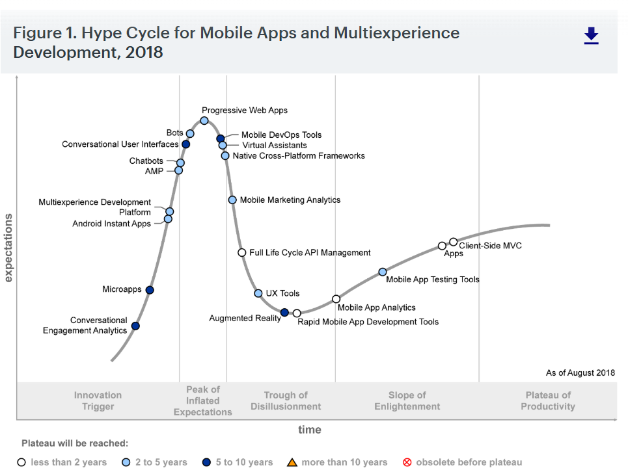
A few years later…
Notes:
For example, an innovation might start with a burst of excitement (driven by media and early success stories), then face a period of disillusionment when it fails to meet inflated expectations and finally recover and stabilize as its real-world value is proven. Each technology thus passes through five stages: beginning with an Innovation Trigger, climbing to a Peak of Inflated Expectations, plunging into a Trough of Disillusionment, rising along a Slope of Enlightenment, and ultimately reaching a Plateau of Productivity.

Slide 7
Phases 1 and 2
Innovation Trigger: A breakthrough, technology trigger or public demo sparks interest. There is early proof-of-concept and media hype, but no functional products yet (commercial viability is unproven).
Peak of Inflated Expectations: A wave of excitement builds and expectations become inflated.
Early publicity yields some success stories – along with many failures.
Companies may rush in due to FOMO (fear of missing out), leading to over-enthusiasm and unrealistic projections.

Slide 8
Phases 3 and 4
Trough of Disillusionment: Reality sets in as trials and implementations fail to meet the hype.
Interest wanes, and many providers or projects fall short or collapse.
Some producers abandon the technology when it doesn't deliver as promised.
Only the credible or resilient innovations persist through this downturn.
Slope of Enlightenment: The technology's practical benefits gradually become clearer. Second- and third-generation products appear, fixing earlier issues.
More organizations experiment in pragmatic ways, learning where the technology is useful and where it is not.
Adoption begins to rise again, driven by real-world improvements (not just hype).

Slide 9
Phase 5
Plateau of Productivity: Mainstream adoption takes off – the technology becomes stable, widely understood, and productive.
Its benefits are proven and accepted, so it enters everyday use.
Criteria for success and best practices are well-defined, and a market standard forms.
At this stage, the technology is no longer "new"; it's an expected part of business or life, delivering real value (e.g. widely deployed essential infrastructure)
Often, at this stage, the technology is more of a commodity than an advantage

Slide 10
A Technology at the Plateau of Productivity
One relatable example of a technology that has reached the plateau stage is Cloud Computing. A decade or so ago, "the cloud" was an emerging concept surrounded by much hype and early skepticism (especially about security and reliability).
Notes:
Over time, those issues were overcome and the benefits became clear – today cloud computing is considered a mature, essential infrastructure for businesses. Services that students use every day, like streaming video (Netflix) or online document storage (Google Drive), run on cloud platforms – yet people now take them for granted as standard utilities. This shows how an initially hyped technology can move through the hype cycle and eventually stabilize into productive mainstream use at the Plateau of Productivity.

Slide 11
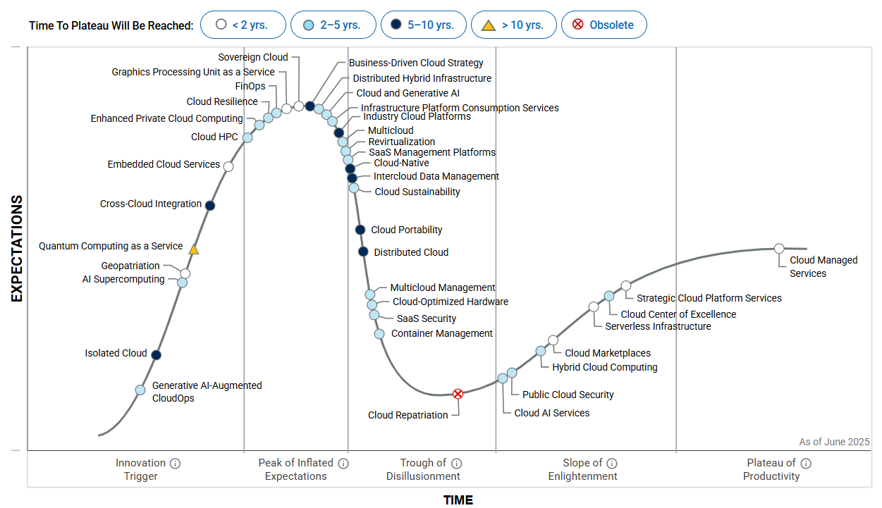
The latest Hype Cycle for Cloud Computing
Notes:
For example, an innovation might start with a burst of excitement (driven by media and early success stories), then face a period of disillusionment when it fails to meet inflated expectations and finally recover and stabilize as its real-world value is proven. Each technology thus passes through five stages: beginning with an Innovation Trigger, climbing to a Peak of Inflated Expectations, plunging into a Trough of Disillusionment, rising along a Slope of Enlightenment, and ultimately reaching a Plateau of Productivity.

Slide 12
Where are we now?
Work in groups
Pick a well-known application of AI
Discuss where that application is in terms of the Hype Cycle

Slide 13
Criticisms (1)
The Hype Cycle is descriptive, not predictive. It shows a pattern but not timing or certainty
Stage placement can be subjective – relies on analyst judgment.
Not all technologies follow the same curve – some stall or evolve differently
Focuses on expectations, not business value or ROI
Can reinforce herd behavior instead of independent analysis
Notes:
- **Descriptive, not predictive**
- Shows a common pattern, but doesn’t reliably predict *when* (or if) a technology will advance.
- **Stage placement can be subjective**
- Based on analyst judgment; not fully transparent or reproducible like a scoring model.
- **Not all technologies follow the same curve**
- Some improve steadily with little hype; others stall, merge into other tech, or disappear.
- **Focuses on “expectations,” not business value**
- High hype doesn’t guarantee ROI; low-hype technologies can be highly profitable and strategic.
- **Can reinforce herd behavior**
- Organizations may adopt/avoid tech because of the chart, instead of doing context-specific evaluation.

Slide 14
Criticisms (2)
Biased towards “big tech” players with established relationships with Gartner. (Shafer’s observation.)
Bottom line: The Hype Cycle is a *conversation starter* and *risk-awareness tool*—not a one stop shop for decision making.

Slide 15
References
Gartner, Inc. (n.d.). Gartner IT glossary: Hype Cycle. https://www.gartner.com/en/information-technology/glossary/hype-cycle
Gartner, Inc. (n.d.). Gartner Hype Cycle research methodology. https://www.gartner.com/en/research/methodologies/gartner-hype-cycle
Gartner, Inc. (n.d.). Understanding Gartner Hype Cycles. https://www.gartner.com/en/research/hype-cycles
Fenn, J., & Raskino, M. (2008). Mastering the hype cycle: How to choose the right innovation at the right time. Harvard Business Press.

Slide 16
References / Criticisms and Limitations
Dedehayir, O., & Steinert, M. (2016). The hype cycle model: A review and future directions. Technological Forecasting and Social Change, 108, 28–41.
Borup, M., Brown, N., Konrad, K., & Van Lente, H. (2006). The sociology of expectations in science and technology. Technology Analysis & Strategic Management, 18(3–4), 285–298.
Steinert, M., & Leifer, L. (2010). Scrutinizing Gartner’s hype cycle approach. In Proceedings of the International Conference on Engineering Design (ICED).

