Slide 1
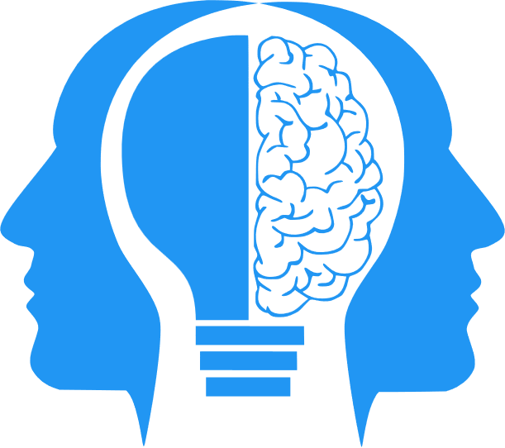
Inference and Machine Learning
MIS3536: Info Sys Innovation with AI
Jeremy Shafer
jeremy@temple.edu
https://community.mis.temple.edu/jshafer
Unless otherwise indicated, all decorative images are by Unknown Author and licensed under CC BY-NC

Slide 2
Learning Objectives
Primary Objective: Understand how (simple) inference contributes to Machine Learning (ML)
Secondary Objectives
Introduce 2 UML diagrams
Establish the ability to run a Python script
Introduce the three fundamental stages of ML development
Understand the difference between ANI, AGI, and ASI
Introduce Scaling Laws

Slide 3
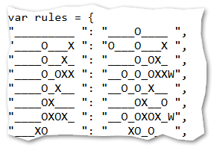
But first …
Tic Tac Toe again https://misdemo.temple.edu/tictactoe
Last class we subtly introduced a big idea
Our Tic Tac Toe game worked on a collection of rules
The rules were expressed as an object
There’s no reason those rules couldn’t be dynamically changed over time
A human programmer would not need to write new code to make the updated rules work

Slide 4
Last time …
We saw that ‘Primitive’ AI worked well on narrowly scoped problems. This kind of intelligence is called Artificial Narrow intelligence (ANI).
In addition to ANI, there’s also AGI, and ASI.

Slide 5
ANI, AGI, ASI
ANI, Artificial Narrow Intelligence
What we have today. Primitive AI, ML and DL are all still considered ANI.
AGI, Artificial General Intelligence
This AI would at least match or surpass human intelligence across all cognitive tasks
ASI, Artificial Super Intelligence
This AI would outperform the best human abilities across every problem domain

Slide 6

Today …
We will start today with simple inference. A lot of the Statistics discipline concerns itself with inference.
Inference is an attempt to determine something unknown (like, the true nature of a whole population) by examining something that is known (a sample).
When we have tools for making an inference, we can often repurpose them to make a prediction.
For example, if I determine that, in the past, pizza sales volume goes up on the day of a big football game, then I can predict that what will happen in the future. When the next big game comes around, I know to prepare for the extra pizza demand.
This Photo by Unknown Author is licensed under CC BY-NC

Slide 7
Chi Square
https://www.youtube.com/watch?v=VskmMgXmkMQ
Nominal data is a type of categorical or qualitative data used to label variables into distinct bins.
The point here is that statistical tests exist that can determine the strength of the correlation between two variables.
Note: I really like the Chi-square test because it is non-parametric. That is, it makes no assumptions about the underlying data distribution.

Slide 8
Let’s take a look
Action Steps
Introduce the scenario
Clean up the data
Make a single inference

Slide 9
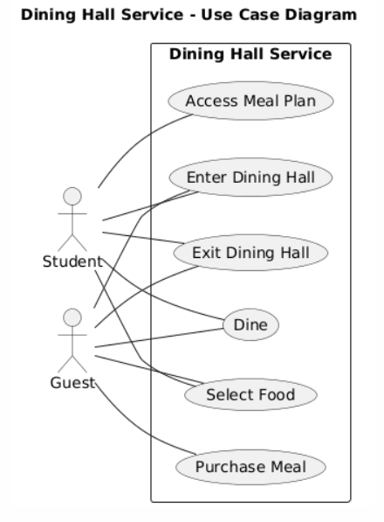
UML Diagram / Use Case Diagram(s)
A use case diagram shows who can do what with the system, not how it is implemented.
In this diagram, there is no automation, and no software system . The dining hall itself is the system.
For simplicity, I have left out the dining hall management and staff.

Slide 10
I can determine a single correlation!
Big deal. So what?
I have all these columns of data? How do I know which ones are important?
And what happens when there is interplay between the columns.
That all seems like a lot of work.
It is. That’s why we have computers.
Like, what if it is game day and there is a snowstorm?

Slide 11
Let’s take another look
More Action Steps
Create a Decision Tree
Examine trees of different depths
Discuss Scaling Laws

Slide 12
Two Fundamental Scaling Laws
More training data yields greater accuracy.
More model complexity (depth) yields greater accuracy.

Slide 13
The 3 Steps of Machine Learning
Data Collection
Data Cleaning
Model Training

Slide 14

But wait, there’s more…
The three steps are powerful, but the process gets more powerful when you automate model retraining. Remember, it’s not really ML if a human programmer must regularly rewrite code!

Slide 15
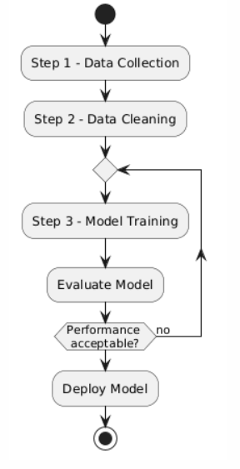
Model Training
UML Diagram / Activity Diagram

Slide 16
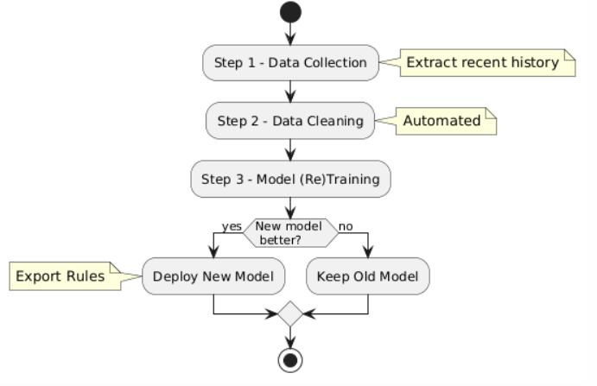
Model Maintenance
UML Diagram / Activity Diagram

Slide 17
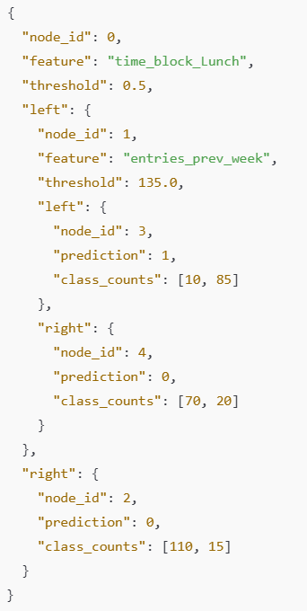
How is Automated Retraining Possible?
It becomes possible when rules are expressed as data (not written in programming code).

Slide 18
Conclusion
In this class, we learned how a statistical test can be iteratively applied to a body of data, with the aim of building a Decision Tree.
A Decision Tree can be expressed as a collection of rules.
This approach makes it possible to build systems that can be trained once and then retrained without explicit human programming.
These systems “learn” and improve on their own based on data collected over time.
This is Machine Learning.

Slide 19
Other important things we have seen today
The 3 stages of Machine Learning
A UML Use Case Diagram
A UML Activity Diagram
The 2 most fundamental scaling Laws
The difference between ANI, AGI, and ASI

