Slide 1
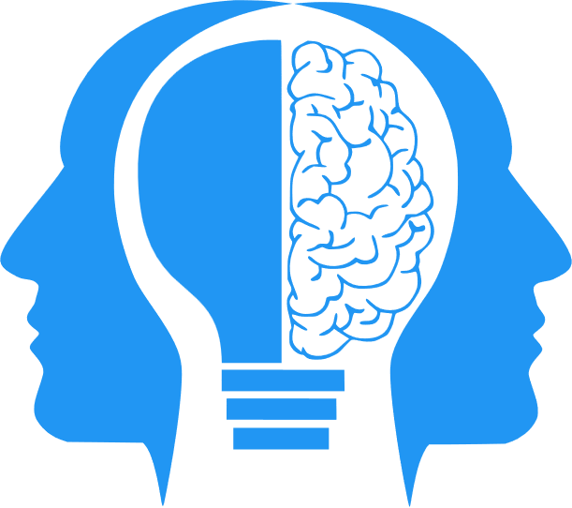
Managing Bias
MIS3536: Info Sys Innovation with AI
Jeremy Shafer
jeremy@temple.edu
https://community.mis.temple.edu/jshafer
Unless otherwise indicated, all decorative images are by Unknown Author and licensed under CC BY-NC

Slide 2
Agenda
My primary source of information for this lecture
Thinking about bias
Talk about technique
Notes:
NIST is the National Institute of Standards and Technology at the U.S. Department of Commerce. The NIST Cybersecurity Framework helps businesses of all sizes better understand, manage, and reduce their cybersecurity risk and protect their networks and data. The Framework is voluntary.

Slide 3
Today’s lecture is brought to you by…
NIST special publication 1270
Towards a Standard for Identifying and Managing Bias in Artificial Intelligence
Published in March of 2022 (Pre ChatGPT3.5)
NIST is short for National Institute of Standards and Technology (which is under the U.S. Department of Commerce)
You can read the whole thing here.

Slide 4
Why bias in AI is important
Consumers are using AI and are being influenced by AI already
AI has influence over many facets of life, large and small.
For example:
  Where will I go to college? Will my application be accepted?
  Will my mortgage application be accepted?
  Will I get a job interview?
  What video will I watch next?
  eHarmony? Match.com?
  What medication will I be prescribed?

Slide 5
Another reason bias is important…
There are laws and regulation in the U.S. (and elsewhere!) addressing discrimination and fairness, especially in the areas of consumer finance, housing, and employment.
Breaking the law is a bad (and costly) thing.
There is no consistent, universal or standardized method used by regulators and courts to assess or measure unacceptable bias across all areas.
Sometimes courts will use statistical tests to evaluate evidence of disparate impact.

Slide 6
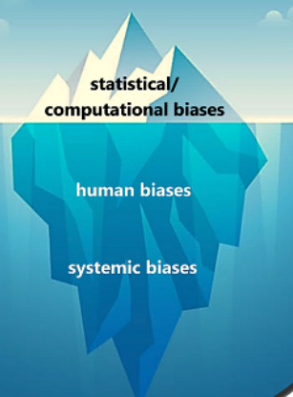
There are different kinds of bias

Slide 7
(1) Statistical/computational bias:
“Statistical and computational biases stem from errors that result when the sample is not representative of the population.
“These biases … can occur in the absence of prejudice, partiality, or discriminatory intent.”
Notice that this is the “tip of the iceberg” bias. It’s relatively easy to discover and conclusively determine.

Slide 8
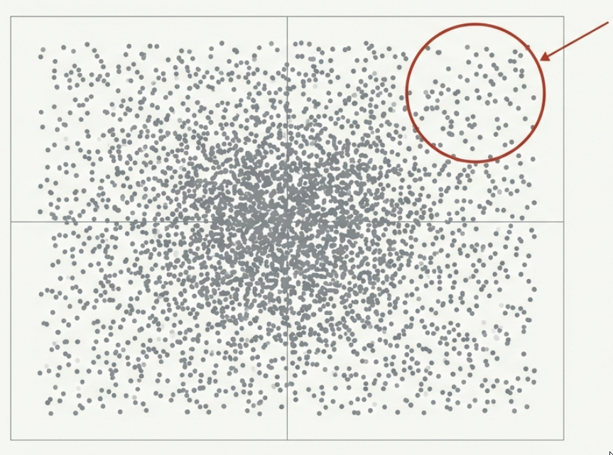
An Example of Statistical Bias
Sampling Bias:
Inferential statistics depend on the notion that, given a sufficiently large random sample, useful inferences can be made about a whole population.
When the sampling is bad, the inferences are biased towards the sample, and not representative of the whole population. A “bad” sample is either too small or not random.

Slide 9
Another Example of Statistical Bias
Measurement Bias: In the case of measurement bias, the problem is not with the sample, but rather the instrument used to measure the sample. The “instrument” could be anything from a device (like a thermostat or sensor) to a survey.
For example:
A survey instrument about cancer that includes questions about smoking, but not other tobacco products, could introduce measurement bias.
The presence of cancer would be incorrectly attributed to other survey questions, when in fact it should be attributed to chewing tobacco.
Notes:
Another real-world example – sadly from research into fetal alcohol syndrome. In some communities, a beer every night is not considered “drinking” while medically it most certainly is!

Slide 10
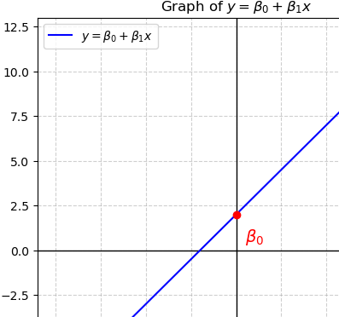
Side Note!
The word “bias” is used in a variety of ways. (How frustrating!)
In mathematics, the bias term in a linear equation is the y-intercept.
The other term … the slope… would be a coefficient.
In more complex models (e.g., neural networks), you can have a separate bias term for each neuron (or each output node), but the concept is similar: a bias term is an additive constant that shifts the model output.
This is not the bias we are talking about today!

Slide 11
(2) Human bias:
“Human biases reflect systematic errors in human thought. Biases are a fundamental part of the human mind.” We all have them.
“There is an entire field of study centered around biases and heuristics in thinking, decision-making, and behavioral economics.” (Three examples follow on the next slide.)
“These biases are omnipresent in the institutions, groups, and individual decision-making processes across the AI lifecycle, and in the use of AI applications once deployed.”

Slide 12
Examples of human bias (subcategories!)
Confirmation Bias: Individuals tend to seek out information that confirms their existing beliefs or hypotheses while ignoring or dismissing evidence that contradicts those beliefs.
Anchoring Bias: An example of anchoring bias is when a person's judgment is influenced by an initial piece of information, called the "anchor," even if it's arbitrary or irrelevant to the decision at hand.
Social Desirability Bias: Individuals tend to answer questions in a way that they believe will be viewed favorably by others. This often leads respondents to overreport behaviors that are considered socially acceptable and underreport behaviors that are not.
There are many, many, more..

Slide 13
Systemic bias:
“Systemic biases result from procedures and practices of institutions that operate in ways which result in certain social groups being advantaged or favored and others being disadvantaged or devalued.”
“This need not be the result of any conscious prejudice or discrimination but rather of the majority following existing rules or norms.”
“Institutional racism and sexism are the most common examples.”
“Systemic bias is also referred to as institutional or historical bias. These biases are present in the datasets used in AI, and the institutional norms, practices, and processes across the AI lifecycle and in broader culture and society.”

Slide 14
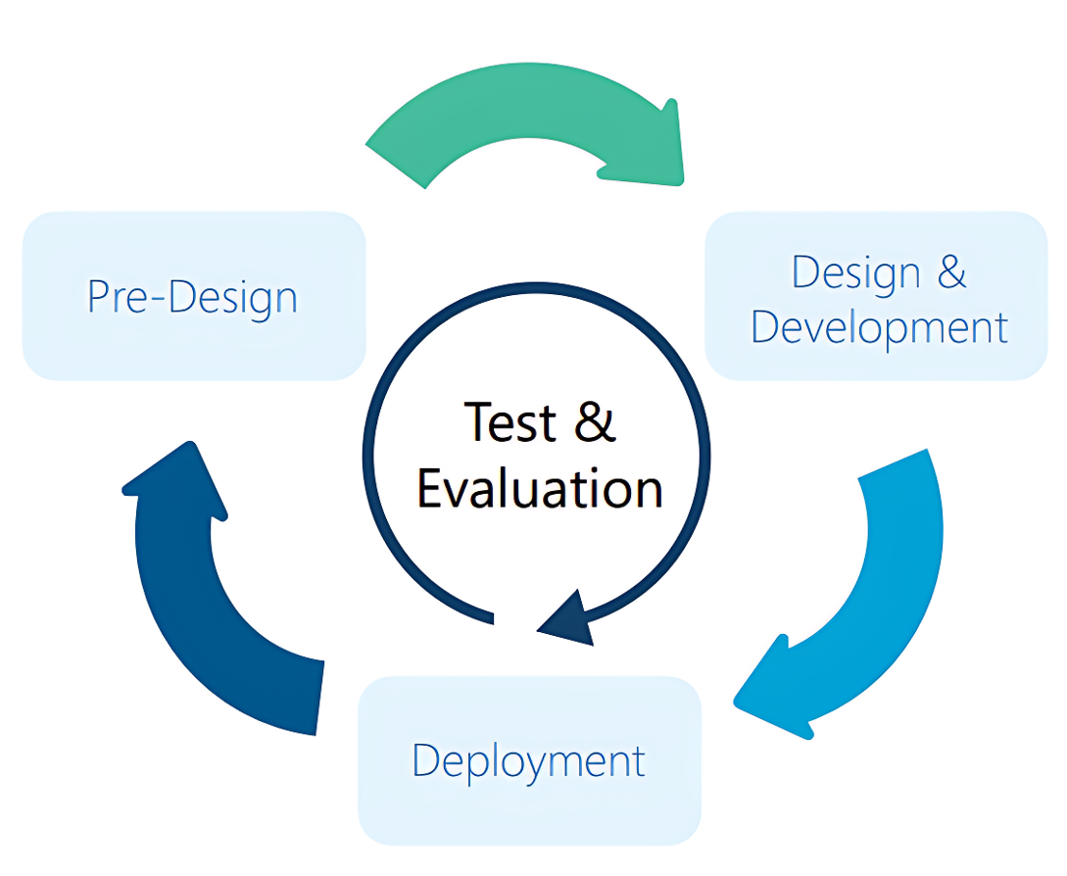
The updated AI life cycle
Needs to be an iterative, multi-stakeholder approach.
Pre-design stage: initial planning, problem framing, and decision-making.
Design and Development stage: choosing the correct model (or building / training a new one) and pre-defining limits before deployment.
Deployment stage: requiring continuous monitoring and reassessment

Slide 15
6 Practical Recommendations
Establish and apply criteria for data quality and representativeness, ensuring that the data used to train, test, and validate the AI system reflects the diversity and characteristics of the target population and domain.
Conduct testing, evaluation, verification, and validation (TEVV) of the AI system throughout its lifecycle, using appropriate methods and metrics to measure and mitigate AI bias and ensure performance, reliability, and safety.
Involve human experts and users in the design, development, and deployment of the AI system, applying human-centered principles and practices to ensure usability, accessibility, and accountability.

Slide 16
Practical Recommendations (continued)
Provide transparency and explainability of the AI system, disclosing the relevant information about its purpose, functionality, limitations, and potential biases to the users and other stakeholders.
Enable user feedback and redress mechanisms, allowing the users to report, correct, or challenge the AI system's outputs or decisions, and providing remedies for any harms or grievances caused by AI bias.
Establish and implement governance policies and procedures for the AI system, defining the roles and responsibilities of the developers, operators, and overseers, and ensuring compliance with ethical and legal standards.

Slide 17
An informal form of bias to guard against:
Techno solutionism is the belief that technology can solve complex social, political, and economic problems without considering broader societal implications or addressing underlying structural issues.
It often involves a simplistic faith in technological solutions as panaceas for all problems, overlooking the complexities of human behavior, power dynamics, and systemic inequalities.
Techno solutionism can lead to the over-reliance on technology to address social issues without adequately considering ethical, cultural, or unintended consequences.
It’s not “bias” in the traditional sense … but it is a *form* of bias. That is, you won’t find it in a psychology textbook!

Slide 18

What could we do now?
Using only the models and techniques we have seen so far, could we attempt to detect bias?
How?
Notes:
DISCUSS - Can we ever completely eliminate bias?
DISCUSS – What kinds of bias might we have in our flipped classroom data set.

