Slide 1
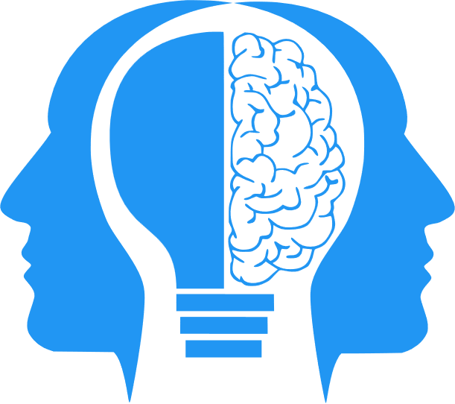
Neural Networks (LLMs part 1)
MIS3536: Info Sys Innovation with AI
Jeremy Shafer
jeremy@temple.edu
https://community.mis.temple.edu/jshafer
Unless otherwise indicated, all decorative images are by Unknown Author and licensed under CC BY-NC

Slide 2
Iteration often begets Innovation
On / Off state, iterated multiple times, can get us the Boolean number system.
A statistical test, iterated multiple times, gets us a decision tree model.
A linear expression, iterated multiple times, gets us a neural network!

Slide 3
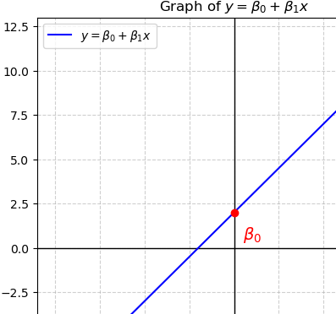
A Linear Equation as a simple, atomic unit
A simple linear expression
It has a single parameter β1
It has a bias β0
... Could a formula like this take more inputs? More parameters? Like:
Y = β0 + β₁X₁ + β₂X₂ + … + β_{n}X_{n}

Slide 4
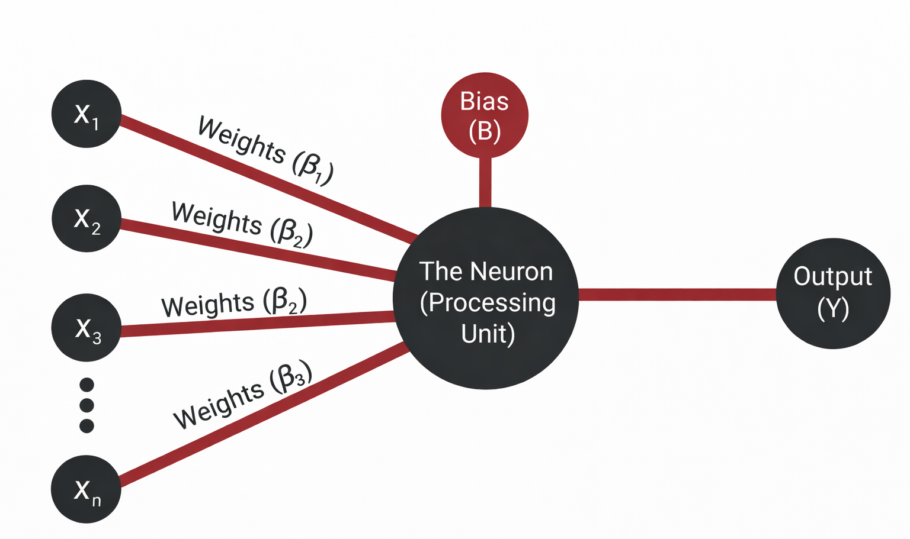
So … with that… could we simulate neuron?
The neuron is the fundamental building block of a neural network. It processes inputs using weights and a bias to produce an output.

Slide 5
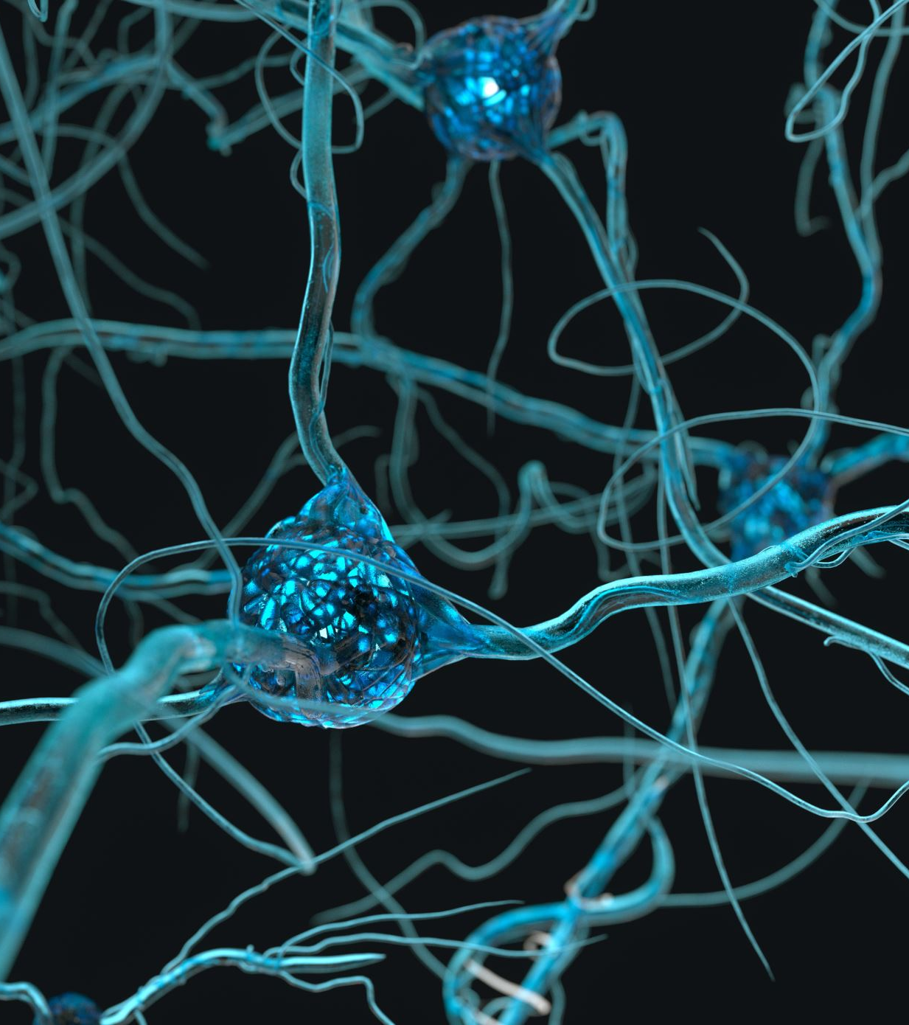
What if …
What if we had thousands of these neurons, connected to each other?
Or … millions? Billions?
Iteration often begets innovation

Slide 6
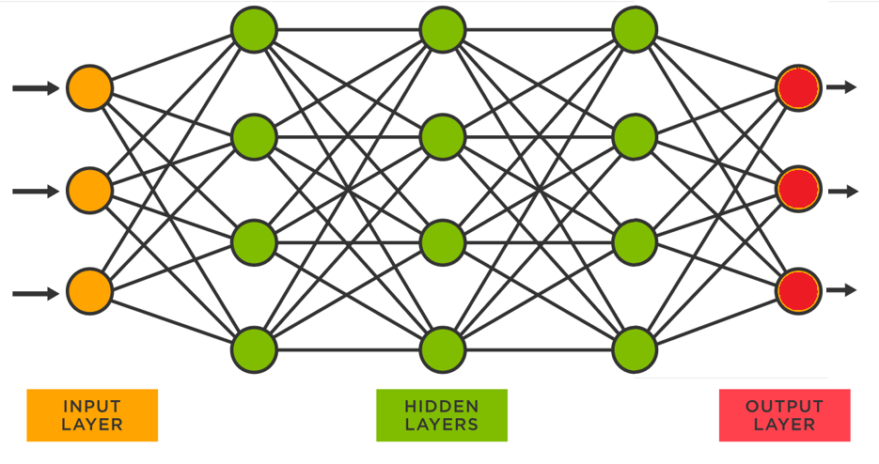
That would be a Neural Network!
The system created when you connect neural layers together is capable of Deep Learning..
These systems are incredibly powerful, yet they are not easily explainable.

Slide 7
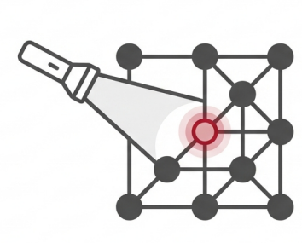
Illuminating the Black Box: L.I.M.E.
L.I.M.E.
Local Interpretable Model-agnostic Explanations
A technique designed to make the "not easily explainable" predictions of neural networks transparent. It acts as a flashlight, revealing which specific inputs led to a specific prediction.
https://youtu.be/ImjdV73IBsY

Slide 8
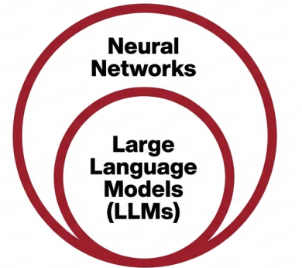
Neural Networks and LLMS
LLMs rely on Neural Networks.
LLMs and Neural Networks are not the same thing.
LLMs are (arguably) the most popular implementation of Neural Networks
How are Neural Networks trained?
https://youtu.be/R9OHn5ZF4Uo?si=RExtK5tbOKlYrcn3

Slide 9

What other kinds of Neural Networks are there?

Slide 10
AlexNet (2012)
Domain: Computer Vision
Architecture: Convolutional Neural Network (CNN)
Why it mattered:
Won the ImageNet competition by a large margin
Demonstrated the power of deep learning + GPUs
Marked the beginning of the modern deep learning era
Business relevance: Enabled breakthroughs in image recognition, medical imaging, retail vision systems.

Slide 11
ResNet (2015)
Domain: Computer Vision
Architecture: Deep CNN with residual (skip) connections
Why it mattered:
Enabled extremely deep networks (100+ layers)
Business relevance: More reliable deep models for vision, diagnostics, and autonomous systems.

Slide 12
AlphaGo (2016)
Domain: Reinforcement Learning
Architecture: Deep neural networks + Monte Carlo Tree Search
Why it mattered:
Defeated world champion Lee Sedol
Demonstrated neural networks in strategic planning
Combined supervised learning and reinforcement learning
Business relevance: Influenced optimization, logistics, and decision automation systems.

Slide 13
Key Distinctions
LLMs are one branch of a much larger neural network family tree.
AlexNet → Vision revolution
ResNet → Architectural breakthrough
AlphaGo → Strategic reasoning
LLMs → Language modeling revolution

Slide 14

What was the key to the LLM revolution?

Slide 15
“Attention”
LLMs as they popularly exist today use what is known as an “attention mechanism”.
The transformer architecture, introduced by the paper "Attention is All You Need" (2017) by A Vaswani revolutionized the landscape of AI.
An “attention mechanism” seeks to determine the significance of a word (or token) as it appears in a string.
For instance, in the sentence "The cat sat on the mat, and it looked fat," the attention mechanism helps the model understand that "it" refers to "the cat," not "the mat."

Slide 16
LLM Terminology
Weights – numeric measure of strength between neurons. Weights are also called “parameters”. It's common to hear about "model size" or "number of parameters", which refers to the total number of these weights (or coefficients) in the model.
Bias – Here we use the word “bias” in a different way. We are just talking about a value added to the weighted sum of the inputs.
Training – Multiple iterations of forward propagation, error calculation, and backward propagation.
Tokens – Tokens can be thought of as the individual "building blocks" of text. For example, if the input text is the sentence "Hello world", the tokens might be: "hello ", " ", "world"

Slide 17
LLMs illustrated
Each circle represents a neuron with each one connected to other neurons in the next layer via programmable parameters that are adjusted as the model ‘learns’ to do the desired task.
“Learning” is implemented by the adjusting parameters in the hidden layer. The parameters are coefficients in a big math problem used to predict the values in the next layer.
GPT-3 was trained on a neural network with 96 layers and 175 billion parameters. GPT-4 reportedly has at least 1 trillion parameters.
Sources
https://www.spotfire.com/glossary/what-is-a-neural-network
https://pub.towardsai.net/building-intuition-on-the-concepts-behind-llms-like-chatgpt-part-1-4cb6654ab67

Slide 18
LLMs illustrated again (2)
Moving from input ( on the left ) to output ( on the right ) is called forward propagation.
Error is calculated at the output layer. If the error is “bad” then we need to move from right to left through the hidden layer, adjusting the parameters.
That is called backward propagation.
Speaking casually, the parameters of the hidden layer are essentially the same as the weights of the hidden layer.
Sources
https://www.spotfire.com/glossary/what-is-a-neural-network
https://pub.towardsai.net/building-intuition-on-the-concepts-behind-llms-like-chatgpt-part-1-4cb6654ab67

Slide 19
Propagation Forward and Backward
Forward propagation - forward propagation computes the predicted output based on the current state of the network’s weights and biases. Make a prediction! (No learning happens here.)
Backward propagation - Adjusts the weights based on the errors. (This is where the learning happens.)

Slide 20
LLMs Supervised vs. Unsupervised vs. Semi-Supervised
Concept | What It Means | When It Happens | Weights Updated? | Learning Type
Pretraining | Model learns general language patterns by predicting next token on massive text corpus | Initial large-scale training phase | Yes | Unsupervised
Fine-Tuning | Model is trained on labeled examples (e.g., instruction–response pairs) | After pretraining | Yes | Supervised
Alignment | Model is adjusted using human preference feedback and reinforcement learning | After supervised fine-tuning | Yes | Semi-Supervised
Inference (Deployment) | Model generates outputs using fixed trained parameters | When users interact with it | No | N/A (No learning occurring)

Slide 21
How are LLMs compared and talked about?
Training size: The amount of data used to train the model can impact its performance and capabilities.
Accuracy: The model's ability to correctly generate text.
Inference speed: The speed at which the model can generate text, which can be important for real-time applications.
Memory usage: The amount of memory required to store and run the model, which can impact hardware requirements.
The number of parameters: that is, all the weights (a.k.a. coefficients) and biases in the model.
The size of the context window: the number of input tokens.

Slide 22
Comparison of LLMs
A good resource is HELM at Stanford
(A Holistic Evaluation of Language Models)
https://crfm.stanford.edu/helm/lite/latest/#/leaderboard

Slide 23
Scaling Laws
OpenAI’s research (e.g., Kaplan et al., 2020) suggests that loss scales predictably with increased parameters, dataset size, and compute.
Model Accuracy improves with:
Model Size: The greater the number of parameters in the model itself the better the accuracy.
Dataset Size: The more training data provided, the better the accuracy.
Compute Power: The greater the number of processors (and/or time) dedicated to training, the better the accuracy.
(New!) Inference time compute: The greater the number of processors (and/or time), dedicated to making an inference, the better the accuracy.

Slide 24
Inference Time Compute
This is the “newest” scaling law.
It is time taken by the LLM system when evaluating a prompt. The idea is that “making an inference” takes place after the model is built. The longer the model “thinks” the better the accuracy.
This “thinking” involves multiple models guiding / crafting / shaping the response over multiple iterations until it reaches a satisfactory state.
This is what’s known as a Reasoning Model / Reflection .
Deepseek is a prominent example of this.

Slide 25

Autoregressive Generation
Token
Input converted t o a vector of tokens
Use the output vector to lookup the next token
Attention Mechanism
Combine the token with the input

Slide 26
And so, once again…
Iteration begets innovation

Slide 27
Summary
We have covered a lot of ground here. Here are some key points for you to consider:
The difference between a neural network and a LLM
Terminology relevant to Neural Networks
Most notably Forward and Backward Propagation
Terminology relevant to LLMs
“Attention” is an important concept that we will revisit
Four Scaling Laws
The iterative nature of modern AI
Some insight into what makes modern AI costly (to train, to use)

