Slide 1

AICyber (AI for Cyber-Security)
MIS3536: Info Sys Innovation with AI
Jeremy Shafer
jeremy@temple.edu
https://community.mis.temple.edu/jshafer
Unless otherwise indicated, all decorative images are by Unknown Author and licensed under CC BY-NC

Slide 2
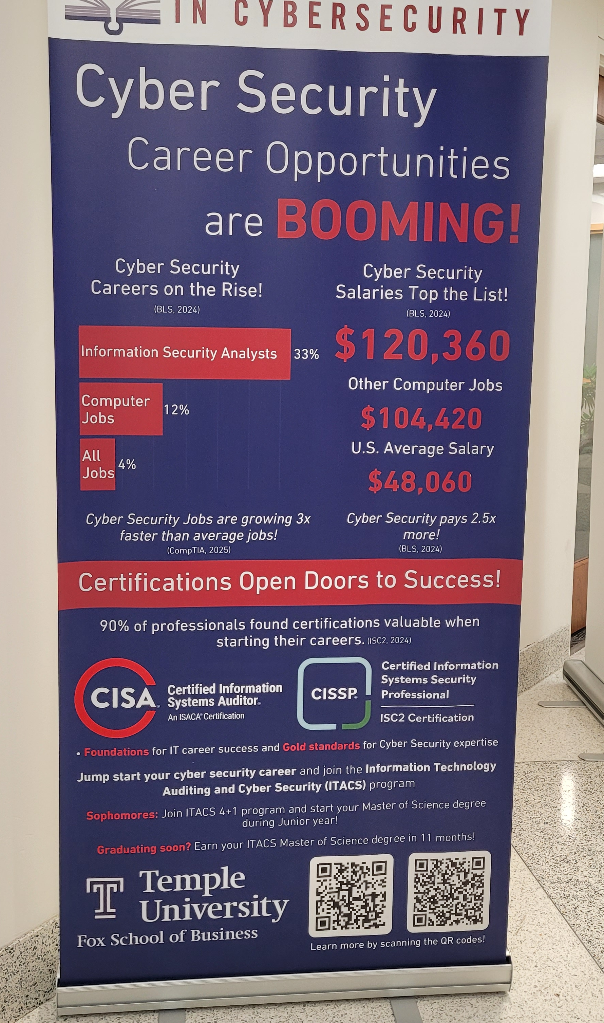
For starters …
Temple is a National Center of Academic Excellence in Cybersecurity
Also (for the entertainment value) this is one of the best applications of AI I have seen: https://youtu.be/RV_SdCfZ-0s?si=Lm1ATp1Onaj5lC1I

Slide 3
Agenda
There’s good money to be made here!
AICyber versus SecureAI
Disclosures
Principles of Traditional Cyber Security
How AI can help
Challenges
A Thought Experiment
Notes:
NIST is the National Institute of Standards and Technology at the U.S. Department of Commerce. The NIST Cybersecurity Framework helps businesses of all sizes better understand, manage, and reduce their cybersecurity risk and protect their networks and data. The Framework is voluntary.

Slide 4
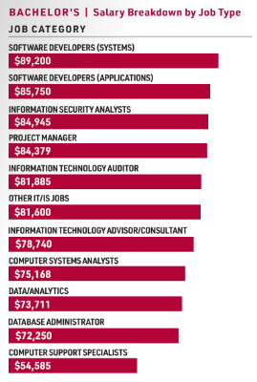
Good money $$$
These stats are from the 2024 IS Jobs Index

Slide 5
AICyber versus SecureAI
Great exam question!
This distinction is made in DoD (Department of Defense) documentation.
AICyber: The application of AI tools to enhance traditional Cyber-Security. ( You can think of it as “AI for Cyber”.)
SecureAI: Addressing cyber-security concerns that are unique to the development and application of AI. ( You can think of it as “Security for AI”.)

Slide 6
Challenges
Challenge: this is a technical topic. In this class we have varied levels of technical exposure.
Challenge: I am not the best person in the Fox School to talk about cyber-security. It is not my area of expertise, and I hold no formal certifications in cyber-security.
But that won’t stop me from trying! ☺
FYI … there are a lot of possible certifications …

Slide 7







Some certifications…
Certified Information Systems Auditor (CISA) Department of Homeland Security
Certified Information Systems Security Professional (CISSP) International Information System Security Certification Consortium / ISC2
CompTIA Security+ Computing Technology Industry Association
CompTIA Cybersecurity Analyst (CySA+) Computing Technology Industry Association / ISACA
Certified Ethical Hacker (CEH) International Council of Electronic Commerce Consultants / EC-Council
Certified Information Security Manager (CISM) Information Systems Audit and Control Association / ISACA
Offensive Security Certified Professional (OSCP) Offensive Security Services, LLC
Certificate of Cloud Security Knowledge (CCSK) Cloud Security Alliance

Slide 8
What to do?
Focus on principles – the various certifications share common principles.
Many of the principles on the following slides come from the Saltzer & Schroeder security principles (1975)—which heavily influenced later standards like NIST publications.
Notes:
NIST is the National Institute of Standards and Technology at the U.S. Department of Commerce. The NIST Cybersecurity Framework helps businesses of all sizes better understand, manage, and reduce their cybersecurity risk and protect their networks and data. The Framework is voluntary.

Slide 9
Core cyber-security principles (1 of 2)
# | Principle | Description
1 | Least Privilege | Users should have only the access they need to perform their job - no more, no less.
2 | Separation of Duties (SoD) | Split responsibilities to prevent fraud or errors (e.g., one person can't both approve and process a payment).
3 | Need to Know | Access to information is granted only if it is essential to perform specific tasks. Often overlaps with least privilege.
4 | Defense in Depth | Use multiple layers of controls (physical, technical, administrative) to protect systems and data.
5 | Fail-Safe Defaults (Default Deny) | Access should be denied by default unless explicitly allowed.
6 | Accountability | Actions must be traceable to individuals through logging and monitoring (e.g., audit trails).

Slide 10
Core cyber-security principles (2 of 2)
# | Principle | Description
7 | Security by Design | Security should be integrated into systems from the start - not added later.
8 | Complete Mediation | Every access attempt must be checked against access control policies - no caching or assumptions. ( Now called a “Zero Trust Architecture”)
9 | Open Design | The security of a system should not depend on secrecy of its design, only on the secrecy of keys or credentials (Kerckhoffs's Principle).
10 | Economy of Mechanism | Security mechanisms should be as simple as possible to reduce the chance of errors.
11 | Least Common Mechanism | Minimize shared resources to reduce the risk of unintended interactions.
12 | Psychological Acceptability | Security controls should not make systems unusable; they must align with user behavior to be effective.

Slide 11

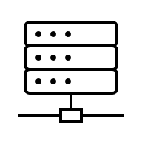
A simple example
Rule Based Firewall Software Adapts to threats
“My” Server
Temple Banner System
Firewall Device #2
Firewall Device #1
The DMZ
No AI here… but where could AI help?

Slide 12
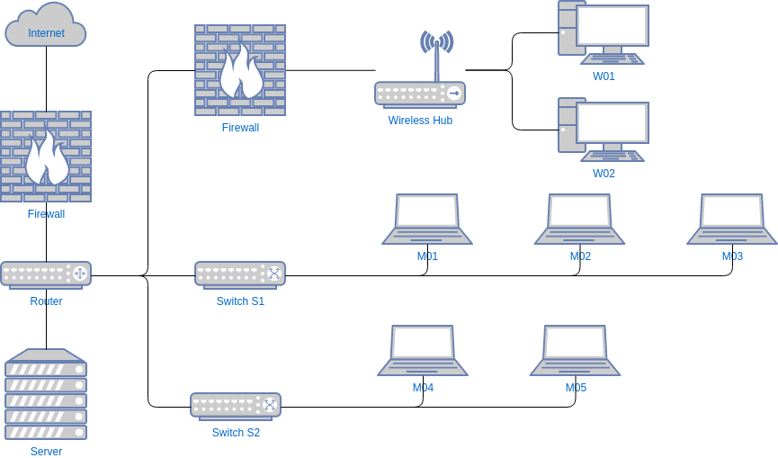


Another example …
If I was a hacker, what might I try to do? What sort of defense would I need?
https://online.visual-paradigm.com/diagrams/templates/network-diagram/office-network-diagram-example

Slide 13
How can AI help?
Theat Detection
Automated Response
User and Entity Behavior Analytics (UEBA)
Phishing and Email Security
Threat Intelligence Platforms

Slide 14
(A) Threat Detection
AI models detect anomalies in real-time (unusual login times, access from unknown IPs).
ML can recognize known malware patterns and predict new/unknown threats (known as zero-day threats).
Example: A model (either a neural network or a decision tree) learns what “normal” traffic looks like, flags anything unusual.
Example: ML can recognize known malware patterns and predict unknown threats (zero-day threats).

Slide 15

(B) Automated Response
AI can trigger automated containment responses
Isolate a compromised device
Update a firewall
Shut down a service
Quarantine a file

Slide 16
(C) User and Entity Behavior Analytics (UEBA)
AI tracks behavioral patterns of users and devices.
Flags insider threats and compromised accounts.
Example: An employee suddenly downloads gigabytes of data at midnight.

Slide 17
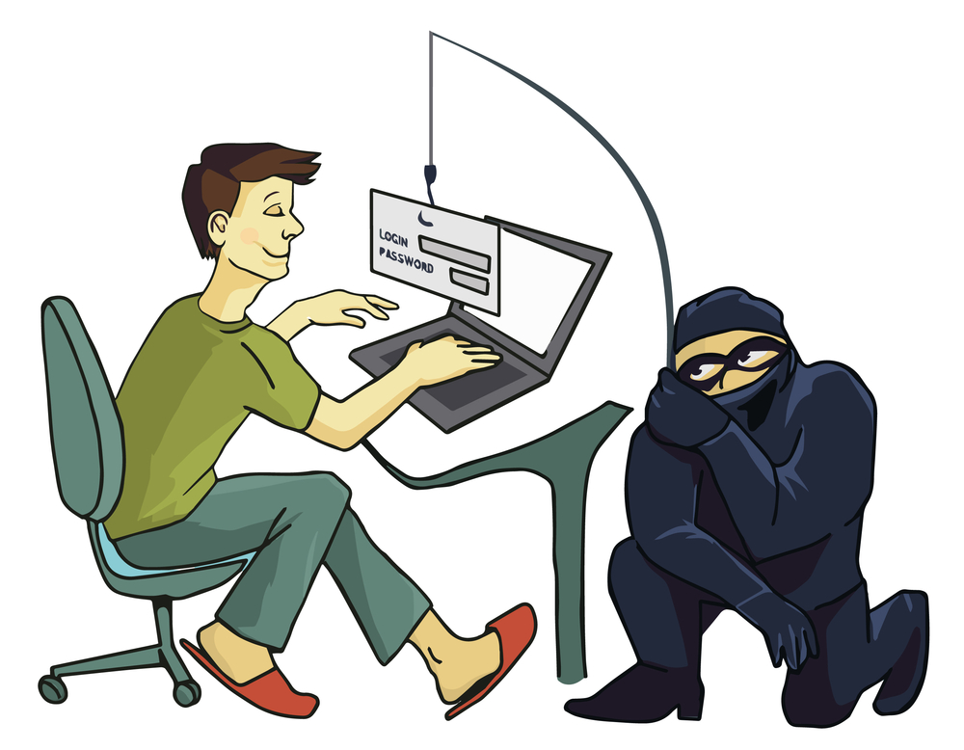
(D) Phishing and Email Security
Natural Language Processing (NLP) helps detect phishing emails.
AI scans email patterns, suspicious links, language irregularities.
Example: Microsoft Defender uses AI to block millions of phishing emails daily.

Slide 18
(E) Threat Intelligence Platforms
Platforms offer AI-driven aggregation and correlation of threat feeds. This is AI enabled SIEM
SIEM stands for Security Information and Event Management.
Example: Microsoft Defender Threat Intelligence
Example: Mandiant Advantage is a SaaS platform, formerly offered by FireEye, that provides organizations with real-time cyber threat intelligence and tools to enhance security response and automate security operations.

Slide 19
Challenges
Adversarial AI: Attackers can trick AI models (e.g., data poisoning, jailbreaking, prompt injection).
False Positives/Negatives: Poorly trained models can miss real threats or cause alert fatigue.
Bias and Explainability: Hard to explain AI decisions—important for compliance.
Cost and Skill Gap: Expensive to implement and maintain; requires skilled staff.

Slide 20

Thought experiment
My Wacatac story … see
What, if anything, could Temple IT have done differently?
What, if anything, could Microsoft have done differently?
How does this story reflect some of the challenges from the last slide?

Slide 21

Conclusion
AI is not a magic bullet, but a powerful force multiplier.
Works best when paired with human expertise.

