Slide 1
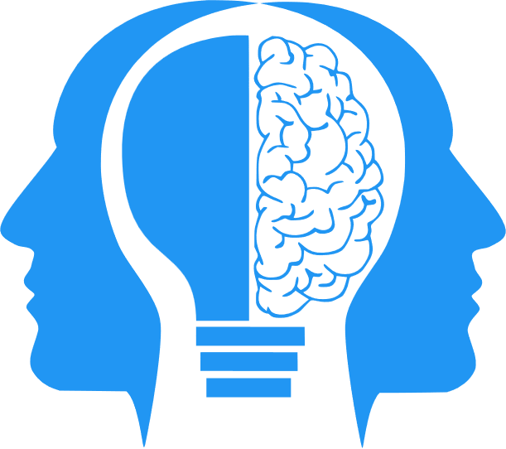
Course Intro
MIS3580: AL and ML in the Workplace
Jeremy Shafer
jeremy@temple.edu
https://community.mis.temple.edu/jshafer
Unless otherwise indicated, all decorative images are by Unknown Author and licensed under CC BY-NC

Slide 2
Agenda
About me.
Why am I teaching this course?
How is this course set up?
Our first discussion exercise.

Slide 3
About me
Teaching full time since 2014
Bachelor’s degree in CS, Master’s degree in MIS
Lifelong interest in learning and higher education
Transitions I have witnessed:
  Dawn of the PC (circa 1980)
  Dawn of the Internet and the first browsers (circa 1993)
  Dawn of the iPhone (2007)
  Dawn of ChatGPT (November 2022)

Slide 4
Why am I teaching this course?
According to a report by investment bank Goldman Sachs, artificial intelligence (AI) could replace the equivalent of 300 million full-time jobs. The report suggests that AI could replace a quarter of work tasks in the US and Europe, but it may also lead to new jobs and a productivity boom.
https://www.bbc.com/news/technology-65102150
According to a recent survey by PwC, almost a third of respondents said they were worried about the prospect of their role being replaced by technology in three years. However, the same survey also found that 77% of respondents who had used AI tools reported that they had a positive experience with them 1.
https://www.bbc.com/worklife/article/20230418-ai-anxiety-artificial-intelligence-replace-jobs

Slide 5
How is this course set up?
First half the semester – lectures, activities, and quizzes
Second half the semester – activities and assignments
Participation is graded. My mechanisms for gauging participation may vary.
You are expected to listen to the AI Breakdown Podcast with Nathaniel Whittemore (a.k.a. NLW) on Spotify.
Let’s review the class site: https://community.mis.temple.edu/mis3580sec001spring2024

Slide 6

Some food for thought
Some people describe themselves as AI Accelerationists
AI Accelerationists want AI to be developed as quickly as possible
Other people described themselves as Effective Altruists
Effective Altruists tend to believe that AI development should be approached cautiously and with regulation.
Use Edge Bing Chat (or ChatGPT) to look up the defintions of “AI Accelerationist” and “Effective Altruist”.
Which one are you?

Slide 7

Our first activity
Go on to Canvas and comment of the discussion question there.
When done, review the answers of some of your peers.
You should “like” one other student’s answer.
You should comment on another student’s answer. (Two or three constructive sentences.)
This Photo by Unknown Author is licensed under CC BY-SA

