Slide 1
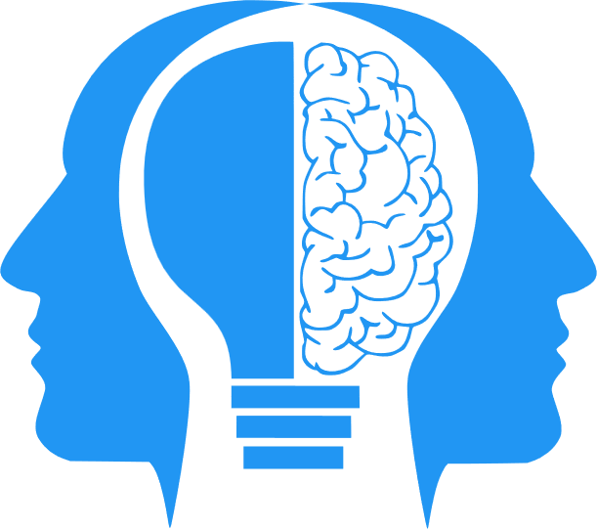
Discussion Week 7 (The way AI will make us value “Soft Skills”)
MIS3580: AL and ML in the Workplace
Jeremy Shafer
jeremy@temple.edu
https://community.mis.temple.edu/jshafer
Unless otherwise indicated, all decorative images are by Unknown Author and licensed under CC BY-NC

Slide 2
Discussion questions
As an MIS student, how did the listening assignment make you feel?
Do you agree with the premise that “technical skills are the most challenged by AI”?
Three kinds of tasks were identified as being most “at risk”
Writing
Transcription
Programming
Do you see any difference in these three tasks?

Slide 3
More discussion questions
What have been your experiences in writing AI prompts?
Do you agree that good prompt writing is similar to effective interpersonal communication between humans?
Can you (educationally) bring the same level of rigor around interpersonal skills as you can with technical skills? What would that look like?

Slide 4
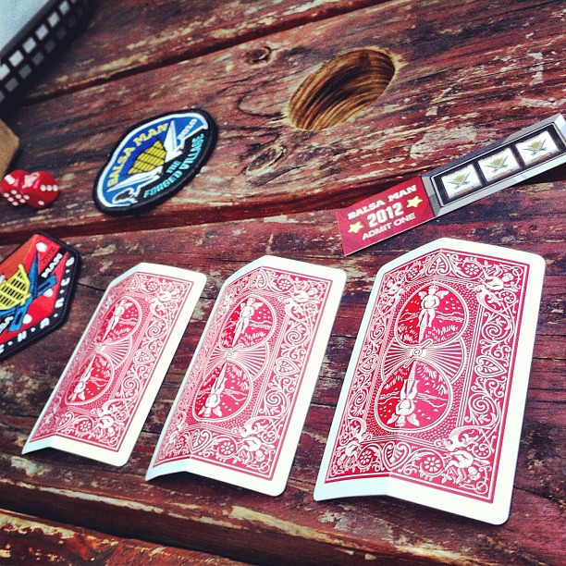
Your prompt…
Answer one of these questions:
What can you emphasize in your own education story, as you engage in your future job search?
Do you feel swindled or burned by higher education? Why?
As in the past, like and constructively comment on another students post.
This Photo by Unknown Author is licensed under CC BY-SA-NC

