Slide 1
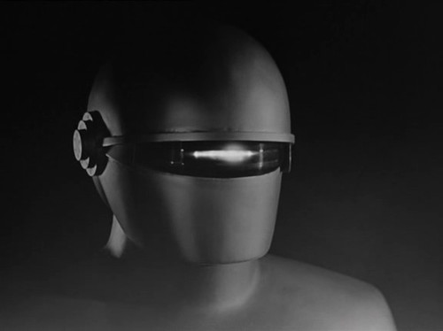
Ethics and the future of AI
MIS3580: AL and ML in the Workplace
Jeremy Shafer
jeremy@temple.edu
https://community.mis.temple.edu/jshafer
Unless otherwise noted, all images in this presentation are by Unknown Author and licensed under CC BY-SA

Slide 2
Agenda
Preface
How I spent my Saturday and my P.O.V.
One reason why this lecture is difficult
Definitions: Morals, Ethics, Law
AI in different ethical arenas
Geopolitical, Business, Personal
Conclusions

Slide 3
Preface (how I spent my Saturday)

Slide 4
Preface (point of view)
Capitalism – In this system, private individuals own and control property and businesses. The production, distribution, and prices of goods and services are determined primarily by competition in a free market. In my opinion, capitalism has done more to raise the global standard of living than any other economic system.
American Exceptionalism – American exceptionalism is the idea that the United States is inherently different from other nations, historically unique with a specific world mission to spread liberty and democracy. This belief is rooted in America's founding ideals, its democratic institutions, and its historical role as a leader in economic, political, and cultural aspects globally.

Slide 5
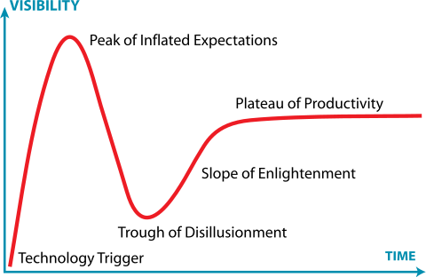
Preface (why this lecture is difficult)
Where are is modern AI?
Are we at the top of the roller coaster?
“Shafer’s wager”
?
Notes:
By “modern AI” I mean colossal neural networks that are designed to simulate human thought

Slide 6
Definitions
Morals – What you personally believe to be right
Ethics – What you believe to be right for society
Law – What is codified and (hopefully) enforced.
Criminal law - “have any rules been broken?”
Civil law – “how can we reconcile this conflict?”
The U.S. Legal System nurtures a particularly high rate of litigation, including civil lawsuits, compared to other countries.

Slide 7
Morals, Ethics, Law: a visual aid
Morals
Ethics
Laws
Morals
Ethics
Laws
IMHO ☺
Quantity

Slide 8
AI + Ethics and the geopolitical arena
Global Governance of ANI, AGI and ASI
Is it even possible?
The necessity of global cooperation to manage superintelligent AI
What this implies: Strategy #1 – A democracy needs to get to AGI first.
AI in Warfare and Security
Economic Disparities and AI

Slide 9
AI + Ethics: Warfare (B)
Lack of Accountability: When autonomous systems make decisions, who — or what — is to be held responsible?
Lowered Threshold for War: Autonomous systems could lower the human cost of entering a conflict, resulting in more conflict.
Ethical Decision Making: Machines lack human judgment and might not be capable of making ethical decisions in complex, rapidly evolving combat situations where the distinction between combatant and non-combatant is not clear-cut.
Autonomous Lethal Force: Should it even be allowed?
Security and Hacking: Autonomous systems could be hacked or malfunction.
Just War Theory Adaptation
Jus ad bellum: Justly entering into war, including just cause, right intention, and proper authority.
Jus in bello: Justice in war
International Humanitarian Law Compliance
AI-driven defense systems must adhere to existing international laws, including the Geneva Conventions and the Hague Conventions, which regulate the conduct of armed conflicts.
Responsibility and Accountability
Establish clear lines of responsibility and accountability for the actions of AI systems. This includes legal frameworks to address potential war crimes committed by autonomous systems.

Slide 10
AI + Ethics: Economic Inequities (C)
Why would this be different than anything else?
Education
Resources
Scientific community & individual efforts will always outpace government programs

Slide 11
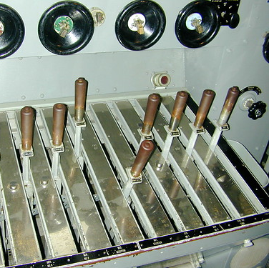
What are the controls?
Chips
Intellectual Property
Power consumption
Federation
Economic Sanctions
Military Action

Slide 12
AI + Ethics in the business arena
Corporate Responsibility and Advanced AI
Key idea: treat AI more like human employees that act as agents of the company
Visible public commitments to profit sharing with current employees
Regulation to ensure that there is a sufficient number of “humans in the loop”
Transparency and Accountability
The challenge: develop systems that ensure ethical oversight over businesses, and even (potentially) independent AI … without destroying capitalism’s advantages
Consumer Data and Privacy
Now is the time for you (personally) to appraise the value of your privacy.
The NY Times lawsuit against OpenAI is playing out in real time… watch this!

Slide 13
AI + Ethics in the personal arena
Individual Responsibility
Being honest about your AI use in your school or workplace
Understanding that what is expedient is not always profitable
Be strong enough to take personal inventory
Embrace your social role
Recognize that “no man is an island”
You either make valuable contributions, or you don’t
Help others sort out fact from fiction
Individual Values
Valuing people
Contribute to the needs of others
Embrace a tradition that is bigger than yourself

Slide 14
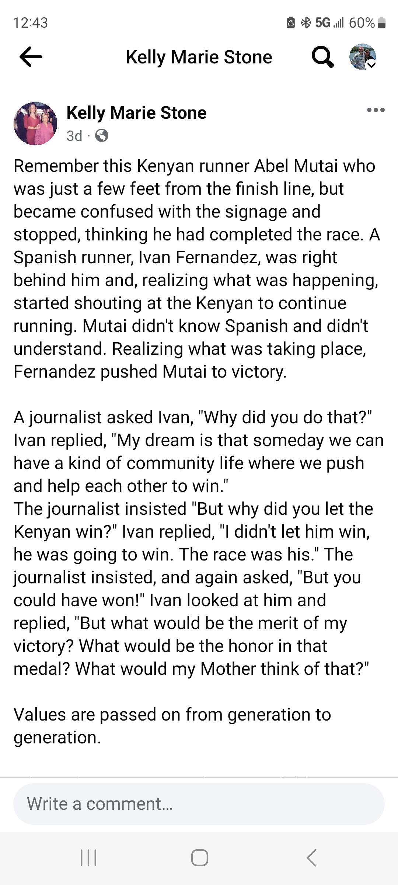
Competition is good, but it is not everything
https://en.wikipedia.org/wiki/Abel_Mutai

Slide 15
Conclusions
Don’t give up…
Your freedoms
Your morals
Your potential
Your legacy

Slide 16
Quotable quotes
Magic
by Shel Silverstein
Sandra's seen a leprechaun,
Eddie touched a troll,
Laurie danced with witches once,
Charlie found some goblins' gold.
Donald heard a mermaid sing,
Susy spied an elf,
But all the magic I have known
I've had to make myself.
“Bad men need nothing more to compass their ends, than that good men should look on and do nothing.” – John Stuart Mill
“The only thing necessary for the triumph of evil is for good men to do nothing.”
-- John F. Kennedy

