Slide 1
Introduction to React Native
By: Dr. Taha Havakhor
Assistant Professor of MIS

Slide 2
What is React Native
React Native is an open source framework for building Android and iOS applications using React (which is basically a JavaScript Library) and the app platform’s native capabilities.
With React Native, you use JavaScript to access your platform’s APIs as well as to describe the appearance and behavior of your UI using React components: bundles of reusable, nestable code.

Slide 3
Cross Platform Technology
Create native apps for Android and iOS using React
Many platforms, one React.
Create platform-specific versions of components so a single codebase can share code across platforms. With React Native, one team can maintain two platforms and share a common technology—React.
Seamless Cross-Platform
React components wrap existing native code and interact with native APIs via React’s declarative UI paradigm and JavaScript.

Slide 4
A Little Bit of History
Facebook released React Native in 2015 and has been maintaining it ever since.
In 2018, React Native had the 2nd highest number of contributors for any repository in GitHub.

Slide 5
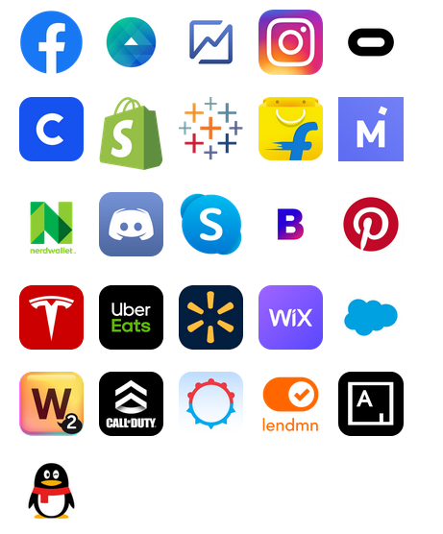
Who uses it?

Slide 6
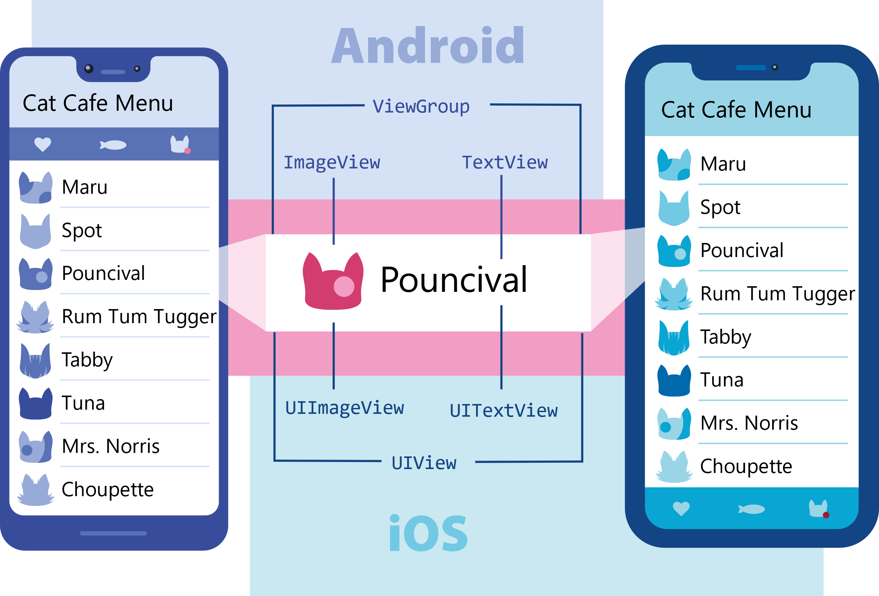
Views and Mobile Development
A view is the basic building block of UI: a small rectangular element on the screen which can be used to display text, images, or respond to user input. Even the smallest visual elements of an app, like a line of text or a button, are kinds of views. Some kinds of views can contain other views. It’s views all the way down!

Slide 7
Native Components
In Android development, you write views in Kotlin or Java; in iOS development, you use Swift or Objective-C. With React Native, you can invoke these views with JavaScript using React components.
At runtime, React Native creates the corresponding Android and iOS views for those components. Because React Native components are backed by the same views as Android and iOS, React Native apps look, feel, and perform like any other apps. We call these platform-backed components Native Components.
React Native also includes a set of essential, ready-to-use Native Components you can use to start building your app today. These are React Native's Core Components.

Slide 8
Core Components
React Native has many Core Components for everything from form controls to activity indicators. You can find them all documented in the API section. You will mostly work with the following Core Components (in this course):
React Native UI Component | Android View | iOS View | Web Analog | Description
<View> | <ViewGroup> | <UIView> | A non-scrollling <div> | A container that supports layout with flexbox, style, some touch handling, and accessibility controls
<Text> | <TextView> | <UITextView> | <p> | Displays, styles, and nests strings of text and even handles touch events
<Image> | <ImageView> | <UIImageView> | <img> | Displays different types of images
<ScrollView> | <ScrollView> | <UIScrollView> | <div> | A generic scrolling container that can contain multiple components and views
<TextInput> | <EditText> | <UITextField> | <input type="text"> | Allows the user to enter text

Slide 9
Ready-Set-Go! (aka Hello World!)
Open the Hello_World file on the community page (time to cook!)
To quickly try it out go to: https://snack.expo.io/

Slide 10
Before we freak out…
What on god’s earth is: const App = () => { …}
It is JS ES6 (2015) notation equivalent of a function!! (aka arrow funcitons)
Function App () {…}

