Slide 1
To Do App:
Introduction to NoSQL and Cloud Firestore
By: Dr. Taha Havakhor
Assistant Professor of MIS

Slide 2
What is a NoSQL database?
Non-relational database
  Well… technically, NoSQL databases are databases that store data in a format other than relational tables.
NoSQL databases emerged in the late 2000s as the cost of storage dramatically decreased.
  Therefore, normalizing data was not a big deal. Duplication became cheaper than structure

Slide 3
What are common types of NoSQL databases?
Document databases store data in documents similar to JSON (JavaScript Object Notation) objects.
  Each document contains pairs of fields and values. The values can typically be a variety of types including things like strings, numbers, booleans, arrays, or objects.
Key-value databases are a simpler type of database where each item contains keys and values.
  A value can typically only be retrieved by referencing its key, so learning how to query for a specific key-value pair is typically simple.

Slide 4
An Example- One-to-Many Case
{
"_id": "joe",
"name": "Joe Bookreader",
"addresses": [
{
"street": "123 Fake Street",
"city": "Faketon",
"state": "MA",
"zip": "12345"
},
{
"street": "1 Some Other Street",
"city": "Boston",
"state": "MA",
"zip": "12345"
}
]
}
Name
Addresses

Slide 5
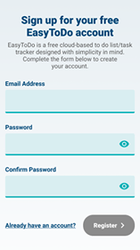
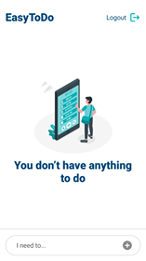
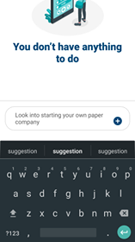
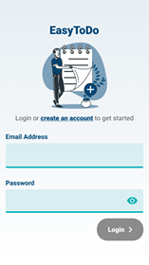
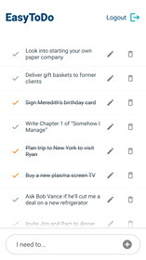
The To-D0 App

Slide 6
Why do I need a database back-end here?
The app will have one database, and each user must see their own tasks
The app does not “save” the tasks on the phone, they are saved and access on the app’s data back-end

Slide 7
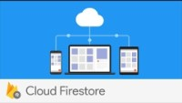
Cloud Firestore

Slide 8
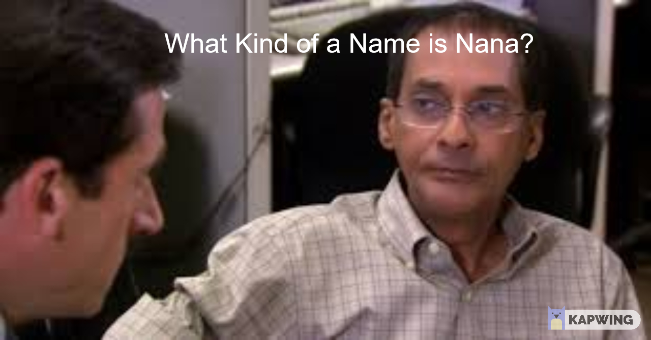
Data Structure
{
[collection; we will call it ‘tasks’]:
[
[DocID-1; autogenerated]:
{
  completed: false,
  date: December 7, 2020 at 10:47:07 PM UTC-5
  task: “Start your own paper company”
  uid: “RkeTOJr8NZT1rjWpITRGRwDDBRRq2”
},
[DocID-2]:
{
  completed: false,
  date: December 8, 2020 at 11:52:08 PM UTC-5
  task: “Hire Vikram”
  uid: “RkeTOJr8NZT1rjWpITRGRwDDBRRq2”
},
[DocID-3]:
{
  completed: false,
  date: December 8, 2020 at 11:53:17 PM UTC-5
  task: “Raise funds from Nana”
  uid: “RkeTOJr8NZT1rjWpITRGRwDDBRRq2”
},
]
}

Slide 9
Now Let’s Setup of Firebase account
Follow instructions in RN-ToDo App.docx posted on the community page

