Slide 1
The Calculator Lab
By: Dr. Taha Havakhor
Assistant Professor of MIS

Slide 2
What have done so far?
Defining the custom components:
Calculator-display
Function-button
Number-button (see files in the community page)
Operation-button (see files in the community page)

Slide 3
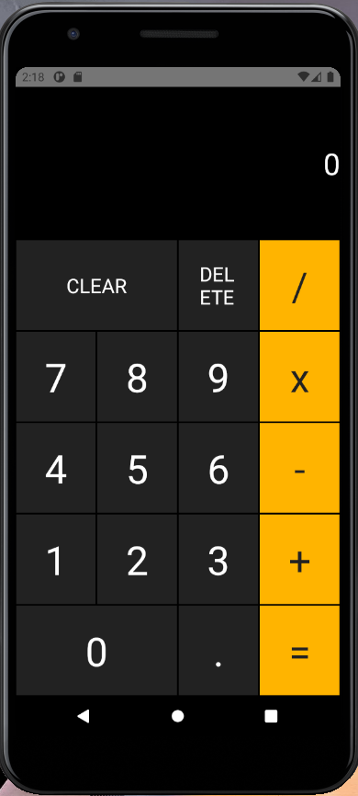
The Calculator App

Slide 4
Import your custom components first
In App.js import your custom components
import CalculatorDisplay from './components/calculator-display’;
import NumberButton from './components/number-button’;
import OperationButton from './components/operation-button’;
import FunctionButton from './components/function-button';

Slide 5
Figure out the layout of the containers and components
<StatusBar/>
<SafeAreaView> //savContainer
//calculator container <View>
//Button row <View>
<CalculatorDisplay />
<View>
//Button row <View>
<FunctionButton />
<FunctionButton />
<OperationButton />
<View>
//Button row <View>
<NumberButton />
<NumberButton />
<NumberButton />
<OperationButton />
<View>
…
</View>
</SafeAreaView>
Status bar
Button Row
Safe area view (SAV), Calculator container

Slide 6
Style the containers
const styles = StyleSheet.create({
calculatorContainer: { display: 'flex', flexDirection: 'column', alignItems: 'stretch', justifyContent: 'center', flexGrow: 1, },
buttonRow: { display: 'flex', flexDirection: 'row', alignItems: 'center', justifyContent: 'flex-start', },
savContainer: { flexGrow: 1, backgroundColor: "#000000", },
});

Slide 7
Add container styles to container tags in return ()
Example:
<SafeAreaView style={styles.savContainer}>
<View style={styles.calculatorContainer}>

Slide 8
Let’s play
Open calculate-app complement file from the community site and follow the instructions.

