Slide 1
Ask Ouija App-Lab (Session 3)
By: Dr. Taha Havakhor
Assistant Professor of MIS

Slide 2
Agenda
Develop greeting and lobby components
Learn about auth()’s updateProfile method

Slide 3
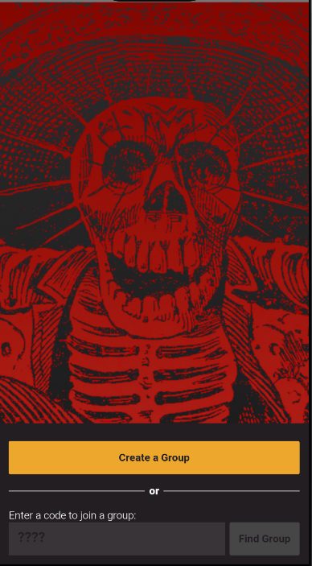
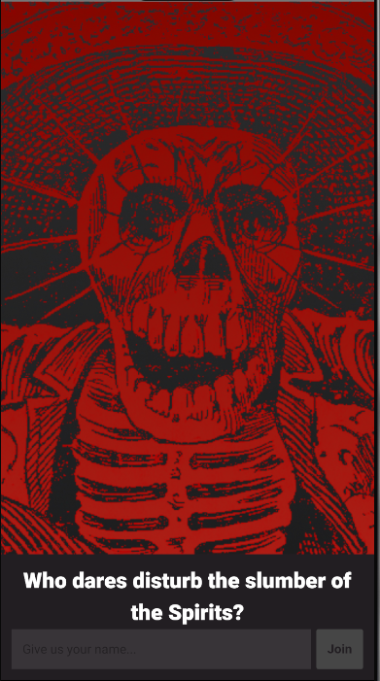
Greeting component has different steps
Class discussion: Look at the DOM in greeting/index.js and see if you can match those “steps” to pictures below

Slide 4
Random Selection from an Array
Class Discussion: explain the code:
const generateGameCode = () => {
const letters = ['A', 'B', 'C', 'D', 'E', 'F', 'G', 'H', 'I', 'J', 'K', 'L', 'M', 'N', 'O', 'P', 'Q', 'R', 'S', 'T', 'U', 'V', 'W', 'X', 'Y', 'Z'];
let newGameCode = '';
for (var x=0; x<4; x++) {
newGameCode+= letters[Math.floor(Math.random() * (25 - 0 + 1) + 0)];
}
return checkGameCode(newGameCode);
};

Slide 5
What is in the promise after adding a document with autogenerated ID?
db.collection("cities").add({
name: "Tokyo",
country: "Japan"
})
.then((docRef) => {
console.log("Document written with ID: ", docRef.id);
})
.catch((error) => {
console.error("Error adding document: ", error);
});

Slide 6
A createGame mystery
Why generateGameCode() is followed by “.then”?
What is the promise returned by generateGameCode()?

Slide 7
Auth()’s updateProfile
You can update a user's basic profile information in auth() module of Firebase.
the user's display name
profile photo URL
var user = firebase.auth().currentUser;
user.updateProfile({
displayName: "Jane Q. User",
photoURL: "https://example.com/jane-q-user/profile.jpg"
}).then(function() {
// Update successful.
}).catch(function(error) {
// An error happened.
});

