Slide 1
Mobile Application Development
By: Dr. Taha Havakhor
Assistant professor of MIS

Slide 2
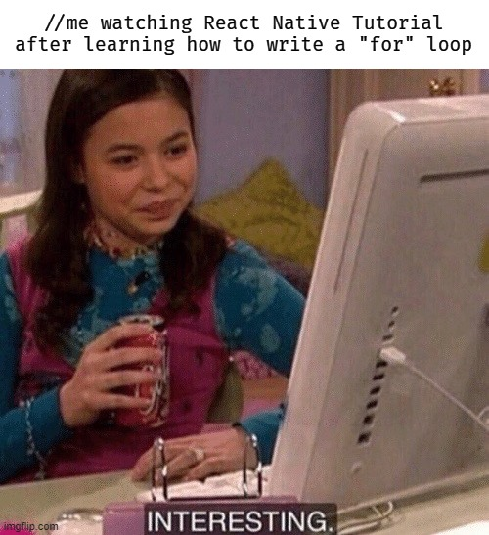

Slide 3
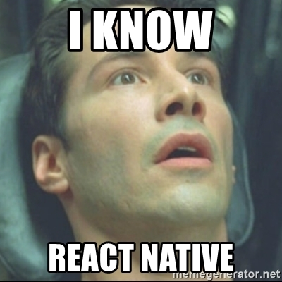

Slide 4
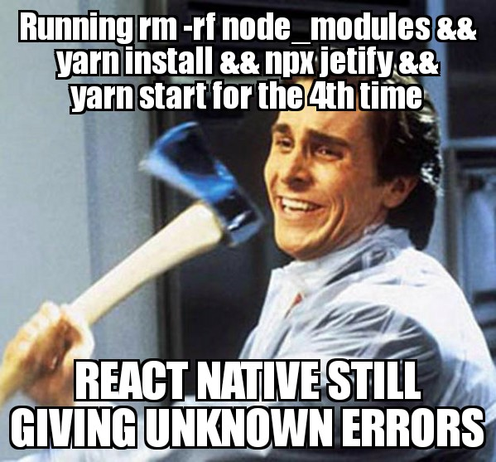

Slide 5
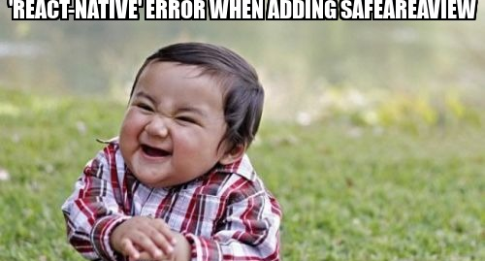

Slide 6
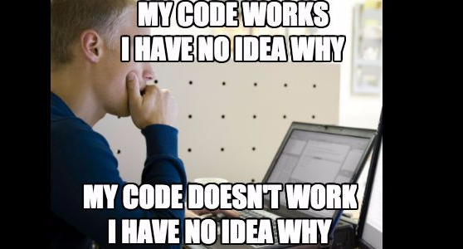

Slide 7
Learning by doing is key
Programming: science or art/craft?
Syntax is vocabulary, but you cannot speak a language only with a dictionary
You don’t learn a language with reading only one book in that language either
Each person has a different learning path, much like drawing

Slide 8
Purpose of the Course

Slide 9
An Additional Dimension
Multi-lingual programmers have a better chance at getting a first job (27% more likely, BEA)
Multi-lingual programmers have a better chance at landing a 6-figure salary in their first 5 years (38% more likely, BEA)
Plain JS + React Framework

Slide 10
Path to a full stack developer
Dynamic application (synchronous and asynchronous interaction with databases) programmers, or full stack developers, land an average salary of +90K per Indeed.Com
Full-stack programming requires understanding different layers of development, i.e., networking (setting up and configuring servers/cloud connections), database design, UX development, backend development, APIs, etc.

Slide 11
Your portfolio
Much like architecture, a modern-day developer needs a portfolio
Open source contributions, sample web and mobile applications
Start publishing your portfolio on GitHub
Have your portfolio accessible on your phone
Keep polishing your portfolio applications

Slide 12
Suggested Resume Additions
GitHub portfolio (include it after your email address or in a section below your skills)
Application Development Skills:
React JS
React Native Mobile Development
NoSQL databases:
Firebase/Friestore
UX/Design Environments:
Figma

