Slide 1
React versus Vanilla JS
By: Dr. Taha Havakhor
Assistant Professor of MIS

Slide 2
React
React is a library that defines the way apps are written.
It does this by setting very clear rules about how data can flow through the app, and how the UI will adapt as a result of that changing data.
There are other libraries that set similar boundaries, such as Angular and Vue.

Slide 3
Vanilla JS
Plain JavaScript code (that is, JavaScript written without libraries) on the other hand, can be thought of as a scripting language that doesn’t set any rules about how data can be defined, or how the UI can be changed.
That makes apps written without these libraries more freeform and customizable. But going this route can also lead to problems down the road.
The one library that we could be included under the umbrella of "plain JavaScript" would be jQuery. jQuery is a convenient wrapper that goes around existing JavaScript functionality to make it easy and consistent to use across browsers. It doesn’t set the same boundaries as a library like React though—so a jQuery app could fall into the same trap as apps written in plain JS.

Slide 4
The Major Differences
How the user interface is first created
How functionality is split up across the app
How data is stored on the browser
How the UI is updated

Slide 5
How the user interface is first created
In plain JS, the initial user interface is generally created in HTML on the server. Meaning, HTML is dynamically created on the server, and might look something like this:
<div>
<h1>Grocery List</h1>
<ul>
<li>Milk</li>
<li>Bread</li>
<li>Eggs</li>
</ul>
</div>
That gets sent to the web browser and displayed—no JavaScript needed yet!

Slide 6
How the user interface is first created
A React app will start with a fixed HTML file that looks like this:
<div id="root"></div> (this is like your entry point index.js)
...which is blank! So how does the UI get created?
Instead of defining the initial UI on the server, the UI gets defined on the browser. So the app starts with a blank container (a div in this case), and then the UI gets loaded into that container.
The UI is defined by a component that returns JSX. JSX looks like HTML, but is actually JavaScript - and might look like this:
function GroceryList(props) {
return (
<div>
<h1>Grocery List</h1>
<ul>
<li>Milk</li>
<li>Bread</li>
<li>Eggs</li>
</ul>
</div>
)
};

Slide 7
How the user interface is first created
And that new GroceryList component gets mounted (or "rendered") into the div container using a library called ReactDOM:
<GroceryList />, <GroceryList />, <GroceryList />, document.getElementById("root") )
This results in the same initial UI as the plain JS example above except that happens on the browser, instead of beforehand on the server.

Slide 8
How functionality is split up across the app
With a plain JS app, there are no requirements about how you split up functionality or UI components in an application.
For example, our initial grocery list can just be defined in a main index.html file:
<div>
<h1>Grocery List</h1>
<ul id="grocery-list">
<li>Milk</li>
<li>Bread</li>
<li>Eggs</li>
</ul>
</div>
And the code that updates the list might be buried deep in a separate javascript file:
function addItemToList() {
// Add item
}

Slide 9
How functionality is split up across the app
This has traditionally been done because splitting the HTML (markup) and JavaScript (functionality) was seen as a "separation of concerns".
However, as the complexity of JavaScript apps has grown, this has caused huge headaches. Because the code that updates a piece of HTML might live in several different JS files across the entire application, developers have to keep all of those files open at once - and they have to "hold in their head" each of those interactions at the same time.

Slide 10
How functionality is split up across the app
In contrast, React enforces that your app is split into components and that each one of those components maintains all of the code needed to both display and update the UI:
function GroceryList(props) {
function addItem() {
// Add Item
}
return (
<div>
<h1>Grocery List</h1>
<ul>
<li>Milk</li>
<li>Bread</li>
<li>Eggs</li>
</ul>
</div>
)
};
This keeps the update code right next to the display code, and makes complicated apps easier to understand.
It also allows for greater code reuse since generic components can be made and shared across an app.

Slide 11
How data is stored on the browser
Once the initial UI is loaded, the user will be able to interact with your app. For interactions like typing into an input box, that text has to be stored somewhere on the browser before it can be used later (to submit to the backend server, for example).
In a plain JS app, that user data is generally stored in the DOM (Document Object Model).
The Document Object Model (DOM) is created and maintained by the browser itself and represents all of the HTML nodes on the entire page. That includes any data stored on those nodes.
For example, a plain JS app might define an input textbox like this:
const input = document.getElementById("item-input"); console.log(input.value);
That may not seem like a very big deal for just one input, but it can get tedious for an entire form. Plus if the id of the input changes, you’ll have to make sure to change it in every single spot where you access that id as well.

Slide 12
How data is stored on the browser
In contrast, React uses a technique called "controlled components" to set the text value in a JavaScript object as the user types it.
First, a bit of state has to be defined to hold the input value:
const [itemInput, setItemInput] = useState("");
And then that set has to be set whenever the input changes. That makes the input box code more complex:
<input type="text" placeholder="Enter an item" value={itemInput} onChange={e => setItemInput(e.target.value)}
But it makes it much easier to know the current value of the input box in JavaScript, because it’s simply reading the value from memory:
console.log(itemInput);
So, by not relying on the DOM to store the current application state, React apps have an advantage when it comes to actually using the user data. And that advantage stacks up over time as the app grows.
Storing the entire current state of the app in JS variables (instead of the DOM) is one of the major benefits React apps have over plain JavaScript apps, especially as the complexity of your app grows.

Slide 13
How the UI is updated
The third major difference between plain JS and React apps is how each app responds to user interaction—like a button press to actually add a new item to list—and then updates the UI to reflect that new change.
In a plain JS app, we could add a button next to the input box that has an id:
<input type="text" placeholder="Enter an item" id="item-input" /> <button id="add-button">Add</button>
and then to respond to that button press, we could first find the button in the DOM (in the same way that we found the input before):
const addButton = document.getElementById("add-button");
And then set a click listener on that button:
addButton.addEventListener("click", function() {
// Append item
})
And then inside of that click listener, we could first get the value of the input box using the same method as before. Then to append a new item to the grocery list, we have to find the list in the DOM, create the new item to append, and then finally append that to the end of the list:
(There are libraries that make this a bit easier to do - but this is how you can do it in just plain JavaScript code)

Slide 14
How the UI is updated
addButton.addEventListener("click", function() {
const input = document.getElementById("item-input");
console.log(input.value);
const list = document.getElementById("grocery-list");
const listNode = document.createElement("li");
const textNode = document.createTextNode(input.value);
listNode.appendChild(textNode);
list.appendChild(listNode);
});

Slide 15
How the UI is updated
In contrast, a React app will be set up to keep the entire state of the list in a JS variable:
const [items, setItems] = useState(["Milk", "Bread", "Eggs"]);
Which will then be displayed in JSX by mapping (looping) over each item, and returning a list element for each one:
<ul>
{items.map(item => (
<li key={item}>{item}</li>
))}
</ul>
Then, the actual button press can be defined right in the function. That means there is no click listener needed, but an onClick attribute can be added to the button itself:
<button onClick={addItem}>Add React</button>
And all that function has to do is append the new item (which is stored in JS memory) to the existing array of items, using the setItems updater function:
function addItem() { console.log(itemInput); setItems([...items, itemInput]); }

Slide 16
How the UI is updated
React will automatically register that there has been a change to the list, and update the UI automatically.
That updater function is the real magic of React. It takes a function from plain JS that looks like this:
addButton.addEventListener("click", function() {
const input = document.getElementById("item-input");
const list = document.getElementById("grocery-list");
const listNode = document.createElement("li");
const textNode = document.createTextNode(input.value);
listNode.appendChild(textNode);
list.appendChild(listNode);
});
...and condenses it all the way down to a single directive:
function addItem() { setItems([...items, itemInput]); }
The automatically updating nature of React apps means that you don’t have to go into the DOM to find where to append your items—it just happens automatically for you.

Slide 17
Conclusion
Plain JS apps usually start with the initial UI created on the server (as HTML), whereas React apps start with a blank HTML page, and dynamically create the initial state in JavaScript.
React requires you to break your UI into components, but plain JS apps can be structured in any way you see fit.
Data for plain JS apps are stored in the DOM itself and has to be found from the DOM before it can be used. React apps store data in regular JavaScript variables
UI updates in plain JS have to happen by finding the DOM node to update and manually appending or removing elements. React automatically updates the UI based on setting and changing state within the component.

Slide 18
Why React (and React Native)?
The reason React was created is because it’s easy to get lost in a bit of maze of DOM searches and updates with plain JavaScript.
We saw how complicated it can become to simply append an item to a list with plain JS, and that just compounds across really complex applications.
Also, the way that React forces you to create components changes the way you approach software development. It helps you create your web applications in a more maintainable way.
So for complex apps, a library like React is definitely worth the extra learning curve at the start. It means you can write more maintainable apps with fewer bugs.

Slide 19
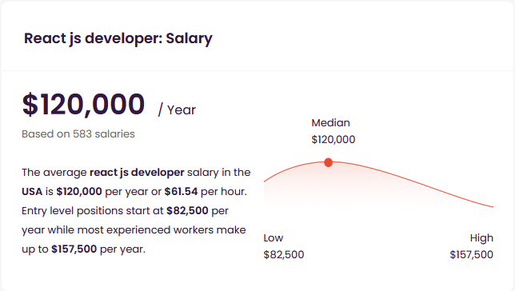
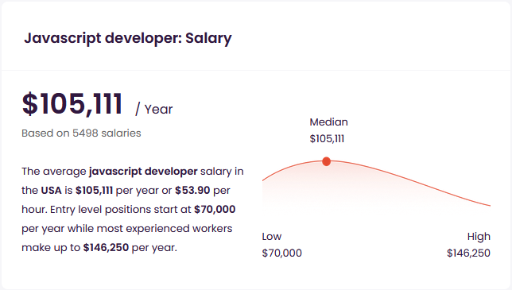
What is the value of learning React? (source: talent.com)

